Slide 1
“

Slide 2
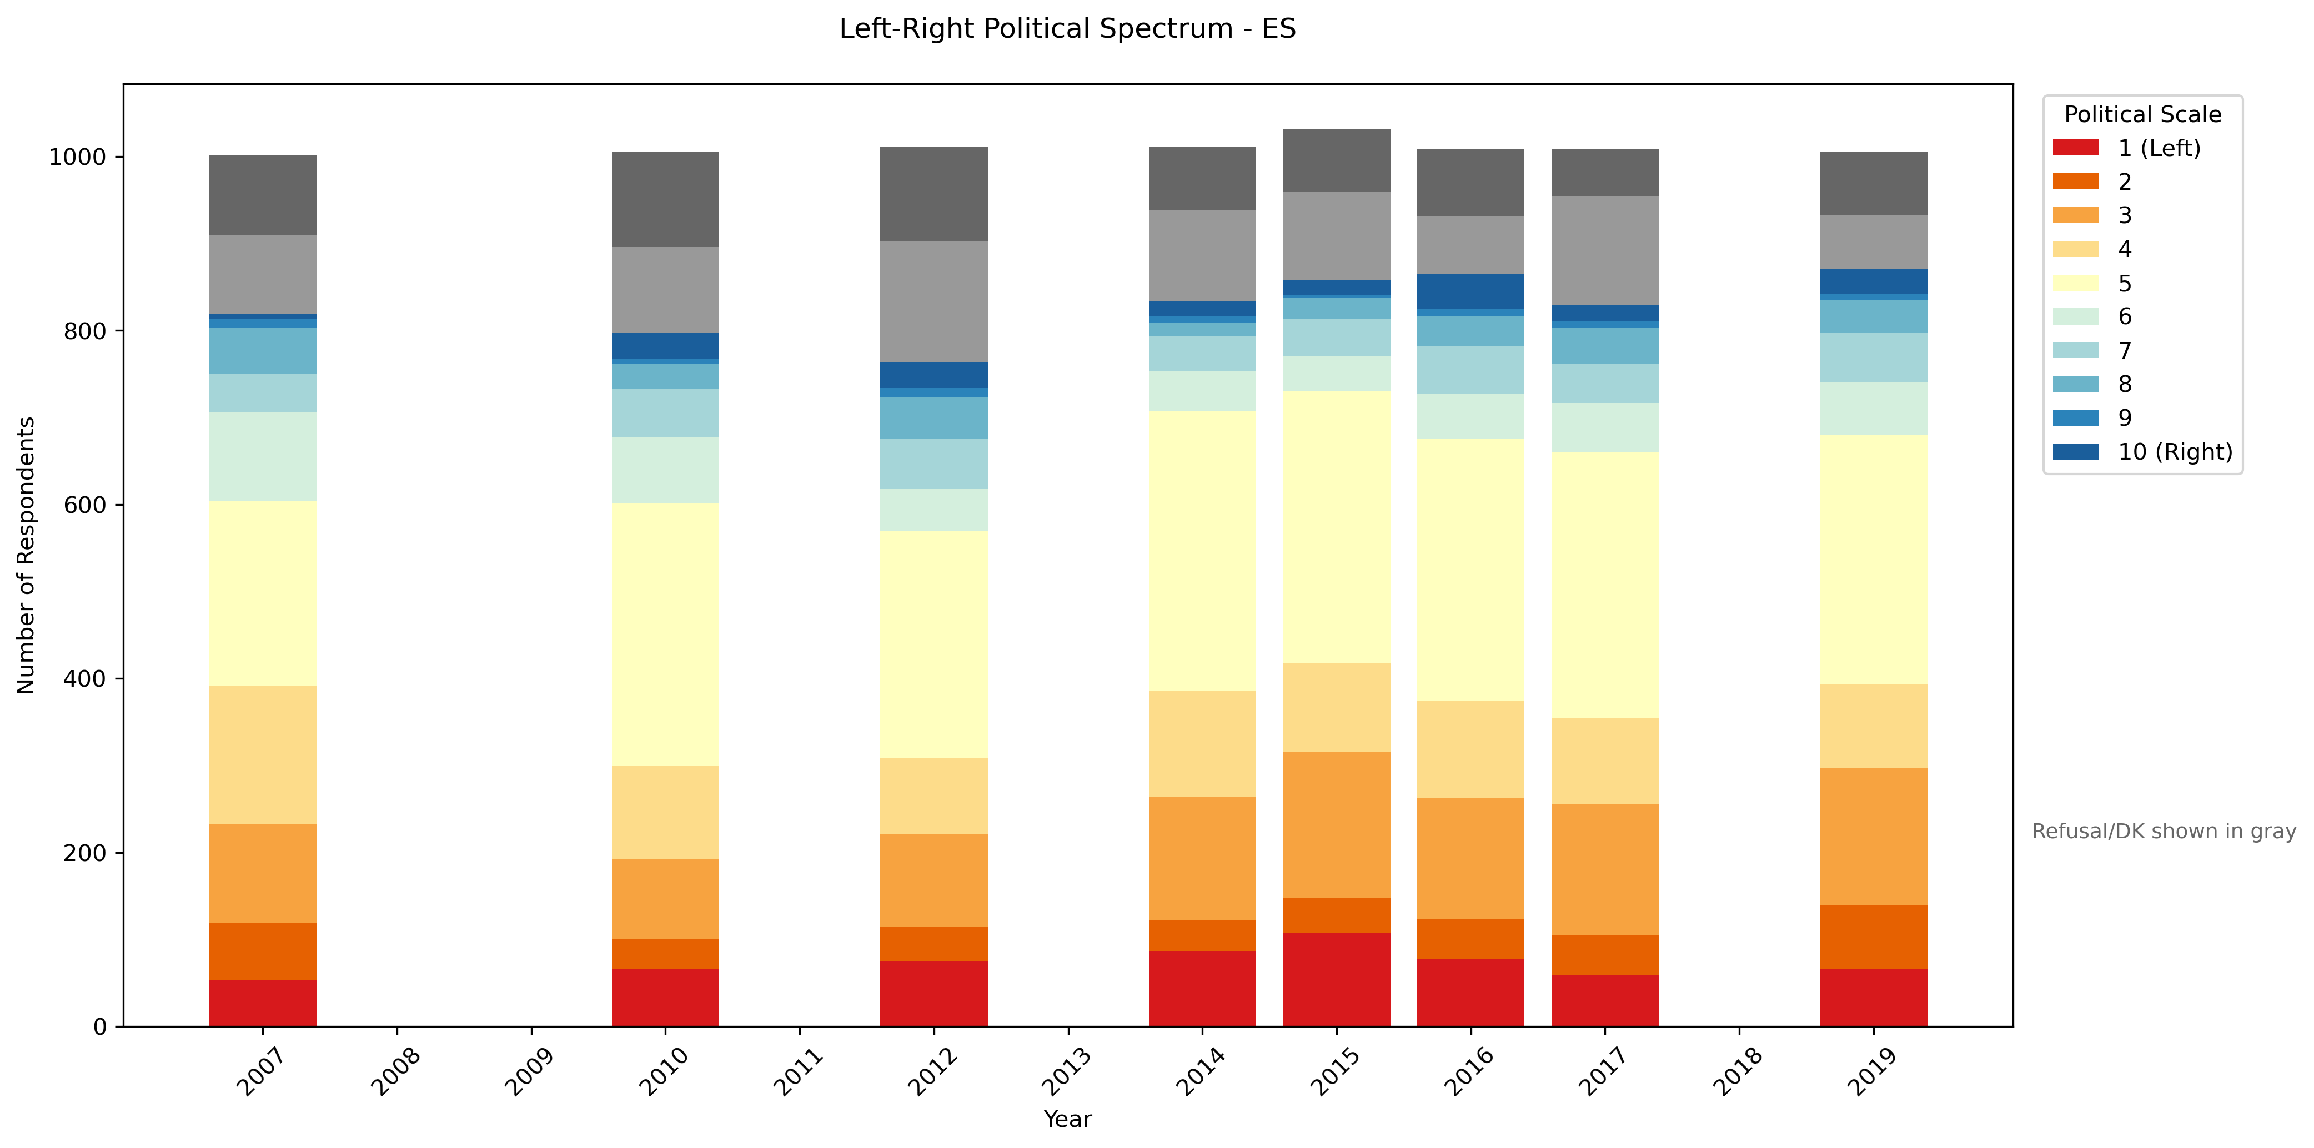
Fat left tail - Spain

Slide 3
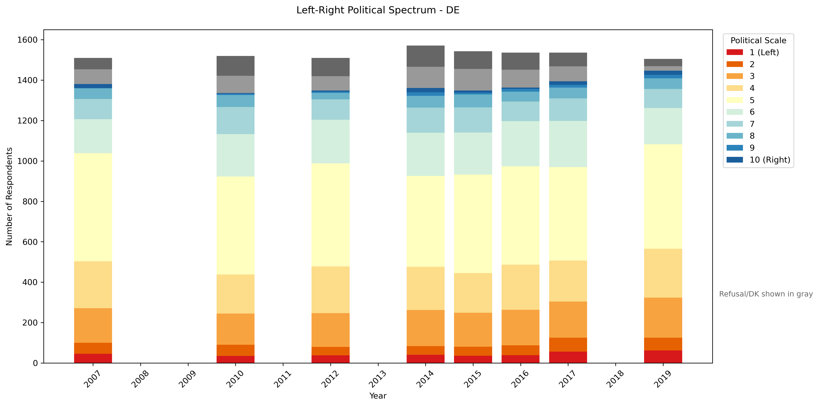
Fat left tail - Germany

Slide 4
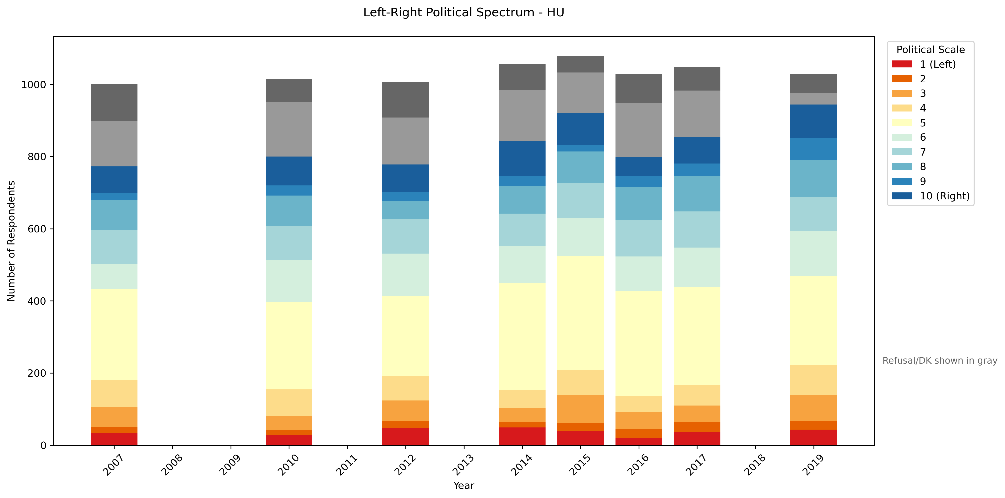
Fat right tail - Hungary

Slide 5
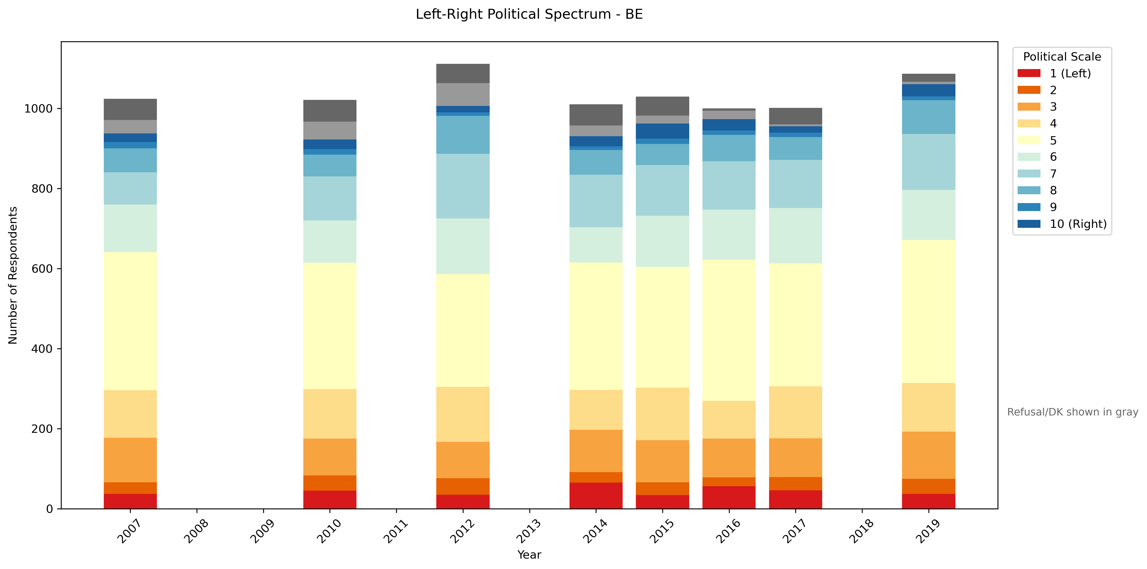
Symmetric and stable (slightly fat left tail) - Belgium

Slide 6
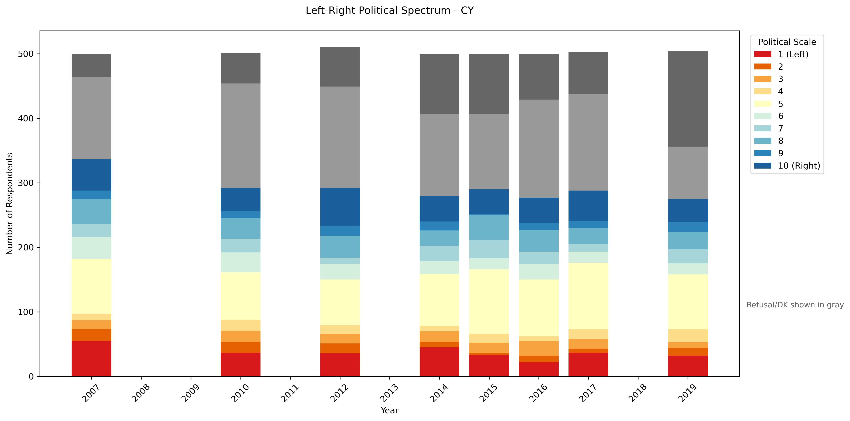
Fat tails - Cyprus

Slide 7
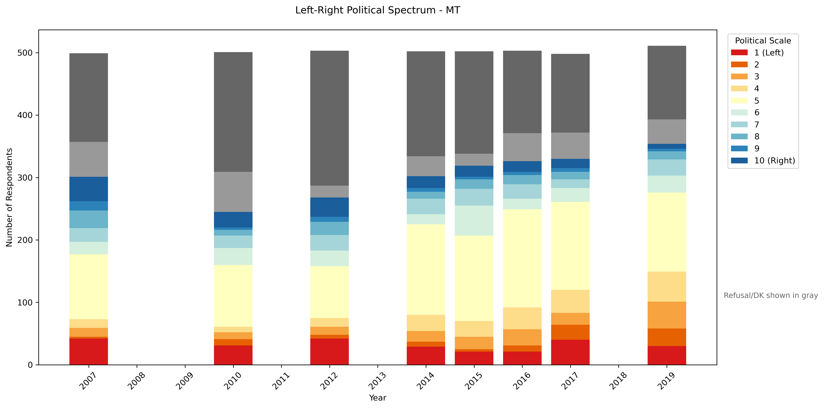
Malta

Slide 8
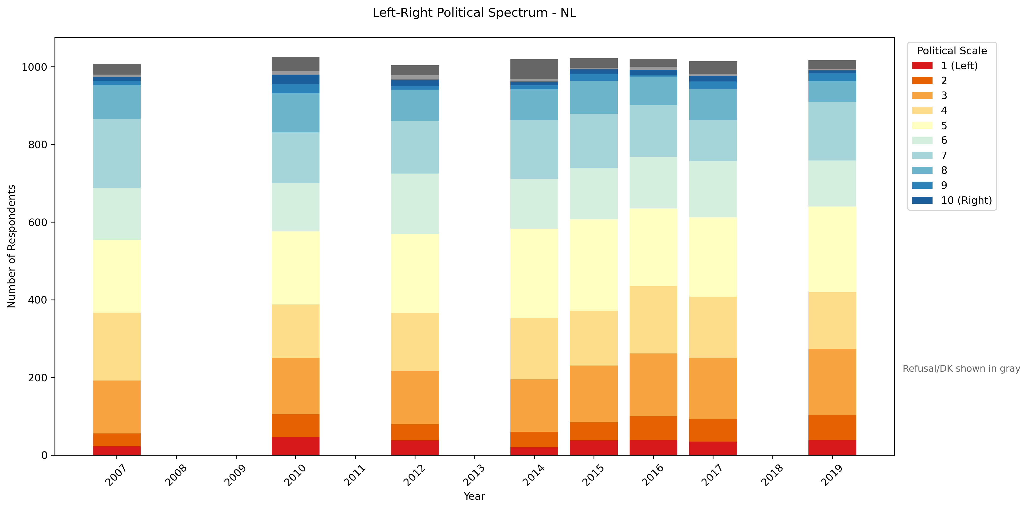
Thin center - Netherlands

Slide 9
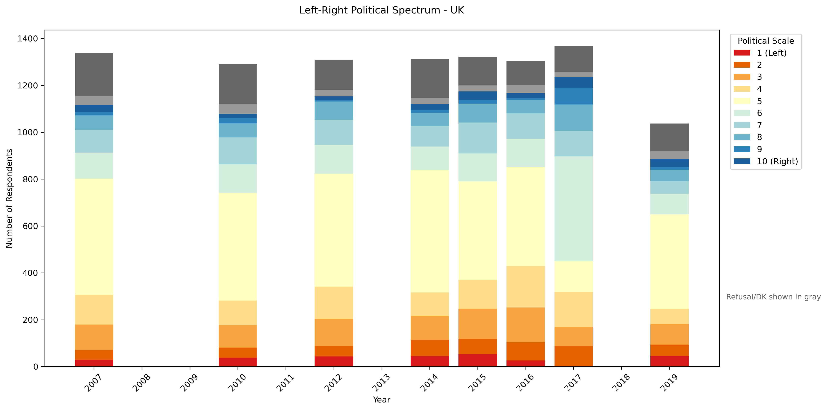
The Only Dramatic Shift – UK during Brexit

Slide 10
Our model might not produce normal outcomes
Heavy convergence

Slide 11
Takeaways/Questions
Opinion distributions from EP data tend to be roughly symmetric and Gaussian to a first approximation, but usually have fat tails.
These distributions look very stable over time, and do not appear to show polarization as we may expect.
We could do a two-step model-to-data comparison approach: first find parameter subrange that produce similar outcomes based on a single metric (σ), then within that subrange search for model outcomes that match the whole distribution.
Possible comparison approaches:
Compare point-wise on the 10-point left-right scale.
Use a mixture model to model the Eurobarometer data.
How might one model EP data as a mixture model – Gaussian + ?
What might one do to make our model generate more stably gaussian-looking outcomes.

