Slide 1
Advancements of Hegselmann-Krause Model
František Kalvas, Ashley Sanders-Jackson, Michael Slater

Slide 2
Work in progress…

Slide 3
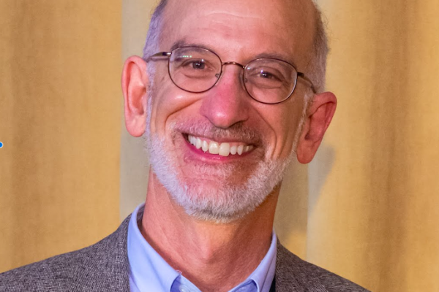
Team

Slide 4
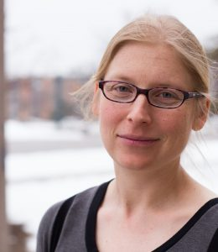

Slide 5
Hegselmann-Krause (2002) model
RQ: How does a group reach a stable state regarding an opinion and how does this consensus look like?
Agents have an uncertainty level $ε$
Agents find all other agents with opinion differing not more than $ε$
Agents then update their opinions to the mean opinion of agents differing not more than $ε$

Slide 6
Our advancements
Small-world networks as additional constraint (agents search only their network neighborhood)
Individual uncertainty level $ε$ (random uniform)
More dimensions
Not always speaking (p = .5, .9, 1)

Slide 7
Results in one picture

Slide 8
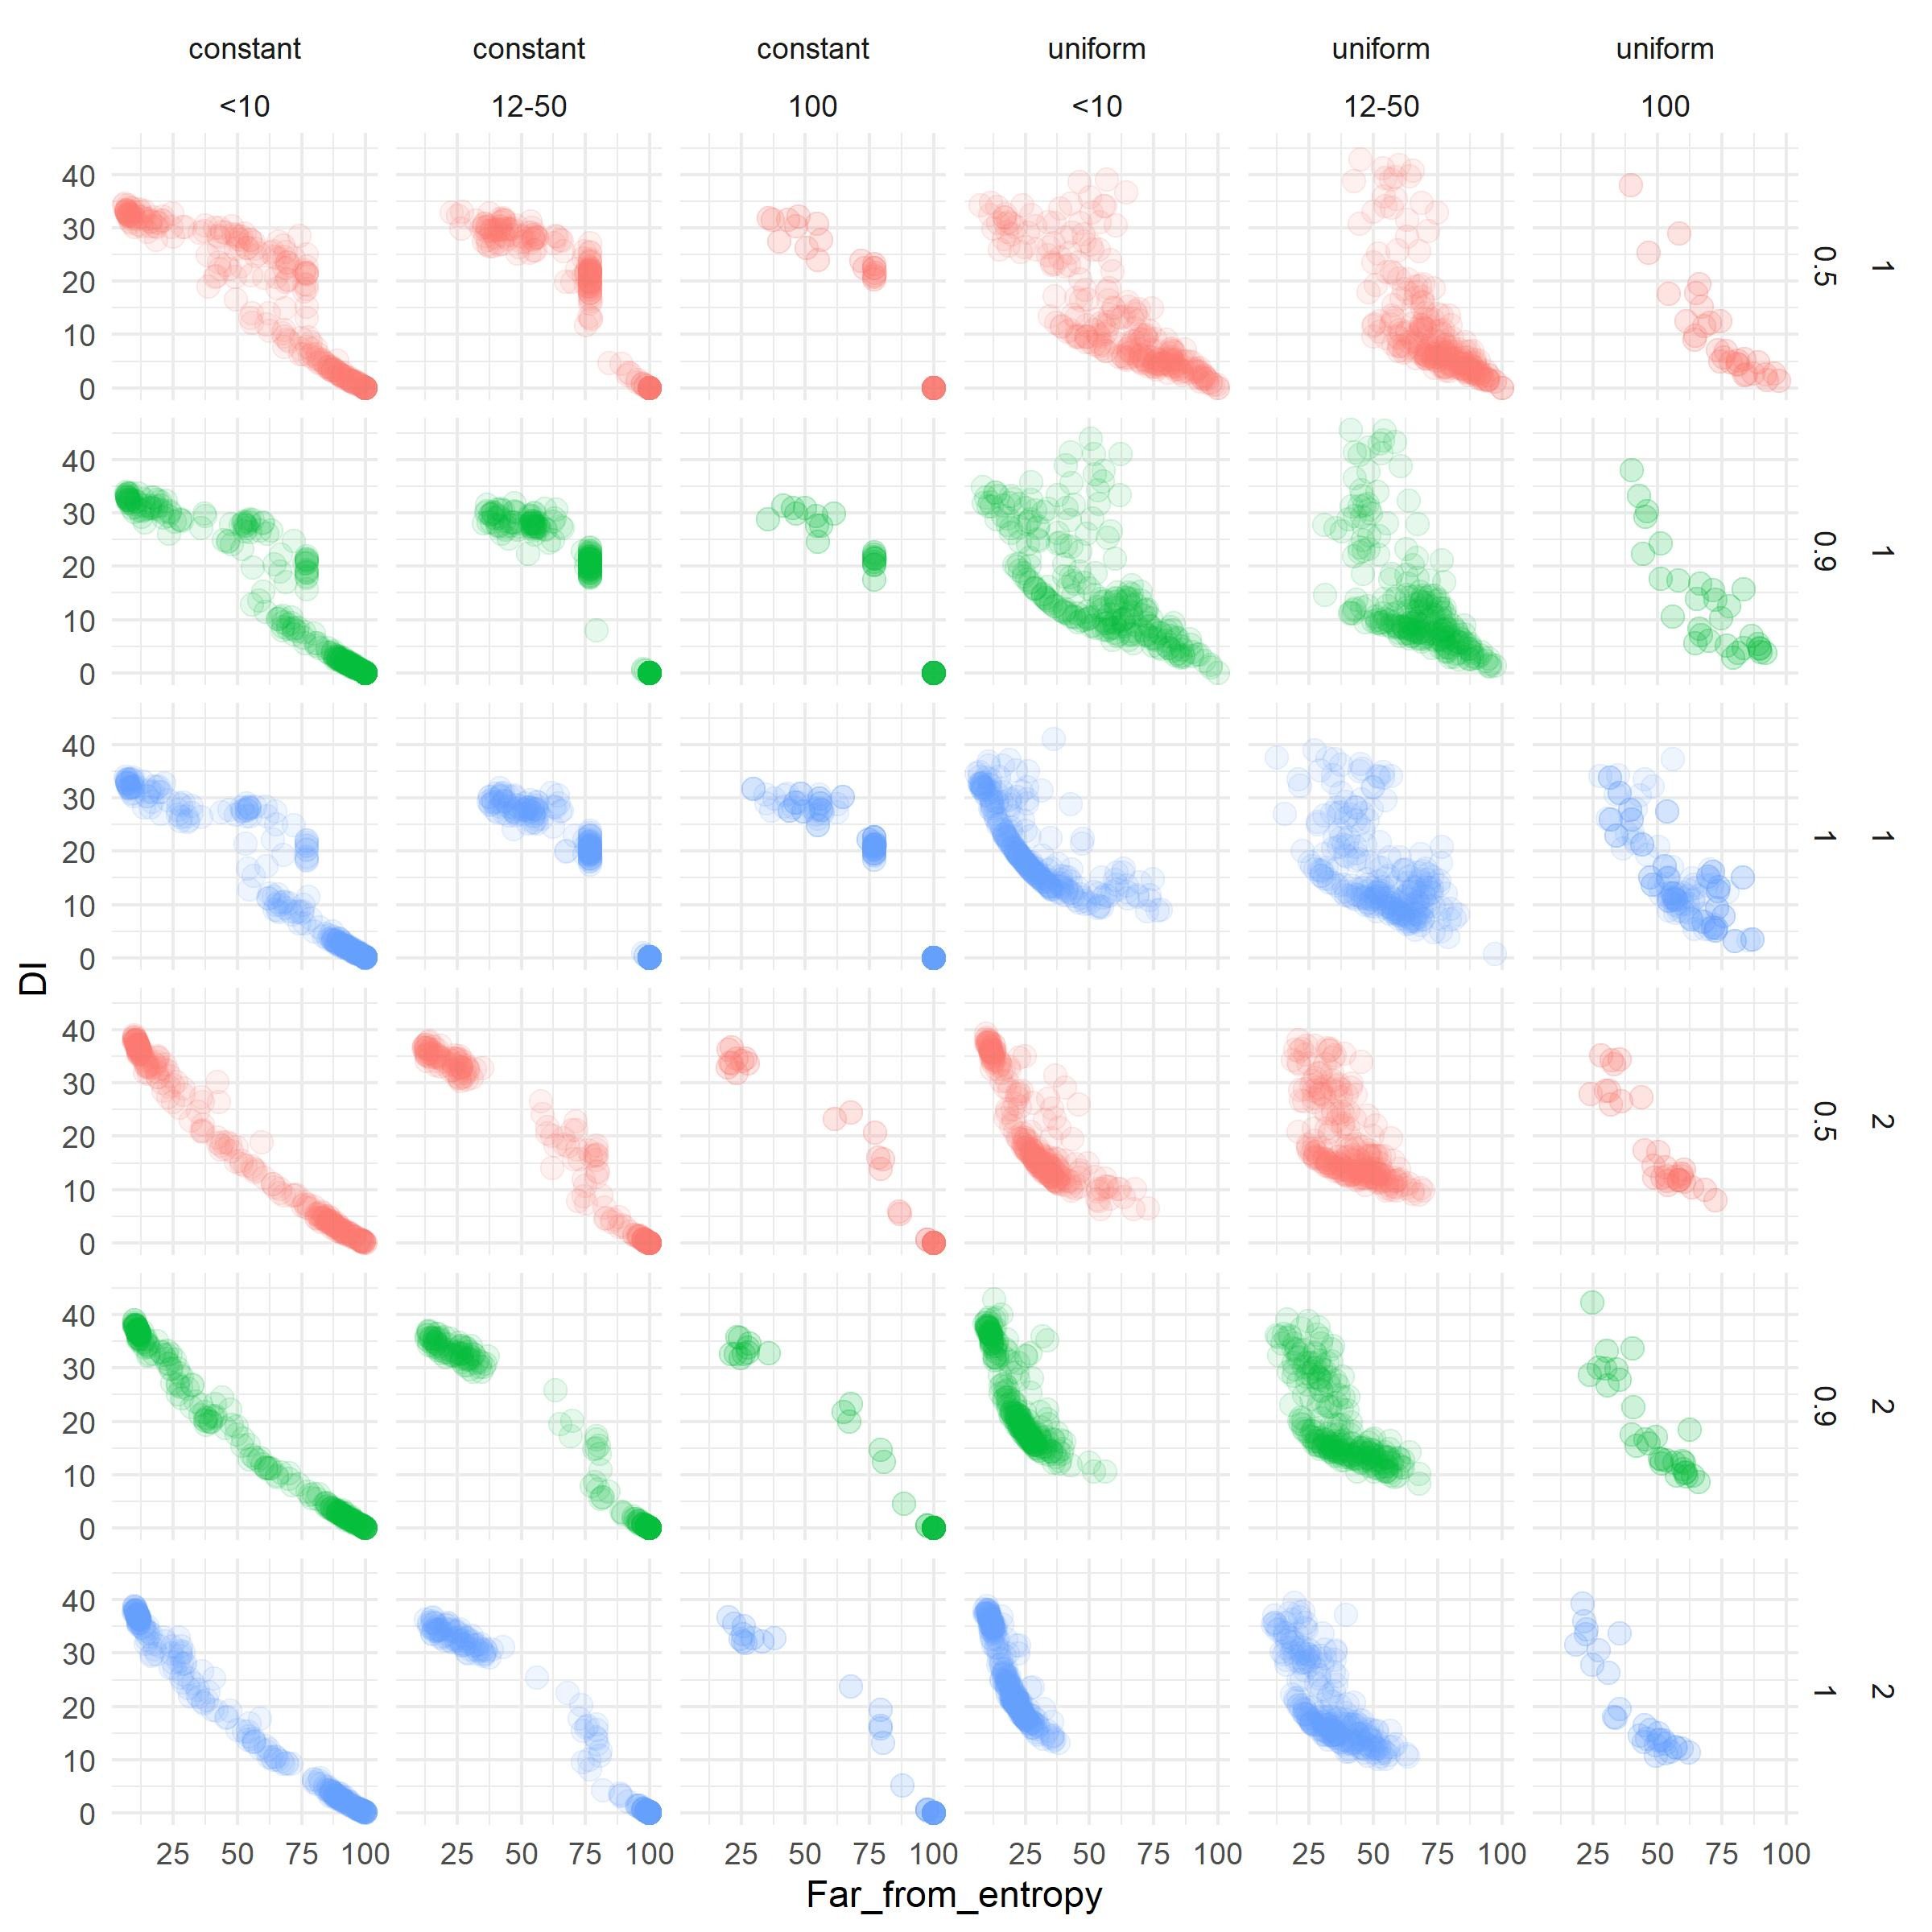

Slide 9
NOTES:

