Slide 1
Seeking Attitude-Consistent & Avoiding Attitude-Discrepant Information? Reviewing the Evidence
R. Kelly Garrett | School of Communication | Ohio State University MEDIA & MISINFORMATION | KNOWLEDGE RESISTANCE PROGRAM
April 13, 2021

Slide 2
Partisan selective exposure
“The motivated selection of messages matching one’s [attitudes and] beliefs”
(Stroud, 2014)
Notes:
Stroud, N. J. (2014). Selective Exposure Theories. In K. Kenski & K. H. Jamieson (Eds.), Oxford Handbook of Political Communication. Oxford University Press.

Slide 3
Approach & Avoidance
Attraction to pro-attitudinal messages & aversion to counter-attitudinal messages
(Cotton, 1985; Frey, 1986; Hart et al., 2009; Garrett, 2009)
Notes:
Cotton, J. L. (1985). Selective exposure to communication (D. Zillmann & J. Bryant, Eds.). L. Erlbaum Associates.
Frey, D. (1986). Recent research on selective exposure to information. Advances in Experimental Social Psychology, 19, 41–80.
Hart, W., Albarracín, D., Eagly, A. H., Brechan, I., Lindberg, M. J., & Merrill, L. (2009). Feeling Validated Versus Being Correct: A Meta-Analysis of Selective Exposure to Information. Psychological Bulletin, 135(4), 555–588. https://doi.org/10.1037/a0015701
Garrett, R. K. (2009). Politically motivated reinforcement seeking: Reframing the selective exposure debate. Journal of Communication, 59(4), 676–699. https://doi.org/10.1111/j.1460-2466.2009.01452.x
Different antecedents and consequences

Slide 4
Networked computers: Catalyst & Laboratory
Unobtrusive tracking, both in experiments and in everyday life
(Lazer, 2009; Garrett, 2013)
Notes:
Lazer, D., Pentland, A., Adamic, L., Aral, S., Barabasi, A.-L., Brewer, D., Christakis, N., Contractor, N., Fowler, J., Gutmann, M., Jebara, T., King, G., Macy, M., Roy, D., & Van Alstyne, M. (2009). Computational Social Science. Science, 323(5915), 721–723. https://doi.org/10.1126/science.1167742
Garrett, R. K. (2013). Selective Exposure: New Methods and New Directions. Communication Methods and Measures, 7(3–4), 247–256. https://doi.org/10.1080/19312458.2013.835796

Slide 5
Consistent Results
Surveys, experiments, and behavioral tracking data tell a consistent story
(e.g., Garrett et al., 2013; Garrett & Stroud, 2014; Gentzkow & Shapiro, 2011)
Notes:
Garrett, R. K., Carnahan, D., & Lynch, E. K. (2013). A turn toward avoidance? Selective exposure to online political information, 2004-2008. Political Behavior, 35(1), 113–134. https://doi.org/10.1007/s11109-011-9185-6
Garrett, R. K., & Stroud, N. J. (2014). Partisan Paths to Exposure Diversity: Differences in Pro- and Counterattitudinal News Consumption. Journal of Communication, 64(4), 680–701. https://doi.org/10.1111/jcom.12105
Gentzkow, M., & Shapiro, J. M. (2011). Ideological Segregation Online and Offline. Quarterly Journal of Economics, 126(4), 1799–1839. https://doi.org/10.1093/qje/qjr044

Slide 6
3 Key Takeaways
Echo chambers are rare
Selective approach more common than selective avoidance
Selective avoidance more common when describing engagement

Slide 7
echo chambers

Slide 8
Echo Chambers
Where individuals never encounter information that runs counter to their own attitudes and beliefs
(Sunstein, 2001)
Notes:
Sunstein, C. (2001). Republic.com. Princeton University Press.

Slide 9
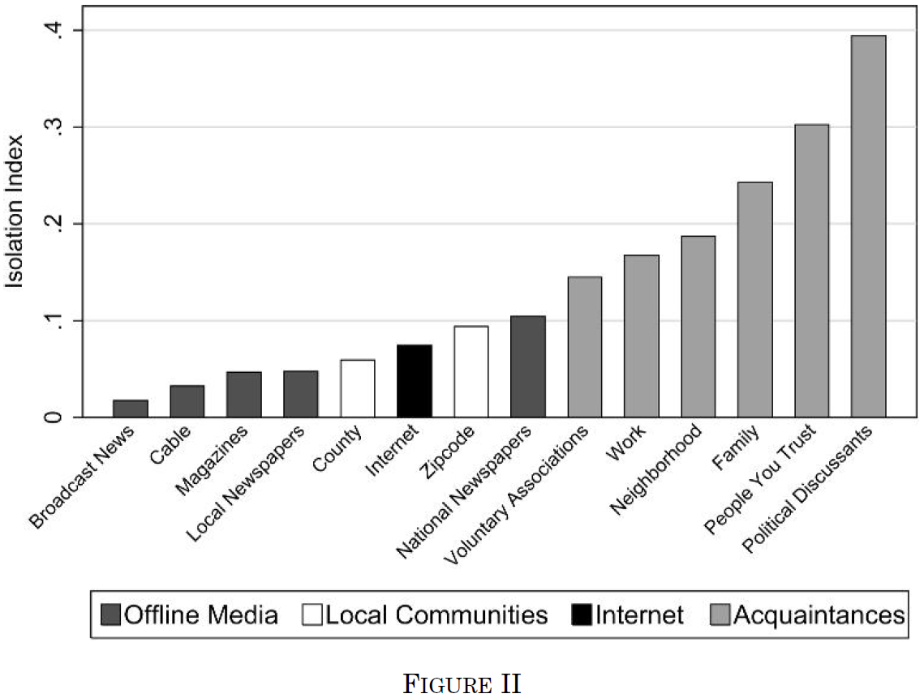
“Ideological segregation on the Internet is low in absolute terms” (Gentzkow & Shapiro, 2011)
Notes:
Gentzkow, M., & Shapiro, J. M. (2011). Ideological Segregation Online and Offline. Quarterly Journal of Economics, 126(4), 1799–1839. https://doi.org/10.1093/qje/qjr044

Slide 10
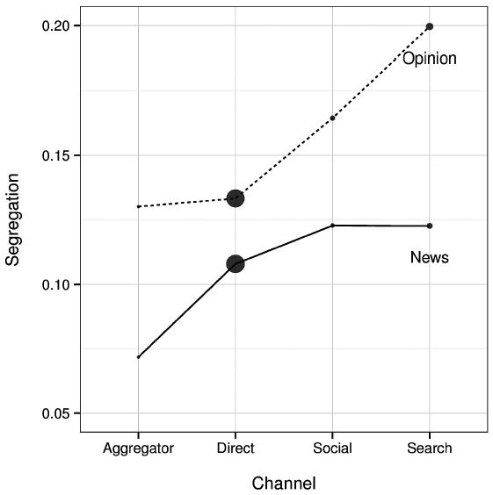
News consumption exhibits very little partisan segregation (Flaxman et al., 2016)
Notes:
Flaxman, S., Goel, S., & Rao, J. M. (2016). Filter Bubbles, Echo Chambers, and Online News Consumption. Public Opinion Quarterly, 80(S1), 298–320. https://doi.org/10.1093/poq/nfw006
Especially when users are choosing among diverse sources, e.g., via aggregators

Slide 11
Segregation may be increasing — but studies use very different samples (Peterson et al., 2021)
Notes:
Peterson, E., Goel, S., & Iyengar, S. (2021). Partisan selective exposure in online news consumption: Evidence from the 2016 presidential campaign. Political Science Research and Methods, 9(2), 242–258. Cambridge Core. https://doi.org/10.1017/psrm.2019.55

Slide 12
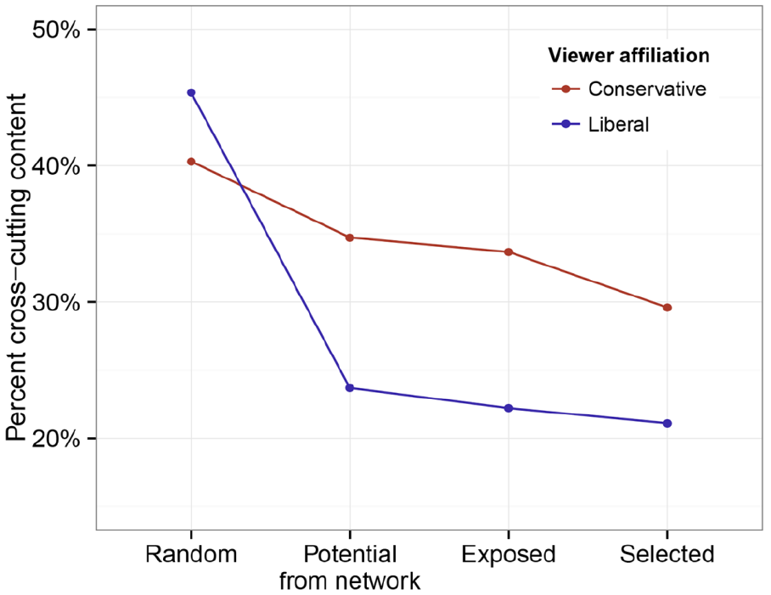
Facebook users regularly select cross-cutting content. (Bakshy et al., 2015)
Notes:
Bakshy, E., Messing, S., & Adamic, L. (2015). Exposure to ideologically diverse news and opinion on Facebook. Science, 348(6239), 1130–1132. https://doi.org/10.1126/science.aaa1160

Slide 13
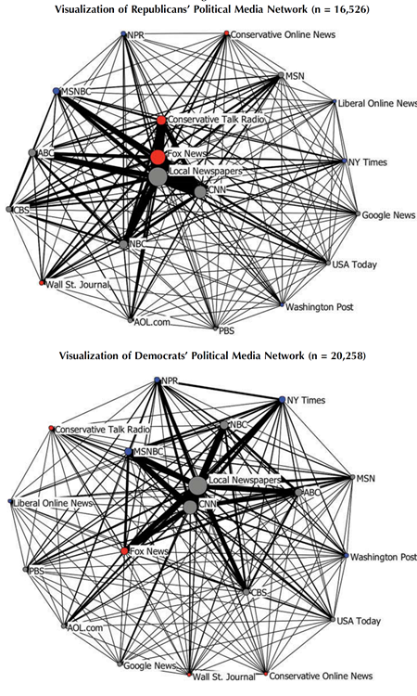
Audience fragmentation
Little evidence that audiences are segregated by political views in the US or Europe
(Weeks et al., 2016; Nelson & Webster, 2017; Fletcher & Nielsen, 2017)
Notes:
Nelson, J. L., & Webster, J. G. (2017). The Myth of Partisan Selective Exposure: A Portrait of the Online Political News Audience. Social Media + Society, 3(3), 2056305117729314. https://doi.org/10.1177/2056305117729314
Weeks, B. E., Ksiazek, T. B., & Holbert, R. L. (2016). Partisan Enclaves or Shared Media Experiences? A Network Approach to Understanding Citizens’ Political News Environments. Journal of Broadcasting & Electronic Media, 60(2), 248–268. https://doi.org/10.1080/08838151.2016.1164170
Fletcher, R., & Nielsen, R. K. (2017). Are News Audiences Increasingly Fragmented? A Cross-National Comparative Analysis of Cross-Platform News Audience Fragmentation and Duplication. Journal of Communication, 67(4), 476–498. https://doi.org/10.1111/jcom.12315
Do outlets have mutually exclusive audiences?

Slide 14
Selective exposure ≠ Echo Chambers
“With respect to political news, partisans differ in their typical media diet even as they do not completely retreat into echo chambers”
(Peterson & Iyengar, 2021)
Notes:
Peterson, E., & Iyengar, S. (2021). Partisan Gaps in Political Information and Information-Seeking Behavior: Motivated Reasoning or Cheerleading? American Journal of Political Science, 65(1), 133–147. https://doi.org/10.1111/ajps.12535

Slide 15
Selective avoidance ➔ Echo Chambers
Not a by-product of selective exposure generally, but selective avoidance specifically
Lack of echo chambers implies that selective avoidance is rare

Slide 16
Approach vs. avoidance

Slide 17
Pro > Counter
Forced to choose between pro-attitudinal and counter-attitudinal, the former consistently dominates (Stroud, 2008; Knobloch-Westerwick & Meng, 2009)
Pattern holds up cross-nationally: Germany (Knobloch-Westerwick et al., 2015), Japan (Knobloch-Westerwick et al., 2019), Israel (Dvir Gvirsman et al., 2014)
Notes:
Stroud, N. J. (2008). Media Use and Political Predispositions: Revisiting the Concept of Selective Exposure. Political Behavior, 30, 341–366. https://doi.org/10.1007/s11109-007-9050-9
Knobloch-Westerwick, S., & Meng, J. (2009). Looking the other way: Selective exposure to attitude-consistent and counter-attitudinal political information. Communication Research, 36(3), 426–448. https://doi.org/10.1177/0093650209333030
Knobloch-Westerwick, S., Mothes, C., Johnson, B. K., Westerwick, A., & Donsbach, W. (2015). Political Online Information Searching in Germany and the United States: Confirmation Bias, Source Credibility, and Attitude Impacts. Journal of Communication, 65(3), 489–511. https://doi.org/10.1111/jcom.12154
Knobloch-Westerwick, S., Liu, L., Hino, A., Westerwick, A., & Johnson, B. K. (2019). Context Impacts on Confirmation Bias: Evidence From the 2017 Japanese Snap Election Compared with American and German Findings. Human Communication Research. https://doi.org/10.1093/hcr/hqz005
Dvir-Gvirsman, S., Tzfati, Y., & Menchen-Trevino, E. (2014). The extent and nature of ideological selective exposure online: Combining survey responses with actual web log data from the 2013 Israeli Elections. New Media & Society. https://doi.org/10.1177/1461444814549041

Slide 18
But is it avoidance?
Choosing between one-sided messages tells us nothing about approach versus avoidance
(Garrett, 2009a; Garrett, 2009b)
Notes:
Garrett, R. K. (2009). Politically motivated reinforcement seeking: Reframing the selective exposure debate. Journal of Communication, 59(4), 676–699. https://doi.org/10.1111/j.1460-2466.2009.01452.x
Garrett, R. K. (2009). Echo chambers online?: Politically motivated selective exposure among Internet news users. Journal of Computer-Mediated Communication, 14(2), 265–285. https://doi.org/10.1111/j.1083-6101.2009.01440.x

Slide 19
Counter < PRO
 |  | Pro-attitudinal
 |  | Lo | Hi
Counter-attitudinal | Lo |  | “Pro-attitudinal” More exposure
 | Hi | “Counter-attitudinal” Less exposure
<
approach or
avoidance

Slide 20
Adding 2-sided messages
 |  | Pro-attitudinal
 |  | Lo | Hi
Counter-attitudinal | Lo |  | “Pro-attitudinal” More exposure
 | Hi | “Counter-attitudinal” Less exposure | ≥ Pro-attitudinal: Approach < Pro-attitudinal: Avoidance

Slide 21
Garrett & Stroud, 2014
Notes:
Garrett, R. K., & Stroud, N. J. (2014). Partisan Paths to Exposure Diversity: Differences in Pro- and Counterattitudinal News Consumption. Journal of Communication, 64(4), 680–701. https://doi.org/10.1111/jcom.12105

Slide 22
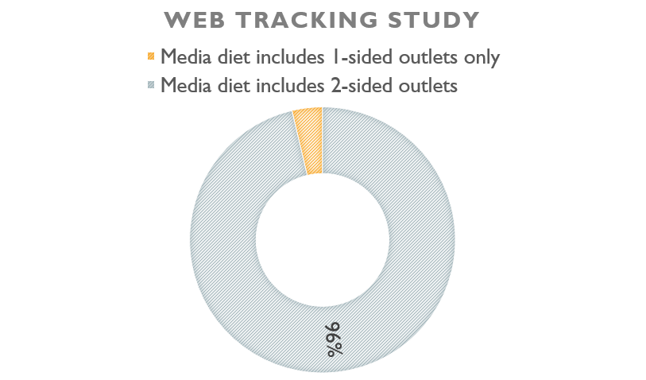
Dvir-Gvirsman et al., 2014
Notes:
Dvir-Gvirsman, S., Tzfati, Y., & Menchen-Trevino, E. (2014). The extent and nature of ideological selective exposure online: Combining survey responses with actual web log data from the 2013 Israeli Elections. New Media & Society. https://doi.org/10.1177/1461444814549041

Slide 23
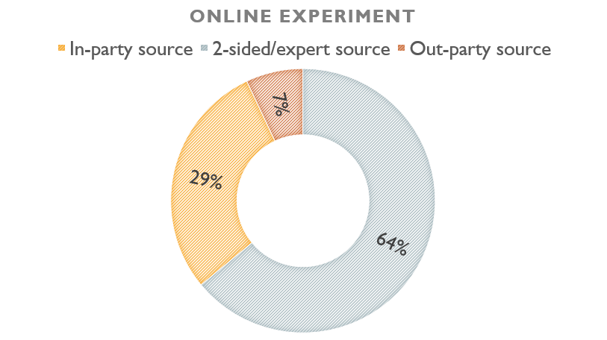

Peterson & Iyengar, In press
Notes:
Peterson, E., & Iyengar, S. (2021). Partisan Gaps in Political Information and Information-Seeking Behavior: Motivated Reasoning or Cheerleading? American Journal of Political Science, 65(1), 133–147. https://doi.org/10.1111/ajps.12535

Slide 24
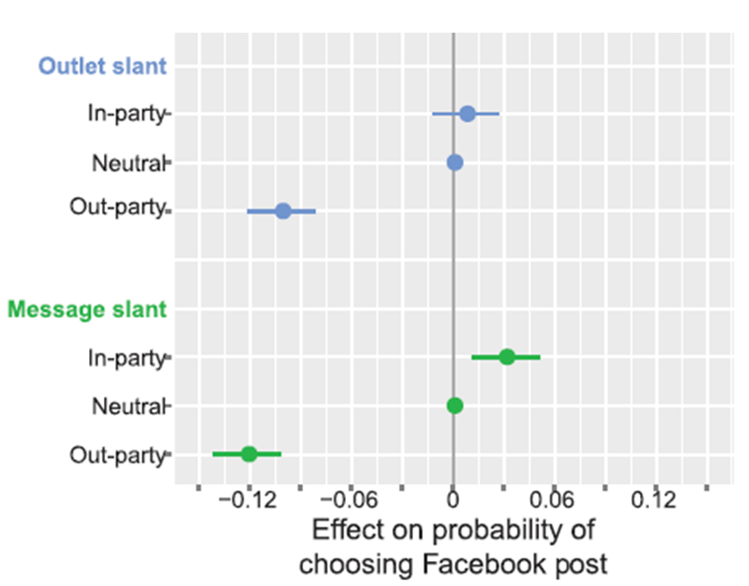
Mukerjee & Yang, 2020
Notes:
Note: Authors interpret this as evidence for avoidance.
Mukerjee, S., & Yang, T. (2020). Choosing to Avoid? A Conjoint Experimental Study to Understand Selective Exposure and Avoidance on Social Media. Political Communication, 1–19. https://doi.org/10.1080/10584609.2020.1763531

Slide 25
Counter > Pro?
People prefer counter-attitudinal information when it has more utility than pro-attitudinal information
(Hart et al., 2009; Knobloch-Westerwick & Kleinman, 2011; Carnahan et al., 2016)
Notes:
Hart, W., Albarracín, D., Eagly, A. H., Brechan, I., Lindberg, M. J., & Merrill, L. (2009). Feeling Validated Versus Being Correct: A Meta-Analysis of Selective Exposure to Information. Psychological Bulletin, 135(4), 555–588. https://doi.org/10.1037/a0015701
Knobloch-Westerwick, S., & Kleinman, S. (2011). Pre-Election Selective Exposure: Confirmation Bias versus Informational Utility. Communication Research, 39(2), 170–193. https://doi.org/10.1177/0093650211400597
Carnahan, D., Garrett, R. K., & Lynch, E. (2016). Candidate vulnerability and exposure to counter-attitudinal information: Evidence from two U.S. Presidential elections. Human Communication Research, 42(4), 577–598. https://doi.org/10.1111/hcre.12088
In these cases, we are more likely to see individuals seeking out counter-attitudinal information, e.g., opposition research.

Slide 26
Exposure vs. Engagement

Slide 27
Looking or Liking
On social media, exposure and engagement often mean different things
(Stroud, 2016)
Notes:
Stroud, N. J., Muddiman, A., & Scacco, J. M. (2016). Like, recommend, or respect? Altering political behavior in news comment sections. New Media & Society, 19(11), 1727–1743. https://doi.org/10.1177/1461444816642420

Slide 28
Conflict aversion helps explain segregation in interpersonal communication networks (Mutz, 2006; Gentzkow & Shapiro, 2011)
Exposure
Engagement
Notes:
Mutz, D. C. (2006). Hearing the other side: Deliberative versus participatory democracy. Cambridge University Press.

Slide 29
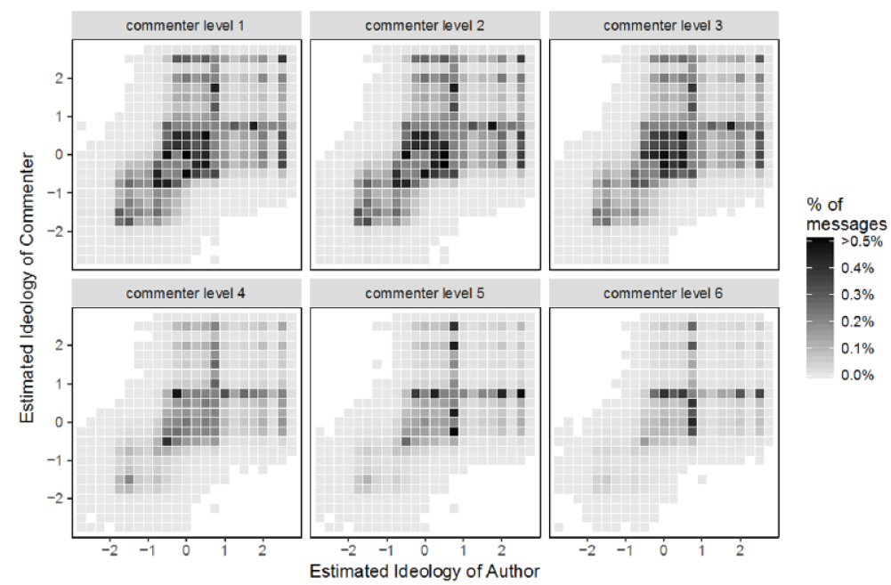
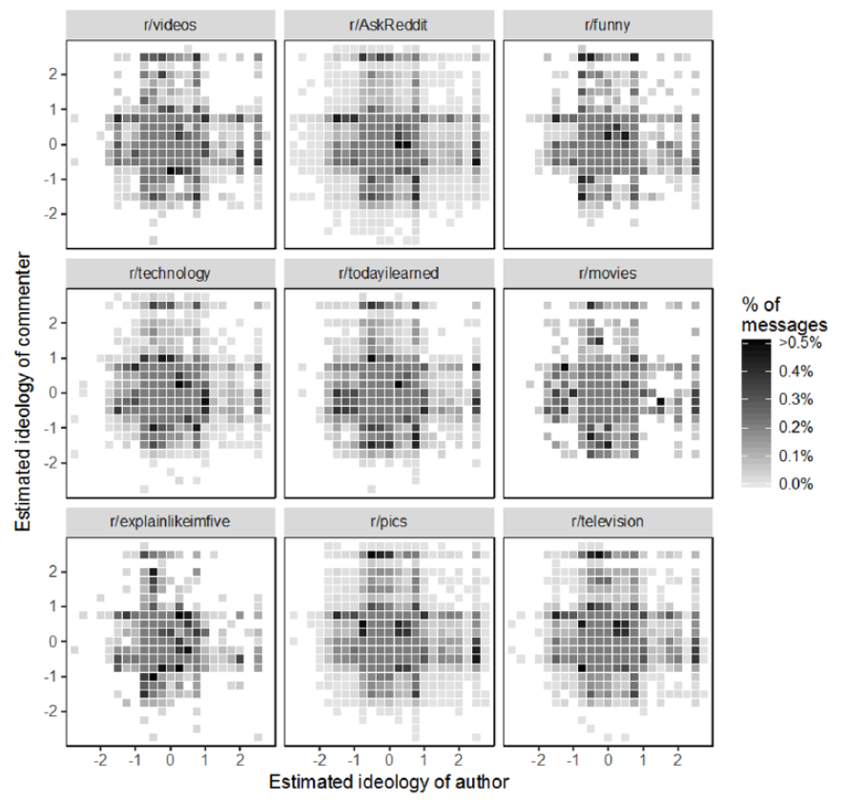
On Reddit, engagement is modestly segregated, but only some circumstances (Bond & Sweitzer, 2018)
Political
vs. non-political spaces
Notes:
Bond, R. M., & Sweitzer, M. D. (2018). Political Homophily in a Large-Scale Online Communication Network. Communication Research, 0093650218813655. https://doi.org/10.1177/0093650218813655

Slide 30
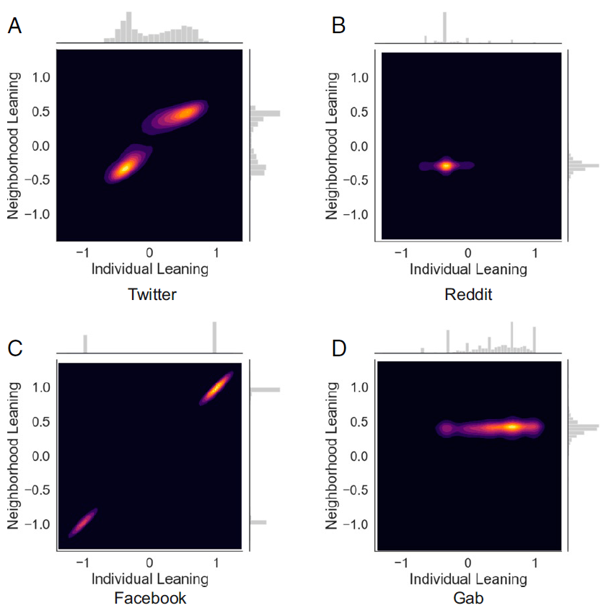
Engagement “echo chambers” vary by platform (Cinelli et al., 2021)
Abortion
engagement echo chamber
Diverse engagement
Vaccine engagement echo chamber
Diverse engagement
Notes:
Cinelli, M., De Francisci Morales, G., Galeazzi, A., Quattrociocchi, W., & Starnini, M. (2021). The echo chamber effect on social media. Proceedings of the National Academy of Sciences, 118(9), e2023301118. https://doi.org/10.1073/pnas.2023301118

Slide 31
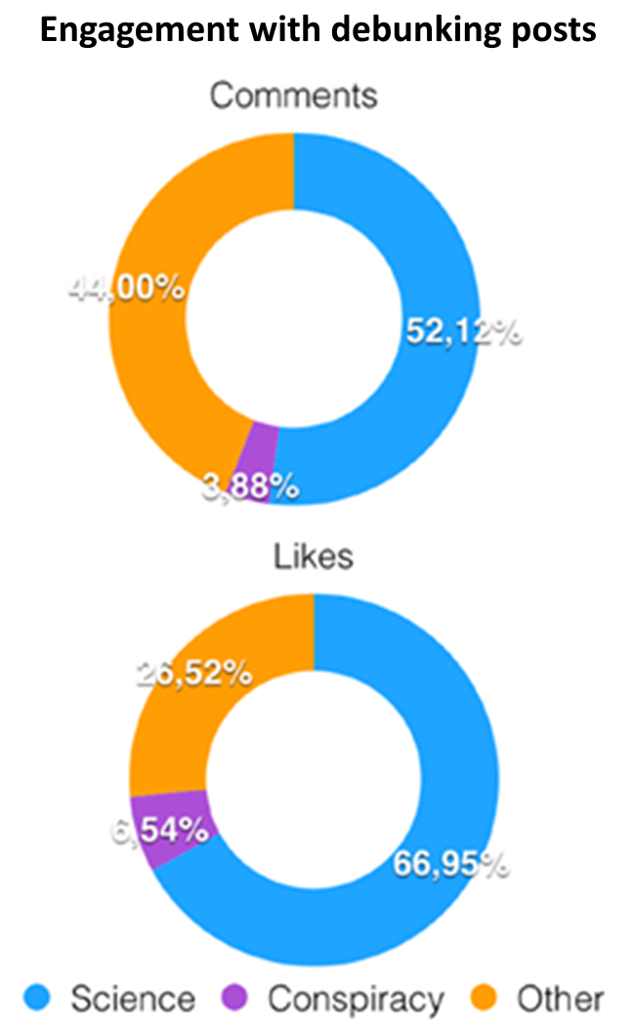
People who engage with pseudo-science on Facebook tend not to engage with legitimate science content (Zollo et al., 2016; Bessi et al., 2015)
Notes:
Zollo, F., Bessi, A., Del Vicario, M., Scala, A., Caldarelli, G., Shekhtman, L., Havlin, S., & Quattrociocchi, W. (2017). Debunking in a world of tribes. PLOS ONE, 12(7), e0181821. https://doi.org/10.1371/journal.pone.0181821
Bessi, A., Coletto, M., Davidescu, G. A., Scala, A., Caldarelli, G., & Quattrociocchi, W. (2015). Science vs Conspiracy: Collective Narratives in the Age of Misinformation. PLOS ONE, 10(2), e0118093. https://doi.org/10.1371/journal.pone.0118093

Slide 32
Selective Engagement
“If we look at Twitter as a social medium we see higher levels of homophily and a more echo chamber-like structure…
But if we instead focus on Twitter as a news medium… we see lower levels of homophily…”
(Colleoni et al., 2014, emphasis added)
Notes:
Colleoni, E., Rozza, A., & Arvidsson, A. (2014). Echo Chamber or Public Sphere? Predicting Political Orientation and Measuring Political Homophily in Twitter Using Big Data. Journal of Communication, 64(2), 317–332. https://doi.org/10.1111/jcom.12084

Slide 33
3 Key Takeaways
Echo chambers are rare
Selective approach more common than selective avoidance
Selective avoidance more common when describing engagement

Slide 34
Thank you
Kelly Garrett
garrett.258@osu.edu
http://rkellygarrett.com

