Slide 1
Opinion dynamic on folded landscape
In alphabetical order:
FranČesko (kalvas@kss.zcu.cz), Guga (mikaberidze@ucdavis.edu)
Why are opinions not a function of information the persons have?
Unpacking the opinion into three dimensions and putting it back together

Slide 2
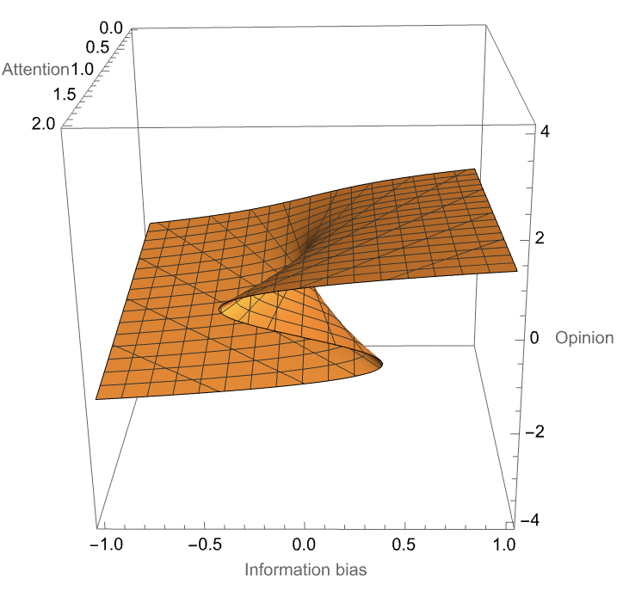
Answer is folded landscape
the public debate on an issue is happening in 3D not just in 1D:
opinion (of course!)
information bias (difference between amounts of negative and positive information)
attention
opinions are on sheet embedded in this 3D space
for higher levels of attention the sheet is folded – the higher attention the more folded
Answer to polarization is high attention
Answer to various opinion distributions is variance of discussants’ attention

Slide 3
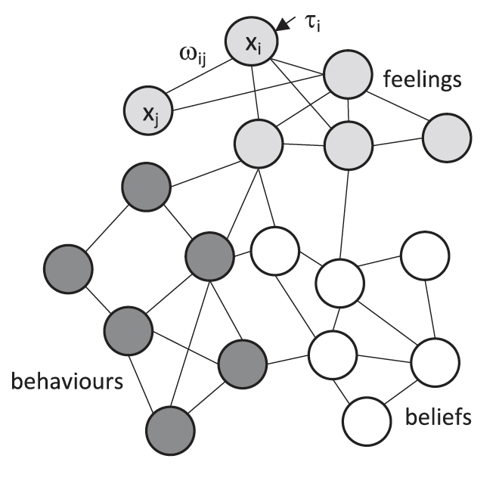
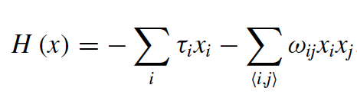
Ising model for internal polarization
Binary nodes x_{i}
Node interactions ω_{ij}
Dispositions / external influences 𝜏_{i}
van der Maas, Han LJ, Jonas Dalege, and Lourens Waldorp. "The polarization within and across individuals: The hierarchical Ising opinion model." Journal of complex networks 8, no. 2 (2020): cnaa010.

Slide 4
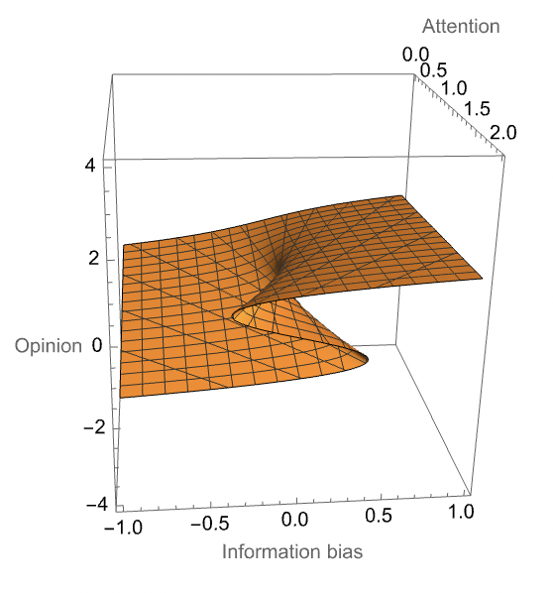
Ising model for internal polarization
cusp catastrophe
Temperature→Inverse attention; External field→Information bias; Magnetization→Opinion

Slide 5
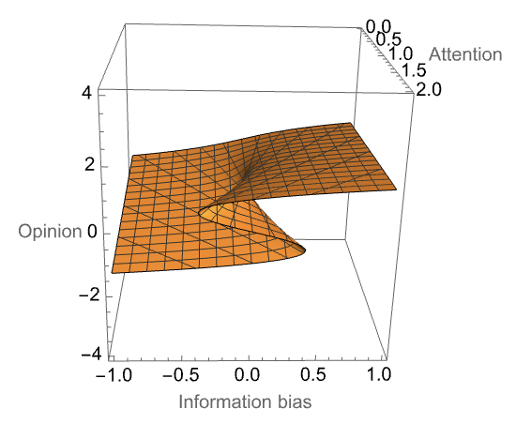
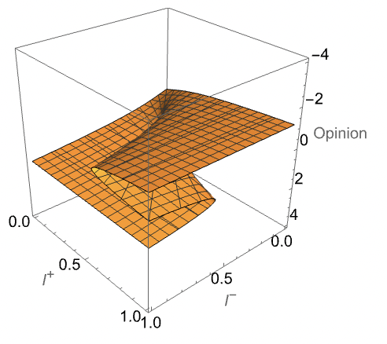
More symmetry → less parameters
Info. bias
Info. bias
Rotate horizontal axes by 45° and reinterpret
Negative information
Attention
Positive information
Attention

Slide 6
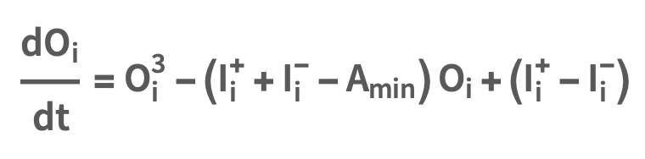
Internal dynamic
Simple differential equation with cusp catastrophe:

Slide 7
Simulation results
Parameters important for the state after 100 steps of simulation:
rate of communication – high rate of communication helps discussants to keep a lot of positive and a lot of negative information which leads to high attention which leads to polarization
ratio of memorized info – low ratio (high forgetting) lets discussants forget dissonant information, ressolves their dissonance and lowers their attention
folding point – regulates folding of landscape, whether happens sooner or later
latitude of acceptance – preserves imperfect symmetry from full break-down

Slide 8
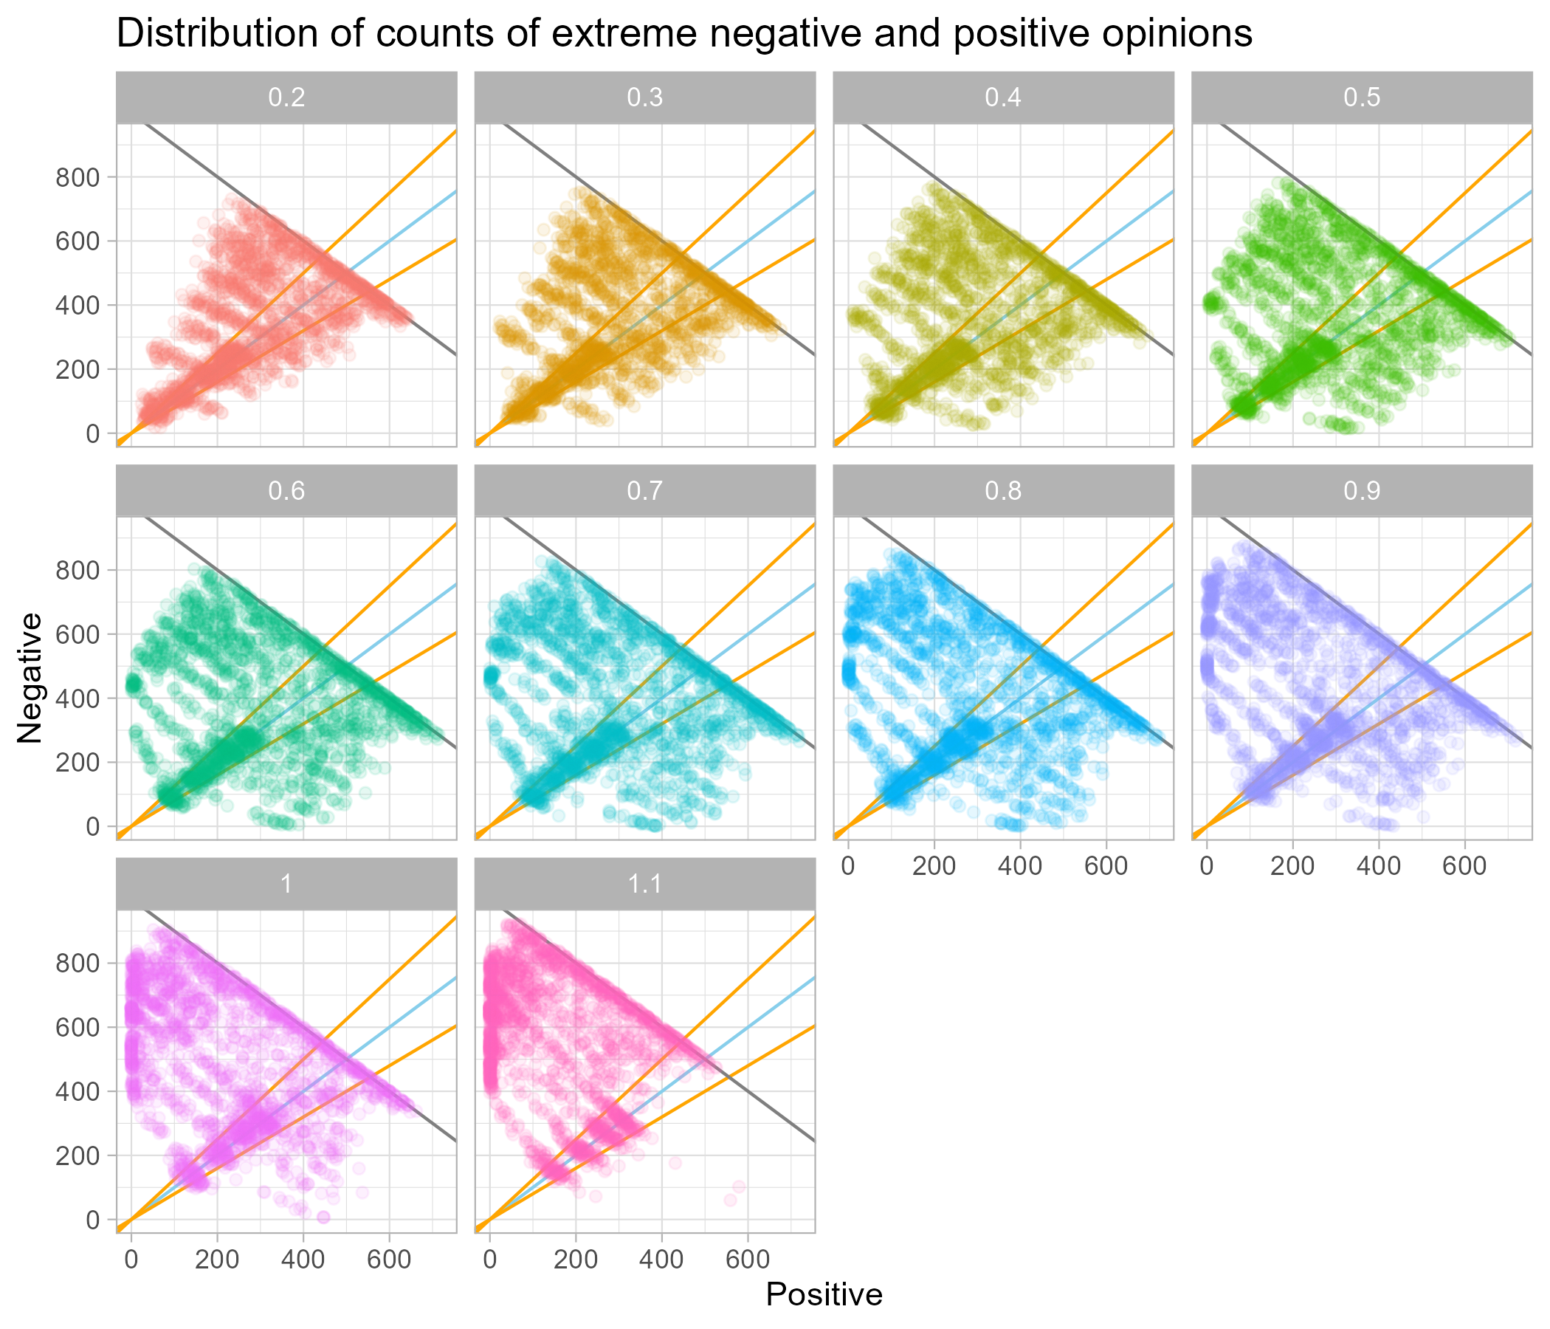
Simulation rejecting results

Slide 9
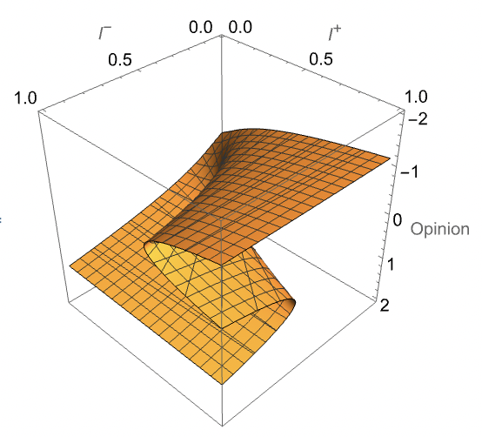
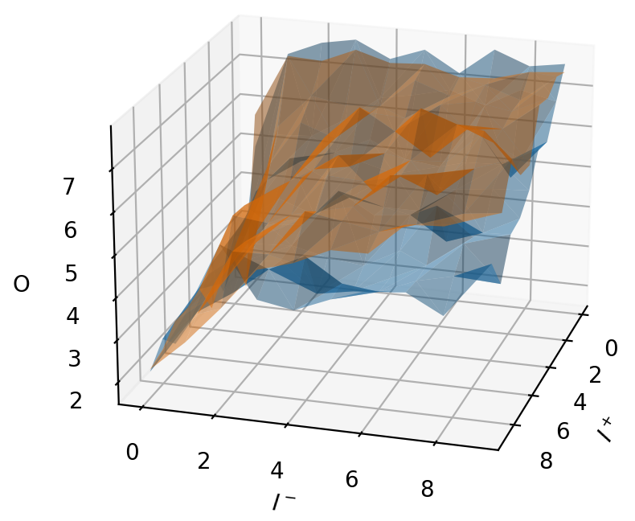
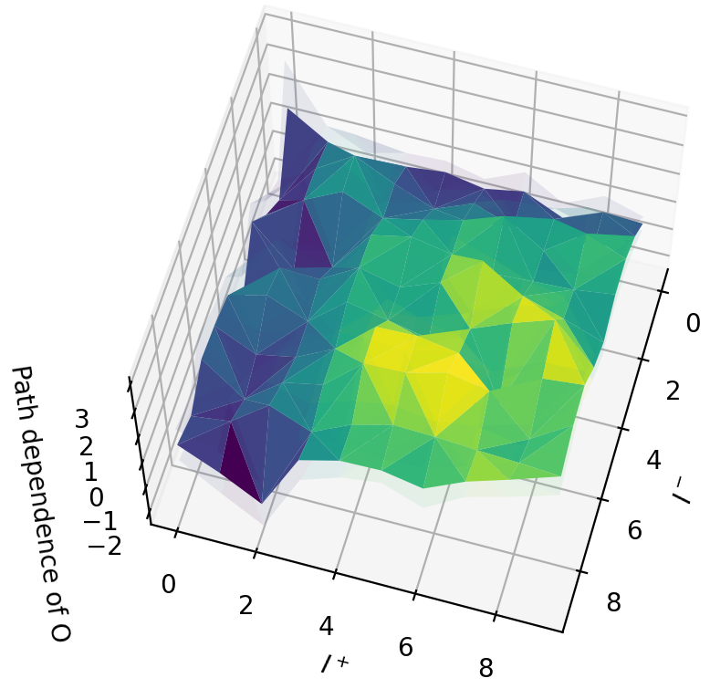
Experiments with ChatGPT
feed a mix of positive/negative info to an LLM and see if the order makes difference
positive info first
negative info first

Slide 10
Future plans
find reasonable and theoretically justified equation for communication rate and let this key parameter update/change dynamically
do the same for ratio of memorized (not forgotten) information
estimate shape of folded landscape of other models (e.g. Galešić et. al. 2023)
apply other opinion dynamic principles than Deffuant 2002 (e.g. repulsion)

Slide 11
Thank you for your kind attention!
Thank you for your questions in advance!
In alphabetical order:
FranČesko (kalvas@kss.zcu.cz)
Guga (mikaberidze@ucdavis.edu)

