Slide 1
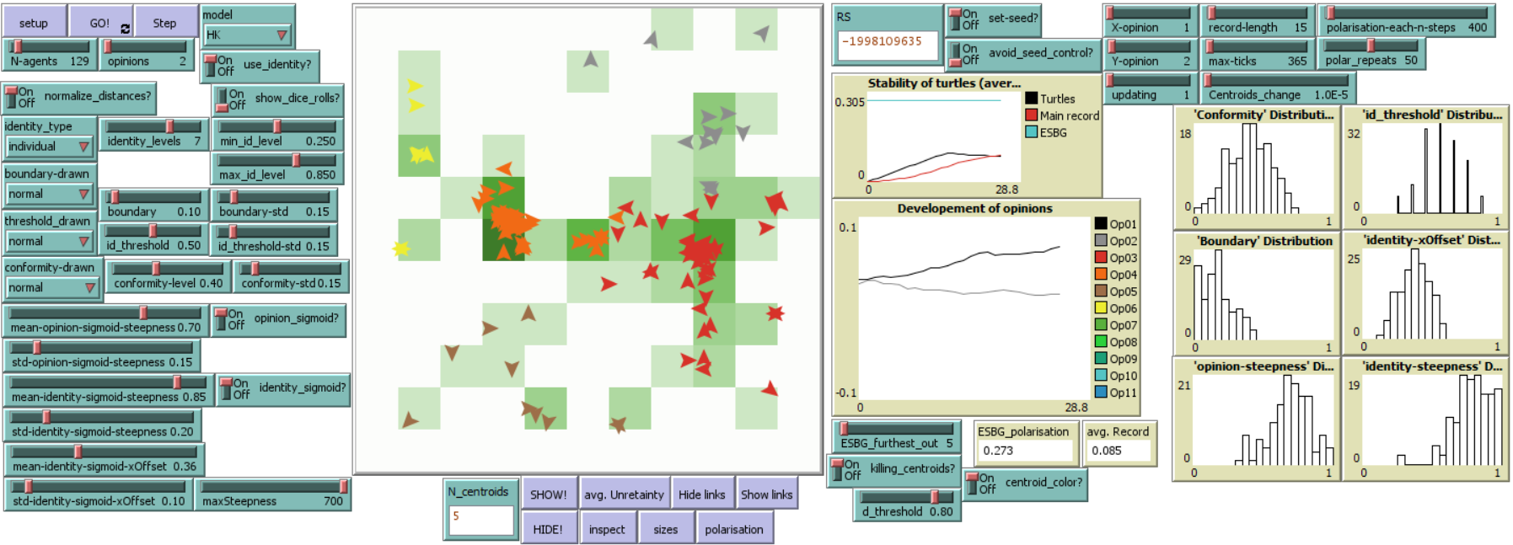
Advancements of Hegselmann-Krause model: identity, variability and dimensions
František Kalvas, University of West Bohemia (Czech Republic, kalvas@kss.zcu.cz); Ashley Sanders-Jackson, Michigan State University (USA, sande411@msu.edu);
Ashwin Ramaswamy, Independent Researcher (India, ashwin.ramaswamy.92@gmail.com); Mike Slater, The Ohio State University (USA, slater.59@osu.edu)
Classical Hegselmann-Krause | Our model
Constant boundary | Random normal distributed boundary
Constant conformity (beta) | Random normal distributed conformity (beta)
One dimensional opinion space | Possibility of multiple dimensions
Deterministic function – opinion is accepted inside boundary, rejected outside boundary | Sigmoid function – probability of acceptation nonlinearly decreases with opinion distance
No other constraints | Identity based on opinion as other constraint – individual (categorized) recognition of identity groups, acceptance of opinions nonlinearly decreases with group centroids distance

