Slide 1



Slide 2
PROBLEM STATEMENT
TODAY’S WORLD IS FACING MANY PROBLEMS WHILE TRAVELLING FROM ONE PLACE TO ANOTHER AND NAVIGATING THROUGH THE TRAVELLING PATH PROPERLY INFORMED.
THE UNDISPUTED APP OF PRESENT TIME, ”GOOGLE MAPS”, FOR NAVIGATION HAS VARIOUS SHORT COMINGS LIKE:
THE BLUE COLOR POINTER SHOULD BE POINTED IN THE DIRECTION WE ARE MOVING BUT IT NECESSARILY DOES’NT,.
GM PROVIDES 2D VIEW OF THE PATH ONLY WHICH IS, MOST OF THE TIME, NOT CLEAR ENOUGH TO NAVIGATE.
THERE IS NO REAL LIFE VIEW IN THEIR NAVIGATION SYSTEM.
THERE IS NO ALERT IF WE ARE HEADING TOWARDS THE WRONG PATH.
NO CONCERNS FOR USER SAFETY
NOT USER FRIENDLY FOR SEARCHING FOR INFO ABOUT PLACES ON THE WAY

Slide 3
SOLUTION
We are using API of google maps and enhancing it using Augmented Reality and Artificial Intelligence .Through this, we’ll be able to picturize virtually the road on which we’re navigating along with pointers assisting us on each turns. It will be easier for everyone to locate places detect its path if we can depict it in real life conditions. Along with this we will also alert user if he/she is moving in the wrong direction and in case they choose to continue on a different path, our app will provide the fastest way from there. There is no place for that pointer confusion which was there in google maps. There will be road sign detection and vehicle detection and related reminders concerning user safety.
If user wants to search for a particular type of places say restaurants, our app will forecast there info via augmented reality for all those that appears in user’s path.

Slide 4
TECHNOLOGIES USED IN BUILDING VISION
AUGMENTED REALITY :Augmented reality (AR) is a live direct or indirect view of a physical, real-world environment whose elements are "augmented" by computer-generated or extracted real-world sensory input such as sound, video, graphics, haptics or GPS data. Here in our app, we are using it to draw pointers/arrows to show us directions on the lane/ road we are currently accessing and also for showing info about the places in user’s looking for.
ARTIFICIAL INTELLIGENCE/MACHINE LEARNING : Machine learning is a field of computer science that gives computers the ability to learn without being explicitly programmed. Through machine learning ,we detect concrete roads/lanes on which the navigation is to be done along with road signs, vehicle and places detection in real time.

Slide 5
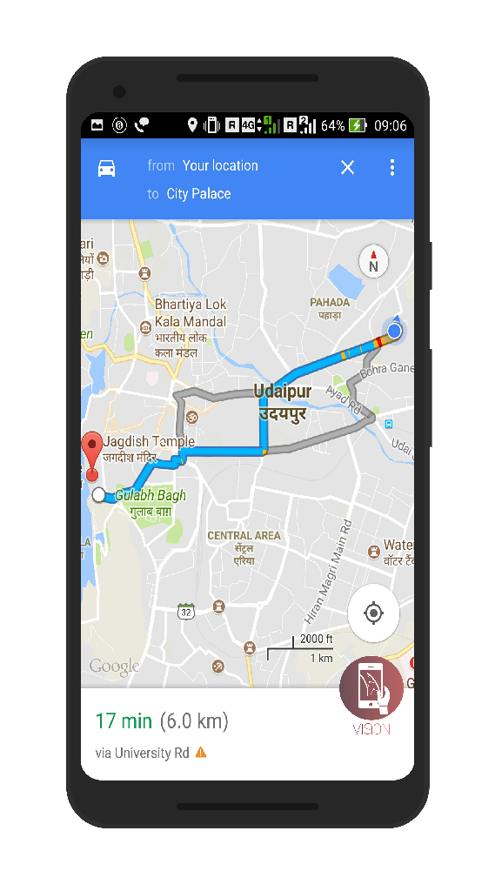
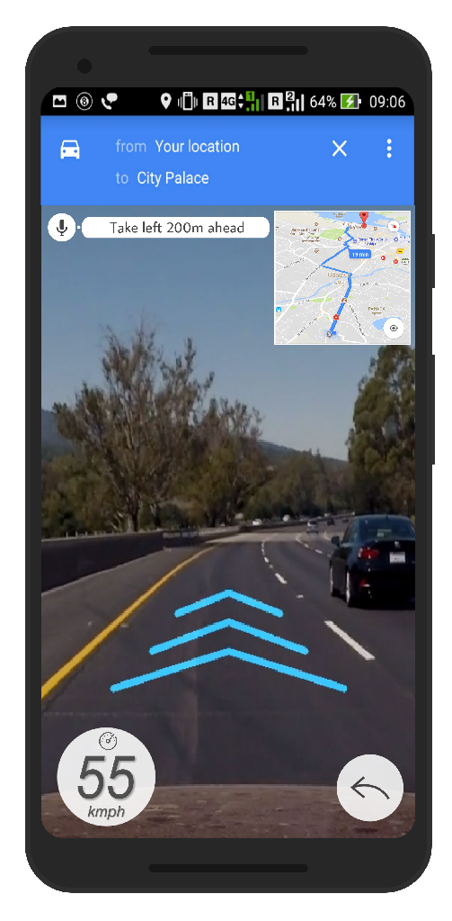

Lets Get Inside

Slide 6
IMPROVEMENTS
We aim to improvise our app on transparent screens which are about to come in the market using them as windshield and our app installed in it can create wonders as all the directions, indications, reminders will be on users windshield in the car.
ROAD SIGNS DETECTION - OUR APP WILL BE DETECTING THE ROAD SIGNS IN REAL TIME AS THEY APPEAR ON THE SCREEN WHILE THE USER IS DRIVING. THIS WILL PROVIDE AN AUDIO PROVIDING INSTRUCTION RELATED
LANE DETECTION - DETECTION OF LANES WHICH EVEN DO NOT HAVE WHITE AND YELLOW LINES ON THEM FOR NAVIGATION PURPOSE.
VEHICLE DETECTION - DETECTING THE DISTANCE BETWEEN THE VEHICLE ITSELF AND THE VEHICLE IN FRONT OF IT AND SENDING ALERT IN CASE OUR VEHICLE GETS TOO CLOSE.
FUTURISTIC TECHNOLOGY IN THE HANDS OF NORMAL PEOPLE.
No calling alerts beyond a speed limit instead a message with caller details.
Users need not look for their desired place or look for menu of that restaurant as it will be all on users mobile on a tap.

Slide 7
OVERVIEW
Easy and real life navigation
Use of latest technologies (AR and AI)
Different Detections (Sign, Speed, Vehicle Distance, Signals, places user looking for)
Simple UI
Use of Google Maps

Slide 8
TEAM MEMBERS
KSHITIZ RAWAT
KUNAL CHAUDHARY
JAI SIROHI
ASHWIN SAXENA

