Slide 1

A Final Year Project
Submitted by:
Anshul Gupta
Ashwin Singh
Kinshuk Jaiswal
Priyanka

Slide 2
INTRODUCTION
This project aims to provide online quality education to users.
Our motto is “Education to anyone, anywhere, anytime”.
The method of teaching involves real time interaction, presentations, eBooks and a real time interactive whiteboard that would emulate a real world classroom blackboard and could provide the environment of a traditional classroom to the user.
It aims to provide the benefits of a classroom based education without the student being physically present

Slide 3
Project Objective
To develop a real time interactive whiteboard, which is analogous to the blackboard in a traditional classroom.
To develop the facilities for personal assessment to keep track of the student’s educational progress.
To provide mechanism for scheduling classes between the teacher and the student for the purpose of imparting education effectively.

Slide 4
Technologies Used
FRONT END :
PHP(PHP Hypertext Preprocessor)
Javascript and AJAX
HTML and CSS
BACK END :
Oracle 10g database express edition
Apache Server (XAMPP)
Oracle Instant Client 11.2

Slide 5
Other Features
User can create and edit his/her profile.
Appropriate security features have been provided to secure user data.
Facility for attending tests, generate reports and view progress.
User can modify his her account at any time.
Announcements can be made to enhance communication between the users.

Slide 6
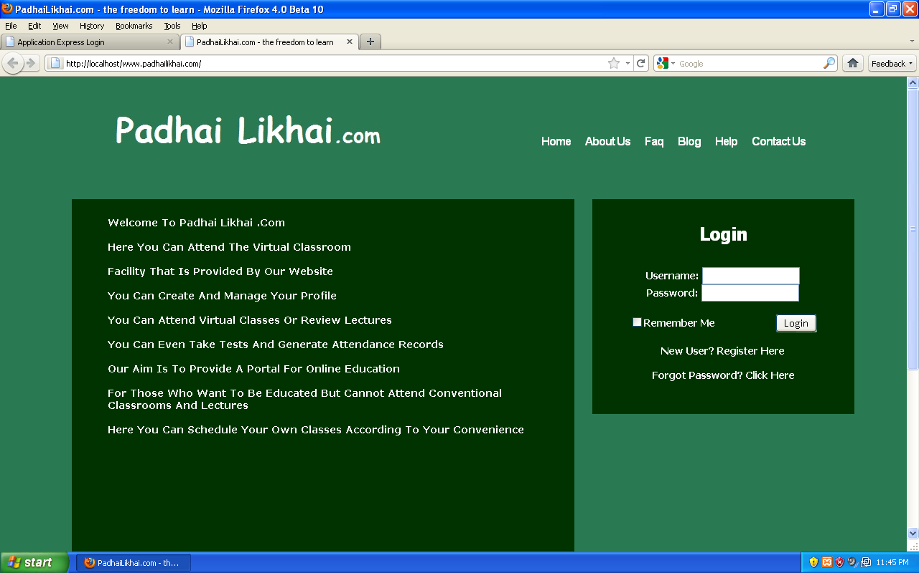
Screen Shots

Slide 7
