Slide 1
Ashwin Vel
Developing a Fine‑Tuned Time Series Model for Automated Test Documentation & Anomaly Detection
Supervisors:
Andy Nelson (TAQA)
Prof Martin Blunt (IMPERIAL)
12.10.2025

Slide 2
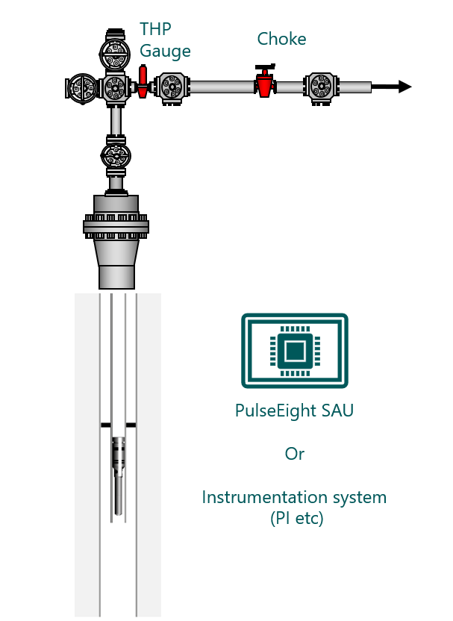
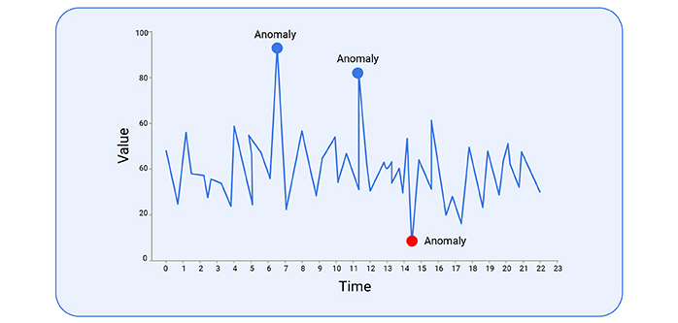
WHAT IS TESTED & WHY
PulseEight ICV (Interval Control Valve)
  downhole choke for zone-level flow control
SIT = workshop bench test of full tool
Anomalies are departures from expected traces
  guiding pass/rework/reject

Slide 3
PROBLEM & OBJECTIVES
Manual review of long SIT traces is slow and inconsistent; subtle issues can be missed
Automate low‑nuisance anomaly triage
Maintain lightweight ONNX/.NET deployment
Provide standardised PDF evidence

Slide 4
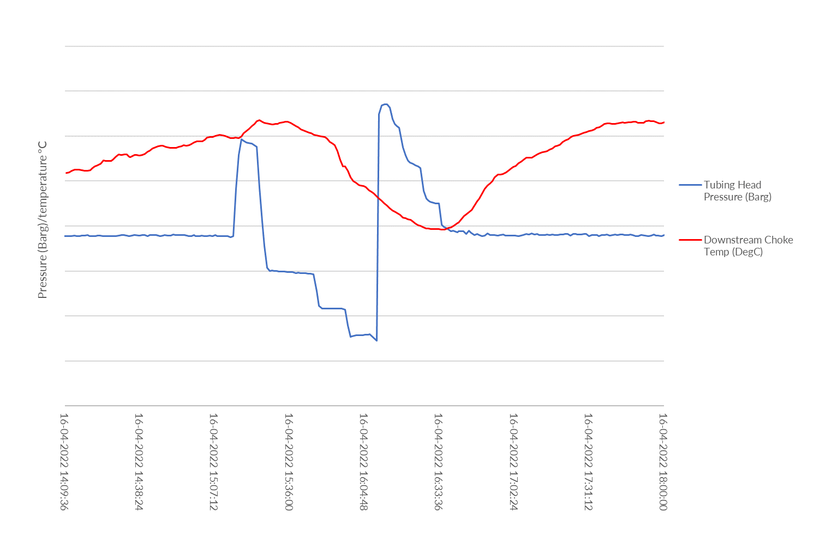
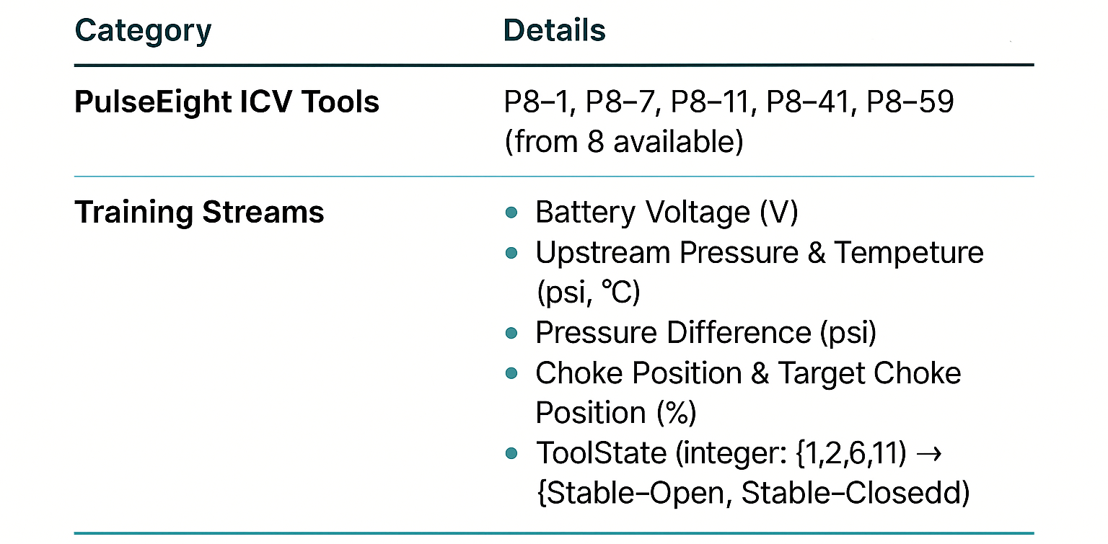
DATA OVERVIEW
Data sourced from AVEVA CONNECT streams/CSV (proprietary)
Over ~1.25M records with irregular sampling intervals (unlabelled)
≈1 Hz telemetry over long runs → time-stamped streams
Features are related (one feature affects another)
Problem: Multivariate unsupervised learning time-series anomaly detection problem
9 features were chosen for the modelling priority
  out of 63 sensors
One hold-out tool with ≈500 expert labels for evaluation

Slide 5
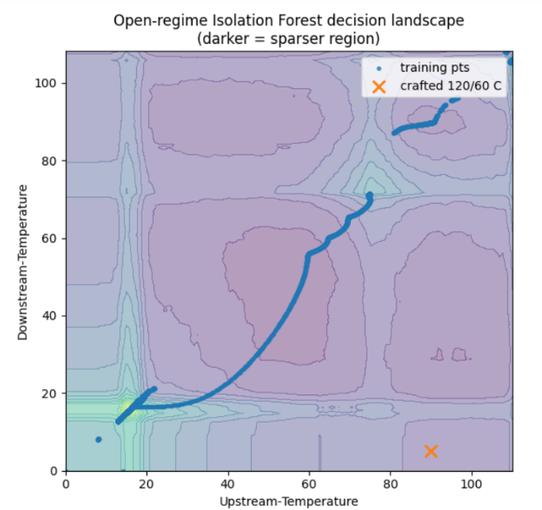
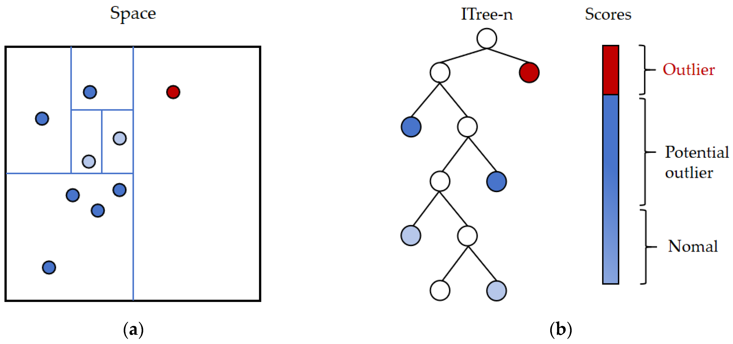
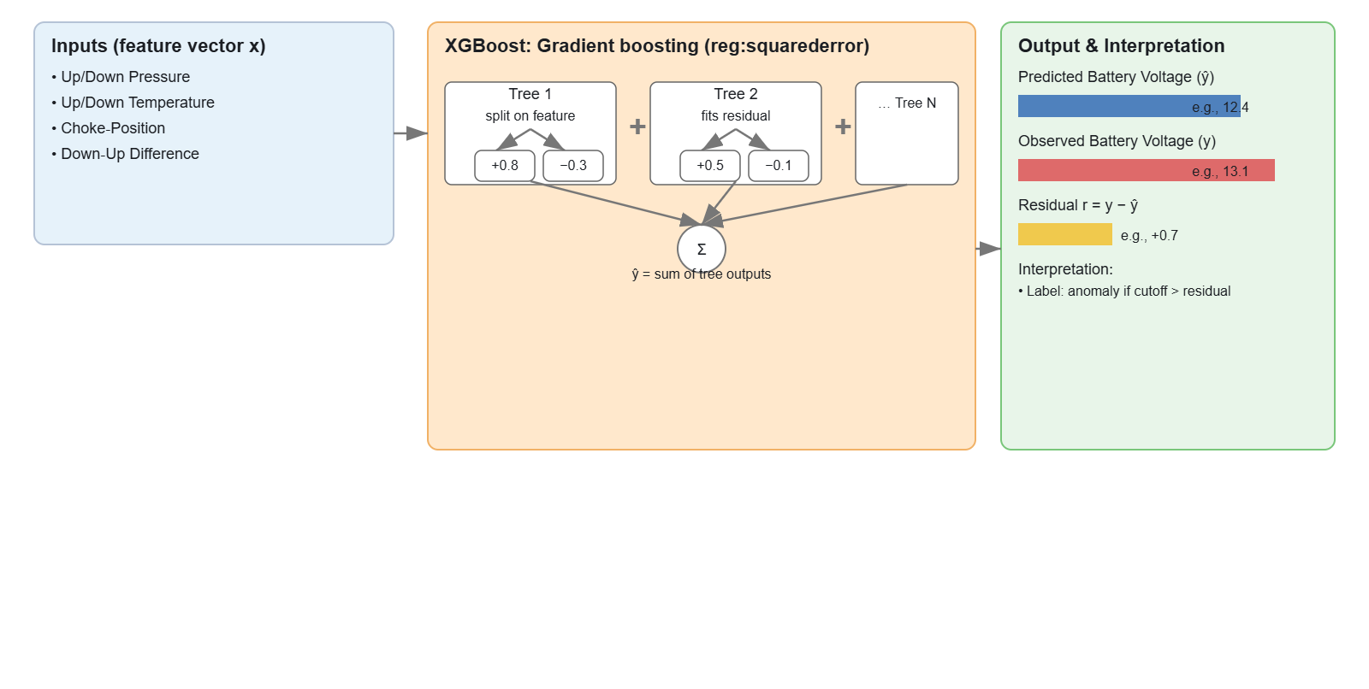
MODELS AT A GLANCE
Isolation Forest
Model | Input | Size | What it detects
1D IF — ΔTemp (open/shut) | DeltaTemperature | 1.18 MB | When there is a seal leakage; will also be regime aware
2D IF Pressure Pair | Upstream-Pressure, Downstream-Pressure | 1.75 MB | Alerts when pressure gauges diverge
3D IF Choke Position | Choke-Position, ToolStateNum, Downstream-Temperature | 1.57 MB | Jitters in choke position
7D IF Full Vector | Battery-Voltage, Upstream-Pressure, Downstream-Pressure, DeltaPressure, Upstream-Temperature, Downstream-Temperature, Choke-Position | 1.76 MB | For never-before-seen operating states; multi-sensor anomalies
6 XGB-Residual models | For feature y, uses other 6 features as input | 0.20–0.67 MB | One-sensor anomalous vs. others normal
Simple DQ watchdog | Rule-based | — | Instantly flags off-scale readings
XGBoostRegressor

Slide 6
Pipeline

Slide 8
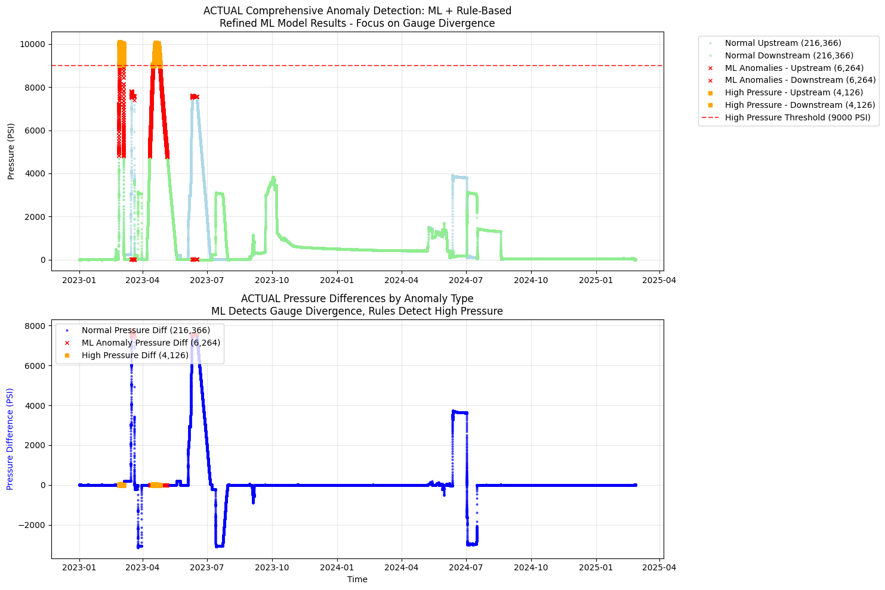
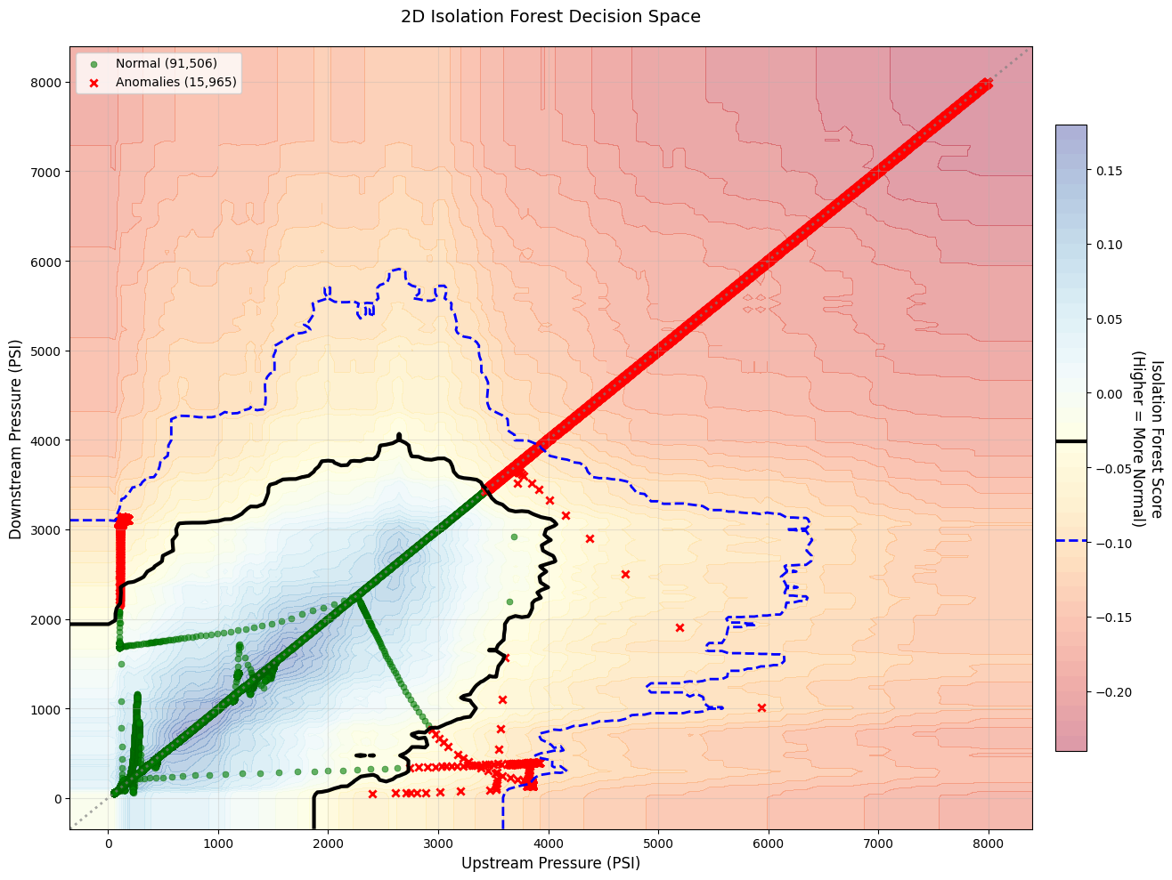
ISOLATION FOREST RESULT: 2D-IF PRESSURE

Slide 9
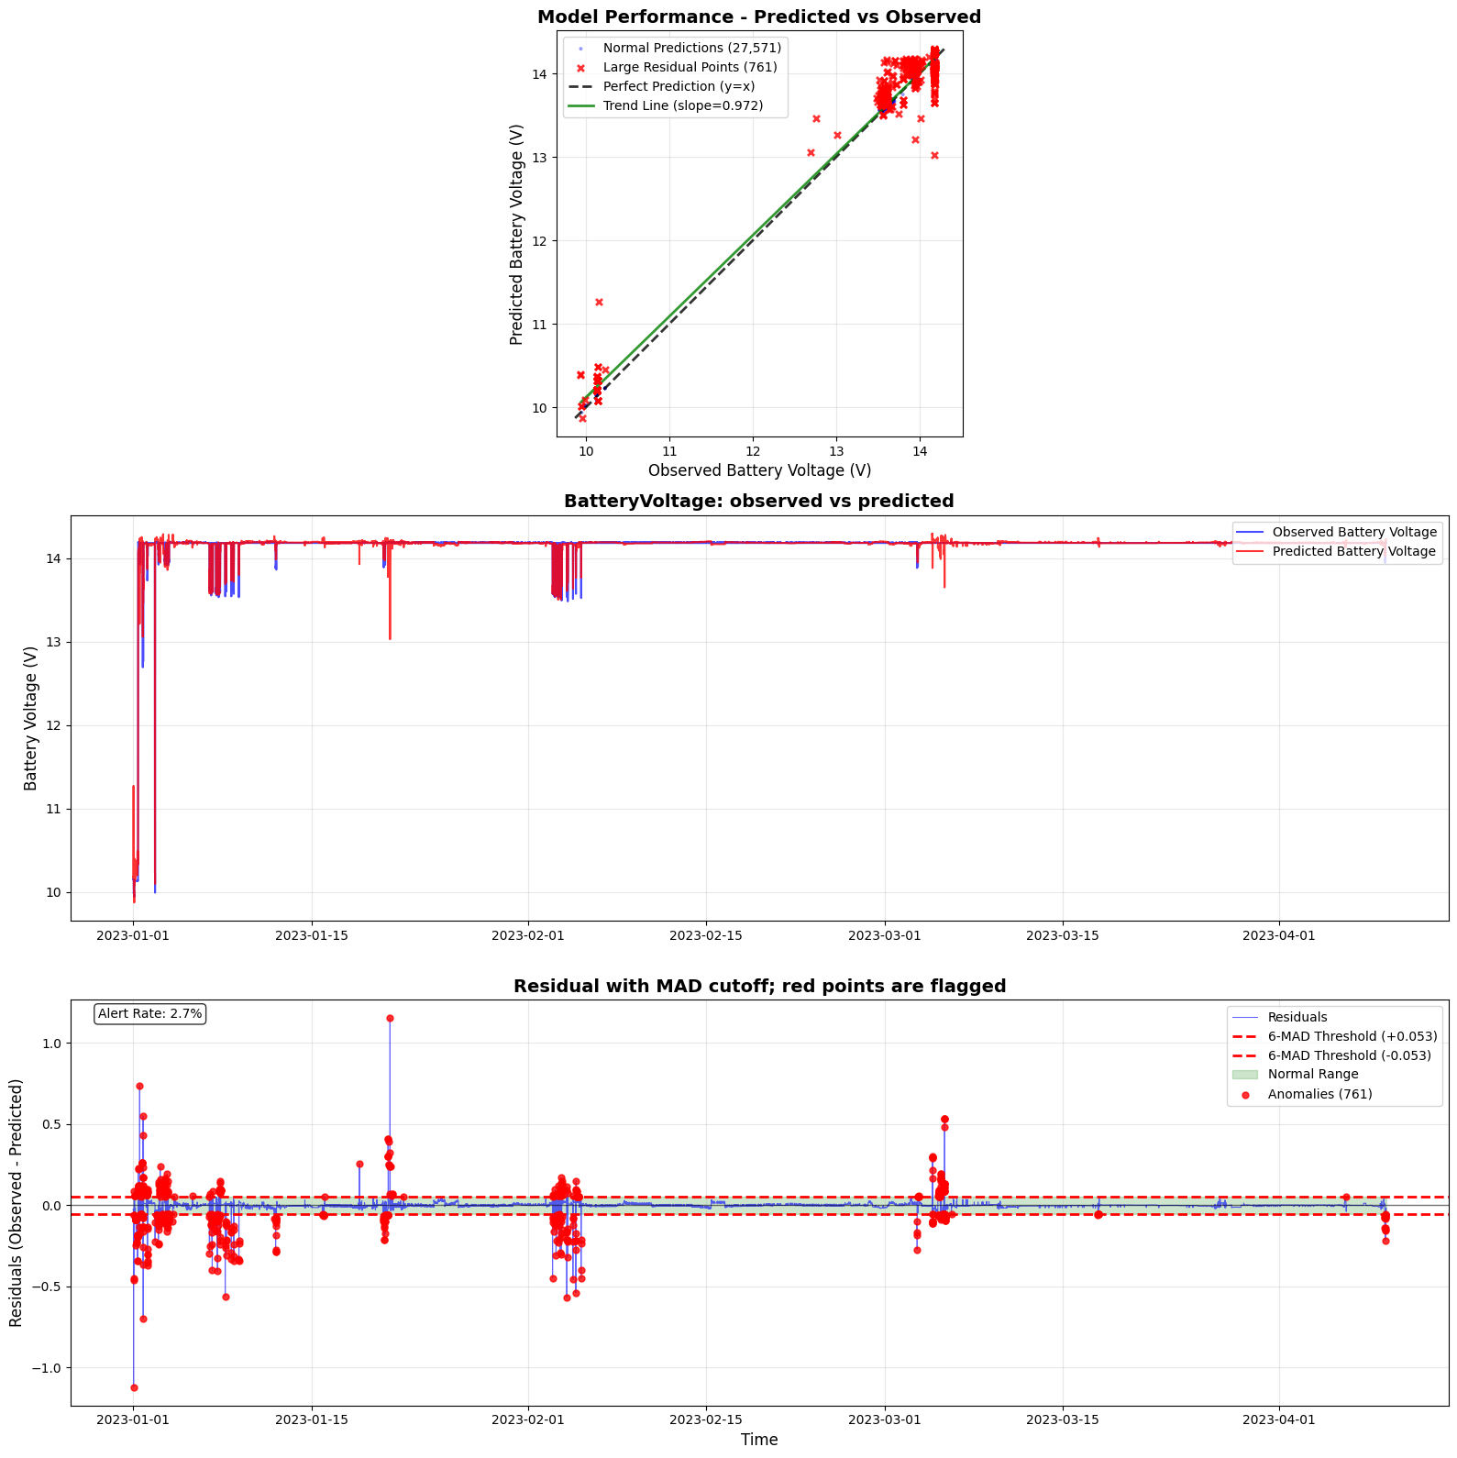
XGB RESIDUAL RESULT: BATTERY VOLTAGE
Notes:
"Panel 1 shows excellent model performance" - Point to R² and correlation
"Panel 2 shows how well we track over time" - Point to the overlapping lines
"Notice the separations in Panel 2?" - Point to areas where lines diverge
"Panel 3 shows these SAME moments as residual anomalies" - Point to red dots
"Only 2.7% flagged - very selective for critical issues" - Emphasize threshold choice

Slide 10
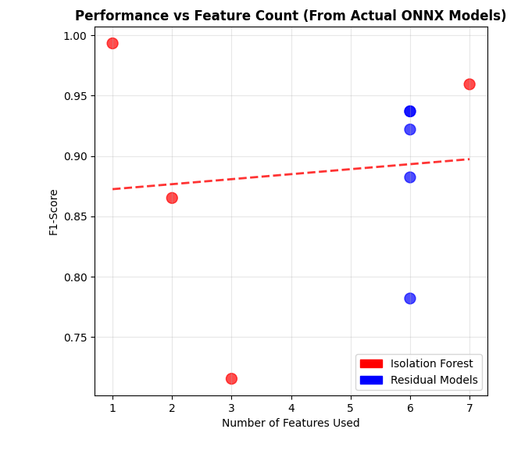

ENSEMBLE MODEL PERFORMANCE
$$f1=2 x\frac{Precision x Recall}{Precision+Recall}$$

Slide 11
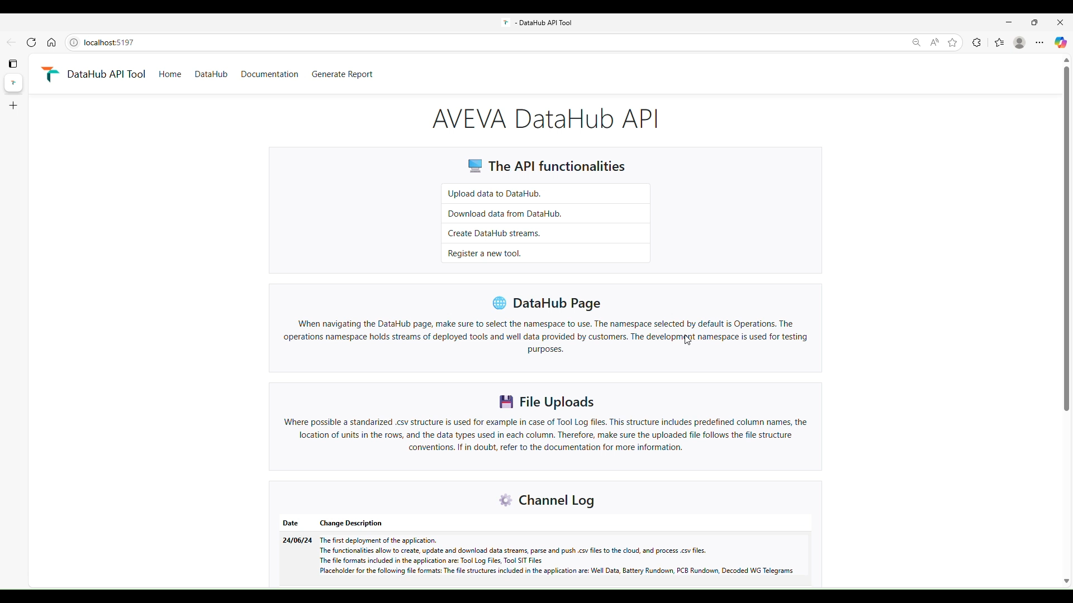
DEMO

Slide 12
Labels from one hold-out tool; small sample size
Point-based detection only; temporal patterns not modelled
Threshold drift possible with different tools
Alert budget monitoring and recalibration needed
Limitations & risks

Slide 13
CONCLUSION & NEXT STEPS
Automated SIT validation and standardised reporting reduce engineer time and re-tests
Physics-guided ΔT features outperform higher-dimensional inputs
Next: cross-tool validation, adaptive thresholds, temporal models (e.g., LSTM)
Potential application to other condition-monitoring tasks

