Slide 1
Product Assistant
Team Name: El Nino

Slide 2
INTRODUCTION
Most online shopping sites have:
A thought process - proposed online shopping:
Search, filter and sort tools that are not natural-language-friendly
Lacks physical store experience
for prospective customers
for people interested in exploring products and options

Slide 3
OUR PRODUCT
Conversational bot to help customers discover and order products
Prospective customers:
who know exactly what they want - provide the desired specifications to find and order the product
who expect better options - converse with the bot about desired products
The bot responds to customer queries using similarity detection

Slide 4











ARCHITECTURE
Tokenization
Stemming
Stopwords
t
s
s
User
Chatbot UI
Tfidfvectorizer()
Data
Pre-processing
Inference
Data
List inventory
Product
Description
Order Product
Bot
Actions
Response Function
Cosine Similarity

Slide 5

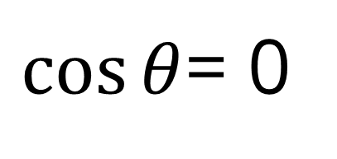
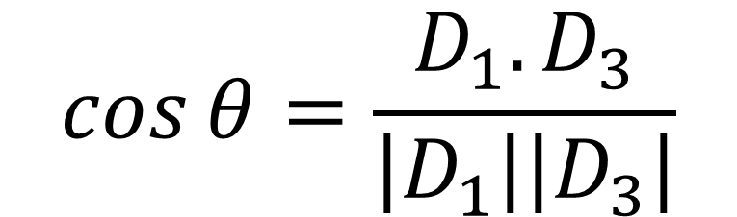
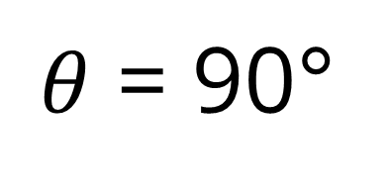
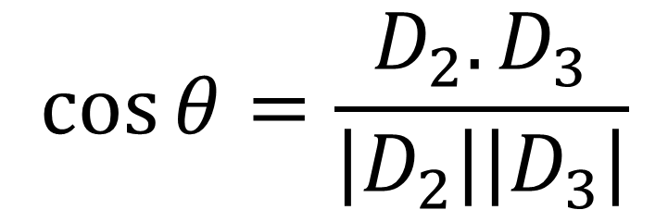
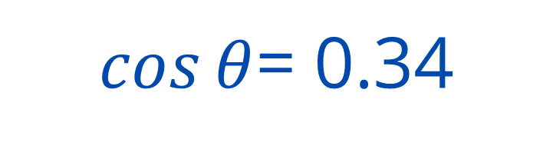
TF-IDF VECTORIZER & COSINE SIMILARITY
Document 1: Will it rain today
Document 2: Rain is beautiful
Document 3: Rain today
TF |  |  |  | IDF | TF-IDF
 | D1 | D2 | D3 |  | D1 | D2 | D3
will | 1/3 | 0/2 | 0/2 | 0.477 | 0.159 | 0 | 0
rain | 1/3 | 1/2 | 1/2 | 0 | 0 | 0 | 0
today | 1/3 | 0/2 | 1/2 | 0.176 | 0.058 | 0 | 0.088
beautiful | 0/3 | 1/2 | 0/2 | 0.477 | 0 | 0.238 | 0
$$\cos{θ}=\frac{D_{1}.D_{3}}{\left|D_{1}\right|\left|D_{3}\right|}$$
$\cos{θ}$= 0.34
$θ$ = 70.12°
$$\cos{θ}=\frac{D_{2}.D_{3}}{\left|D_{2}\right|\left|D_{3}\right|}$$
$\cos{θ}$= 0
$θ$ = 90°

Slide 6
TF-IDF VECTORIZER & COSINE SIMILARITY
Document 1: Will it rain today
Document 2: Rain is beautiful
Document 3: Rain today
TF |  |  |  | IDF | TF-IDF
 | D1 | D2 | D3 |  | D1 | D2 | D3
will | 1/3 | 0/2 | 0/2 | 0.477 | 0.159 | 0 | 0
rain | 1/3 | 1/2 | 1/2 | 0 | 0 | 0 | 0
today | 1/3 | 0/2 | 1/2 | 0.176 | 0.058 | 0 | 0.088
beautiful | 0/3 | 1/2 | 0/2 | 0.477 | 0 | 0.238 | 0
$$\cos{θ}=\frac{D_{1}.D_{3}}{\left|D_{1}\right|\left|D_{3}\right|}$$
$\cos{θ}$= 0.34
$θ$ = 70.12°
$$\cos{θ}=\frac{D_{2}.D_{3}}{\left|D_{2}\right|\left|D_{3}\right|}$$
$\cos{θ}$= 0
$θ$ = 90°

Slide 7
ARCHITECTURE
Tokenization
Stemming
Stopwords
t
s
s
User
Chatbot UI
Tfidfvectorizer()
Data
Pre-processing
Inference
Data
List inventory
Product
Description
Order Product
Bot
Actions
Response Function
Cosine Similarity

Slide 8
CHALLENGES FACED
Conversation with the chatbot was initially instructive due to issues with static matching
Getting a dialog dataset to aid with detecting the similarity between test data and inference data

Slide 9
POTENTIAL FEATURES
An integrated web application
Enhancing the chatbot for better context parsing
Notifying users about product availability and price drops through email or SMS

Slide 10


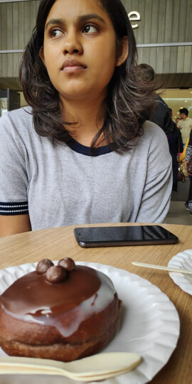
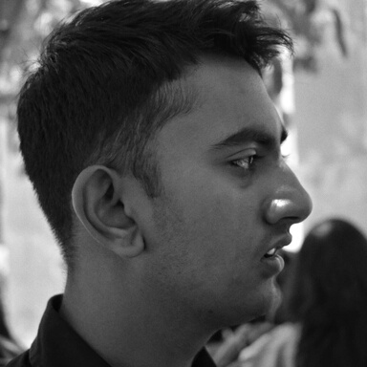
Ashwin
Karthik
Nithya
"Build a team so strong that you don't know who the boss is"
Thank you!

