Slide 1
TVIX
Dataset taken from 01/01/2017

Slide 2
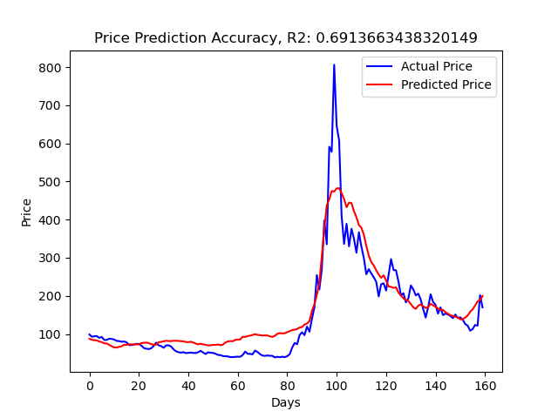
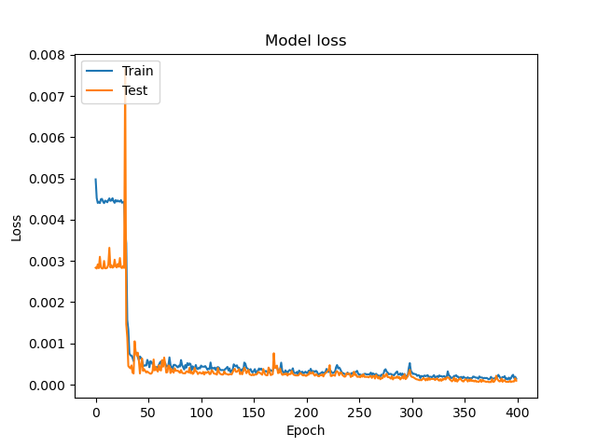
10 layers, 1d candle

Slide 3
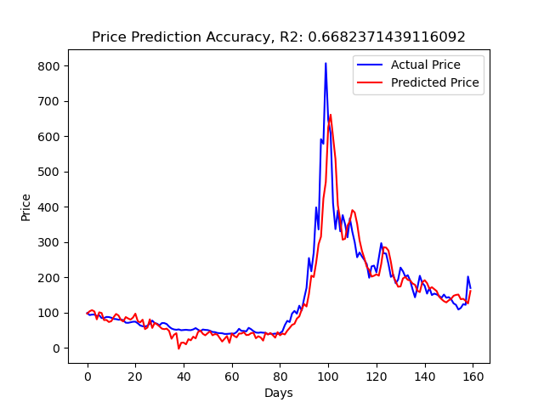
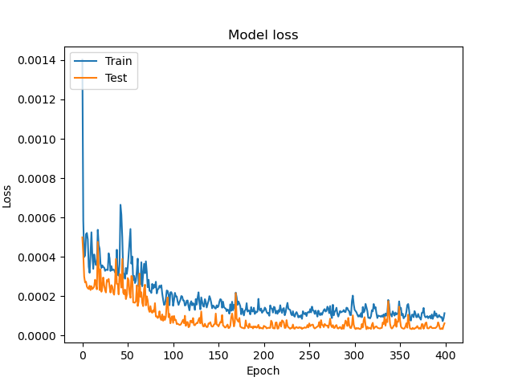
3 layers, 1d candle
X_train shape: (637, 5, 70)
X_test shape: (160, 5, 70)
y_train shape: (637,)
y_test shape: (160,)

Slide 4
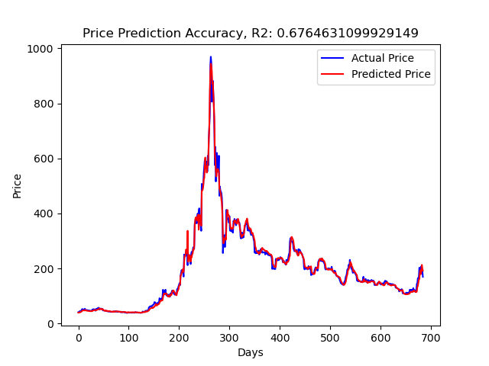
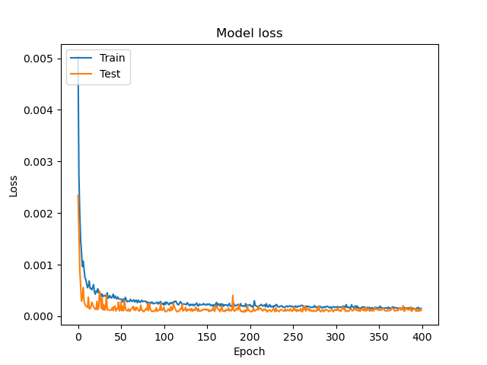
3 layers, 1h candle (Only past 729 days can be extracted)
X_train shape: (2736, 5, 70)
X_test shape: (685, 5, 70)
y_train shape: (2736,)
y_test shape: (685,)

