Slide 1

ZOMATO DATA ANALYSIS
This report presents a comprehensive analysis of the sales data with the objective of uncovering key insights and trends. The analysis addresses specific questions regarding sales performance, customer behavior, and overall business efficiency.

Slide 2
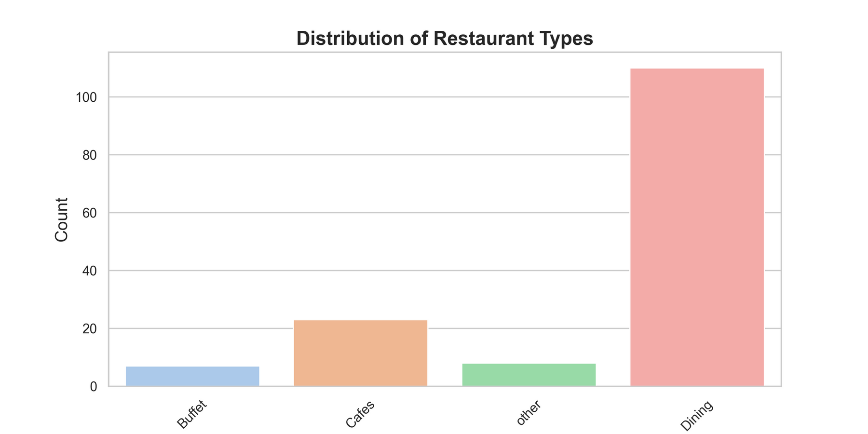
RESTURANTS FROM WHICH MAJORITY OF CUSTOMERS ORDER ?
Conclusion: Dining

Slide 3
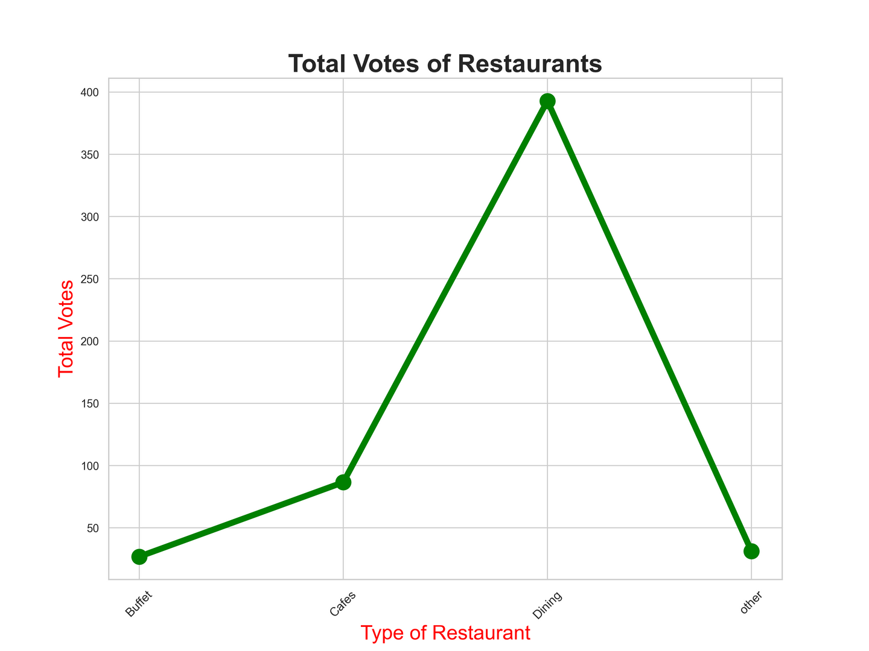
NUMBER OF VOTES HAS EACH TYPE OF RESTURANT RECEIVED FROM CUSTOMER ?
Conclusion: Dining Resturant

Slide 4
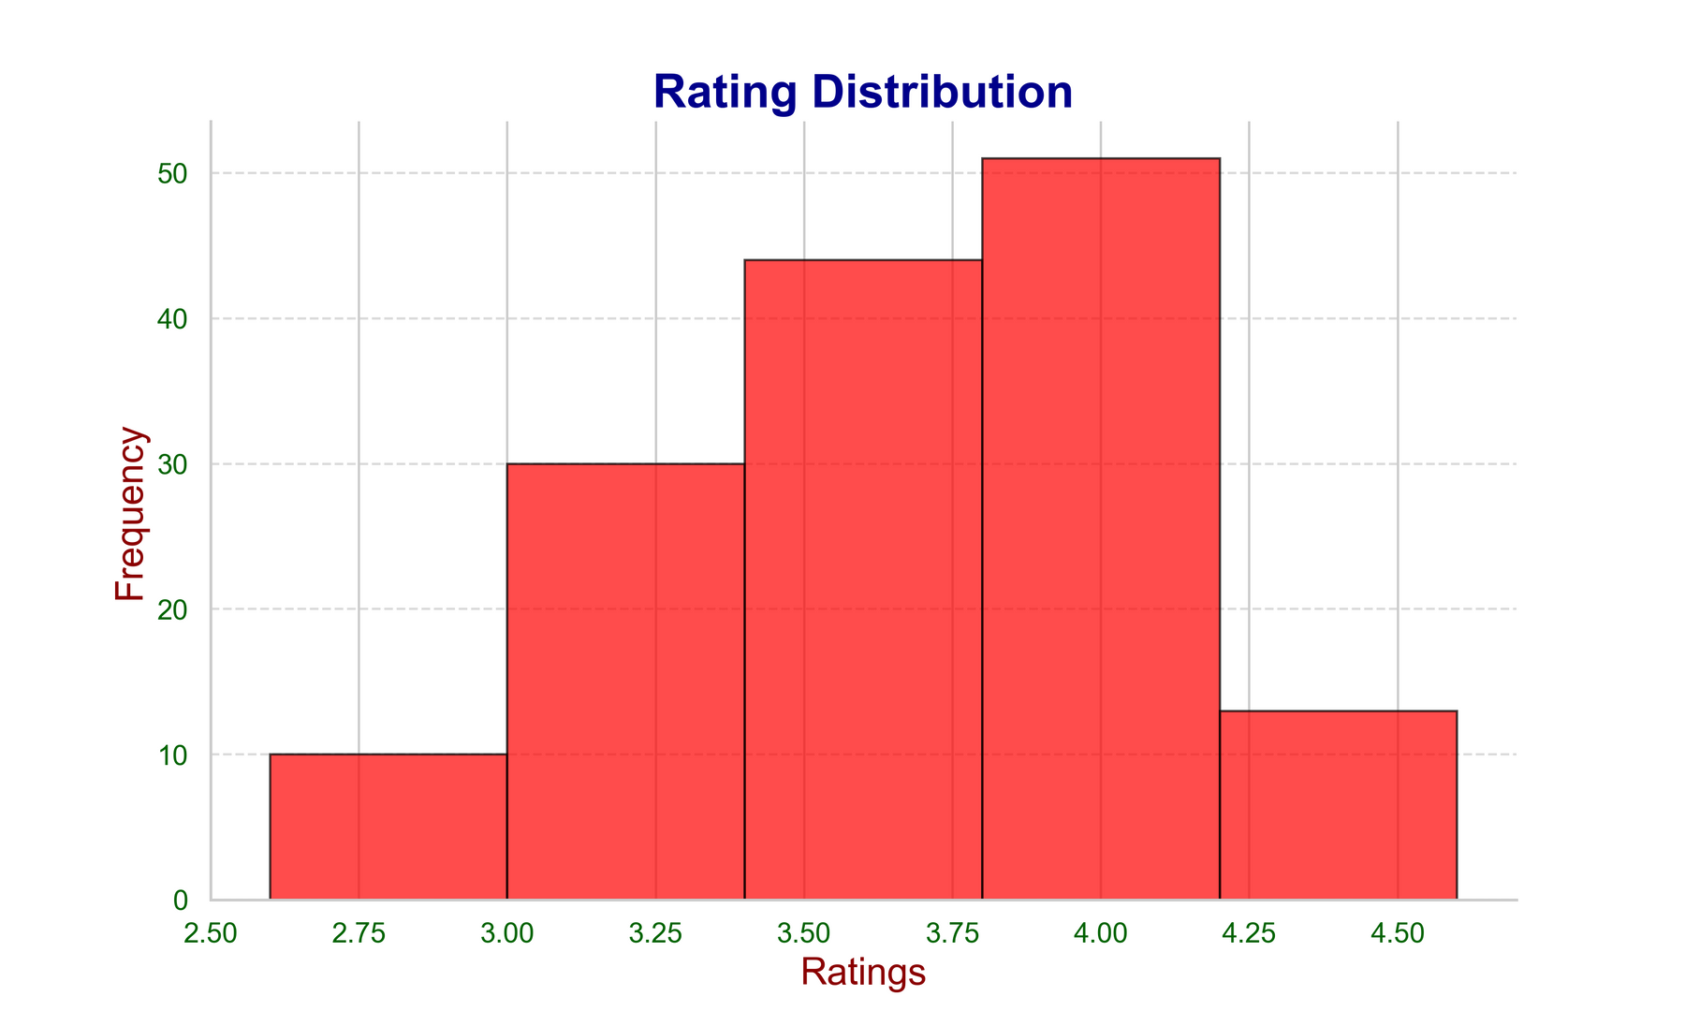
RATINGS THAT THE MAJORITY RESTURANTS HAVE RECIEVED ?
Conclusion: Most ratings are from 3.37 to 4.00 which is good sign.

Slide 5
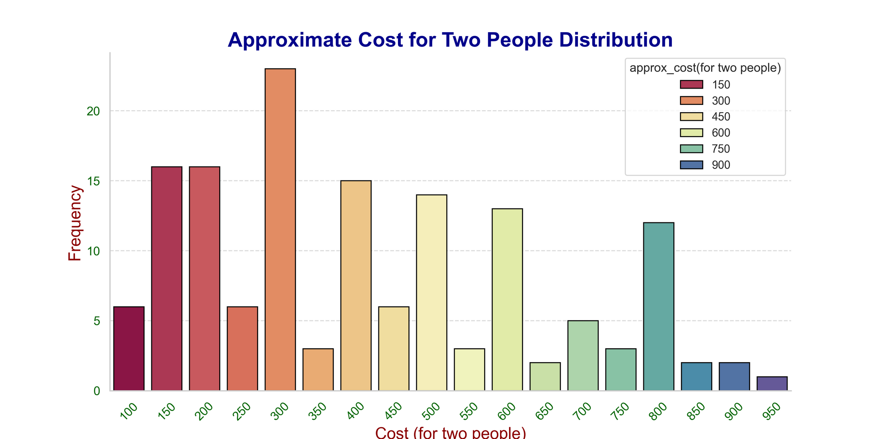
ZOMATO OBSERVED MOST COUPLE ORDERS. WHAT IS THERE AVERAGE SPENT ?
Conclusion: Average order spent is rs. 300

Slide 6
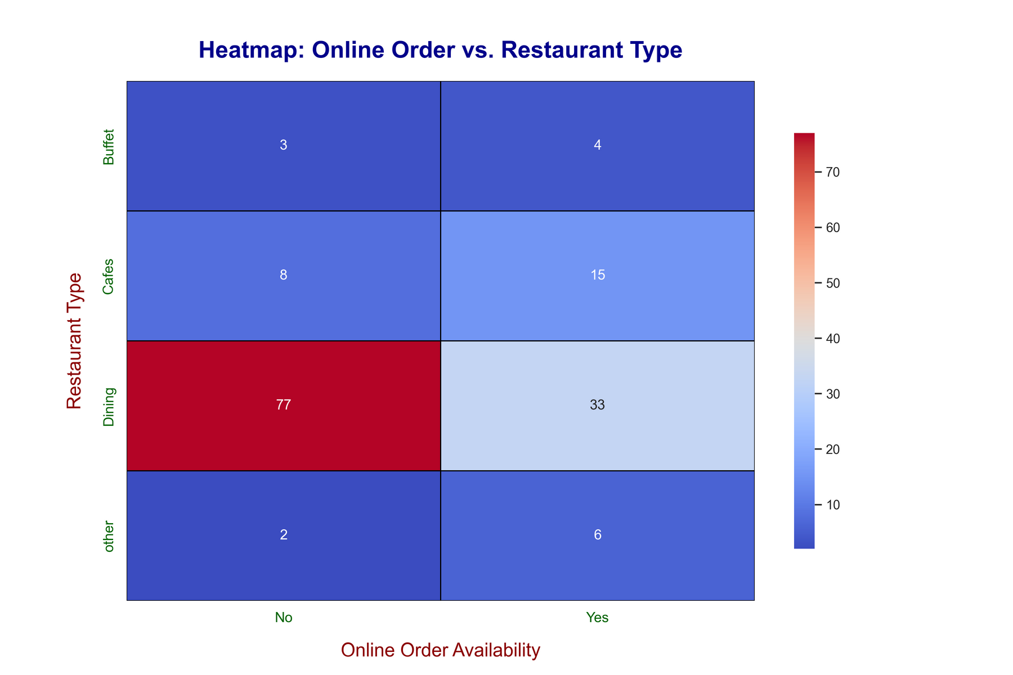
ZOMATO OBSERVED MOST COUPLE ORDERS. WHAT IS THERE AVERAGE SPENT ?
Conclusion: People mostly prefer offline mode in dining restaurants and online mode in cafes

Slide 7
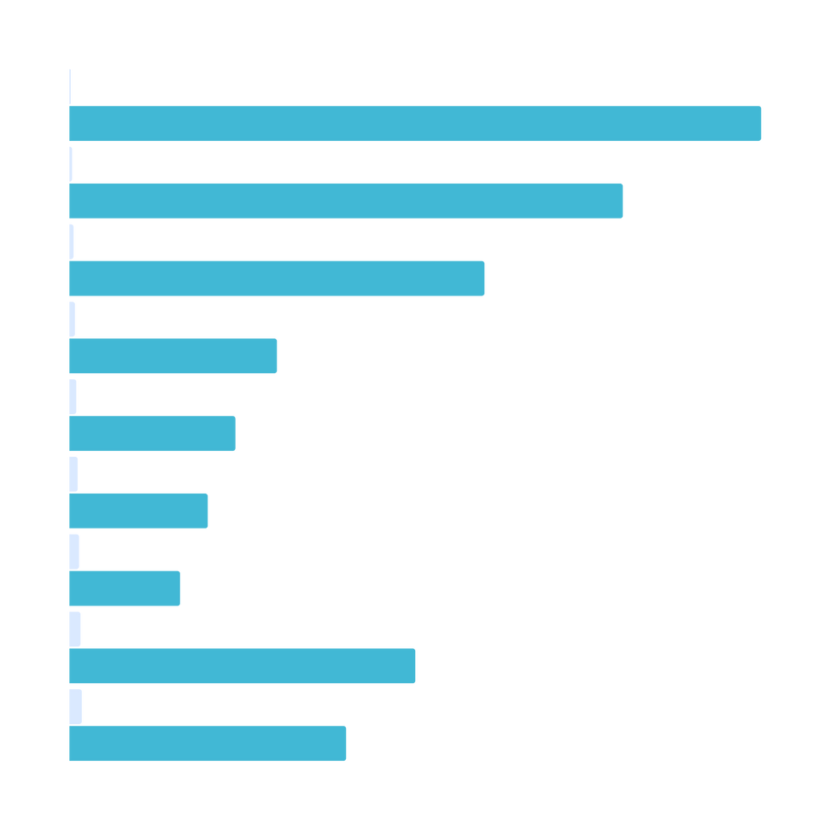
Thank You !

