Slide 1

EDA in GNU/Linux
Ashwith J. Rego
ashwith@ieee.org
http://ashwith.wordpress.com

Slide 2

Introduction

Slide 3

Before We Begin
Pay attention – you need not prepare notes as these will be provided.
Work with me.
Stop me if I'm unclear or too fast.
Work on the assignments provided.
Explore further on your own.
My name is Ashwith not sir :-)

Slide 4
What Will You Learn?
Fedora Linux administration basics.
Using Fedora Linux.
Analog circuit simulation.
Mathematical analysis in Scilab.
Python Programming.
Prototyping using the Arduino platform.

Slide 5
Why Learn All This Now?
Tools are needed in engineering.
Most of these are expensive.
Piracy will land you in trouble.
Industry – standard tools are similar.
Learning these now will keep you ready when you need them in higher semesters or in work.

Slide 6

Introduction To Fedora Linux

Slide 7
Contents
Installing Fedora – Demo
Installing/Removing software
BASH Shell
Basic shell scripting
Text editing
Programming
Makefiles
Version Control

Slide 8

What is GNU/Linux?
Unix-like OS
Started off with the GNU Project in 1984. everything except the kernel was ready.
Linux Kernel added when Linus Torvalds released it in 1992.
Image from 'Anatormy of the Linux Kernel', M. Tim Jones
http://www.ibm.com/developerworks/library/l-linux-kernel/

Slide 9
Why Learn The Bash Shell?
Very powerful command-line interface.
Scripts help remove repeated use of commands.
Push the work back to the computer – GUI's require one to point and click each time.

Slide 10
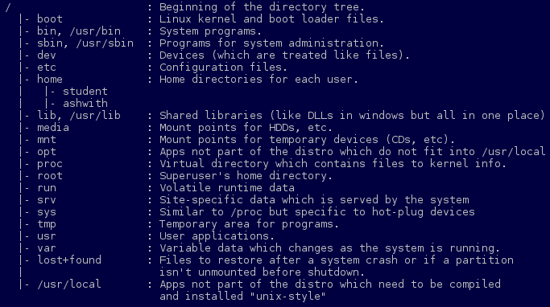
Directory Structure.
Single file system hierarchy under '/'
Devices are also files.
Defined by the Filesystem Hierarchy Standard (FHS).

Slide 11
General Command Syntax
<command> <options> <arguments>
Example:
ls -ltrh /usr
command
options
arguments

Slide 12
Enough Theory, Lets get to Work!
Shell Commands
The Vim editor
Shell scripting
Tomorrow:
Programming
Makefiles
Version Control (Using git)

