Slide 1


Introduction To Fedora Linux

Slide 2
Contents
Installing Fedora – Demo
Installing/Removing software
BASH Shell
Basic shell scripting
Text editing
Programming
Makefiles
Version Control

Slide 3

Revision – The GNU/Linux OS
Image from 'Anatormy of the Linux Kernel', M. Tim Jones
http://www.ibm.com/developerworks/library/l-linux-kernel/

Slide 4
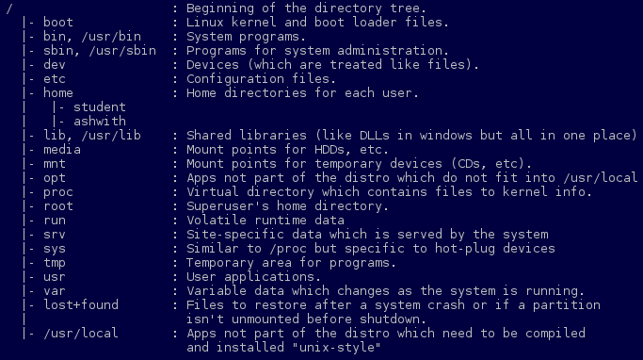
Revision – Directory Structure

Slide 5
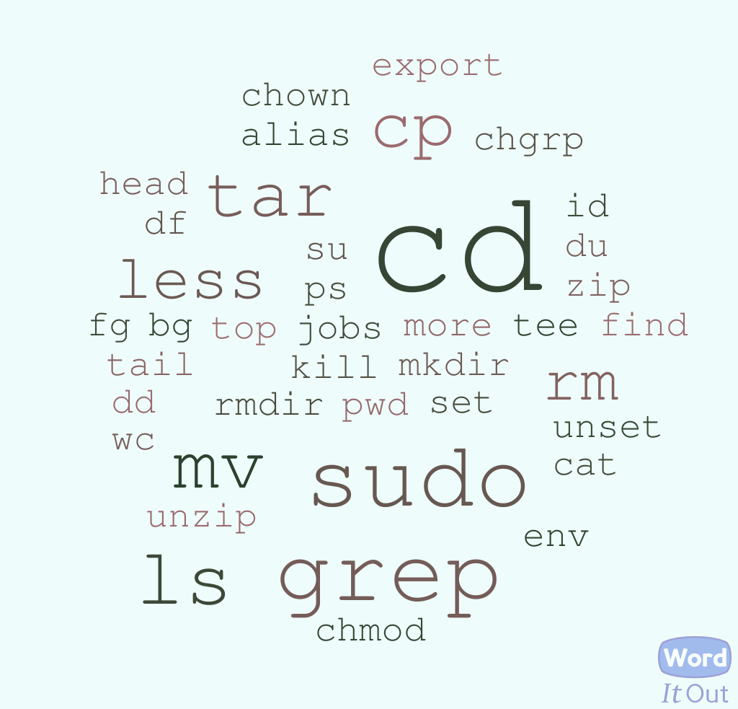
Revision – Shell Commands
<command> <options> <arguments>

Slide 6
Revision – Shell Scripts
name=”This gets assigned to name”
echo “This is how $name used”
read inputFromUser
echo “You typed $inputFromUser”
echo “$(date) allows command
Substitution”
echo “Add numbers: $((10 + 32))”

Slide 7
Revision – Shell Scripts
if [ $number -lt 10 ]; then
echo “That's less than 10”
else
echo “That's greater than 10”
fi

Slide 8
Revision – Shell Scripts
case $character in
[[:upper:]] ) echo “UPPERCASE”
[[:lower:]] ) echo “lowercase”
[0-9] ) echo “digit”
* ) echo “@nything €l$€”
esac

Slide 9
Revision – Shell Scripts
while [ $largerTen -gt 10 ] do
echo “The number is large”
largerTen = $((largerTen + 1))
done

Slide 10
Revision – Shell Scripts
Parameters
Shell Script name: add.bash
Run using: ./add.bash 1 2 3 6
Number of args = $# = 4
Vars: $1 = 1, $2 = 2, $3 = 3, $4 = 6
Use $@ in a for loop.

Slide 11
Contents
Installing Fedora – Demo
Installing/Removing software
BASH Shell
Basic shell scripting
Text editing
Programming
Makefiles
Version Control

Slide 12
Makefiles
Build automation.
Compiles only what's needed.
Handles dependencies.
targer1 target2 ... : dep1 dep2 ...
<TAB> command1
command2
.
.
.

Slide 13
Version Control
Manages updates to files.
Resolves conflicts.
Helps backtrack to previous versions.

Slide 14



Slide 15

point.c
line.c
circle.c
polygon.c

Slide 16

point.c
line.c
circle.c
polygon.c

Slide 17
point.c
point.c
line.c
line.c
circle.c
circle.c
polygon.c
polygon.c
Version 1

Slide 18
point.c
circle.c
line.c
circle.c
circle.c
polygon.c
Version 1

Slide 19
point.c
circle.c
circle.c
line.c
circle.c
circle.c
circle.c
polygon.c
Version 1

Slide 20
point.c
circle.c
circle.c
line.c
circle.c
circle.c
circle.c
circle.c
polygon.c
Version 2

Slide 21

point.c
line.c
circle.c
circle.c
circle.c
circle.c
polygon.c
Version 2

Slide 22
point.c
line.c
circle.c
circle.c
circle.c
circle.c
polygon.c
circle.c
Version 2

Slide 23
point.c
line.c
circle.c
circle.c
circle.c
circle.c
polygon.c
circle.c
circle.c
Version 2

Slide 24
point.c
line.c
circle.c
circle.c
circle.c
circle.c
circle.c
polygon.c
circle.c
circle.c
Version 3

Slide 25
point.c
line.c
circle.c
circle.c
circle.c
polygon.c
Version 3

Slide 26
Git
Developed by Linus Torvalds.
Distributed version control.
Create free git repository on github.org

