Slide 1

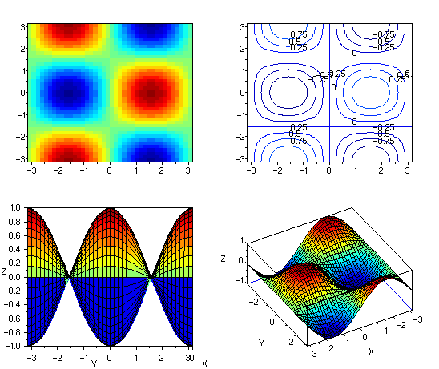
Scilab
-Ashwith Jerome Rego
ashwith@ieee.org
http://ashwith.wordpress.com
Figure by Christophe Dang Ngoc Chan (cdang).
Source URL: http://commons.wikimedia.org/wiki/File:Scilab_exemple_3d_2.png

Slide 2
What Use Is It?
Free of charge.
Interested in starting a company? Don't need to worry about licensing.
Free & Open Source – Change it the way you like.
Ariane space program uses it – our satellites are in space thanks to their rockets.
Not convinced? Visit http://scilab.org/scilab/gallery/applications

Slide 3
Did Someone Say Matlab + Torrents?
Don't try your luck with that in research – you need to do things legally.
Can't do this if you want to start a company either.
It's not right to steal.
Encourage the use of FOSS software – it will drive improvement.

Slide 4
Language Basics
Variables & Assignments
Basic Operations
Matrices
Branching & Looping
Functions
Plotting
Strings & Printing
Useful functions

Slide 5
Mathematics
Linear Algebra
Differential Equations

Slide 6



Practice Makes Perfect
Lets Begin!

