Slide 1
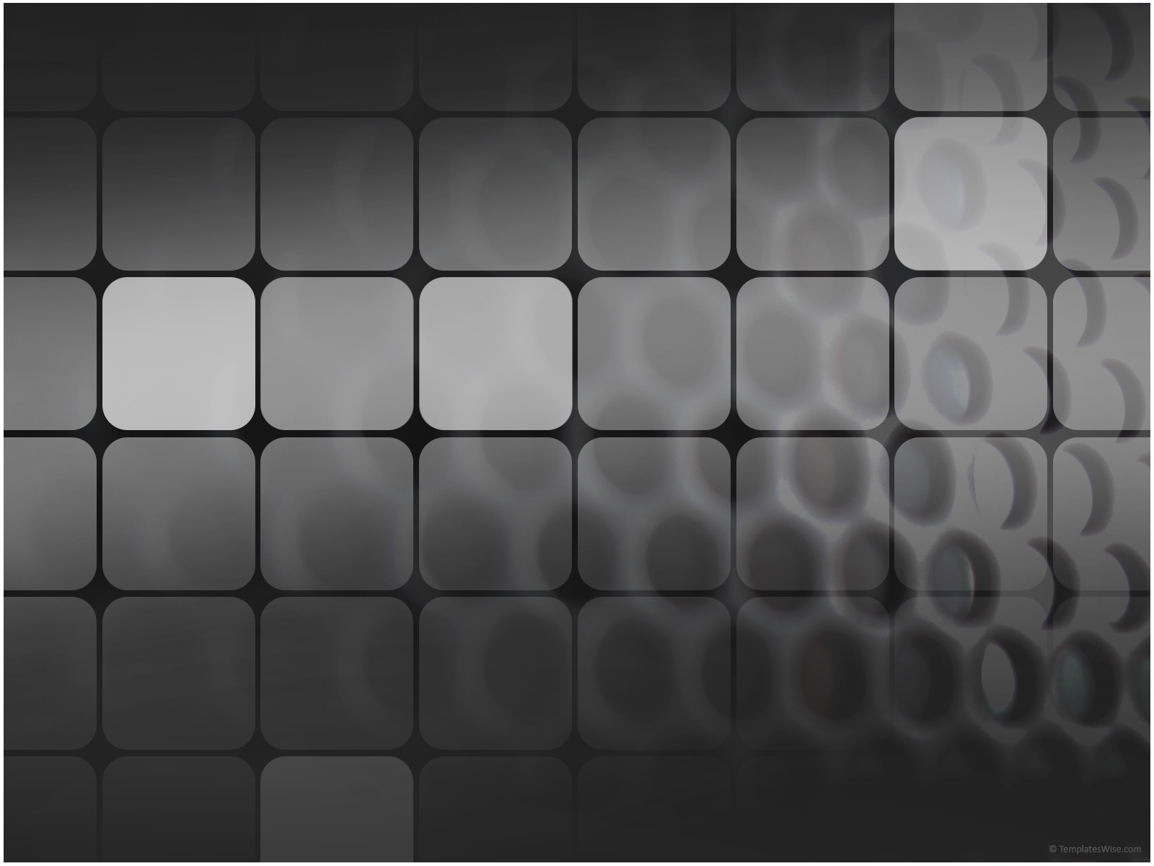
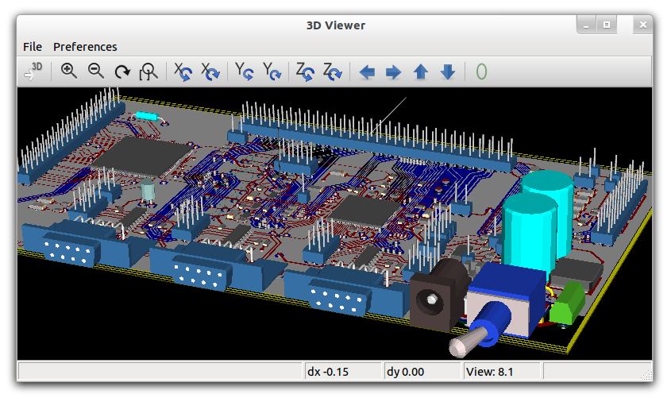
Circuit Simulation in GNU/Linux
-Ashwith Jerome Rego
ashwith@ieee.org
http://ashwith.wordpress.com
This work is licensed under a Creative Commons Attribution-ShareAlike 3.0 Unported License.
http://creativecommons.org/licenses/by-sa/3.0/

Slide 2
Why Fedora (Electronic Lab)?
Bleeding edge GNU/Linux distribution.
FEL is maintained by people in the electronics industry.
Aims to be a complete package which meets industry standards.

Slide 3
gEDA Workshop

Slide 4
gEDA
EDA tools under the GPL license.
Circuit Design.
Schematic Capture.
Simulation
Prototyping.
Production.
www.geda-project.org

Slide 5
Procedure
Symbol
Creation
Schematic
Capture
Netlist
Generation
Simulation
Results
PCB Design
(Not Today)

