Slide 1

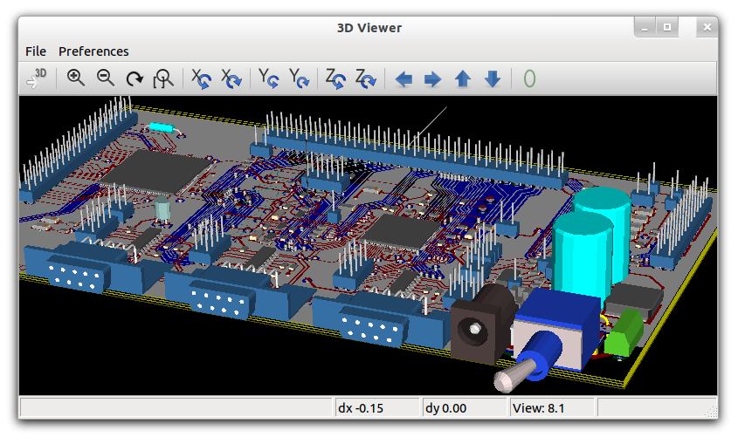
Circuit Simulation in GNU/Linux
-Ashwith Jerome Rego
ashwith@ieee.org
http://ashwith.wordpress.com
This work is licensed under a Creative Commons Attribution-ShareAlike 3.0 Unported License.
http://creativecommons.org/licenses/by-sa/3.0/

Slide 2
Revision
Step 1?
Schematic Capture
  Place the components (Shortcut = i)
  Rearrange them (Shortcut = er for rotate, ei for mirror)
  Add nets to connect them (Shortcut = n)
  Add attributes (Double click) – Remember to be careful here and make sure you pick the right attribute names.

Slide 3
Revision
Step 2?
Netlist generation
  gnetlist -g spice-sdb -o <output>.net <input>.sch
Step 3?
Simulation (use -b for batch mode)
  ngspice <netlist>.net
View results (gaw or withing ngspice.

Slide 4
Today's Session
Few more examples...
Symbol creation.

