Slide 1

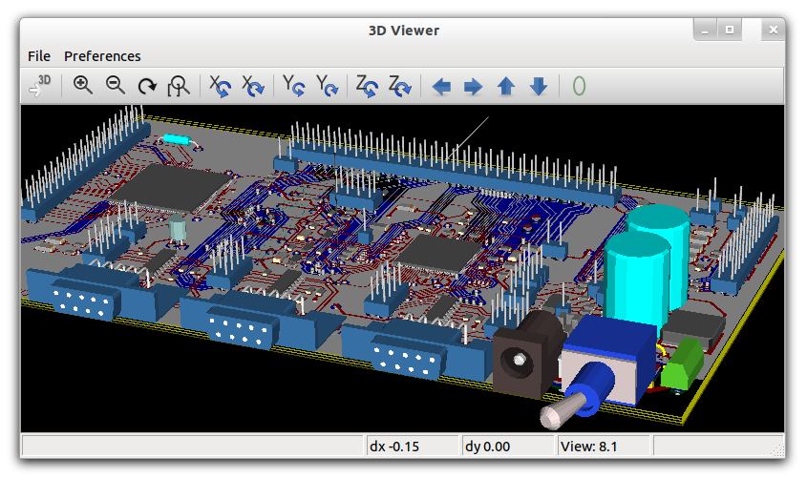
Circuit Simulation in GNU/Linux
-Ashwith Jerome Rego
ashwith@ieee.org
http://ashwith.wordpress.com
This work is licensed under a Creative Commons Attribution-ShareAlike 3.0 Unported License.
http://creativecommons.org/licenses/by-sa/3.0/

Slide 2
Revision
Step 1?
Schematic Capture
  Place the components (Shortcut = i)
  Rearrange them (Shortcut = er for rotate, ei for mirror)
  Add nets to connect them (Shortcut = n)
  Add attributes (Double click) – Remember to be careful here and make sure you pick the right attribute names.

Slide 3
Revision
Step 2?
Netlist generation
  gnetlist -g spice-sdb -o <output>.net <input>.sch
Step 3?
Simulation (use -b for batch mode)
  ngspice <netlist>.net
View results (gaw or withing ngspice.

Slide 4
Revision
Symbol Creation
  Draw the symbol
  Add Pins
  Edit pin attributes
  Show/Hide Inv Text
  Add device and refdes attributes
  Symbol Translate
  Make sure you save in the correct format.

Slide 5
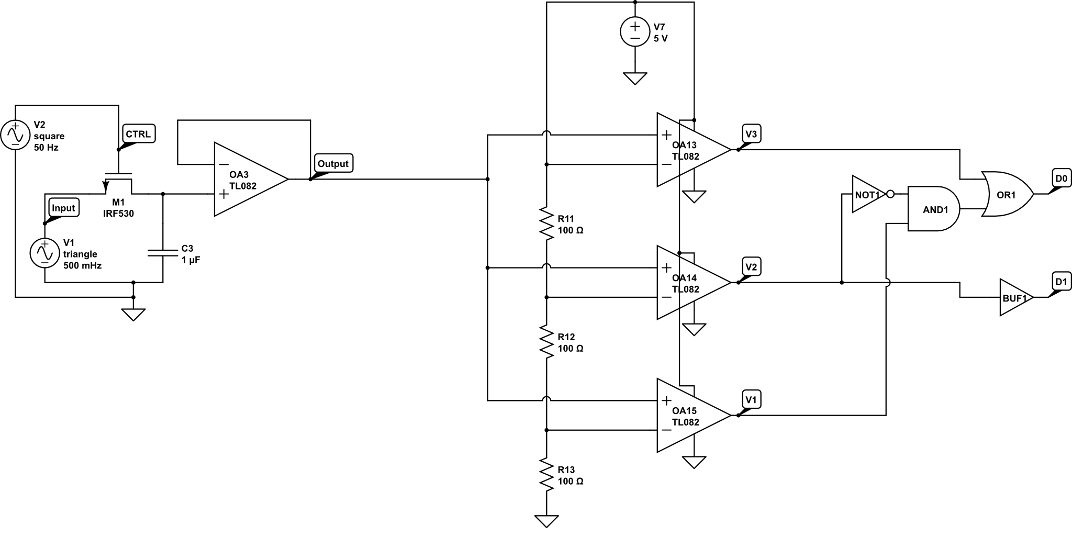
Hierarchical Design
What is this?!

Slide 6
Hierarchical Design
How about now?
Sample and Hold
Sample and Hold
Voltage Follower
Flash ADC
Thermometric Code
to Binary Decoder

Slide 7
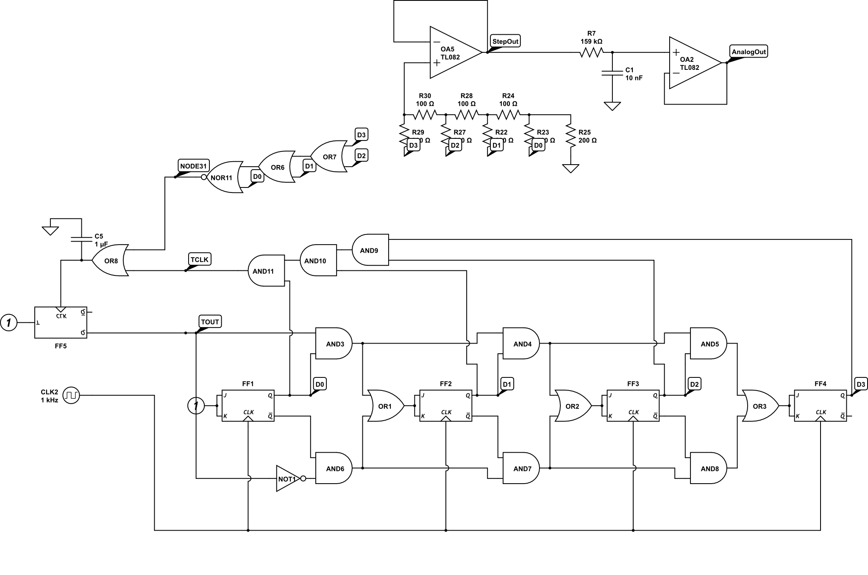
Hierarchical Design
What is this?

Slide 8
Hierarchical Design
Now?
DAC
Up/Down Counter
R/2R Ladder
Voltage Follower
Low Pass Filter

Slide 9
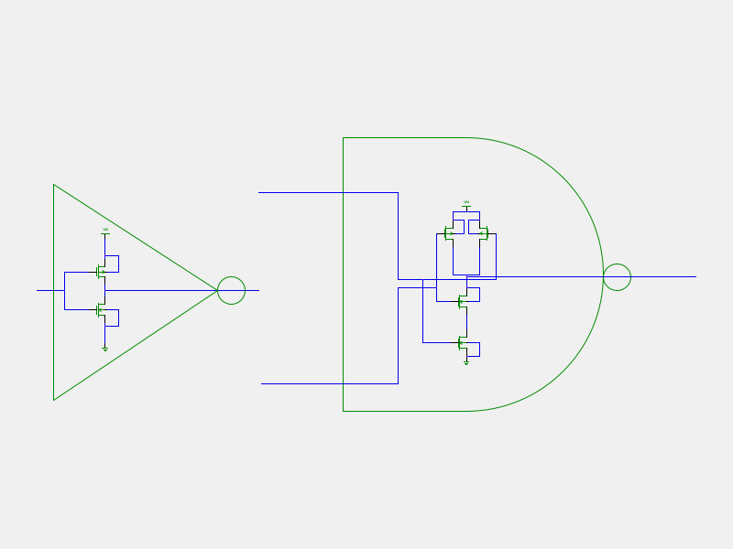
Nothing New About It

