Slide 1

CMR COLLEGE OF ENGINEERING & TECHNOLOGY
Kandlakoya, Medchal, Hyderabad - 501401
Department of Computer Science and Engineering
A Distributed Approach for efficiently extracting common patterns from large datasets
Name of the student & Roll No.
Ch.Ashwith(20H51A0586)
N.Pranay(20H51A05A2)
G.Soniya(20H51A05C2)
Under esteemed guidance of
Guide Name
Dr.P.Senthil

Slide 2
Outline
Abstract
Introduction
Research Objective
Problem Definition
Project Scope
Literatue Review
Result
Conclusion
References
Notes:
2

Slide 3
Abstract
Notes:
3

Slide 4
ABSTRACT
In recent times, knowledge discovery in databases has become a valuable tool for extracting meaningful and useful information. Frequent pattern mining and association rule mining have been widely explored for various real-life applications. However, traditional mining algorithms that rely on centralized and memory-resident data face limitations in terms of handling large datasets, bandwidth constraints, and energy consumption in distributed databases, especially in the context of big data.
To address these challenges and enhance performance, we present a website based on FP growth. These algorithms efficiently discover frequent patterns (FPs) while offering fast and scalable service in distributed computing environments. Additionally, we propose a compact data structure for storing items and counts, reducing data transmission overhead on the network.

Slide 5
INTRODUCTION
Notes:
5

Slide 6
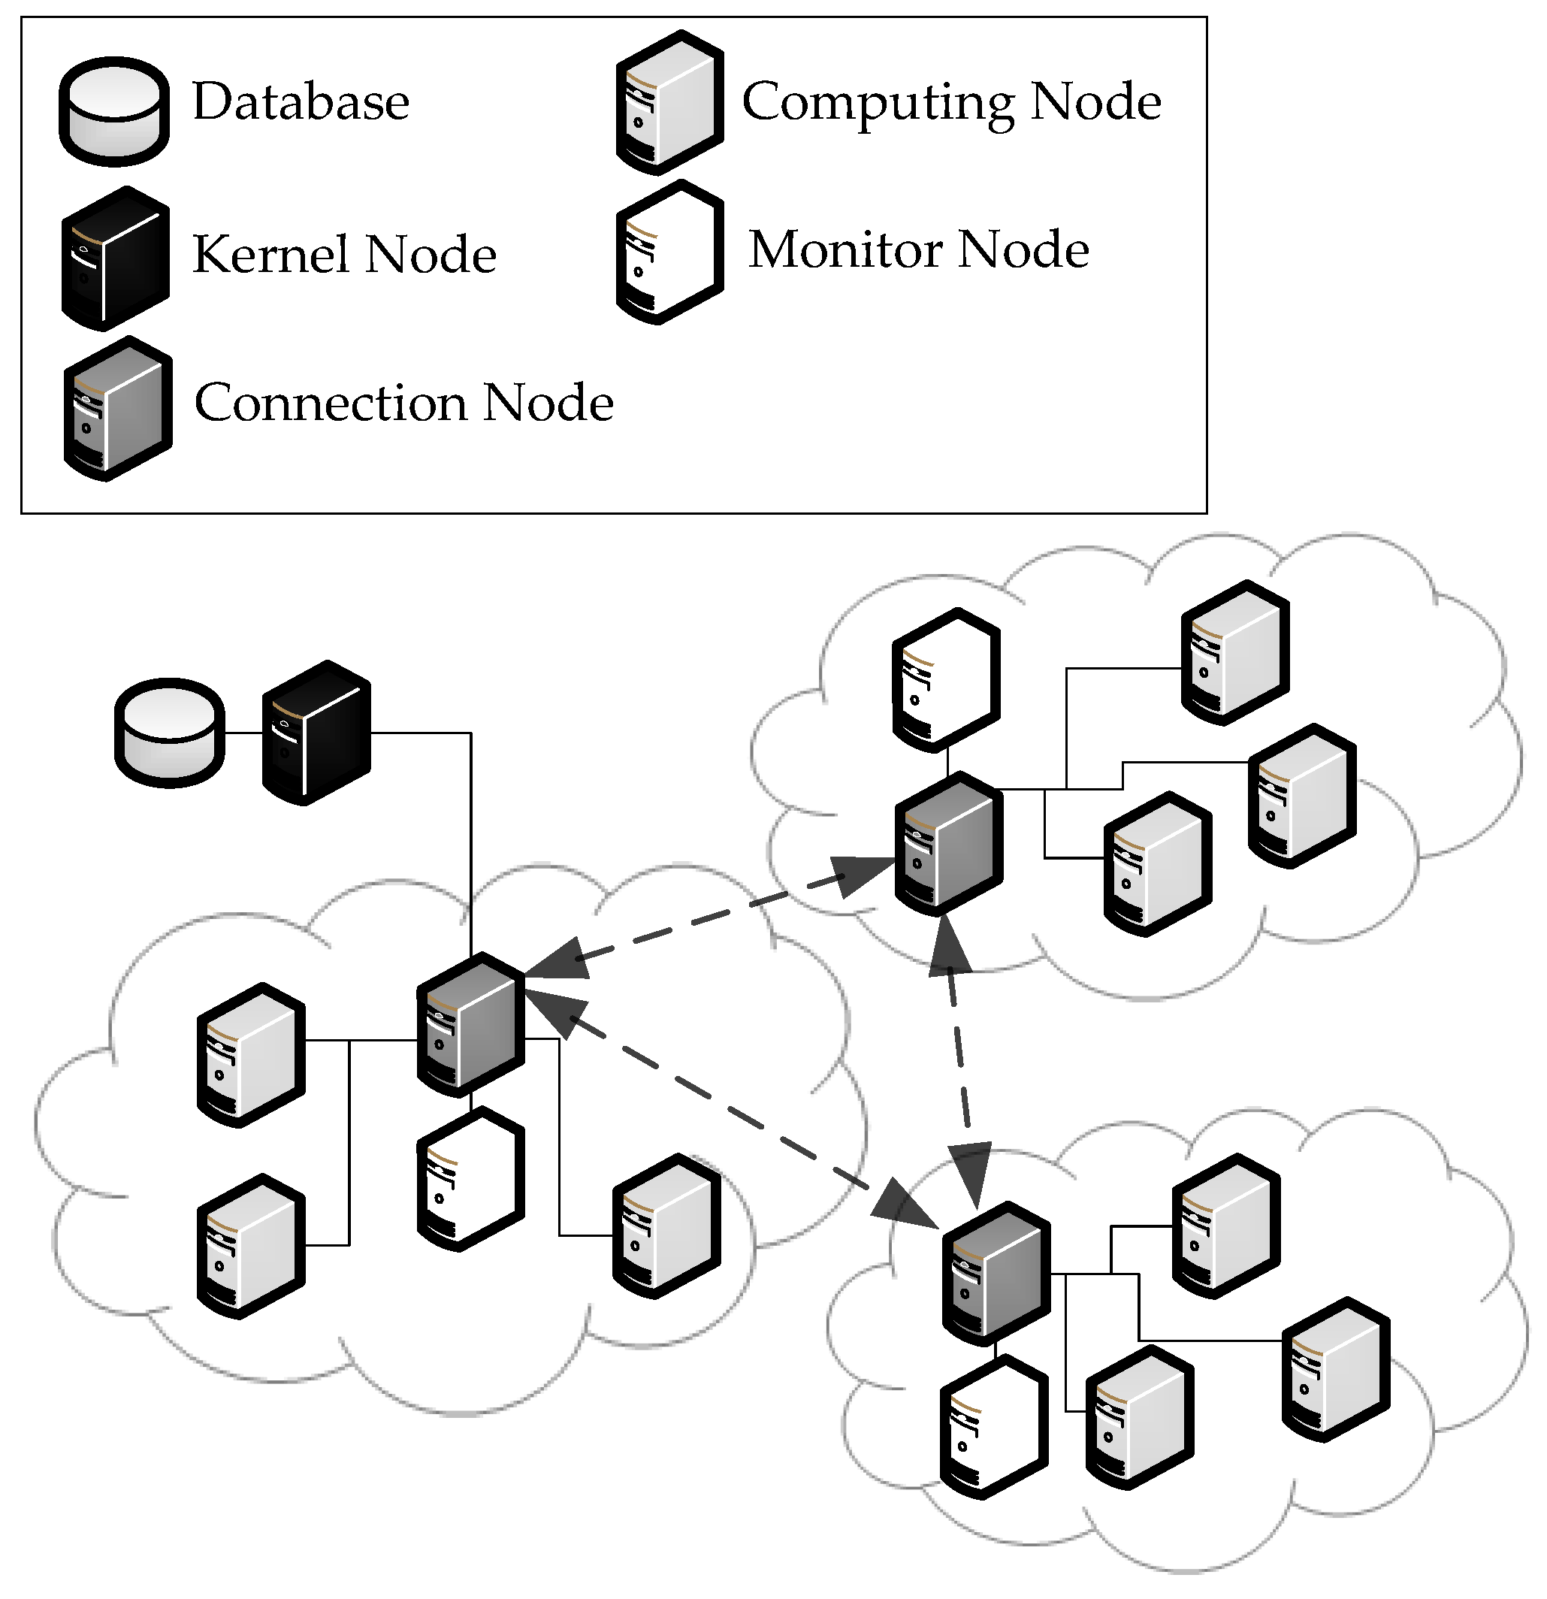
Introduction
In traditional mining algorithms, data are centralized and memory-resident. As a result of the large amount of data, bandwidth limitation, and energy limitations when applying these methods to distributed databases, especially in this era of big data, the performance is not effective enough. Hence, data mining on distributed environments has emerged as an important research area. The use of field programmable gate array (FPGA) for implementing parallel computing was also proposed by Tehreem et al.
To improve the execution time and the redundant execution cost, we propose a distributed and parallel computing method called DFP (distributed frequent pattern mining) in the website. The basic flow of DFP is as follows. The primary contributions of this study are:
(1) a set of algorithms based on FP growth that discover FPs that are capable of providing fast and scalable service in distributed computing environments and
(2) a brief data structure to store items and counts to minimize the data for transmission on the network.
Notes:
6

Slide 7
Research Objective
Notes:
7

Slide 8
Research objective
Data mining on distributed environments has emerged as an important research area.
Research illustrated that FP tree-like algorithms performed better than Apriori-like algorithm based on distributed, parallel computing, and Hadoop techniques, as well as other algorithms based on the well-known framework Apache Spark, such as PFP (parallelize the FP-Growth) algorithm based on Hadoop.
Research proposed approaches to mining frequent item sets from secondary memory when the database or the data structures used in the mining are too large to fit in the main memory.
These research provide new opportunities but pose some challenges, such as a long execution time and redundant execution, thus resulting in waste during data mining.

Slide 9
Problem Definition
Notes:
9

Slide 10
Problem Definition
The FP-growth algorithm is not efficient when processing a big database. Hence, numerous algorithms related to distributed or parallel computing have emerged. However, these methods have high communication cost, insufficient memory, low computing efficiency, and redundant computing waste. Therefore, DFP was proposed based on FP growth.
If the first stage failed during mining, then the proposed method would estimate the necessary memory and nodes for further distributed computing steps. The excellent performance of DFP is presented in the Experiment Results section. If the memory of the nodes is less than the estimated necessary memory, then the extended database projection method called mixing projection (MP) will be activated. MP is used to store compressed crucial information and develop an efficient FP tree-based mining method.

Slide 11
Scope Of Project

Slide 12
Scope
1. Scalability: Distributed approaches are well-suited for handling massive datasets that cannot be processed on a single machine. They can efficiently scale out to accommodate increasing data sizes.
2. Performance: These approaches can significantly improve the speed of pattern extraction by parallelizing the task across multiple nodes or machines.
3. Large Dataset Analysis: Distributed pattern mining is essential for applications involving vast datasets, such as social media analytics, genomic data analysis, financial transaction data, and more.
4. Identifying Common Patterns: This approach can efficiently extract common patterns, trends, or associations in data, enabling insights and decision-making.
5. Fault Tolerance: Distributed systems can be designed to be fault-tolerant, ensuring that if one machine fails, the process can continue without data loss.

Slide 13
Literature Review

Slide 14
Comparison table for the existing system
S.No | Authors and Journal Name& Year of publication | Problem Statement | Name of the Proposed solution/Method | Solution | Remarks
1 | Han, J. Pei, Y. Yin, and R. Mao |  | . FP Mining On Big Data Using MapReduce | MapReduce, a parallel and distributed programming model | Complexity Data Shuffling Overhead Limited Real-Time Processing
2 | R.Agrawal, T. Imieliński |  | Association Rule Mining | Frequent Itemset Generation | Curse of Dimensionality
3 | A. Tehreem, G.Khawaja |  | Parallel Frequent Pattern Mining | leveraging parallel and distributed computing techniques | Resource Intensive Load Balancing

Slide 15
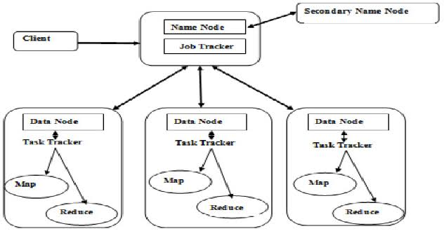
MAP REDUCE

Slide 16
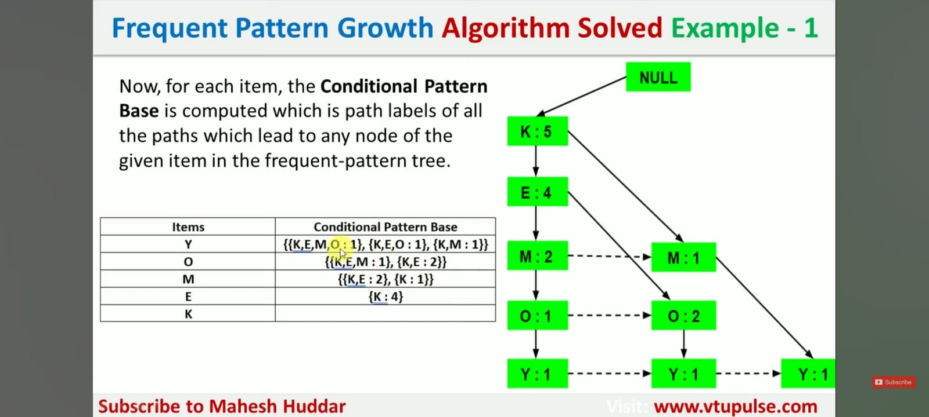
METHOLOGY

Slide 17
Implementation of Existing System
Market Basket Analysis: Association rule mining is widely used in retail for market basket analysis. Retailers can identify which products are frequently purchased together, enabling them to optimize store layouts, cross-sell products, and run targeted promotions.
Cross-Selling and Recommendations: E-commerce platforms and recommendation systems use association rules to suggest related products to customers. If a customer buys a camera, for example, the system might recommend camera accessories.
Medical Diagnosis: In healthcare, association rule mining can be used to discover relationships between symptoms and diseases. Identifying co-occurring symptoms can aid in diagnosing medical conditions.

Slide 18
Implementation of Existing System
Resource Configuration: Configure the cluster's resources to ensure efficient processing, considering factors like memory, CPU, and network bandwidth.
Optimization: Apply optimization techniques to handle data skew, minimize I/O, and improve overall performance.
Testing and Evaluation: Thoroughly test the implementation on large datasets to ensure correctness and efficiency. Evaluate the results based on performance metrics and the quality of mined patterns.

Slide 19
Limitations
1. Implementation Complexity: Building and managing a distributed system is complex and requires expertise in distributed computing, data engineering, and distributed data storage systems.
2. Cost: The hardware and infrastructure required for distributed computing can be expensive, including the cost of setting up clusters of machines and maintaining them.
3. Data Privacy and Security: Distributed systems must address data privacy and security concerns, particularly when dealing with sensitive or regulated data.
4. Data Distribution: Distributing data across multiple nodes can lead to data skew issues, where some nodes may have more data than others, affecting the efficiency of pattern extraction.
5. Algorithm Suitability: Not all pattern mining algorithms are easily parallelizable or suitable for distributed computing. Some may not be as effective in a distributed environment.

Slide 20
Result

Slide 21
Result
The results of these existing solutions highlight the significance of distributed methods for frequent pattern mining from big data. They offer scalability, efficiency, and applicability in various domains. However, challenges exist in terms of implementation complexity, resource utilization, and privacy concerns.
When choosing an approach, it's essential to consider the specific requirements of the task at hand. For instance, MapReduce-based frequent pattern mining is well-suited for scalable batch processing, while parallel frequent patterns offer real-time capabilities. Association rule mining, on the other hand, is ideal for retail and market basket analysis but must address privacy issues.
Ultimately, the choice of method depends on the characteristics of the dataset, the desired outcomes, and the resources available for implementation. Further research and advancements in these methods are expected to address existing challenges and broaden their applicability in the era of big data

Slide 22
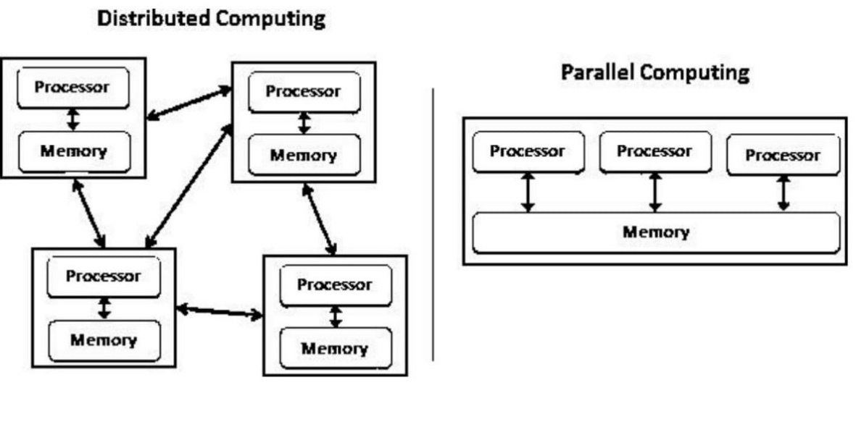
Fig 1

Slide 23
Conclusion
In this study, the DFP algorithm was proposed to improve the mining efficiency for association rule by distributed mechanism. In reported articles, the distributed mechanism cannot be applied easily for processing databases. Hence, the transmission cost would increase easily as communication among clients increases .Our experiments show that the proposed DFP algorithm successfully overcame this problem by transferring the mining result from the executing client to the server because the integrated information would go through the server instead of being communicated among clients.
The proposed method , through the estimated necessary memory and clients, reduces the computing efficiency as well. The DFP algorithm overcomes insufficient memory and repeated scans by estimating the limitation of TIDs for each client, and the remaining TIDs are processed by an extended mechanism called Mixing Projection. The proposed algorithm exhibits good performance during big data mining. In addition, the DFP algorithm can determine a suitable number of clients automatically according to various datasets. The proposed DFP algorithm shows potential for future applications.

Slide 24
References

Slide 25
References
[1] R. Agrawal and R. Srikant, ‘‘Fast algorithms for mining association rules in large databases,’’ presented at the 20th Int. Conf. Very Large Data Bases, Sep. 1994.
[2] J. Han, J. Pei, Y. Yin, and R. Mao, ‘‘Mining frequent patterns without candidate generation: A frequent-pattern tree approach,’’ Data Mining Knowl. Discovery, vol. 8, no. 1, pp. 53–87, 2004.
[3] R. Agrawal, T. Imieliński, and A. Swami, ‘‘Mining association rules between sets of items in large databases,’’ in Proc. ACM SIGMOD Int. Conf. Manage. Data (SIGMOD), 1993, pp. 207–216.
[4] J. Han, J. Pei, and Y. Yin, ‘‘Mining frequent patterns without candidate generation,’’ ACM SIGMOD Rec., vol. 29, no. 2, pp. 1–12, 2000.
[5] A. Tehreem, S. G. Khawaja, M. U. Akram, S. A. Khan, and M. Ali, ‘‘Parallel architecture for implementation of frequent itemset mining using FPgrowth,’’ in Proc. Int. Conf. Signals Syst. (ICSigSys), May 2017, pp. 92–98.

Slide 26
Thank You!

