Slide 1

Data Engineering 2: Big Data Architectures Project Presentation
Ashwith Anand Poojary (11038008)
Muskaan Chhabra (11038196)

Slide 2
Agenda
01
02
Data Pipeline
User Stories
03
Challenges
04
Conclusion

Slide 3
Data Pipeline
01

Slide 4
Data Pipeline
A data pipeline is a set of processes designed to systematically move data from one system to another, typically involving stages of extraction, transformation, and loading. This setup facilitates the efficient handling, processing, and analysis of large volumes of data.
Steps in the data pipeline –
Data Extraction
Data Ingestion
Data Transformation and Processing
Visualisation

Slide 5

Data Source
The New York City Taxi and Limousine Commission (TLC), created in 1971, is the agency responsible for licensing and regulating New York City's Medallion (Yellow) taxi cabs, for-hire vehicles (community-based liveries, black cars and luxury limousines), commuter vans, and paratransit vehicles.

Slide 6
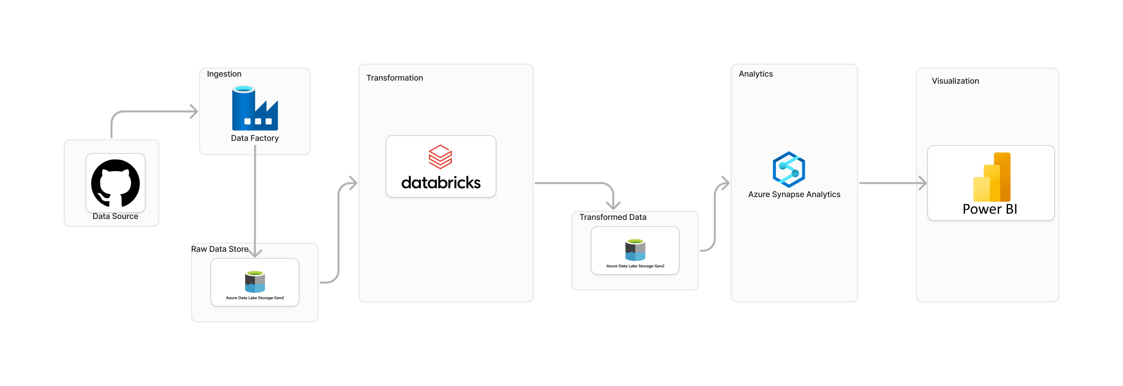
Data Pipeline Architecture

Slide 7
Data Ingestion Data Store
Downloading the data from New York City Green Taxi
We take the Raw data url of that file
Copy data to Data Lake Gen 2

Slide 8
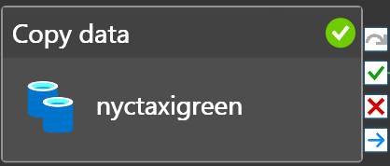
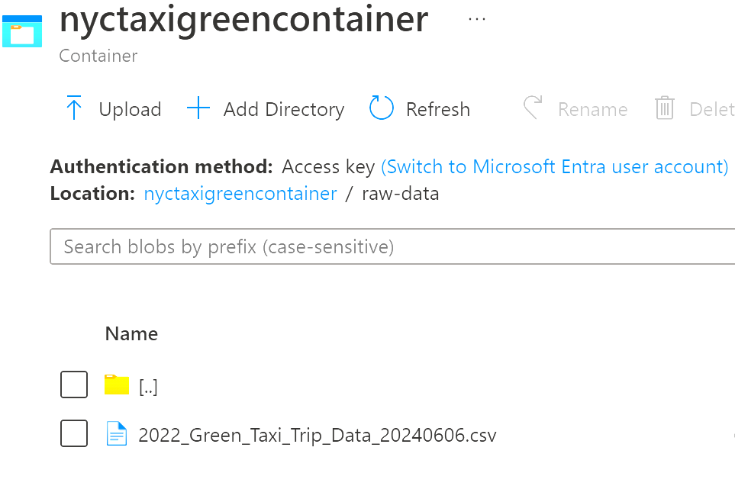
Data Ingestion using Data Factory
Using Data Factory to perform the ingestion.
Using Copy Data in Azure Data Factory to perform this operation.
Set up Source which points to data stored in Github.
And then set up Sink to store the data to the Azure Storage Account.

Slide 9
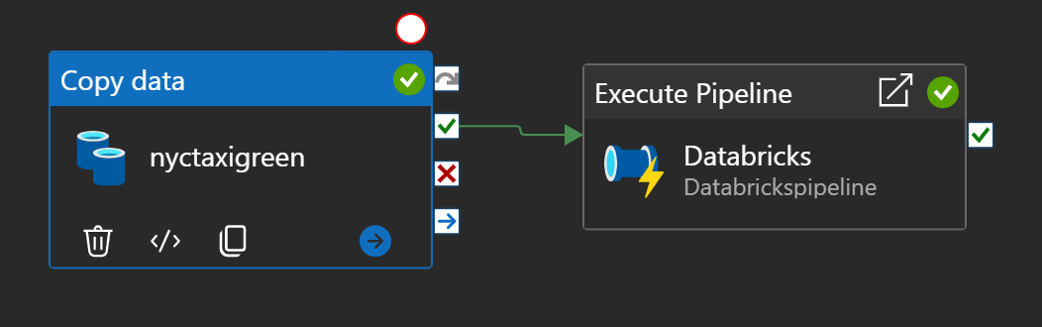
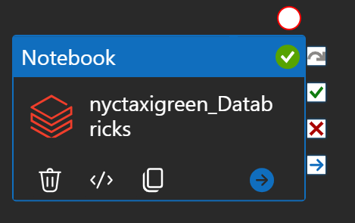
Data Pipeline for Ingestion and Transformation

Slide 10
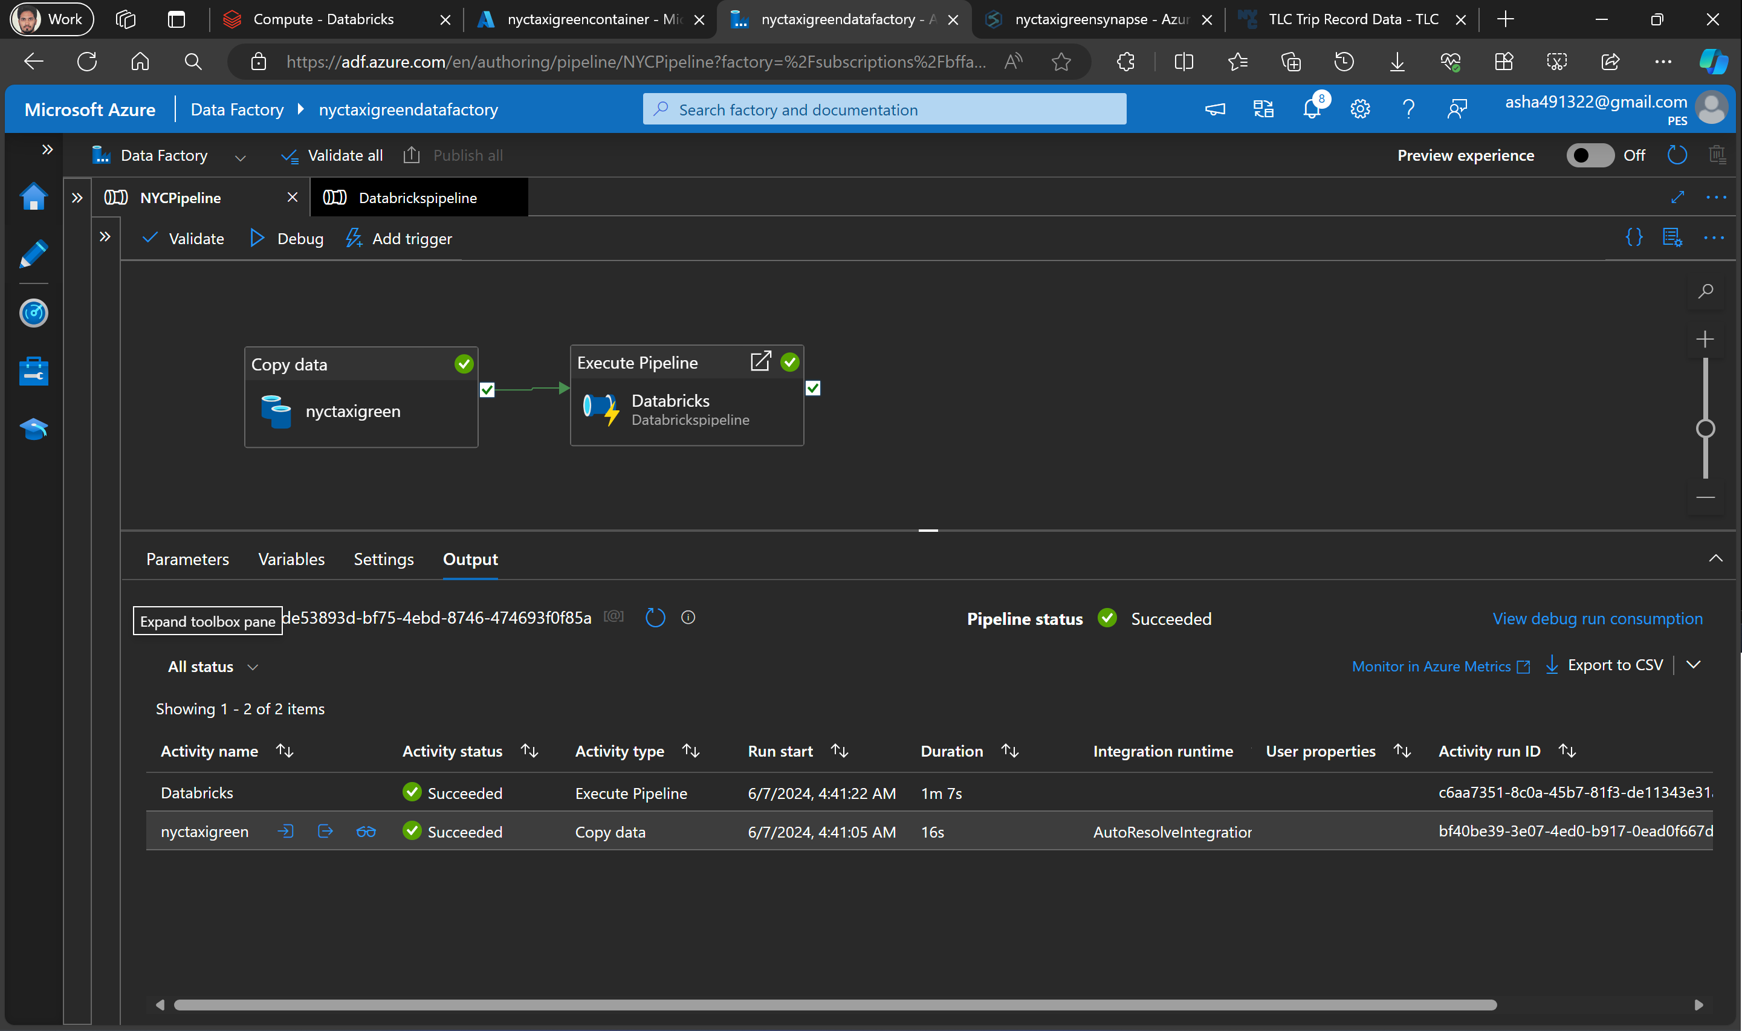
Data Pipeline Execution

Slide 11
User Stories
02

Slide 12
Data Transformation
Use Azure Databricks to do the transformation
Check the datatypes of columns
Removing null values
Deleting unnecessary columns
Removing duplicate values
Plots to understand data
Notes:
In this I am doing transformation steps using databricks apache spark.

Slide 13
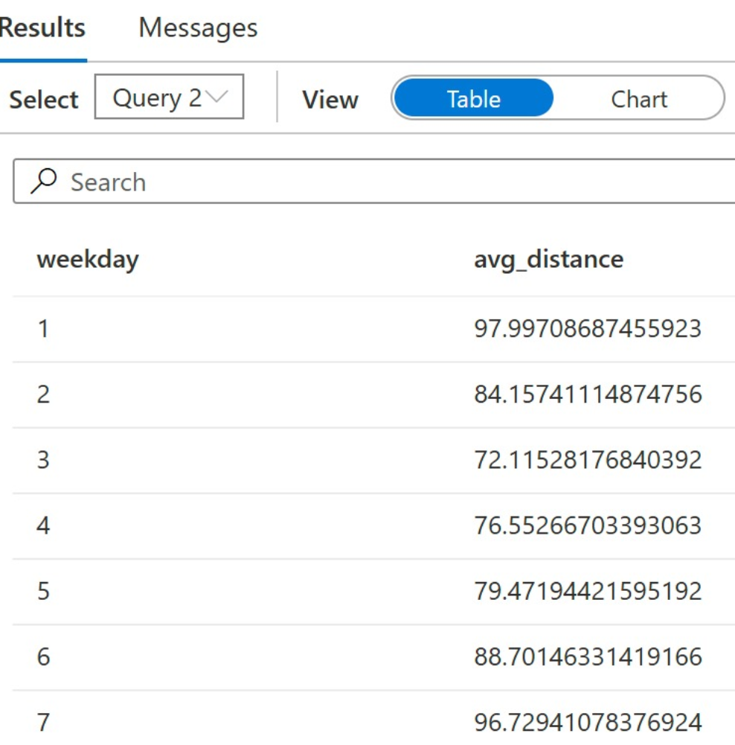
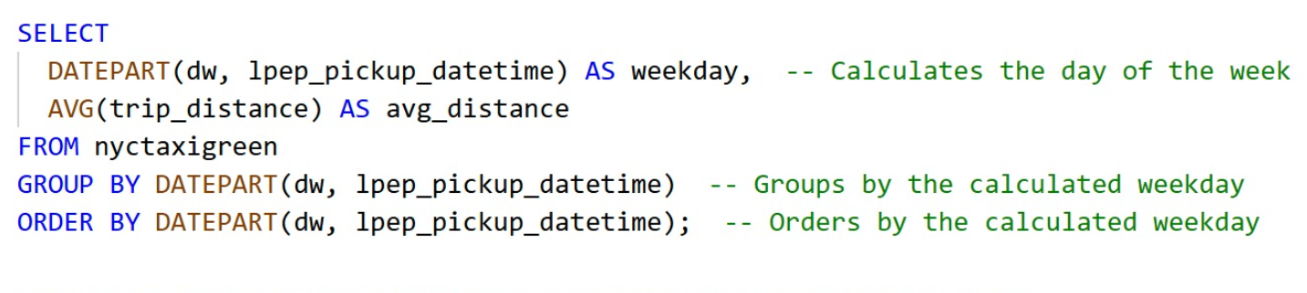
User Story 1
As a Financial Analyst, I want to find the average distance of trips by weekday, so that I can analyze busiest days of a week.
Notes:
Use the transform data in azure synapse analytics to run analytical or business queries. Synapse analytics is like data warehouse on azure cloud and works like google big query

Slide 14
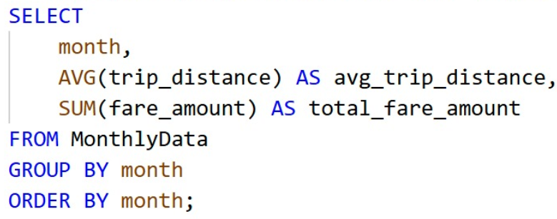
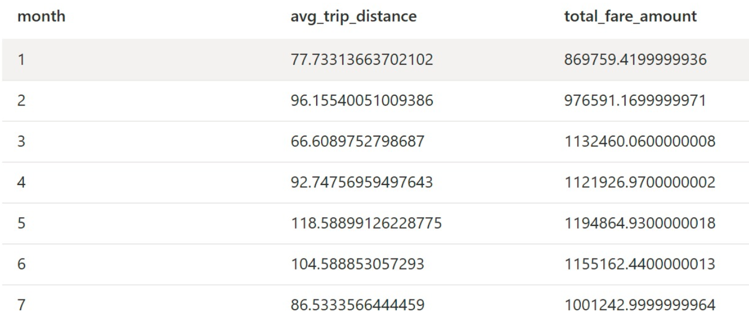
User Story 2
As a financial analyst, I want to predict monthly fare amount trends based on data so that we can better forecast budget allocations and financial planning.

Slide 15
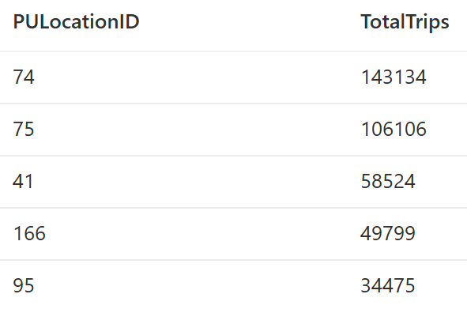
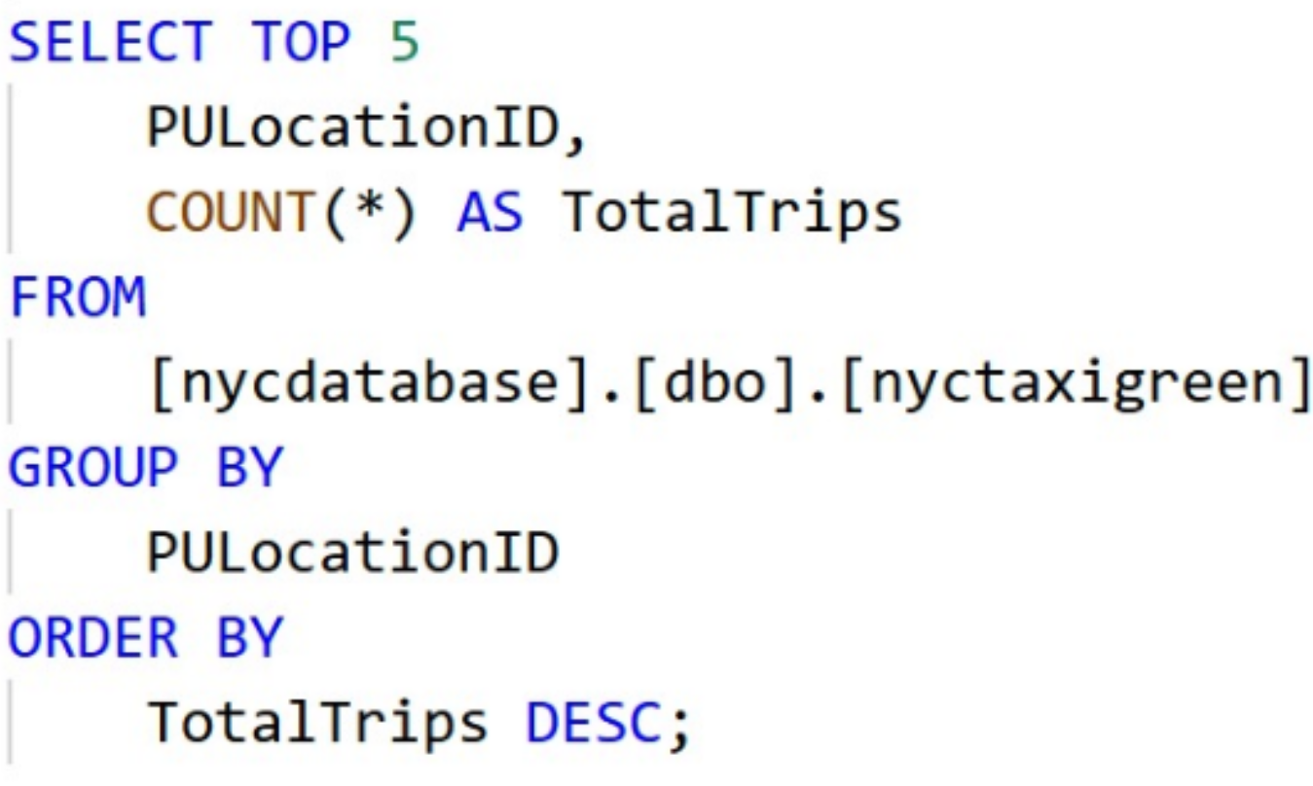
User Story 3
As a data analyst at a taxi company, I want to analyze top pickup locations to identify top locations so that we can optimize driver schedules and increase revenue.

Slide 16
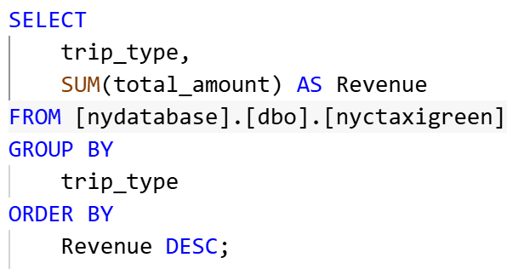
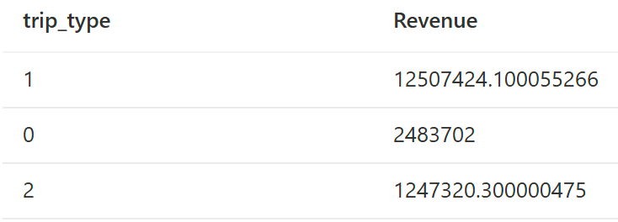
User Story 4
As a business manager, I want to analyze how different types of trips contribute to our overall revenue. So that I can optimize our service pricing strategies to increase profit.

Slide 17
Visualization
03

Slide 18
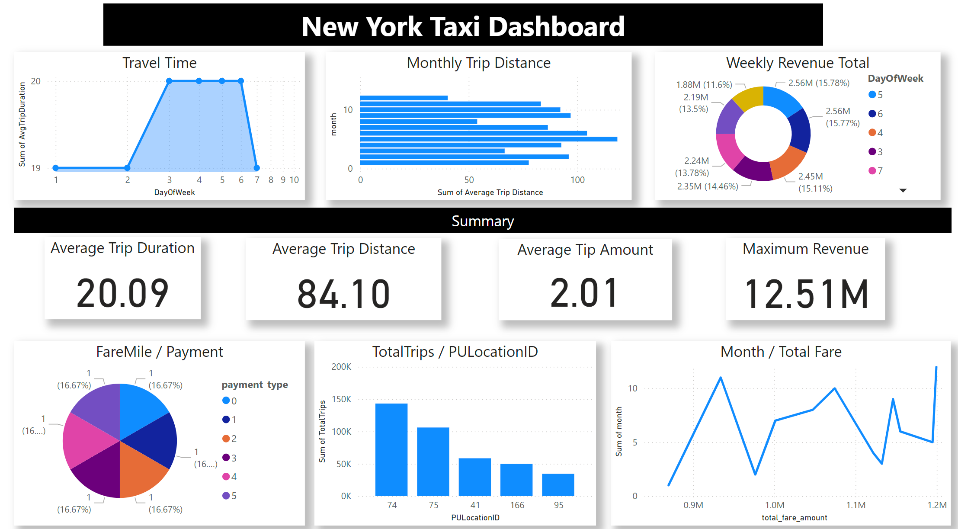

Slide 19
Challenges
04

Slide 20
Challenges faced
Connecting Azure Synapse Analytics to Power BI we faced difficulties.
In Microsoft Azure there are many authentication steps that make the process difficult.

Slide 21
Conclusion
05

Slide 22
Conclusion
Implementing Efficient Data Pipeline using Microsoft Azure
Utilizing Tools like databricks, azure synapse analytics for Improved Data Handling
Solving Business Problems by Answering User Queries
Navigating Challenges Successfully

Slide 23
Thank You

