Slide 1

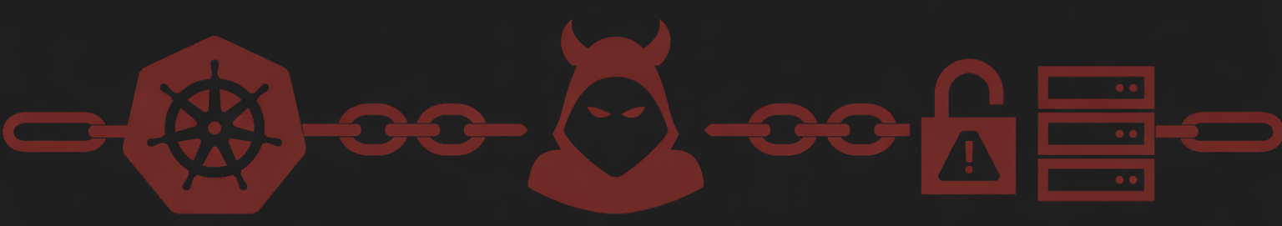
Chain Reaction: LLM-Guided Validation of Kubernetes Attack Chains
Team Helmsman
Ashwin Charathsandran

Slide 2
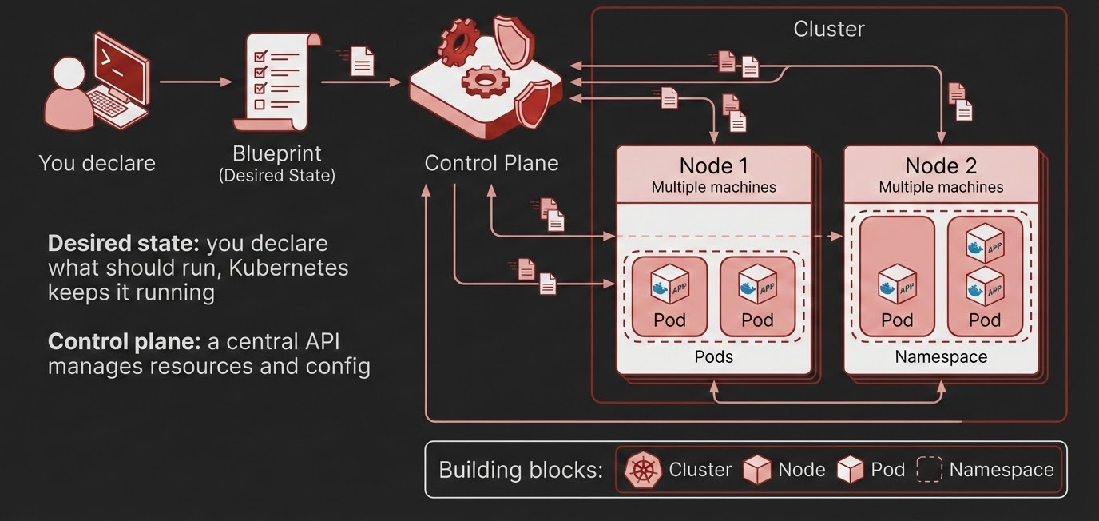
What is Kubernetes?

Slide 3
The Gap
Static scanners (config and compliance)
- Analyze YAML and cluster settings against checklists
- Often high noise because they lack runtime context
- Cannot prove if a finding is reachable or exploitable from a real workload
Dynamic scanners (scripted probing & frameworks)
- Run a fixed set of checks or known tests
- Limited adaptability: cannot reason about environment-specific constraints
- Miss novel combinations and still struggle to produce defender-grade proof
What is missing
A way to validate what is actually possible from a constrained, in-cluster foothold, with evidence

Slide 4
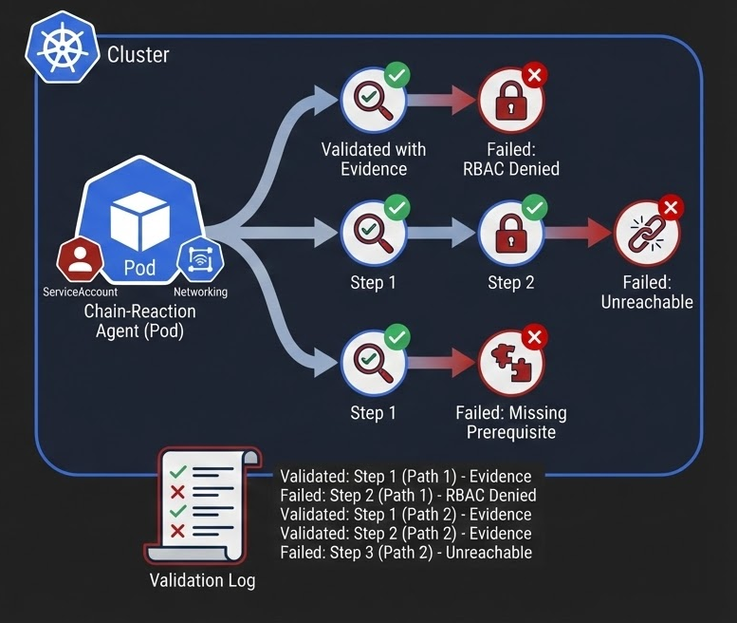
My Idea: Chain-Reaction
An agent that is in the cluster and runs as a normal Kubernetes Pod (most realistic threat model).
Constrained to only having ServiceAccount + standard Cluster Networking access.
Iterates and attempts multiple ways to break in (like an attacker), multi-step paths + record.
The result is:
- Validated steps with evidence (logs etc.)
- Failed steps with the reason (RBAC denied, unreachable, missing prerequisite, guardrail)
Helps a defender better understand and fix seemingly benign issues that may lead to a compromise.

