Slide 1


HiCET Edu
Academics Management Android App

Slide 2


Abstract:
This application provides a way for students to provide basic academic activities through their smartphones instead of approaching the faculties on-premise. Students are facing issues in getting bonafide certificates and other certificates from college due to timing constraints. Students also feel uncomfortable in interacting with faculties regarding subject-related doubts and clarifications. This application enables a transparent medium through which the students can register application for leave, requesting bonafide from college , access their fees data and confirm the rectification of the issues they are facing.
Keywords : Android Programming – Kotlin, Firebase.

Slide 3



Introduction:
According to a global study, about 94% of the students use smartphones every hour while they are in College. Keeping this in mind, we wanted to minimize the effort of students on managing their academic activities through their smartphones online.
This Application can help them save their time standing in queue in the students section to request/resolve their queries and help them easily access their academic profile , schedule, events , remainders about finishing work before academic deadlines.
As the smartphone market is only based on two main operating systems - Android and iOS, we decided to develop the app on both platforms only after successful development of the application in the former platform.

Slide 4




Existing System & Limitations :
Currently, desktop/web version is officially available for students access which provide similar but limited functionalities (no DN, Outdated UI , Limited functions).
Only alpha(unreleased) version of this software is available which is yet to be revealed officially.
This alpha version named ‘e-Campus HICET’ provides only minimal capabilities when compared to its web version.
Students still need to appear in-person regarding many queries. This situation can be minimized to a better extent with our application which provides personalized profiles to each student with better accessible features , with optimizing authenticity and authority to a certain level.

Slide 5

Proposed System & Advantages :
HiCET Edu can be installed on any smartphone running on Android 6.0 Marshmallow(API 23) & above and, available to download on Google Play Store.
Students can login into the application using their registered mobile number with OTP.
Session terminates automatically when their sim cards are once changed, which preventing spoofing.
Clutter-free modern UI with Android API 29,even supporting all current and future flagship android smartphones available in the market.
Still under proposal and development , yet to release.☺

Slide 6
Proposed System Architecture :
Student
Management
Admin
Faculty
HiCET Edu

Slide 7
Modules :
User Module:
Authenticating user with registered Mobile Number as username and OTP as password.
If username and password is valid then they will be taken to their static screens.
When they get matched with each other, system checks their status and transfer the control to respective user-interface.
(b) Database Module :
Uses MySQL as its database and Apache Tomcat Server because of their simplicity and flexibility.
Stores every single information about students, faculty and model their data on specified operations.
The operations can be storing student attendance, result data or can be authentication credentials.

Slide 8
(c) Staff Module :
Designed for faculty , which use mobile phone to take attendance, upload result and upload college notifications.
The entered admin details are encrypted and sent to server for verification.
Only after successful authentication the operations are performed. If username and password cannot match, he/she can enter in to next static screen.
(d) Notification Module:
This module allows the department HOD to update students about any college related information through notifications.
The students can view notifications provided by the interface provided by application.
HOD can send message to only available options like all student, all faculty, specific faculty and to all.

Slide 9
(e) Discussion Forum Module:
This module is a feature where students and teachers can discuss the queries from the students.
This discussion is done with the mobile device via this feature and upon any interaction in a particular discussion thread.
All the users ( involved ) in that discussion gets a notification on their devices .
In this discussion forum, the respective subject teachers can upload notes, respond to student queries.
The student can put forth their queries and at the same time upload any notes.

Slide 10
(f) News and Event Service:
The news and event service is for all students and staff .
As soon as news about the university/college is released on the university/college website, a notification is sent to all the students and staff .
(g) Academic Management Module :
This service is for both the staff and students ,however both have different usage of feature.
Students - will be able to request the following information
Requesting Leave
Requesting On-Duty
Requesting Bonafide
Requesting Certificates
Requesting Fees Structure/Bill Information
Staff will be able reply to these queries regarding actions taken to these particular requests.

Slide 11
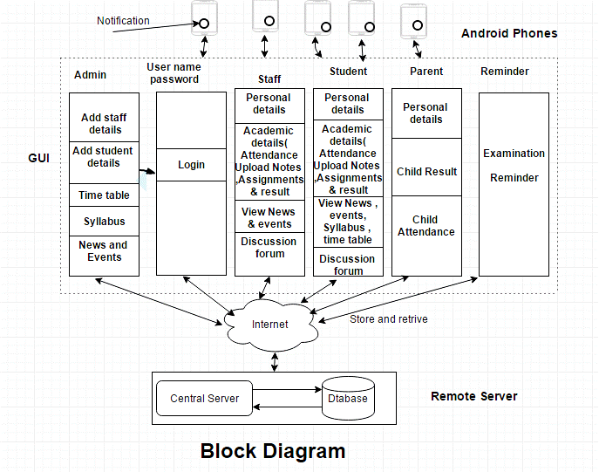
Data Flow Diagram:

Slide 12






























Conclusion and Future Work :
We will strive hard in making HICET Edu, a
perfectly crafted on-the-go mobile solution for students.
After analyzing the technical and time
constraints, decisions will be made on modifying features to this application
HiCET Edu will be available as an open
source application ,so that the fellow students can contribute their part in making this application as on of the best mobile campus management solutions.
“Internet isn’t a luxury, it’s a necessity.”
-Barack Obama

Slide 13

The Team
Anandhakumar.P
Ashwin.G
Dinakaran.K.P
17110009
17110013
17110027

