Slide 1
MAJOR PROJECT | SEMESTER VIII
Remote Sensing-Based Detection of
Land Degradation & Vegetation Dynamics
Using Multi-Temporal Geospatial Data — A Trajectory-Based Analysis of Karbi Anglong, Assam (1990–2025)
Presented by: [Your Names] | [Roll Numbers]
Guide: [Guide Name] · Department of [Dept], [College]

Slide 2
MOTIVATION
Degradation the Desertification Atlas Cannot See
32%
<10%
10–15 → 4–5 yr
of India's land area is under
degradation processes (SAC-ISRO)
Assam's 'degraded' share by the
desertification-oriented atlas lens
reported shortening of jhum
cycles — never tested with time series
1
Northeast degradation is different.
Water erosion, forest loss and jhum intensification — not desertification. The standard lens undercounts it.
2
Jhum is cyclic by definition.
Slash, cultivate, fallow, regrow. Every standard trend test assumes monotonic change — the assumption fails exactly here.
3
Nobody has quantified the failure.
Regional studies map jhum extent between year-pairs; none characterise 35-year pixel trajectories or test what linear trends miss.
2

Slide 3
PROBLEM STATEMENT
Linear trends cannot see cyclic degradation.
Mann-Kendall and Sen's slope — the backbone of NDVI-based degradation assessment — test for monotonic change. A jhum pixel cycles: cyclic variance either masks a genuine embedded decline (intensification goes undetected) or, unluckily phased, mimics one (healthy rotation flagged as loss). Wessels et al. (2012) showed NDVI must fall 30–40% before trend tests reach significance; in cyclic systems the bar is higher still.
We classify each pixel's 36-year TRAJECTORY — fusing trend, rainfall-decoupled residuals (RESTREND), breakpoint structure (LandTrendr) and spectral cyclicity — into stable, cropland, cyclic jhum, degrading, or recovering, and quantify exactly what the standard method misses.
Base paper: Pasha et al. (2021) map WHERE jhum happened. We characterise WHAT each pixel's 35-year story is.
3

Slide 4
SCOPE OF WORK
Objectives
1
Build the 36-year series
Harmonized Landsat 5/7/8/9 post-monsoon NDVI composites (1990–2025) + CHIRPS rainfall, prepared entirely in Google Earth Engine.
2
Compute trajectory statistics
Autocorrelation-corrected Mann-Kendall + Sen's slope, RESTREND residual trends, breakpoint timing and magnitude, FFT cyclicity in the 4–12-year jhum band.
3
Classify trajectories
Random Forest on 12 engineered features vs a 1D-CNN on raw series; five classes from stable forest to recovering.
4
Quantify the blind spot
Cross-tabulate what linear MK, RESTREND and trajectory ML each report on known cyclic and degrading land.
5
Report for policy
SDG 15.3.1-style productivity maps, jhum cycle-length estimates, and an interactive dashboard.
4

Slide 5
RELATED WORK
Literature Survey
Author (Year) | Contribution | Gap this project fills
Pasha et al. (2021), Remote Sensing — BASE PAPER | DTMT threshold mapping of NE-India shifting cultivation 1975–2018; >85% accuracy; 75% extent decline | Year-pair extent only; cannot separate healthy cycles from intensifying ones
Yengoh et al. (2015), Springer/UNEP | Definitive review of NDVI for degradation assessment | Documents weaknesses; no cyclic-land remedy
Wessels et al. (2012), RSE | Detectability limits: 30–40% NDVI loss needed for significant trends | Limit never measured for cyclic systems — we measure it
Ibrahim et al. (2015), Remote Sensing | RESTREND with NDVI3g/soil moisture, W. Africa | Drylands method; untested in monsoon NE India
Easdale et al. (2019), Ecol. Indicators | <1% monotonic vs >85% cyclic phases in Patagonia; challenges linear trends | Conceptual call — we operationalise it with ML
Kennedy et al. (2010, 2018) | LandTrendr segmentation; GEE port | Breakpoints alone don't classify trajectories
Thong et al. (2019), RSASE | Manipur jhum dynamics; cycle-shortening claims unsubstantiated | We estimate cycle length per pixel from spectra
SDG 15.3.1 Assam chapter (2023); Bari et al. (2024) | Indicator framework applied regionally (Trends.Earth) | Coarse products; no trajectory structure
5

Slide 6
LARGEST DISTRICT OF ASSAM
Study Area — Karbi Anglong, Assam
WHY HERE
The full degradation gradient in one frame: forest, jhum, cropland, hotspots, recovery
TERRAIN
Outlier block of the Meghalaya Plateau, rising from the plains to over 1,300 m
LAND USE
[ Insert district map here ]
Extensive jhum on mid-slopes; reported cycle shortening never verified with time series
Hill core (semi-evergreen forest) · mid-slope jhum belt ·
plains agriculture · 92.30–93.85°E, 25.55–26.60°N
DATA DEPTH
Landsat coverage since 1988; post-monsoon window (Oct–Dec) is the least cloudy in NE India
NO COMPETITOR
No published trajectory-based ML degradation study for this district
6

Slide 7
DATASETS
Data — All Free and Open
Data | Product | Resolution / Span | Role
NDVI series | Landsat 5/7/8/9 C2 L2, OLI→ETM+ harmonized (Roy et al. 2016) | 30 m · 1990–2025 | Primary vegetation signal
Compositing | Post-monsoon median (Oct 15 – Dec 31) | annual | Cloud-minimal, peak biomass
Rainfall | CHIRPS Daily, annual totals | ~5 km · 1990–2025 | RESTREND covariate
Segmentation | GEE native LandTrendr on inverted NDVI | 30 m | Break year, magnitude, duration
Training labels | Photo-interpretation (GE Pro history) + Pasha et al. maps | points | Trajectory classes
Boundary / terrain | District shapefile · SRTM DEM | vector · 30 m | Clipping, hill/plain strata
Everything acquired and preprocessed server-side in Google Earth Engine — no data purchase, no local downloads of 36 years of Landsat.
7

Slide 8
FRAMEWORK
Methodology — Four Signals, One Trajectory
01
02
03
04
GEE Preprocessing
Trend
RESTREND
Breakpoints
QA masking, harmonization,
annual composites, CHIRPS
Mann-Kendall + Hamed-Rao
correction; Sen's slope
NDVI ~ rainfall OLS;
residual trend = human signal
LandTrendr segmentation:
when, how big, how long
05
06
07
08
Cyclicity
Trajectory ML
The Blind-Spot Test
Reporting
FFT power fraction in the
4–12-yr jhum band + period
RF on 12 features;
1D-CNN benchmark on raw series
Cross-tabulate MK vs RESTREND
vs RF on known-truth land
SDG 15.3.1-style maps, cycle-
length atlas, dashboard
8

Slide 9
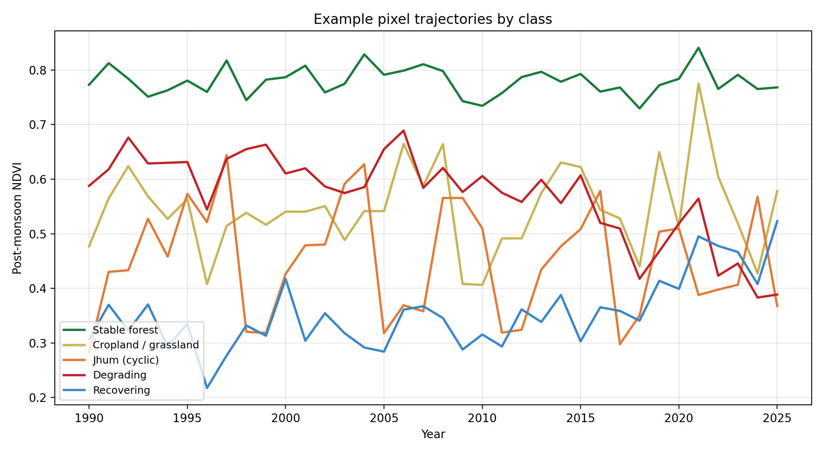
THE CORE IDEA, VISUALLY
What Each Class Looks Like in Time
Sawtooth = jhum
Break then decline = degrading
Break then rise = recovering
Flat high = forest
A single number (a trend slope) cannot distinguish these shapes. Twelve trajectory features can.
9

Slide 10
DEMONSTRATION RESULT
The Headline: Linear Trends Are Blind Here
0.0%
67.6%
98.8%
of intensifying jhum flagged by
Mann-Kendall — cyclic variance
completely masks the decline
of even MONOTONIC degradation
caught by MK — late-onset
breaks are missed
of jhum correctly identified as
cyclic by the trajectory RF;
100% of degradation caught
Empirically reproduces the Wessels et al. (2012) detectability limit in the cyclic case — and shows the fix. The classifier also recovers the median jhum cycle length (7.2 yr), turning the tool into a test of the reported 10–15 → 4–5 yr shortening.
Policy implication: SDG 15.3.1 productivity reporting built on significant linear decline systematically undercounts degradation in cyclic-agriculture regions.
10
Notes:
Numbers are from the synthetic demonstration run; say so if asked. The blindness is a property of the METHOD and persists on real data.

Slide 11
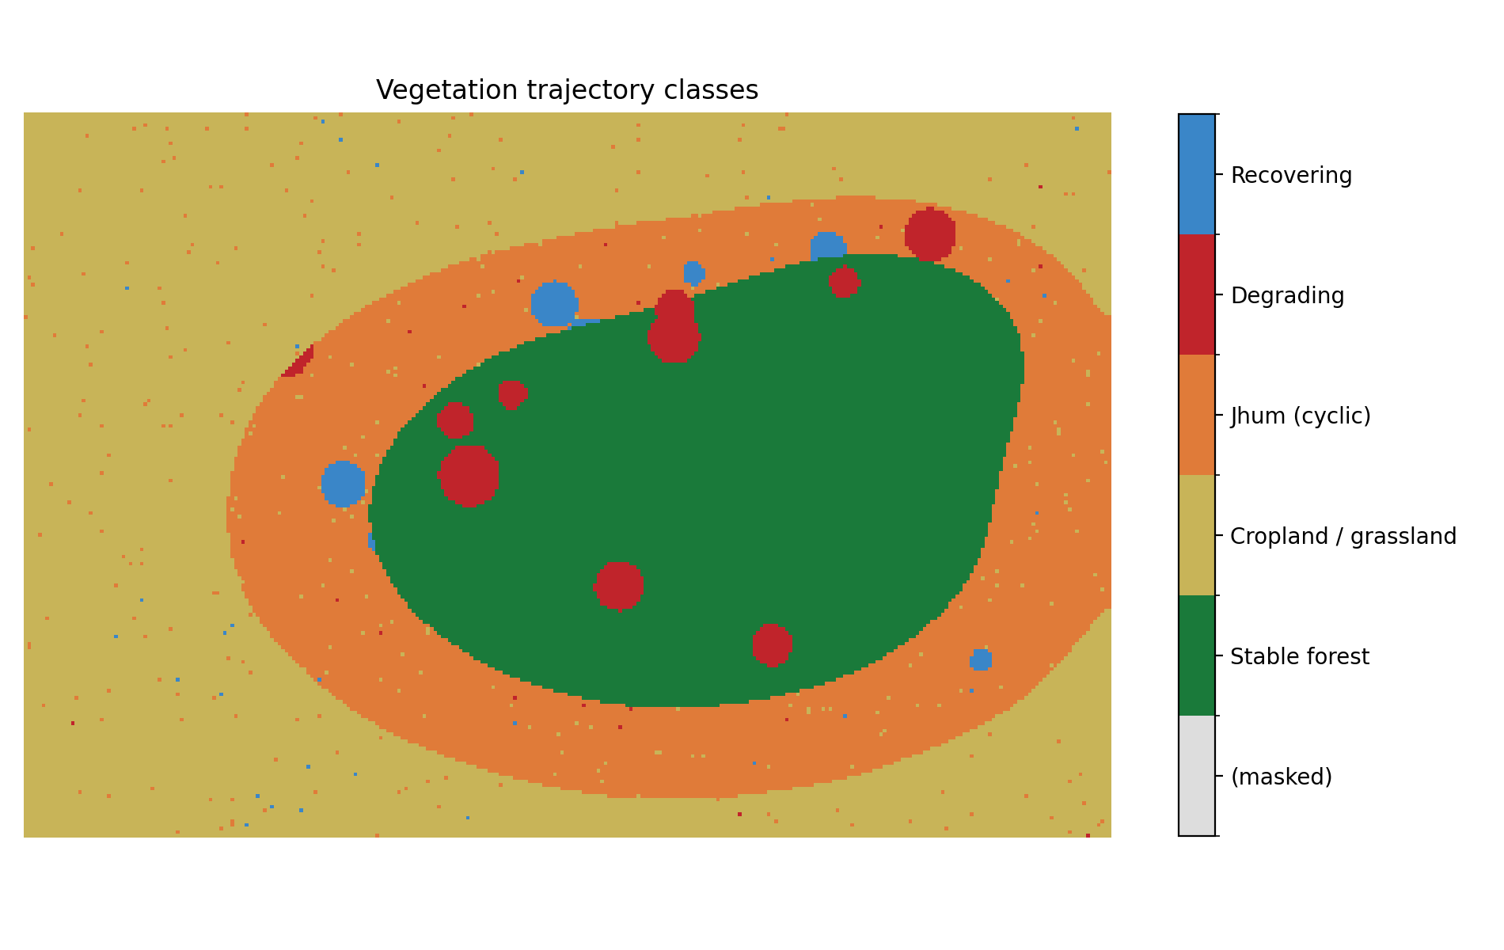
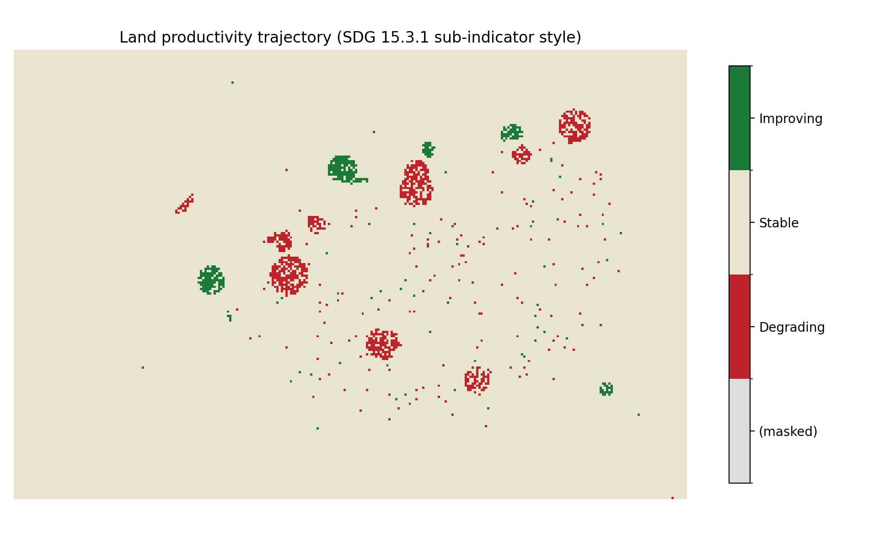
DEMONSTRATION RUN
Outputs — From Statistics to Maps
Trajectory classes: forest core, jhum belt, hotspots, recovery
SDG 15.3.1-style productivity: only 1.5% 'degrading' — the jhum belt's intensification is invisible to this statistic
11

Slide 12
IMPLEMENTATION STACK
Tools & Technologies
Data platform
Google Earth Engine (Python API)
36-year Landsat + CHIRPS processed server-side; LandTrendr runs natively in GEE
Statistics
NumPy / SciPy (vectorized) · pymannkendall
MK+Sen ~1000x faster than looping; verified against pymannkendall each run
Machine learning
scikit-learn (Random Forest) · PyTorch (1D-CNN)
Feature-based vs end-to-end trajectory classification
Geospatial
rasterio · geopandas
Stack handling, sampling, clipping
SDG reporting
Trends.Earth (QGIS plugin)
UNCCD-endorsed 15.3.1 sub-indicators for the final report
Delivery
Matplotlib · QGIS · Streamlit
Maps, cartography, interactive dashboard
12

Slide 13
TWENTY WEEKS
Project Timeline
Wk 1–3
Literature, study area, GEE onboarding
Wk 4–7
GEE exports: NDVI/rain stacks, LandTrendr
Wk 8–9
Training samples via photo-interpretation
Wk 10–13
Statistics + classification + blind-spot test
Wk 14–15
Maps, SDG report, cycle-length analysis
Wk 16–17
Dashboard + paper draft
Wk 18–20
Report, presentation, submission
Milestones: Week 9 (dataset + labels frozen) · Week 13 (headline analysis complete).
13

Slide 14
CLOSING
Deliverables & Anticipated Questions
Trajectory class map (5 classes, 30 m) + trend, RESTREND and break-year maps
Isn't jhum cultural, not degradation?
The cycle itself, no. The INTENSIFICATION — shorter fallows, falling regrowth peaks — is degradation by the productivity definition; we detect exactly that component.
Quantified blind-spot analysis: MK vs RESTREND vs trajectory ML
Per-pixel jhum cycle-length atlas — first time-series test of the shortening claim
SDG 15.3.1-style productivity assessment + ward/block statistics
Why not just use Trends.Earth?
We do, for reporting format. But its productivity trend is the linear statistic whose blindness we quantify — our trajectory layer is the added value.
Streamlit dashboard + reproducible open-source pipeline + paper draft
How will you label real training data?
Photo-interpretation of Google Earth history + Pasha et al. published jhum maps; 150–300 points/class; accuracy reported on a held-out set.
Thank you — questions welcome.
14

