Slide 1
Quarto Document
A simple example Ly

Slide 2
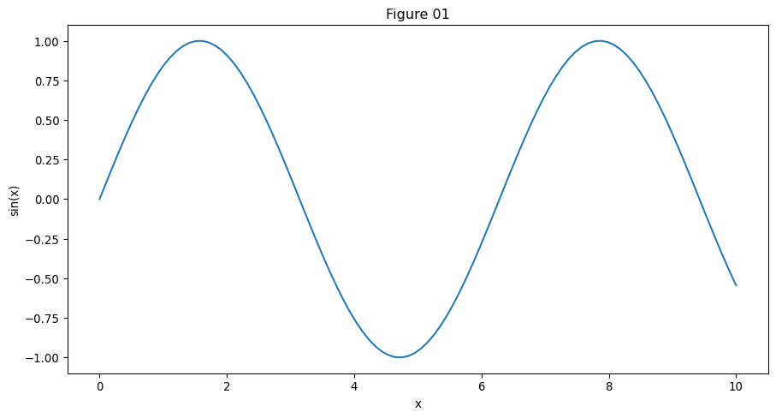
import matplotlib.pyplot as plt import numpy as np # Generate data x = np.linspace(0, 10, 100) y = np.sin(x) # Plot plt.plot(x, y) plt.xlabel("x") plt.ylabel("sin(x)") plt.title("Figure 01") plt.show()
Figure 1: Sine function

