Slide 1
EDES 301
Morse Code Trainer Proposal
October 4th, 2026
Asher Yellen

Slide 2
Background Information
Overall, my project will be a way for people to learn and practice writing in Morse Code. It will have a training mode, teaching the user to write letters in Morse Code similar to Google’s Hello Morse, and then have a display mode, where the user can enter messages.
This is slightly inspired from two previous projects: Morse Code Decoder and Morse Code Transceiver, but I plan to make a few improvements
  The decoder project didn’t actually seem to function, so I would like to make a functional prototype by the end of the course
  The transceiver project seems complex and not very intuitive, so I would like mine to be a bit simpler and easier to operate
  I would also like to improve the hardware, possibly using 3D printing to make the whole project look a bit nicer

Slide 3
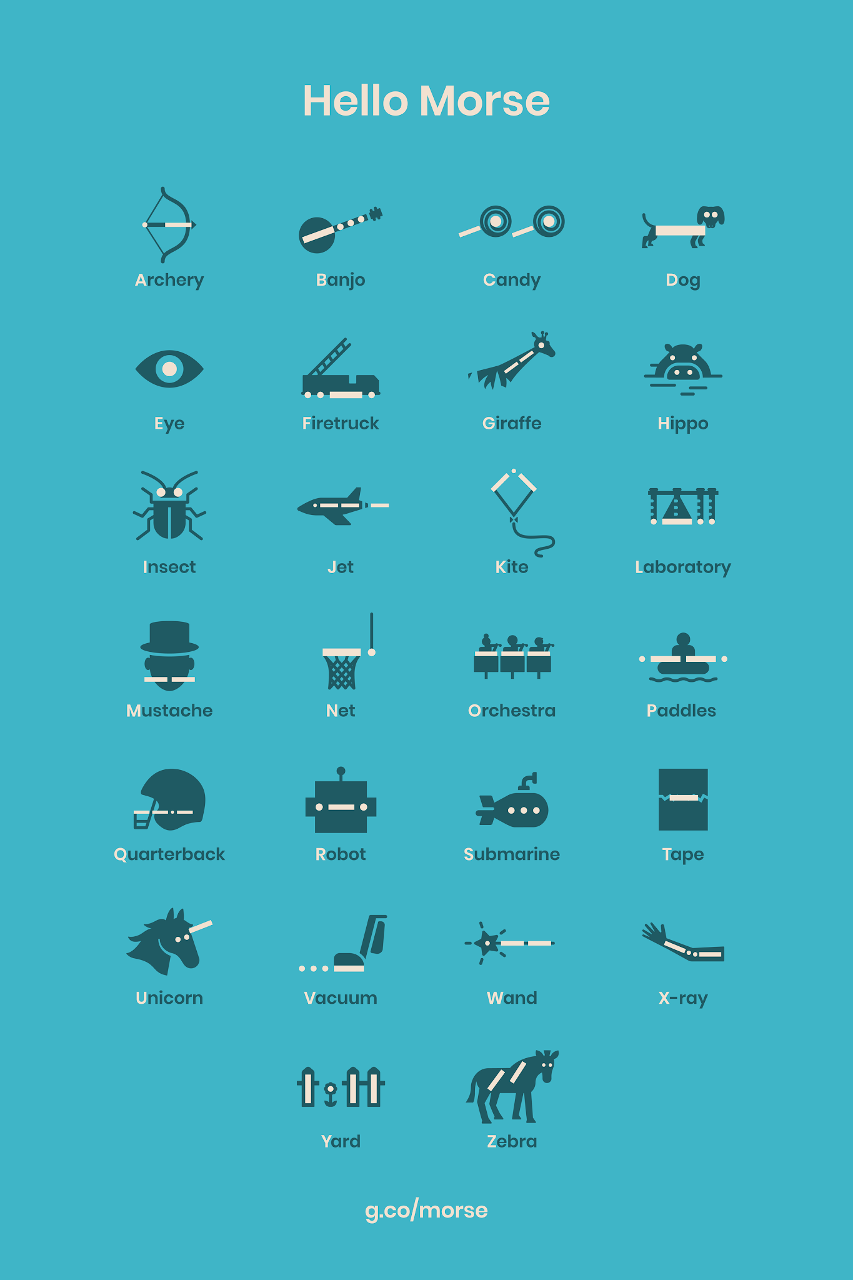
Background Information - Continued
My project will have a few modes:
  Training: the corresponding image for a letter will appear, as shown in the graphic on the right. The user will then have to enter the letter in morse code with the button input. Once they enter it correctly, it will move on to another letter
  Display: the user can write messages with morse code that will be shown on the display screen
  Game (possible): A letter will flash on the screen and the user has to type it in morse code. As they get more right, the time to enter the letter will reduce, making it harder. My focus is more on the first two modes, but this would be a nice extension.
There will be one main button for morse code input, and a LED will light up as the button is pressed. There will be two other buttons to help with system navigation. There also may be a small piezobuzzer

Slide 4
System Block Diagram
PocketBeagle
Display Screen
Button 1
(blue, main input)
P2_30
Button 2
(green, mode select)
P2_32
P2_34
Button 3
(red, backspace)
P2_33
LED
P2_02
Piezobuzzer

Slide 5
Power Block Diagram
PocketBeagle
3 Buttons
LED
Piezobuzzer
display
5V
USB from PC
3.3V

Slide 6
Software Framework - block diagram
Displays graphic for letter (from chart) on screen, flashes on LED and buzzes 2x
Start Screen
Prompts user input on screen
Red Button (typing mode)
Green Button (training mode)
User inputs letter with blue button. LED and buzzer match input
Instructions / explanation screen
Instructions / explanation screen
Check letter match
Match = false
Match = true
User inputs with blue button, deletes with red, completes with green. LED and buzzer match input
Trains all letters
Display “try again” message, restart
Display “nice job” message, goes to next letter
Message displayed
Congrats screen

Slide 7
Software Framework - Classes
Hardware
Button (gathers data about button press)
MorseKey (translates button press to dot/dash)
Display (controls the display)
Indicator (controls Morse output on LED and buzzer)
Logic
MorseCode (translates between dot/dash and letter, both ways)
TrainingMode (controls steps in training mode)
TypingMode (controls steps in typing mode)
MorseTrainer (controls start screen, triggers TrainingMode and TypingMode)

Slide 8
Software Framework - Workflow
MorseTrainer → Display
MorseTrainer → TrainingMode
TrainingMode → Display (displays letter)
TrainingMode → Indicator (displays MorseCode of letter)
TrainingMode → MorseKey (converts input to dot/dash)
TrainingMode → MorseCode (converts dot/dash to letter)
TypingMode would use the same classes, converting button input→dot/dash→letter→display. Indicators will be directly tied to button input, flashing/buzzing whenever the button is pressed.

Slide 9
Components / Budget
Component | EDES301 to Buy? | Cost
Included in parts kit (buttons, wiring, PocketBeagle, etc.) | X
Display (happy to switch for something better, just wanted something w/out touchscreen) | Yes | $18.49
See Next Slide for Instructions

