Slide 1
MODULE 4
TIMER/ COUNTER PROGRAMMING

Slide 2
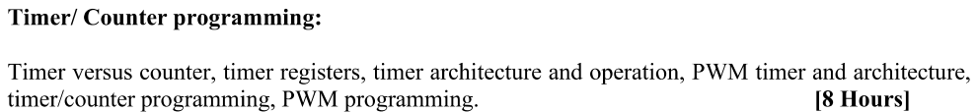

Slide 3
Timers are one of the important peripherals of modern microcontrollers.
WHY???
To generate periodic interrupts (in ‘Timer’ mode)
To count events (in ‘Counter’ mode)
To generate precise delays, which are non-blocking delays

Slide 4
The Timer is a crucial hardware component of microcontrollers.
Timers are used to measure elapsed time like processor ticks or count external events.
The name Timers and Counters interchangeably used in embedded systems.
The timer peripheral is an integral part of a large number of applications ranging from simple LED Control and periodic event generation to complex motor control applications.
Note: If you remember the LPC1768 GPI, we have given a simple LED Blinky program with hardcoded delay. This method of hardcoding delays is not desirable as it blocks the processor during the period of delay and doesn’t allow any other operations (like interrupts).

Slide 5
Using delays in a software code is usual in embedded programing.
A normal delay function might be used to create a period of no operation through a for loop iterating for a few 1000 cycles.
These types of delays need not be accurate and fundamentally, it is not a good programming practice.
TIMER/COUNTER is a software designed to count the time interval between events. It counts the cycle of the peripheral clock or an externally-supplied clock.
The correct way to generate delays is using the Timer peripheral of the MCU. Delays generated using Timers are very precise and are also non-blocking i.e. they allow interrupts.

Slide 6
There are four identical Timer peripherals in LPC1768
Timer0
Timer1
Timer2 and
Timer3.
All four timers are 32-bit timers with programmable 32-bit pre-scaler.
Each Timer block can be used as a ‘Timer’ (like for e.g., triggering an interrupt every ‘t’ microseconds) or as a ‘Counter’
They are designed to count cycles of the peripheral clock or an external clock signal and optionally generate interrupts (or other actions) at specified timer values (based on four match registers).

Slide 7
Each Timer module has its own Timer Counter (TC) and Pre-scale Register(PR) associated with it.
When a Timer is Reset and Enabled, the TC is set to 0 and incremented by 1 every ‘PR+1’ clock cycles – where PR is the value stored in Pre-scale Register. When it reaches its maximum value, it gets reset to 0 and hence restarts counting.
Pre-scale Register is used to define the resolution of the timer. If PR is 0 then TC is incremented every 1 clock cycle of the peripheral clock. If PR=1, then TC is incremented every 2 clock cycles of peripheral clock and so on.
By setting an appropriate value in PR we can make timer increment or count : every peripheral clock cycle or 1 microsecond or 1 millisecond or 1 second and so on.
Another important register associated with Timers is the Match Register. There are four match registers for each timer peripheral. Users can load the values into these match registers and for every TC increment, the value in TC is compared to the value in match register.

Slide 8
PC: Prescale Counter Register (32 bit) – This register increments on every PCLK (Peripheral clock).
This register controls the resolution of the timer. When PC reaches the value in PR , PC is reset back to 0 and Timer Counter is incremented by 1.
Hence if PR=0 then Timer Counter Increments on every PCLK.
If PR=9, then Timer Counter Increments on every 10th cycle of PCLK.
Hence by selecting an appropriate pre-scale value we can control the resolution of the timer.

Slide 9
Each Timer has four 32-bit Match Registers, MR0-MR3 and two 32-bit Capture Registers, CR0, CR1.
Timer 0,1,3 have two Match outputs while Timer 2 has four.
Match Register
A Match Register is a Register which contains a specific value set by the user.
When the Timer starts – every time after TC is incremented, the value in TC is compared with match register. If it matches, then it can Reset the Timer or can generate an interrupt as defined by the user.

Slide 10
Match Registers can be used to
Stop Timer on Match(i.e when the value in count register is same as that in Match register) and trigger an optional interrupt.
Reset Timer on Match and trigger an optional interrupt.
To count continuously and trigger an interrupt on match.
External Match Output
When a corresponding Match register (MRx) equals the Timer Counter(TC) the match output can be controlled using External Match Register(EMR) to either toggle, go HIGH, go LOW or do nothing.
External Match Output - When a match register (MR3:0) equals the timer counter (TC) this output can either toggle, go low, go high, or do nothing.
The External Match Register (EMR) controls the functionality of this output.
Notes:
If the values are a match, then the match register can perform any of the following action:
An interrupt is generated.
The TC will be reset
TC and PR will be stopped and corresponding TCR will be set to 0.
Additionally, when the values in Match Register and TC matches, you can also control the External Match Register (EMR) to set an External Match Output pin as LOW, HIGH or Toggle.
Timers 0, 1 and 3 have two External Match Outputs each while Timer 2 has four External Match Outputs.
Using this functionality, we can toggle an LED connected to one of the Match Output Pins without intervention from the processor or any GPIO functionality.

Slide 11
LPC1768 Timer Pins
The Timer in LPC1768 MCU has two sets of pins associated with it.
One set of pins are Capture Input Pins while the other set of pins are External Match Output Pins.
The naming convention for the pins names of the timer peripheral is as follows:
CAPx.y means Capture Input y of Timer x

Slide 12
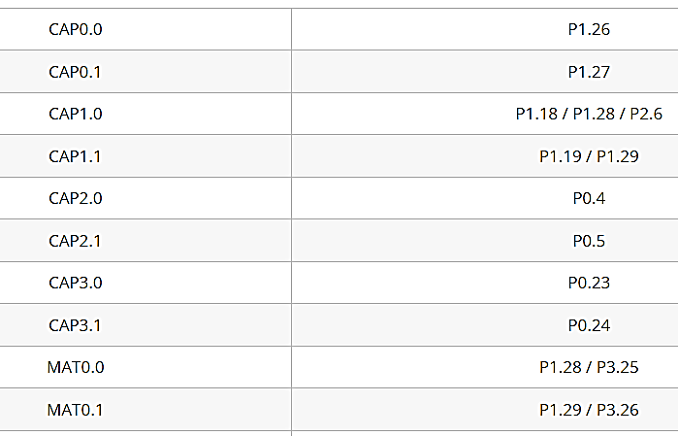
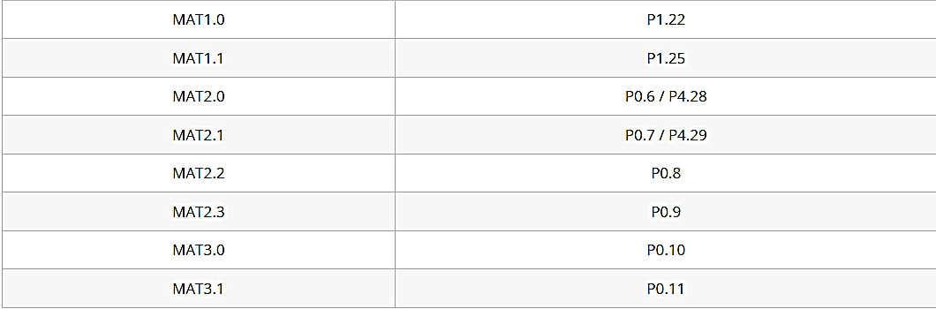
Table shows the pin mapping of the Timer Peripheral with the port pins of LPC1768

Slide 13
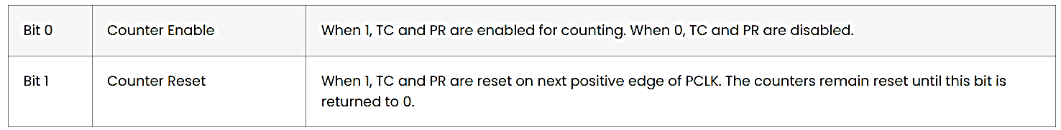
Timer Registers of LPC1768
TCR – Timer Control register
Used to control Timer Counter functions i.e., enable, disable and reset.

Slide 14
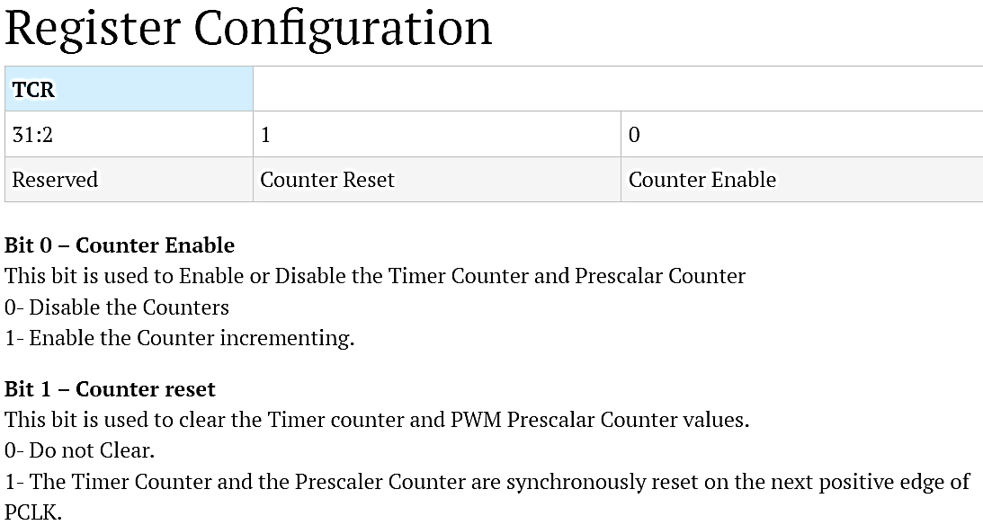

Slide 15
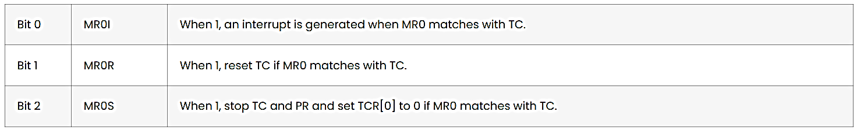
TC – Timer Counter Register: It is a 32-bit register and is incremented at every PR+1 cycles of PCLK. Unless it is reset in the middle, it reaches its maximum 0xFFFFFFFF and wraps back to 0 and begins incrementing again.
PR – Prescale Register: It is a 32-bit register and specifies the maximum value for the Prescale Counter (PC). When PC value is equal to the value in PR, TC is incremented in the next clock cycle and also PC is cleared.
PC – Prescale Counter Register: It is a 32-bit register. The value in PC is incremented on every PCLK cycle and when its value matches the value in PR, the TC is incremented and the value in PC is reset on the next PCLK cycle. When PR is 0, TC increments on every PCLK cycle. When PR is 1, TC increments for every 2 PCLK cycles.
MCR – Match Control Register: Used to control the operation on the TC when one of the Match Register matches with TC.
Bits [2:0] are used for MR0, Bits [5:3] are used for MR1, Bits [8:6] are used for MR2 and Bits [11:9] are used for MR3. Remaining bits are reserved.

Slide 16
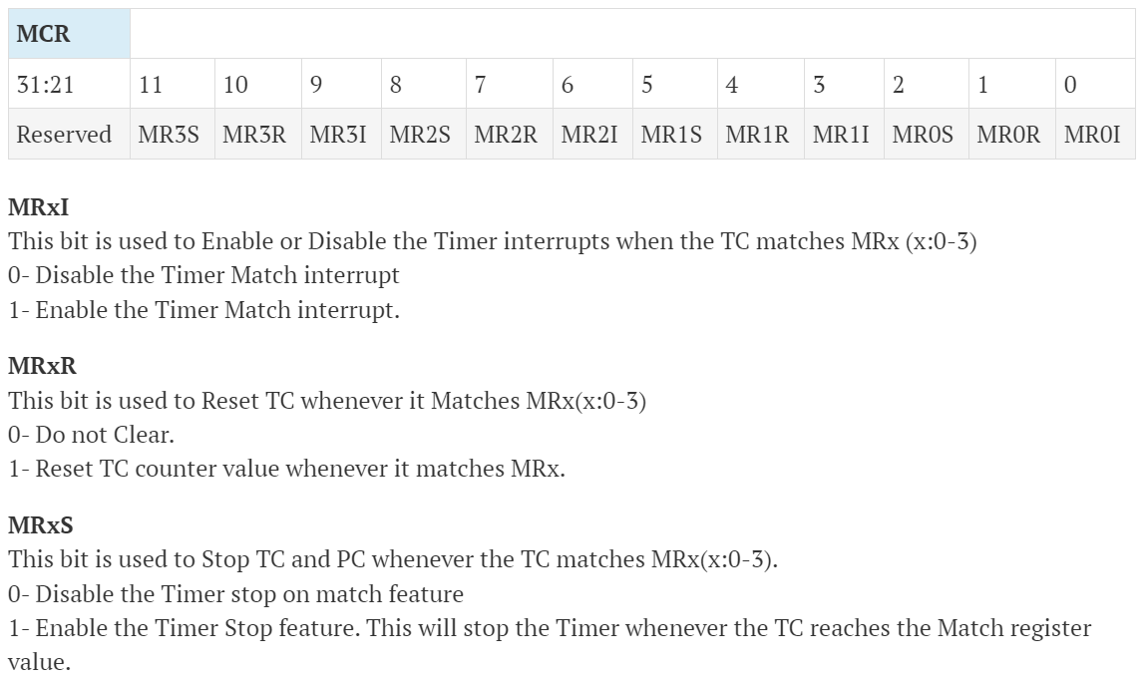

Slide 17
NOTE:
Similarly, other bits are used to control operation on other Match registers.
MR0 – MR3 – Match Registers: Contains user loaded values to be compared with TC. When value in Match Register matches with TC, appropriate action can be performed as directed by MCR register.

Slide 18
EMR: External Match Register – It provides both status and control of External Match Output Pins.
First four bits are for EM0 to EM3. Next 8 bits are for EMC0 to EMC3 in pairs of 2.
Bit 0 – EM0: External Match 0. When a match occurs between TC and MR0, depending on bits[5:4] i.e. EMC0 of this register, this bit can either toggle, go LOW, go HIGH, or do nothing. This bit is driven to MATx.0 where x=Timer number.
Similarly for Bits 1, 2 & 3.
Bits[5:4] – EMC0: External Match 0. The values in these bits select the functionality of EM0 as follows:
0x0 – Do nothing
0x1 – Clear the corresponding External Match output to 0 (MATx.m pin is LOW).
0x2 – Set the corresponding External Match output to 1 (MATx.m pin is HIGH).
0x3 – Toggle the corresponding External Match output.
Similarly for Bits[7:6] – EMC1, Bits[9:8] – EMC2, Bits[11:10] – EMC3.

Slide 19
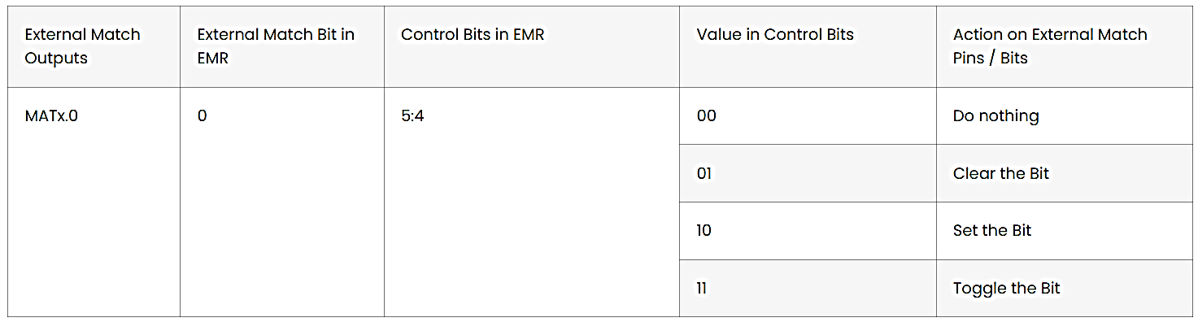
Similarly,
MATx.1, External Match Bit is 1 and Control bits are [7:6].
MATx.2, External Match Bit is 3 and Control bits are [9:8].
MATx.3, External Match Bit is 4 and Control bits are [11:10].
NOTE: MATx.2 and MATx.3 are available only for Timer 2.

Slide 20
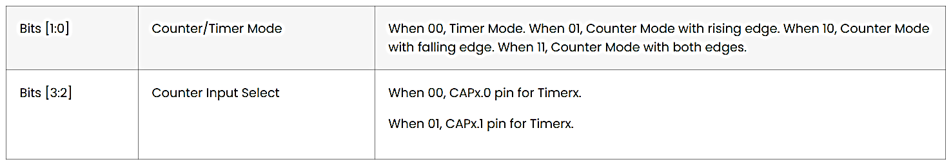
CTCR – Count Control Register: Used to select either Timer Mode or Counter Mode. If counter mode is select, you can also select the input capture pin as well as the edge for counting (rising, falling or both).

Slide 21
Capture Register (CAP0-CAP3)
As the name suggests it is used to Capture Input signal.
When a transition event occurs on a Capture pin, it can be used to copy the value of TC into any of the 4 Capture Register or to generate an Interrupt.

Slide 22
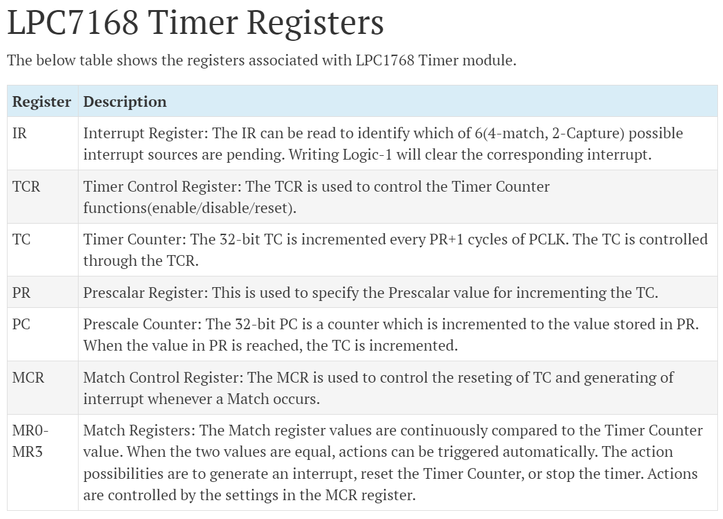
Summary of the registers associated with LPC1768 Timer Module

Slide 23
Setting up & configuring Timers in LPC1768
All the Registers used to program and use timers are defined as members of structure(pointer)
LPC_TIMx
where x is the Timer module from 0 to 3. So, for Timer0 we will use LPC_TIM0 and so on.
Registers can be accessed by de-referecing the pointer using “->” operator. For, example we can access TCR of Timer0 block as
LPC_TIM0->TCR.

Slide 24
Set appropriate value in LPC_TIMx->CTCR
Define the Prescale value in LPC_TIMx->PR
Set Value(s) in Match Register(s) if required
Set appropriate value in LPC_TIMx->MCR if using Match registers / Interrupts
Reset Timer – Which resets PC and TC
Set LPC_TIMx->TCR to 0x01 to Enable the Timer when required
Reset LPC_TIMx->TCR to 0x00 to Disable the Timer when required

Slide 25
void initTimer0(void)
{
LPC_TIM0->CTCR = 0x0; //timer mode
LPC_TIM0->TCR = 0x02; //Reset Timer
LPC_TIM0->PR = 2; //Increment TC at every 2+1 clock cycles,
//PCLK = 3 MHz,Timer resolution = 3/(3MHz) = 1µs
LPC_TIM0->MR0 = 999;
// Since TC increments every 3 clock cycles, the delay is:
//(999 + 1) * 3 clock cycles = 3000 clock cycles.
//PCLK = 3 MHz, delay: 3000 / 3 MHz = 1 ms delay.
LPC_TIM0->MCR = 2; //(010),reset TC after 1 ms delay
LPC_TIM0->EMR = 0x20; // when match occurs bit 0 of EMR will set (binary: 0010 0000)
LPC_TIM0->TCR = 0x01; //enable timer0
}

Slide 26
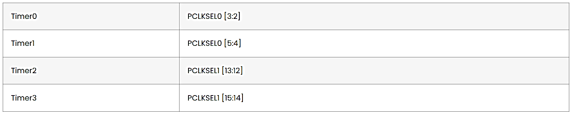
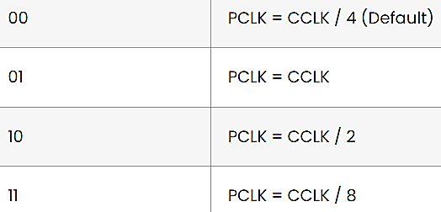
Calculating Timer Pre-scaler
First, we have to select the peripheral clock for the Timer. This is done with the help of PCLKSEL0 and PCLKSEL1 registers. The following table shows the PCLKSEL Register bits for each timer.
The value in these PCLKSEL bits will determine the final PCLK of the Timers.

Slide 27
Program to get 1ms delay using timer0
void initTimer0(void)
{
LPC_TIM0->CTCR = 0x0; //timer mode
LPC_TIM0->TCR = 0x02; //Reset Timer
LPC_TIM0->PR = 2; //Increment TC at every 2+1 clock cycles, Tres = 1us
LPC_TIM0->MR0 = 999; // for 1 ms delay TC counts 0 to 999
LPC_TIM0->MCR = 2; // reset TC after 1 ms delay
LPC_TIM0->EMR = 0x20; // when match occurs bit 0 of EMR will set
LPC_TIM0->TCR = 0x01; //enable timer0
}
void delay(void)
{
initTimer0();
while(!(LPC_TIM0->EMR &1));// Wait until EMR bit 0 becomes 1
}

Slide 28
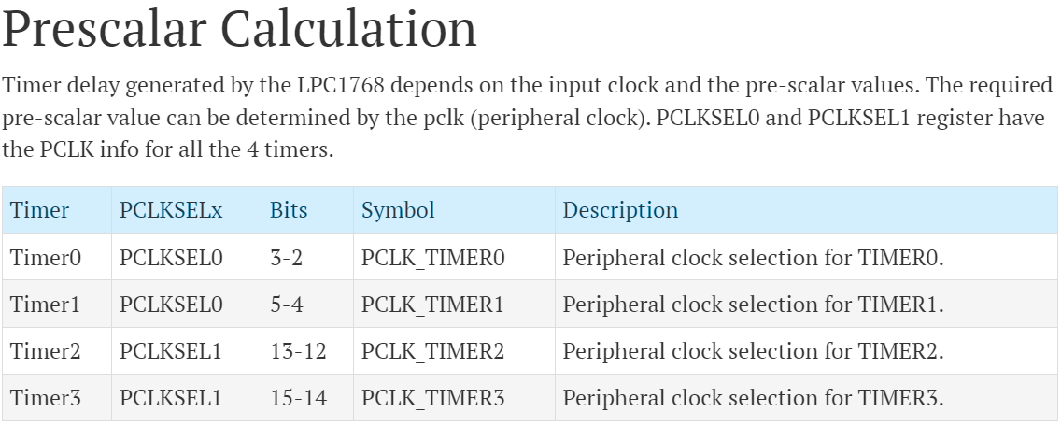
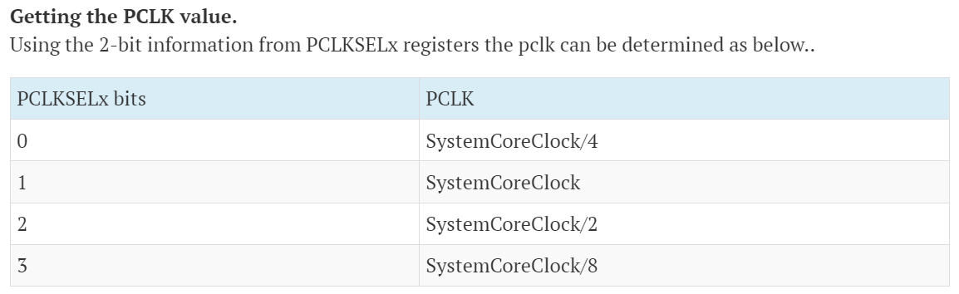

Slide 29
LPC1768 Timer Pre-scaler Calculations
The delay or time required for 1 clock cycle when PCLK = ‘X’ Mhz is given by :
T_{PCLK} = 1/PCLK_{Hz}
=1/( X * 10⁶ )Seconds
It is also the maximum resolution Timer block can provide at a given PCLK frequency of X Mhz. The general formula for Timer resolution at X Mhz PCLK and a given value for prescale (PR) is as given below:
T_{RES} = (PR+1)/PCLK_{Hz}
=(PR+1)/(X * 10⁶ )Seconds

Slide 30
Hence, we get the Formula for Prescaler (PR) for required Timer resolution (T_{RES} in Secs) at given PCLK(in Hz) frequency as:
PR = (PCLK_{Hz} * T_{RES}) – 1
PR = ((X * 10⁶) * T_{RES}) – 1
Note that here, the resolution is also the time delay required to increment TC by 1.
Hence, Pre-scaler value for 1 micro-second resolution at 3 Mhz PCLK is,
PR_{1us} = (3Mhz * 1uS) -1 = (3*10⁶ * 10⁻⁶) -1 = 2

Slide 31
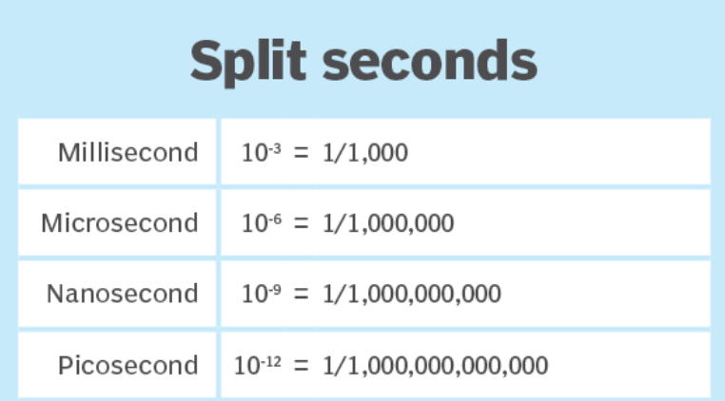
Calculate the PR value for various timer resolutions. For example, if we want 1 milli second resolution on a timer with 25 MHz PCLK.
PR = (25 * 10⁶ * 1 * 10⁻³) – 1 = 24999

Slide 32
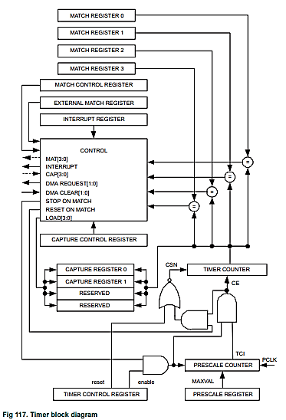
Timer Architecture and Operation
Ref:
UM10360 LPC 176x/5x User Manual Chapter 21

Slide 33
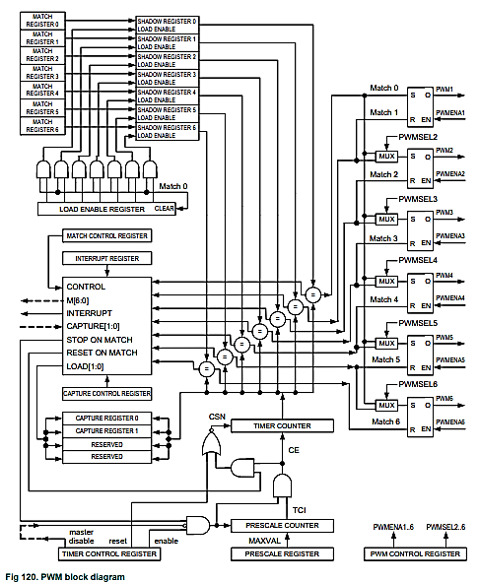
Ref:
UM10360 LPC 176x/5x User Manual Chapter 24

Slide 34
PWM Programming
Pulse Width Modulation Basics
Pulse Width Modulation or PWM is a way to encode data such that it corresponds to the width of the pulse with a given fixed frequency.
It is also a way to control motors , power circuits , etc., using the ‘width’ of the pulse. PWM has numerous uses like Motion Control, Dimming, Encoding Analog Signal into its Digital form, in Power Regulation , etc.
Notes:
PWM is short for Pulse Width Modulation. It is a simplest way of producing analog values using digital system. the width of the Pulse i.e. the duration for with the pulse stays ON in a period is varied. Hence, it is called Pulse Width Modulation.

Slide 35
The PWM is based on the standard Timer block and inherits all of its features, although only the PWM function is pinned out on the LPC1768.
The Timer is designed to count cycles of the peripheral clock (PCLK) and optionally generate interrupts or perform other actions when specified timer values occur, based on seven match registers. The PWM function is in addition to these features and is based on match register events.
PWM can be used for more applications. For instance, multi-phase motor control typically requires three non-overlapping PWM outputs with individual control of all three pulse widths and positions.

Slide 36
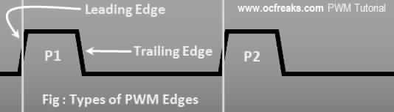
PWM Edges
A PWM signal contains 2 types of Edges which are called Leading Edge and Trailing Edge. The Diagram shown below explains this:

Slide 37
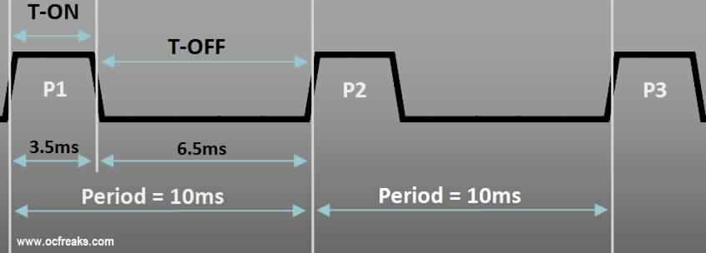
T-ON , T-OFF & Duty Cycle :
Duty Cycle =
T-ON
T-ON + T-OFF
Duty Cycle % =
T-ON
T-ON + T-OFF
X100
Period i.e T = 10ms
Frequency = 100hz
T-ON = 3.5ms T-OFF = 6.5ms DutyCyle = 35%

Slide 38
Types of PWM
PWM Signal can be Classified in Different ways.
Single Edge PWM
2) Double Edge PWM
Single Edge PWM
In Single Edge PWM, the Pulse can either be at the Beginning or the End of the Period and hence can be further Classified into Leading Edge (Right Aligned) PWM and Trailing Edge (Left Aligned) PWM.

Slide 39
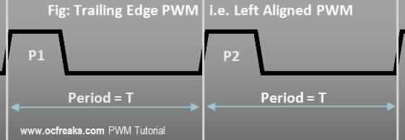
In Trailing Edge PWM, the Leading Edge is fixed at the Beginning of a Period and the Trailing Edge is Modulated i.e. Varied.

Slide 40
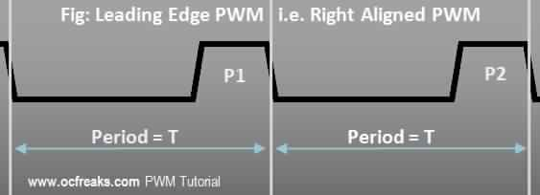
In Leading Edge PWM the Trailing Edge is fixed at the End of a Period and the Leading Edge is Modulated i.e. Varied.

Slide 41
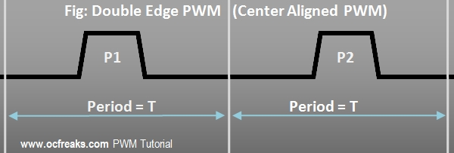
Double Edge PWM
In Double Edge PWM, the Pulse can be Positioned anywhere within the Period. It’s called “Double Edge” because both the Edges are Modulated or Varied. In applications like Multi-Phase Motor control Double Edge PWM is used where the Pulse is Center Aligned to reduce Harmonics.

Slide 42
PWM Voltage
The Average Voltage of a PWM Output depends on its Duty Cycle. Lower the Duty Cycle lower will be the Voltage and Vice-Versa.
V_{average} = DutyCycle x V_{H}
In case the Low State Represents a Negative Voltage then the above equation can be generalized as follows:
V_{average} = (DutyCycle x V_{H}) + ((1-DC) x V_{L})
Where , V_{H} = Voltage for High State & V_{L} = Voltage for Low State

Slide 43
ARM Cortex-M3 LPC1768 PWM Module
The LPC1768 Contains a single PWM Module called PWM1 and supports 2 types of PWM:
Single Edge PWM – Pulse starts with new Period i.e., Pulse is always at the beginning
Double Edge PWM – Pulse can be present anywhere within the Period

Slide 44
A PWM block, similar to a Timer block, has a Timer Counter and an associated Prescale Register along with Match Registers. These work exactly the same way as in the case of Timers.
Match Registers 1 to 6 (except 0) are pinned on LPC1768 i.e. the corresponding outputs are given to actual Pins on LPC1768 MCU. The PWM function must be selected for these Pins, using PINSELx Register, to get the PWM output. These pins are:

Slide 45
Output | PWM1.1 | PWM1.2 | PWM1.3 | PWM1.4 | PWM1.5 | PWM1.6
Pin Name | P1.18 P2.0 | P1.20 P2.1 P3.25 | P1.21 P2.2 P3.26 | P1.23 P2.3 | P1.24 P2.4 | P1.26 P2.5
PWM1.1 output corresponds to PWM Match Register 1 i.e., PWM1MR1 , PWM1.2 output corresponds to PWM1MR2 , and so on.
Also Match Register 0 i.e., PWM1MR0 is NOT pinned because it is used to generate the PWM Period. In LPC1768, PWM1.3 is not pinned out.

Slide 46
There are 7 match registers inside the PWM1 block.
The first Match register PWM1MR0 is used to generate PWM period and hence we are left with 6 Match Registers PWM1MR1 to PWM1MR6 to generate 6 Single Edge PWM signals or 3 Double Edge PWM signals.
Double edge PWM uses 2 match registers hence we can get only 3 double edge outputs.

Slide 47
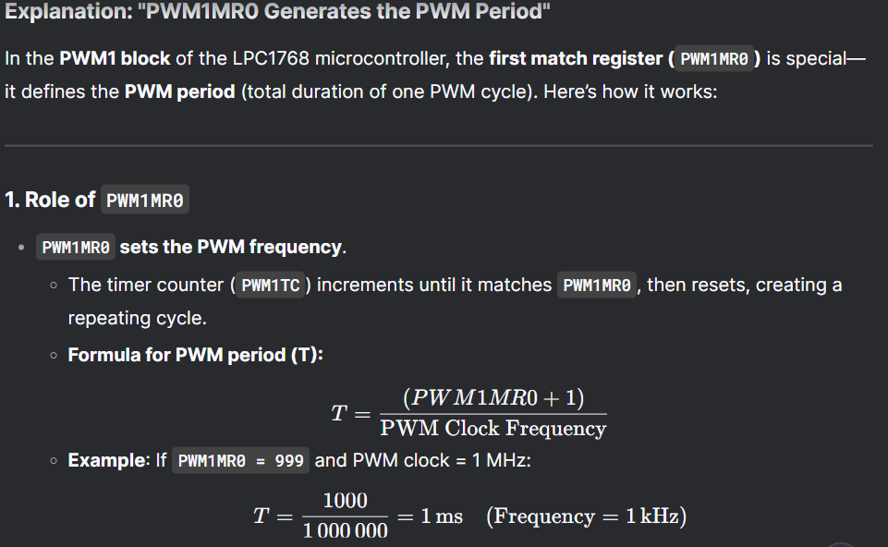

Slide 48
PWM Rules –
The Rules for Single Edged PWM are:
All single edged PWM outputs will go high at the beginning of a PWM cycle unless their match value is 0.
Each PWM output will go low when its match value is reached.
Note: If no match occurs i.e. Match value is greater than Period then the output will remain high!

Slide 49
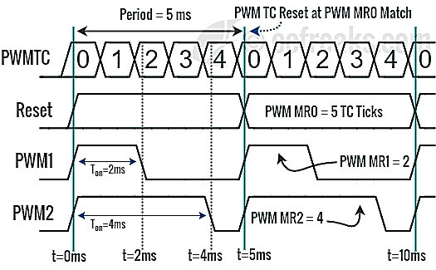
Consider that our PWM Period duration is 5 milliseconds and TC increments every 1 millisecond using appropriate prescale value. We set PWM1MR0 to 5 i.e. 5 ticks of PWM TC. We have PWM1MR1 = 2 and PWM1MR2 = 4. Whenever the value in TC matches the value in any of the match register, its corresponding output is set to low until the start of next PWM cycle as shown in PWM Timing Diagram below:

Slide 50
Registers used in LPC176x PWM Programming
PWM1TCR – PWM Timer Control Register: This register is used to control the Timer Counter inside the PWM block. Only Bits: 0, 1 & 3 are used rest are reserved.
Bit 0 : When 1 both PWM Timer counter and PWM Prescale counter are enabled. When 0 both are disabled.
Bit 1 : When set to 1 it will reset both Timer and Prescale counter of PWM block (at next edge of PCLK).
Bit 3 : Enables PWM mode i.e., the PWM outputs.
Other Bits : Reserved.

Slide 51
PWM1PR – PWM Prescale Register: PWMPR is used to control the resolution of the PWM outputs. The Timer Counter(TC) will increment every PWMPR+1 Peripheral Clock Cycles (PCLK).
PWM1MR0 – PWM1MR6 (Match Registers):
The seven Match registers contain Pulse Width Values i.e the Number of PWM1TC Ticks.
PWM1MR0 holds the value of 1 complete cycle or the period.

Slide 52
PWM1MCR – PWM Match Control Registers: The PWM Match Control Register is used to specify what operations can be done when the value in a particular Match register equals the value in TC. For each Match Register we have 3 options : Either generate an Interrupt , or Reset the TC, or Stop, which stops the counters and disables PWM. Hence this register is divided into group of 3 bits. The first 3 bits are for Match Register 0 i.e PWMMR0 , next 3 for PWMMR1 , and so on.
Bit 0 : Interrupt on PWM1MR0 Match – If set to 1 then it will generate an Interrupt else disable if set to 0.
Bit 1 : Reset on PWM1MR0 Match – If set to 1 it will reset the PWM Timer Counter i.e. PWM1TC else disabled if set to 0.
Bit 2 : Stop on PWM1MR0 Match – If this bit is set 1 then both PWM1TC and PWM1PC will be stopped & disable the Counters.
Similarly {Bits 3,4,5} for PWM1MR1 , {Bits 6,7,8} for PWM1MR2 , {Bits 9,10,11} for PWM1MR3 ,{Bits 12,13,14} for PWM1MR4 ,{Bits 15,16,17} for PWM1MR5 , {Bits 18,19,20} for PWM1MR6.

Slide 53
PWM1IR – PWM Interrupt Register: If an interrupt is generated by any of the Match Register then the corresponding bit in PWM1IR will be set high. Writing a 1 to the corresponding location will clear that interrupt.
Bits 0,1,2,3 are for PWM1MR0, PWM1MR1, PWM1MR2, PWM1MR3 respectively and
Bits 8,9,10 are for PWM1MR4 , PWM1MR5 , PWM1MR6 respectively. Other bits are reserved.

Slide 54
PWMLER – Load Enable Register:
The PWM Load Enable Register is used to control the way Match Registers are updated when PWM generation is active.
When PWM mode is active and we apply new values to the Match Registers the new values won’t get applied immediately. Instead, what happens is that the value is written to a “Shadow Register”. It can be thought of as a duplicate Match Register. Each Match Register has a corresponding Shadow Register.
The value in this Shadow Register is transferred to the actual Match Register when: PWM1TC is reset (i.e., at the beginning of the next period) and the corresponding Bit in PWM1LER is 1.
Bit ‘x’ in PWM1LER corresponds to match Register ‘x’. i.e., Bit 0 is for PWM1MR0 , Bit 1 for PWM1MR1 , .. and so on.

Slide 55
PWM1PCR – PWM Control Register: This register is used for Selecting between Single Edged & Double Edged outputs and also to Enable/Disable the 6 PWM outputs which go to their corresponding Pins.
Bits 2 to 6 are used to select between Single or Double Edge mode for PWM 2,3,4,5,6 outputs. If Bit 2 is set to 1 then PWM1.2 (i.e., the one corresponding to PWM1MR2) output is double edged else if set 0 then its Single Edged. Similarly Bit x for PWM1.x correspondingly.
Bits 9 to 14 are used to Enable/Disable PWM outputs. If Bit 9is set to 1 then PWM1.1 output is enabled , else disabled if set to 0. Similarly remaining bits for PWM1.x correspondingly.

Slide 56
How to generate PWM?
When the value for the cycle time or the period is loaded into MR0, The selected PWM output goes high.
TC starts counting. When it matches with the value in the corresponding match register, the PWM output goes low and remains low until TC matches with the MR0. Then the next cycle starts.
For the next cycle if the match register value corresponding to the PWM output is changed, the pulse width is changed.

Slide 57
Configuring and Initializing PWM Block
Select the PWM function for the PIN on which you need the PWM output using applicable LPC_PINCON->PINSELx register.
Select Single Edge or Double Edge Mode using LPC_PWM1->PCR. By default its Single Edge Mode.
Load the value to LPC_PWM1->PR.
Set the Value for PWM Period in LPC_PWM1->MR0.
Set the Values for other Match Registers i.e the Pulse Widths.
Set appropriate bit values in LPC_PWM1->MCR, like for e.g. resetting PWM1TC for PWMMR0 match and optionally generate interrupts if required
Set Load Enable Bits for the Match Registers that you’ve used. This is important!
Then Enable PWM outputs using LPC_PWM1->PCR.
Now Reset PWM Timer using LPC_PWM1->TCR.
Finally, Enable Timer Counter and PWM Mode using LPC_PWM1->TCR.

Slide 58
void PWM_Init(void) {
// 1. Set P2.1 as PWM1.2 (PINSEL4: P2.0 to P2.15 and P2.1: Bits 2 and 3 in PINSEL4)
LPC_PINCON->PINSEL4 = 0x04; // (Binary: 0100) Set bits 2:3 to '01' for P2.1 (PWM1.2)
// 2. Configure PWM Prescaler for 1 MHz clock (assuming CPU clock = 10 MHz)
LPC_PWM1->PR = 9; // 10 MHz / (1 MHz) – 1 = 9
// 3. Set PWM Period (for 1 kHz frequency)
LPC_PWM1->MR0 = 999; // (1 MHz / 1kHz) - 1 = 999
// 4. Set Duty Cycle (50% Double Edge: MR2 = rising, MR3 = falling)
LPC_PWM1->MR2 = 250; // Rising edge at 25% of period
LPC_PWM1->MR3 = 750; // Falling edge at 75% of period
// 5. Enable PWM1.2 output and set Double Edge Mode
LPC_PWM1->PCR = 0x404; //(0100 0000 0100) Bit 10 (Enable PWM1.2) | Bit 2 (Double Edge)
// 6. Load MR0, MR2 and MR3 values
LPC_PWM1->LER = 0x0D; // (0000 1101) Update MR0 (bit 0), MR2 (bit 2), MR3 (bit 3)
// 7. Reset and Enable PWM
LPC_PWM1->TCR = 0x02; // (0000 0010) Bit 1 = 1 (Reset PWM Timer counter)
LPC_PWM1->TCR = 0x09; // (0000 1001) Bits 0 & 3 = 1 (Enable PWM and Timer) }

