Slide 1
METAL CASTING

Slide 2
Metal Casting:
It is the process of producing metallic parts by pouring a molten metal in to the mould and allowing the metal to solidify.

Slide 3
Casting Process
Mould prepared.
Metal is Heated Above Melting Temp.
Liquid Metal Poured into Mold
Metal Solidifies into Shape of Mold
Part Removed from Mold
Post Casting Operations
Clean Up
Machining

Slide 4
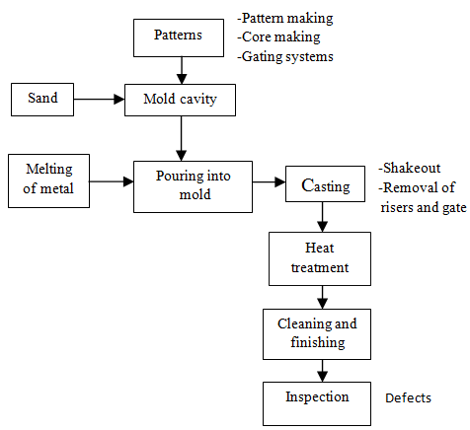

Slide 5
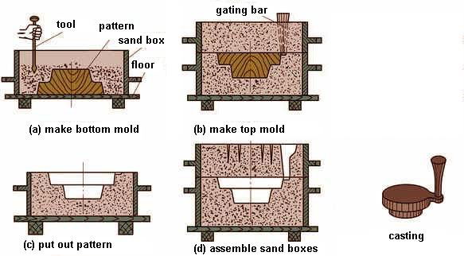

Slide 6
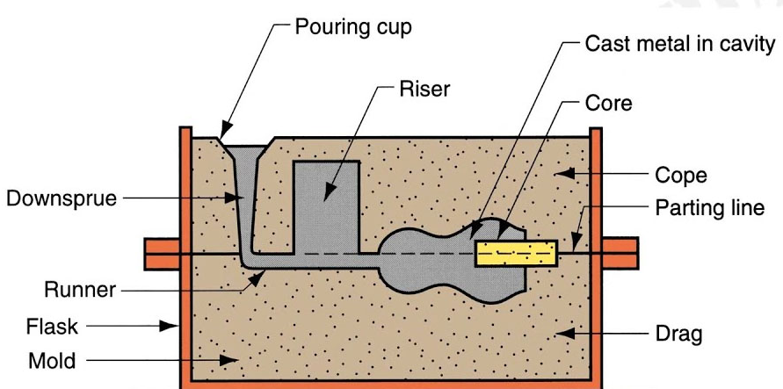

Slide 7
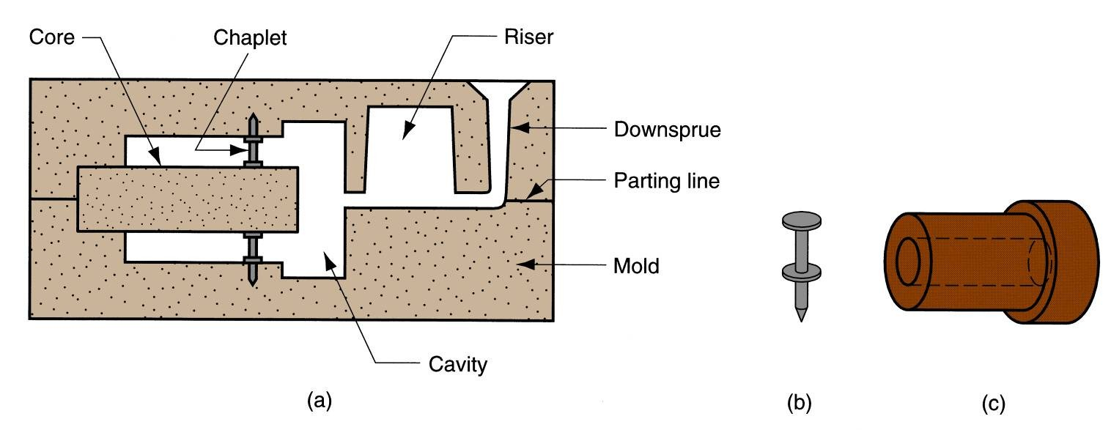

Slide 8
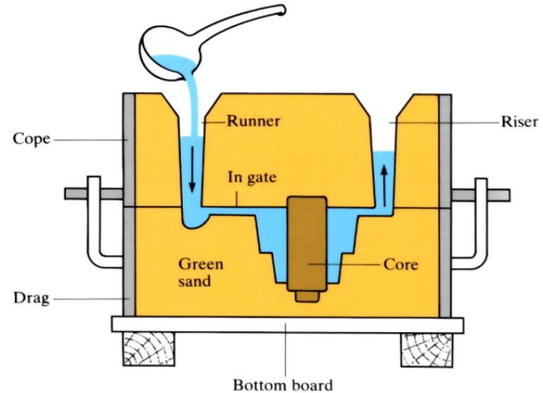

Slide 9
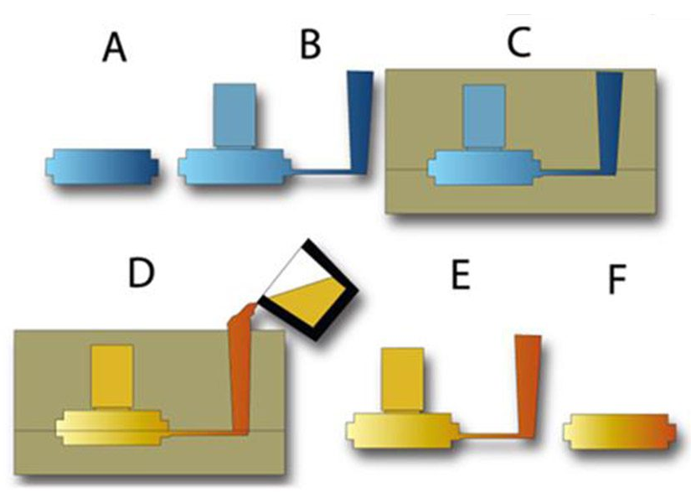

Slide 10
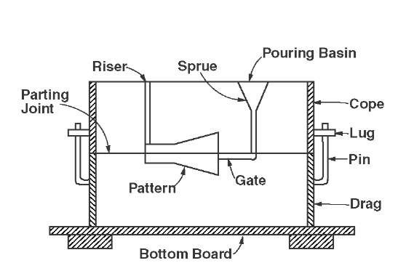

Slide 11
Molding sand classification
They can be classified as:
Natural molding sand (Green sand)
- Taken from river beds & contain major amount of clay
- easily available at low cost
Synthetic sand
- contain little or no binder (clay)
- strength & bonding property can be easily controlled
- more expensive than natural sand
Special sand
- ideal in getting special characteristics..

Slide 12
Sand preparation
Very few natural sands have all the qualities required by a molding sand
It is mixed with other sands which possess the required characteristics
Sufficient moisture must be added to the sand
Sand must be properly conditioned before use

Slide 13
Properties of a molding sand
Porosity (permeability)
Sand must be porous to allow the gases/ moisture present within the molds to be removed freely when molten metal is poured
Adhesiveness
sand particles must be capable of adhering to sides of molding boxes
Cohesiveness / Strength
Ability of sand particles to stick together
Should be sufficient to permit the mold to be formed to the desired shape even after the hot metal is poured in the mold
Refractoriness
Molding sands with a poor refractoriness may burn on to the casting
Measured by sinter point of sand

Slide 14
Properties of a molding sand
Collapsibility
Mold made out of sand to collapse as the molten metal gets
solidified in it
Flowability
Ability of the sand to behave like a fluid so that, when rammed sand will flow to all portions of a mold and around the pattern and take up the required shape
It increases as clay & water content increase
High flowability is required of a molding sand of uniform density
To obtain good impression of the pattern in the mold.

Slide 15
Gating System

Slide 16
Components of Gating System
Pouring Basin
Sprue
Sprue base
Runner
In-gate
Riser

Slide 17
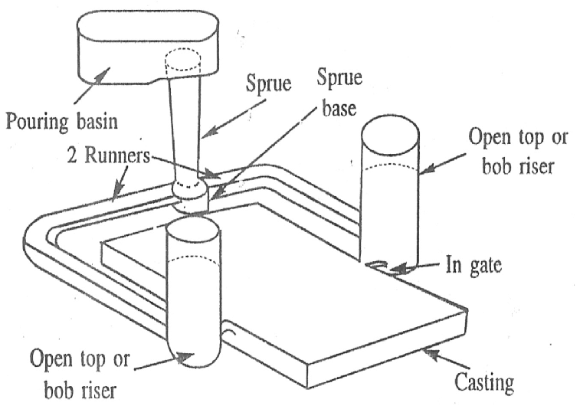

Slide 18
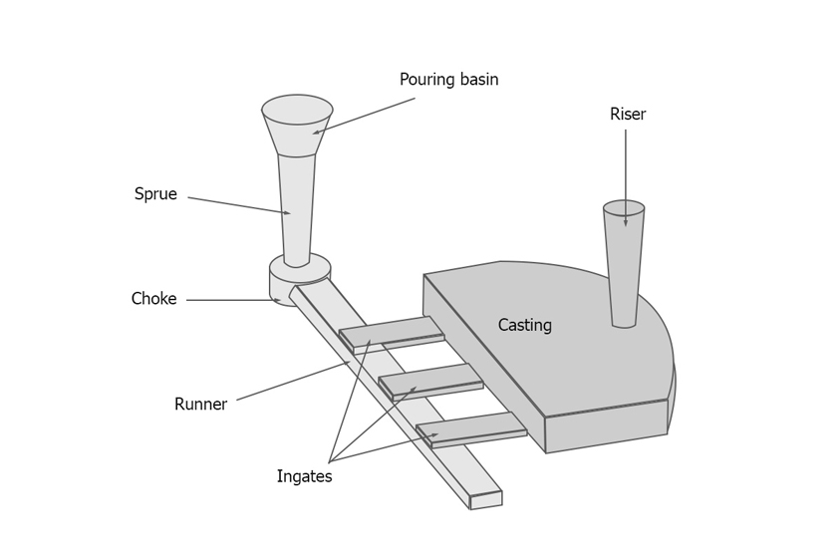

Slide 19
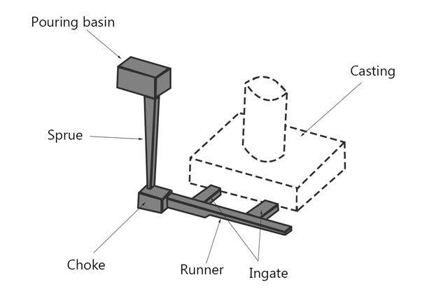

Slide 20
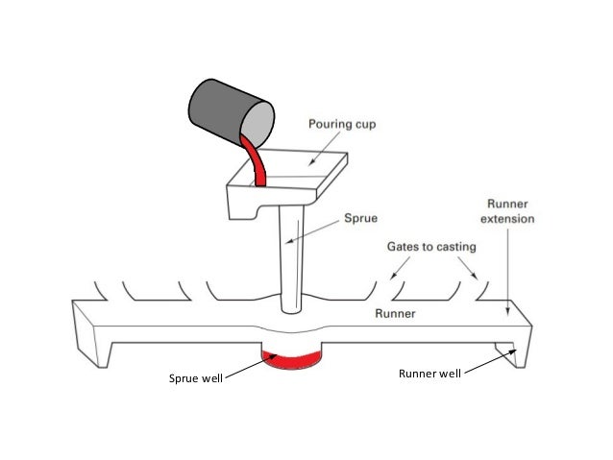

Slide 21
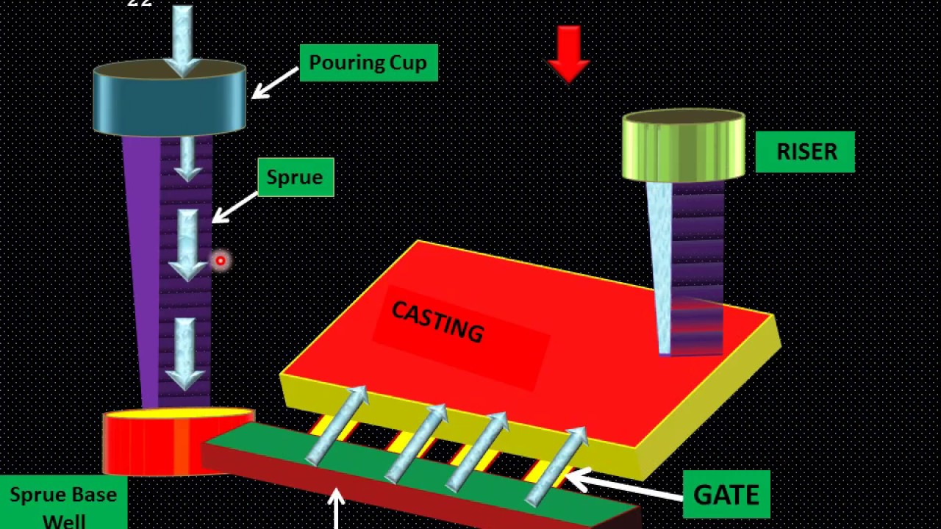

Slide 22
PATTERN
A pattern is an replica of a casting to be made.
Using pattern, impressions (mould cavity) can be formed in the damp sand to make a mould.
Pattern materials
Any material which will retain exact outline of the design for required number of molds

Slide 23
Pattern materials
Wood – easy to work & readily available
– can be cut in to required shapes
– used when small number of castings
Metal - do not change their shape when subjected to moist condition
– used when small number of castings
Plastics – do not absorb moisture, smooth
– can be withdrawn from the mold easily, without damaging the mold
Plaster – High compressive strength

Slide 24
Green sand mold

Slide 25
Basic steps in making sand casting
Pattern making
Core making
Moulding
Melting and pouring
Cleaning

Slide 26

Green sand mold
with pattern
Drag
Drag
Drag
Drag
Pattern
Pattern
Molding board
Molding board
Molding board
Molding board
FIRST OPERATION
FIRST OPERATION
Vents
Weight
Lifter
Riser pin
Sprue pin
Pouring basin
Cope
Riser
Parting
line
Parting
line
Runner
Gate
Core
SECOND OPERATION
COMPLETE MOLD

Slide 27
Scooping
It is the process of making a cavity in the sand mould
without using a pattern.
Instead it makes use of casting hand tools like shovel,
rammer etc.

Slide 28
Types of patterns
Single piece pattern
Match plate pattern
Gated pattern
Split pattern
Cope & Drag pattern
Loose-piece pattern
Skeleton pattern

Slide 29
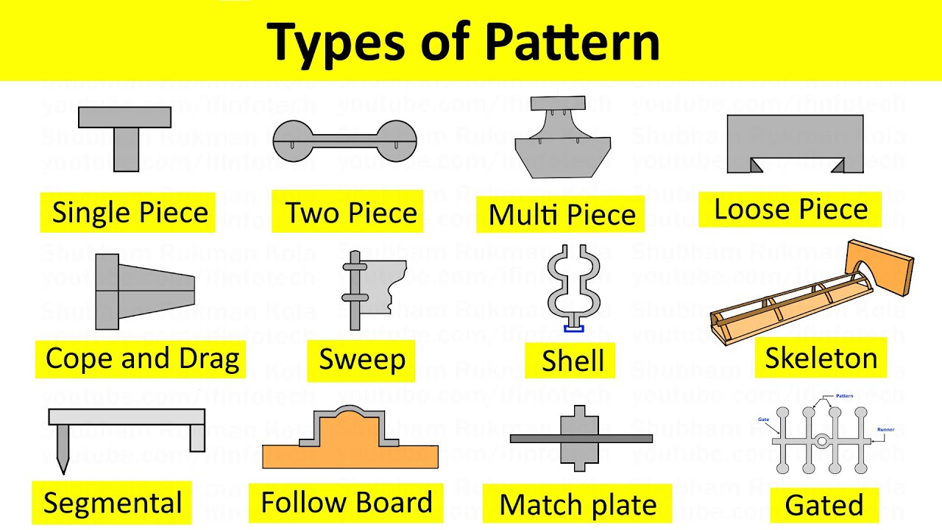

Slide 30
Single piece pattern
Made from one piece & does not contain loose pieces
Inexpensive & are of simplest type
Split pattern
Most widely used pattern for intricate castings
Here the pattern is split in to 2 parts so that one part is in
the cope & other is in the drag
Two halves of the pattern is aligned properly by using
dowel pins

Slide 31
Cope and Drag pattern
Similar to split patterns
The cope & drag halves of the pattern along with the gating
and risering systems prepared separately
But they are attached separately to the metal or wooden
plate along with alignment pins
Match plate pattern
An extension of cope and drag pattern
Here the cope & drag patterns along with the gating &
risering are mounted on a single matching or metal plate
on either side

Slide 32
Loose piece pattern
Used when contour of the part is such that withdrawing the
pattern from the mold is not possible
Obstructing part is held as a loose piece
Skeleton pattern
Made of strips of wood for preparing final pattern
by pouring the sand around the pattern and packing it

Slide 33
Gated pattern
Usually made of metal which increases their strength and
reduces tendency to warp
Section connecting different patterns serve as runner
and gates
A gated pattern can manufacture many castings at one
time
Used in mass production systems

Slide 34
Pattern Allowances
Shrinkage allowance
Machining or Finishing allowance
Draft or Taper allowance
Camber or distortion allowance
Shake or Rapping allowance
Mould wall movement allowance

Slide 35
Pattern Allowances
Shrinkage allowance
Most of the metals used in casting contract during cooling from pouring temperature to room temperature
Provided to compensate for solid contraction by providing adequate allowances in the pattern
Amount of contraction varies with different metals

Slide 36
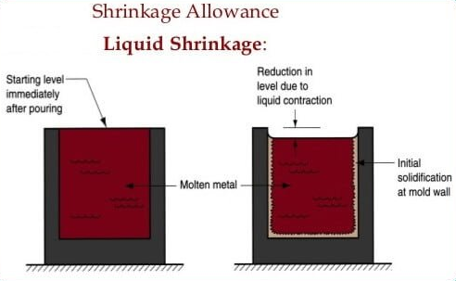

Slide 37
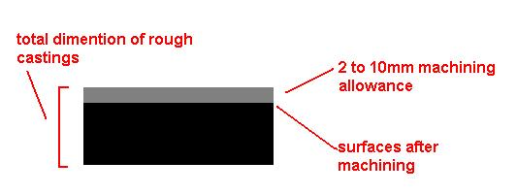
Pattern Allowances
2. Machining allowance
Given on the surface of the pattern by increasing the metal
thickness there to compensate for loss of metal due to
machining on these surfaces
Depends mainly upon method of machining to be employed
Given in addition to the shrinkage allowance

Slide 38
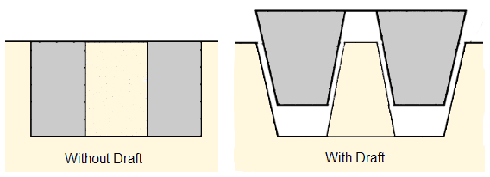
Pattern Allowances
3. Draft or Taper allowance
Given slight taper on the vertical surfaces of the pattern
parallel to the direction of withdrawal from the mould
Provided on both internal & external surfaces
For easy withdrawal of pattern from the mould

Slide 39
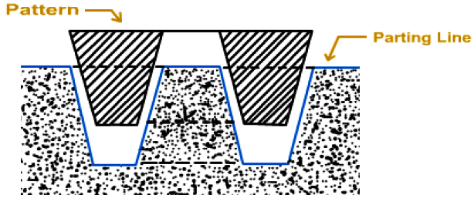
Pattern Allowances
4. Rapping allowance
Negative allowance to be provided in the pattern
When pattern is withdrawn from the mould by striking over
it from side to side, size of the cavity increases
To compensate this rapping allowance is provided

Slide 40
Pattern Allowances
5. Distortion allowance
Castings having irregular shape, will not have uniform
contraction during their cooling
Results in distortion of the castings
Remedy:
An opposite distortion is provided in the pattern

Slide 41
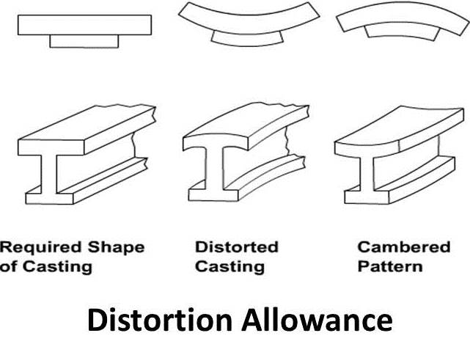

Slide 42
Pattern Allowances
6. Mould wall movement allowance
Mould wall movement takes place because of excessive
heat and pressure applied by the molten metal on the surface
layer of the sand
Affects the size of the casting
Remedy:
Provide proper allowance in the pattern
Controlling the density & temperature of molten metal
Controlling the composition of the molding sand

Slide 43
DEFECTS IN METAL CASTING

Slide 44
CLASSIFICATION OF CASTING DEFECTS
Gas Porosity Defects
Pinholes
Subsurface Blowhole
Open hole
2. Shrinkage Casting Defects
Open Shrinkage defects
Closed Shrinkage defects
3. Mould Material casting defects
Cuts and Washes
Fusion
Runout
Swells
Drops
Rat tails, veins and buckles
Metal penetration

Slide 45
4. Metallurgical Casting Defects
Hot Tear/Crack
Hot/Hard Spots
5. Pouring Casting Defects
Cold Shut/Lap
Misruns
Cold shots
Slag Inclusion (Scab)
6. Casting Shape Defects
Shift/Mismatch
Flash, Fin & Burrs
Warping

Slide 46
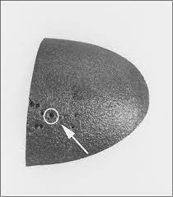
GAS POROSITY DEFECTS
Pinholes
Pinholes, also sometimes referred to as porosities, are very tiny holes (about 2 mm) usually found in the cope (upper) part of the mold, in poorly vented pockets.
They are always visible to the naked eye and don’t require equipment to identify.

Slide 47
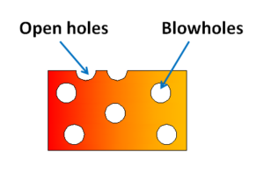
b) Subsurface Blowhole
Blowholes, or simply blows, are larger cavities than pinholes.
A subsurface blowhole appears on the inside of a cast and usually isn’t visible until after machining.
Subsurface blowholes can be difficult to detect before machining, requiring harmonic, ultrasonic, magnetic or x-ray analysis.
c) Open Holes
These blowholes appear on the surface of the cast and are easier to detect than subsurface blowholes.
Causes and prevention of gas porosity:
There are several causes of cavity defects.
Poor venting of mold and cores.
Insufficient drying of mold and cores.

Slide 48
SHRINKAGE CASTING DEFECTS
Shrinkage occurs because metals are less dense as a liquid than a solid.
A shrinkage cavity is a depression in a casting which occurs during the solidification process.
Large shrinkage cavities can undermine the integrity of the casting and may cause it to eventually break under stress.
Shrinkage can result in two types of casting defects.

Slide 49
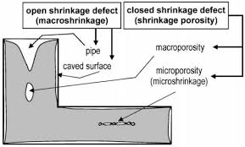
a) Open Shrinkage defects
These are open to the atmosphere. Air compensated as the shrinkage cavity forms.
Pipes are open shrinkage defects that form at the surface and burrow into the casting.
Caved surfaces are shallow, open shrinkage defects that form across the surface of the casting.

Slide 50
b) Closed Shrinkage defects
Also known as shrinkage porosity, closed shrinkage defects form within the casting.
Macro shrinkage can be viewed with the naked eye, but micro shrinkage cannot.
Closed shrinkage defects usually appear at the top of hot spots, or isolated pools of hot liquid.

Slide 51
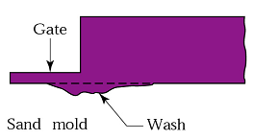
MOULD MATERIAL CASTING DEFECTS
Mold material casting defects are related to the mold material, which is most commonly sand.
Cuts and Washes
Cuts and washes are areas of excess metal.
These appear when the molten metal erodes the molding sand.
A cut appears as a low projection along the surface of the drag face, decreasing in height as it extends from one side of the casting to the other.

Slide 52
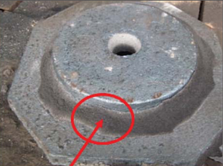
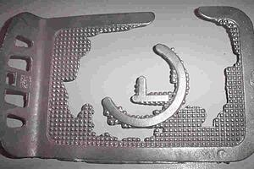
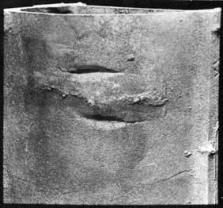
b) Fusion:
Fusion occurs when sand grains fuse
with molten metal.
It appears as a thin crust with a brittle,
glassy appearance firmly adhered to the casting.
c) Run out:
Run out is when liquid metal leaks out
of the mold, leading to an incomplete
or missing casting.
d) Swells:
Swells are an enlargement of the casting.
Swells typically take on the shape of a slight,
smooth bulge on the vertical face of castings.

Slide 53
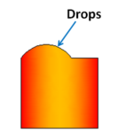
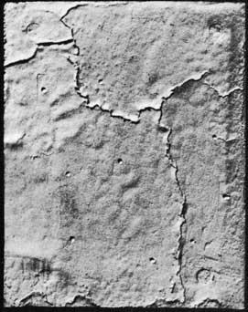
e) Drops
Drops occur when pieces of sand fall into metal
casting when it’s still liquid.
Drops appear as an irregularly shaped
projection on the cope (top) surface of a casting.
f) Rat tails, veins and buckles
Rat tails, or veins, appear as an irregular
line or crack on the casting, when the surface
of the molding sand buckles up.
Rat tails usually occur on the surface of the
mold bottom, an area covered with molten
material.
Buckles are a more severe form of rat tails.

Slide 54
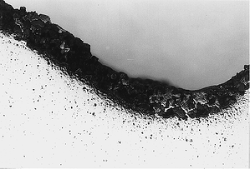
g) Metal Penetration
Metal penetration occurs when liquid metal penetrates gaps in the molding sand.
The penetration is visible to the naked eye as a rough and uneven surface finish of the casting.

Slide 55
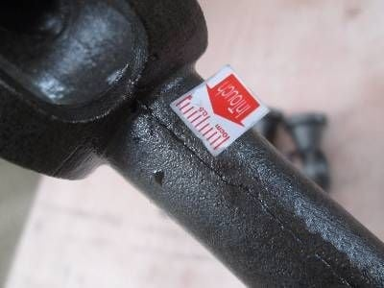
METALLURGICAL CASTING DEFECTS
Hot Tear/Crack
Cracks appear in the form of irregular
crevices in a branched pattern.
Cracks occur as the casting cools,
towards the end of solidification.
b) Hot/Hard Spots
Hot spots are spots that are harder than the surrounding area.
This is because they cooled more quickly than the surrounding material.
Hard spots can interfere with machining and increase tool wear.

Slide 56
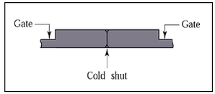
POURING CASTING DEFECTS
Cold Shut/Lap:
Cold shut is a type of surface defect. You will see a line or crack with a round edge on the casting surface.
This defect is visible to the naked eye and often results in rejecting the cast, as it creates a weak spot.

Slide 57
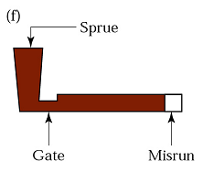
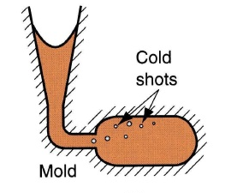
b) Misruns:
Misruns occur when the liquid metal is
too cold to flow to the extremities of the
mold cavity before freezing and solidifying.
The liquid metal does not completely
fill the mold cavity.
The misrun is the unfilled portion or space in the mold.
c) Cold Shots:
Splattering during pouring of a liquid
can cause solid globules to form.
As these globules freeze, they become
entrapped in the casting.
Cold shots are typically ball, drop or
pearl shaped and loosely attached to the metal.

Slide 58
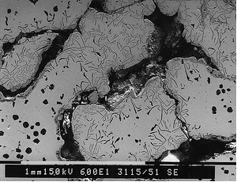
d) Slag Inclusion (Scab)
These irregular metallic crusts are found on the casting surface.
Scabs are typically only a few millimeters thick but can be seen by the naked eye.
Scabs are closely related to rat tails and they usually appear together.
Removal of scabs will typically reveal a rat tail underneath.

Slide 59
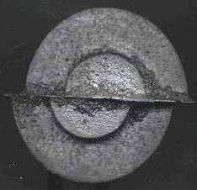
CASTING SHAPE DEFECTS
Shift/Mismatch:
Mold shift is due to misalignment of upper (cope) and lower (drag) part of the mold.
Mold shift is usually reflected as a horizontal displacement.

Slide 60
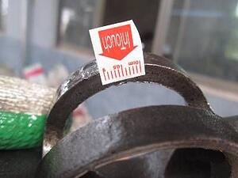
b) Flash, Fin & Burrs
Flash is one of the most frequently occurring casting defects and also a common injection molding defect.
Flash, also known as casting fin or burrs, is any unwanted and excess material attached to a cast.
It’s typically a thin sheet of metal that forms at the parting faces.
Flash is a waste material that turns into dross after being re-melted.

Slide 61
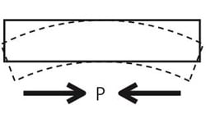
c) Warping:
Warping is an unwanted casting deformity that can occur over time, which results in a change in the dimensions of the final product.
It can happen during or after solidification.

