Slide 1
Smithing & Forging

Slide 2
Smithing
It is a process of performing various operations on relatively small work pieces, heated in an open fire (hearth) by means of hand hammers or small power hammers in a smithy shop.
Forging
Is a process of producing those parts, which must be heated in a closed furnace, by means of heavy hammers or forging machines or presses.

Slide 3
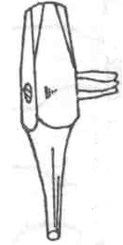
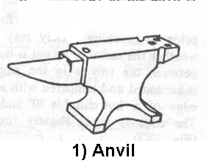
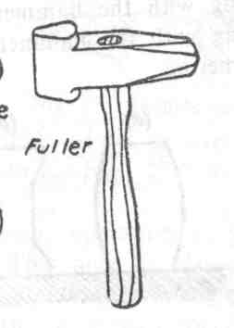
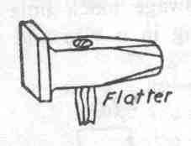
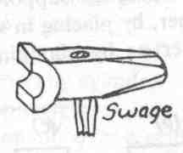
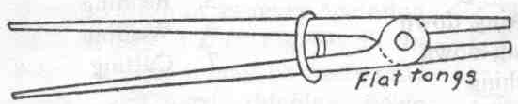
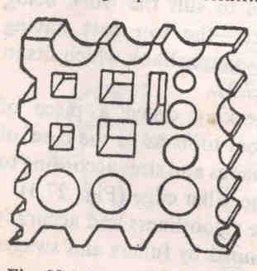
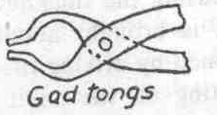
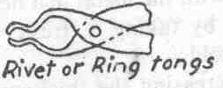
Forging Tools
Beak
2) Fuller
3) Punch
4) Flatter
5) Swage
6) Flat tongs
7) Ring Tongs
8) Gad Tongs
9) Swage block

Slide 4
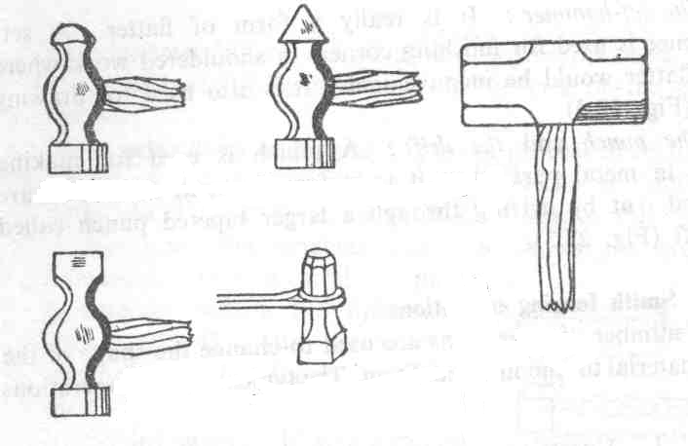
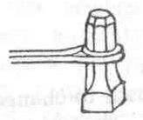
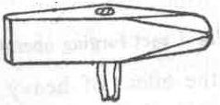
Hammers
a) Ball peen
b) Cross peen
Sledge Hammer
Set Hammer
c) Straight peen
Chisels
Hot Chisel
Set hammer

Slide 5
Anvil: Provides a support for blacksmith’s workpiece when hammering.
-Beak is used for bending the workpieces
Fuller: Necking down a piece of work
Swage: To obtain reduced and finished to round, square or hexagonal form
- Made with half grooves of dimensions to suit the work being reduced
Punch: Used for making holes in metal part when it is in forging heat.
Flatter: To give smoothness and accuracy to components which have been already shaped by fullers and swages.

Slide 6
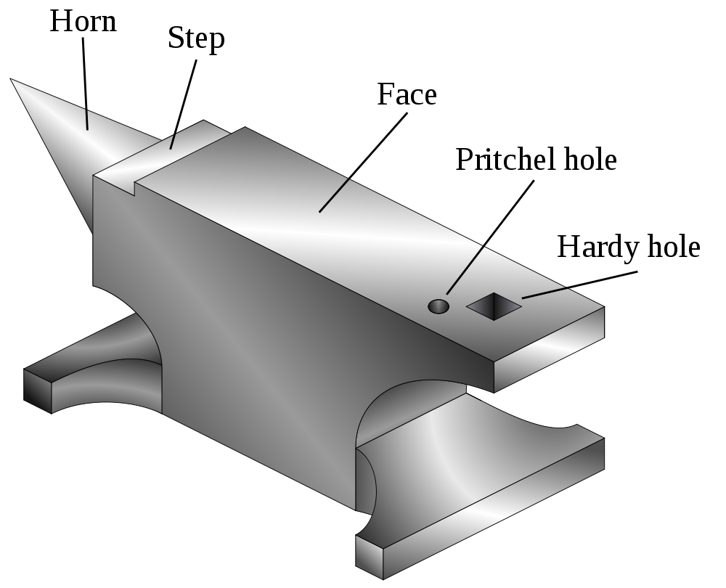
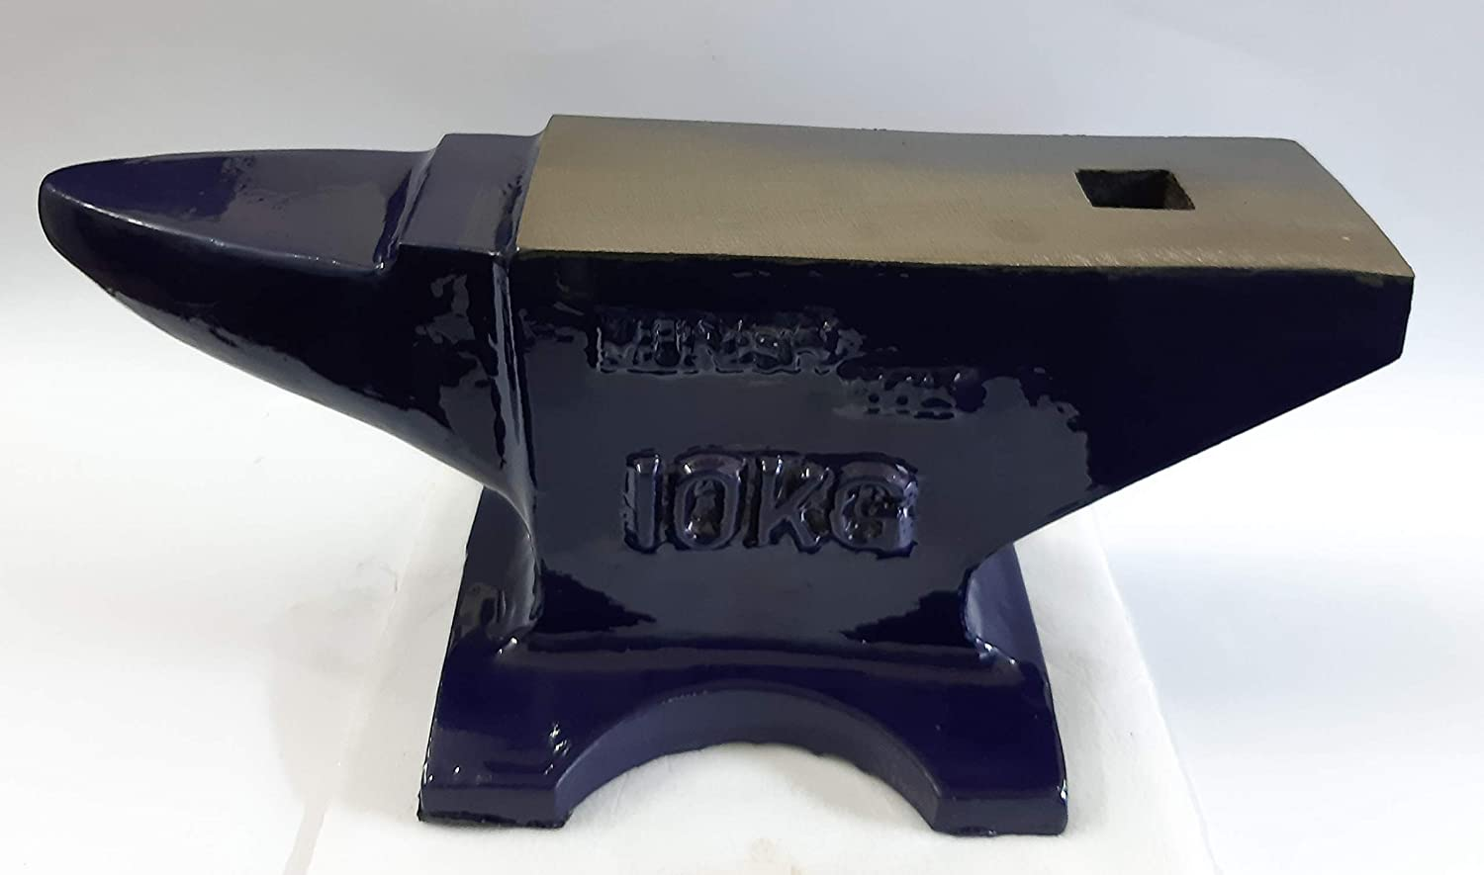
ANVIL
Back

Slide 7
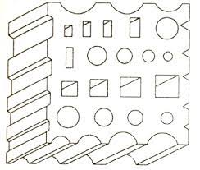
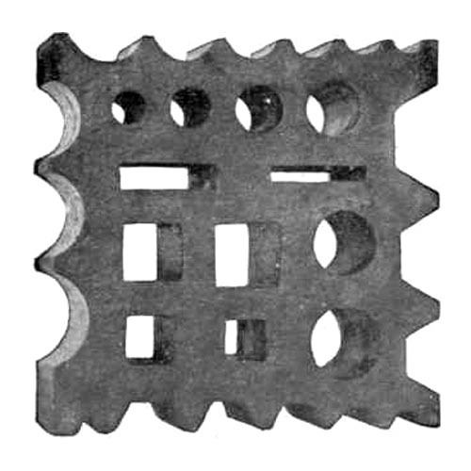
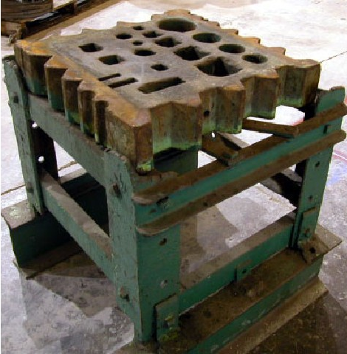
SWAGE BLOCK

Slide 8
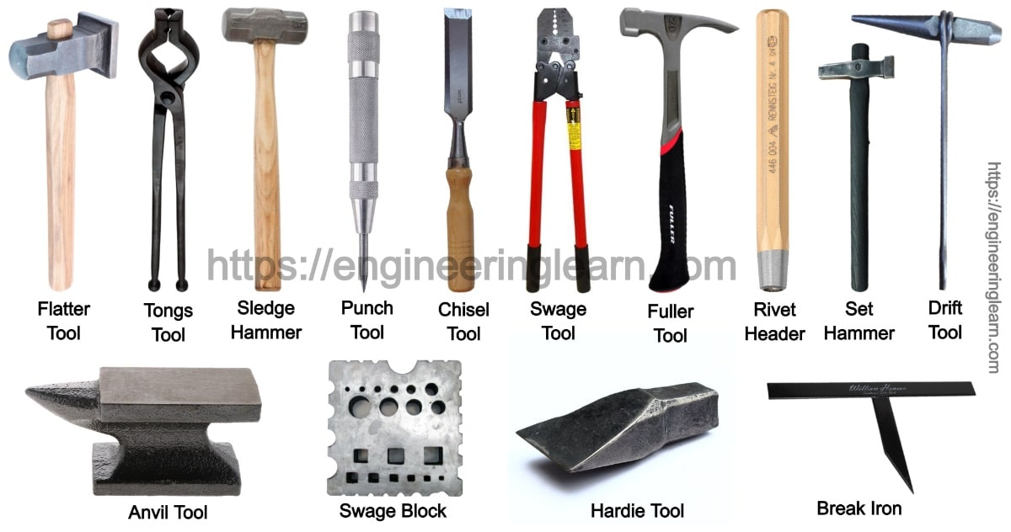

Slide 9
Tongs: To hold the workpiece
Flat Tong : For holding work of rectangular section
Ring Tong : For holding work of circular section
Gad Tong : For general pick-up, either straight or tapered
Swage block:
Used for squaring, sizing, bending operations
Chisels: For cutting metals & for nicking prior to breaking
- They may be hot or cold depending on the metal to be cut
is hot or cold.
Hand hammers: They may be classified as a) Ball peen hammer
b) Straight peen hammer c) Cross peen hammer
d) Sledge hammer
Set hammer: Used for finishing corners in shouldered work, where flatter is inconvenient.

Slide 10
Forging processes
They are classified as:
Smith Die forging
a) Hand Forging
b) Power Forging
2) Impression Die forging
a) Drop Forging
b) Press Forging
c) Machine Forging

Slide 11
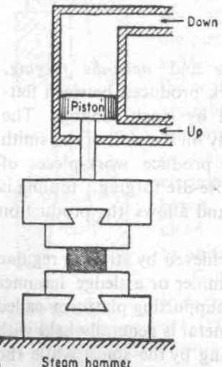
Power forging
-Also called as an air and
steam hammer
-Operated by either steam or
compressed air
Principle of operation is
illustrated in the sketch
Require additional facilities
for supplying high pressure steam or compressed air.
Ram
Upper Die
Work
Lower Die
Anvil
Fig. Steam Hammer

Slide 12
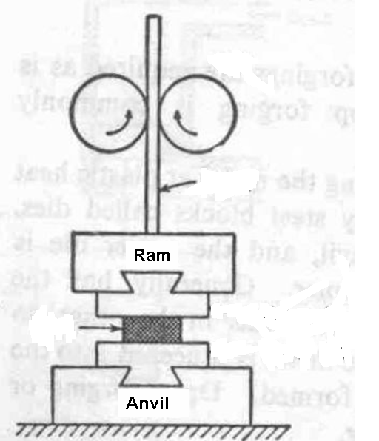
Drop Forging (Stamping/ Die forging)
Also called as Gravity Hammer
Working:
Ram is fixed to the lower end of
the board
Board is placed between 2 rolls
Ram will be lifted, when both rolls
are pressed against the board
-Working stroke is produced when
the rolls are released.
-Process continues till operator
holds down the treadle
Roll
Board
Upper Die
work
Lower Die
Fig. Board Hammer

Slide 13
Smith forging operations
Most commonly used forging operations are:
Upsetting
Bending
Punching
Drawing down
Setting down
Cutting
Fullering

Slide 14
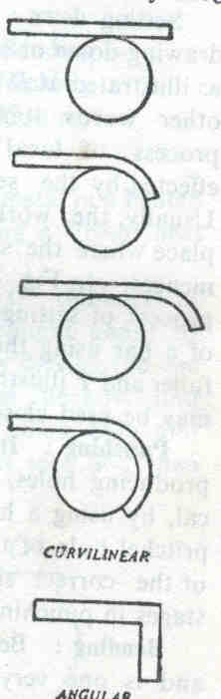
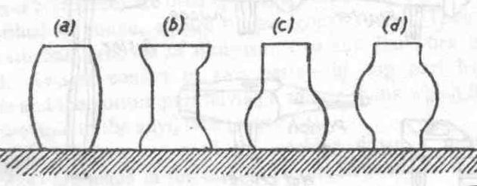
Smith forging operations
Upset forging operations
Upsetting:
Process of increasing the thickness of a bar by reducing its length by end pressure.
Bending:
Curvilinear
Process of producing curvilinear or angular bends on a bar.
Done on the edge of the anvil face or beak or swage block
Angular
Bending operations

Slide 15
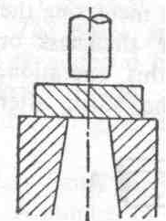
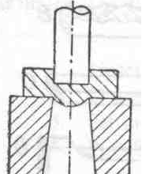
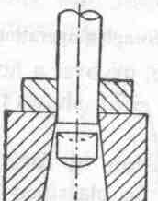
Punching operation
Process of producing of holes by a hot punch by placing the job over the pritchel hole of the anvil.
Step 1
Step 2
Step 3

Slide 16
Drawing down or Swaging
Process of increasing the length of a bar at the expense of its width or thickness or both.
Setting Down
It is a localized drawing down or swaging operation.
Cutting
Process of removing a forging from the stock.
Fullering
Process of spreading the metal along the length of the job.

Slide 17
Drop forging
Uses drop hammers of 2 types
Hammers can make 50 – 75 strokes/ min
Lower maintenance cost & easy to operate
Tools, Gear blanks, Machine parts
Gravity hammer
Steam hammer
Press forging
Done in presses than with hammers
More accurate than drop forgings
Relatively slow squeezing but better penetration
Screws, nuts & rivets can be made
High operating speed

Slide 18
Machine / Upset forging
Lengthwise pressure will be applied on the component held
between grooved dies to enlarge some sections
Operates at very high rate
Bolts, nuts, washers can be made
Produce 400 – 600 forgings per hour

