Slide 1
Tutorial: Markov Chains
Steve Gu
Feb 28, 2008

Slide 2
Outline
Markov chain
Applications
  Weather forecasting
  Enrollment assessment
  Sequence generation
  Rank the web page
  Life cycle analysis
Summary

Slide 3
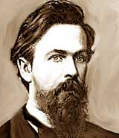
History
The origin of Markov chains is due to Markov, a Russian mathematician who first published in the Imperial Academy of Sciences in St. Petersburg in 1907, a paper studying the statistical behavior of the letters in Onegin, a well known poem of Pushkin.

Slide 4
A Markov Chain

Slide 5
Transition Probability Table

Slide 6
Example 1:
Weather Forecasting^{[1]}

Slide 7
Weather Forecasting
Weather forecasting example:
  Suppose tomorrow’s weather depends on today’s weather only.
  We call it an Order-1 Markov Chain, as the transition function depends on the current state only.
  Given today is sunny, what is the probability that the coming days are sunny, rainy, cloudy, cloudy, sunny ?
  Obviously, the answer is : (0.5)(0.4)(0.3)(0.5) (0.2) = 0.0054
0.1
0.5
0.4
sunny
0.4
rainy
0.3
cloudy
0.3
0.3
0.5
0.2

Slide 8
Weather Forecasting
Weather forecasting example:
  Given today is sunny, what is the probability that it will be rainy 4 days later?
  We only knows the start state, the final state and the input length = 4
  There are a number of possible combinations of states in between.
0.1
0.5
0.4
sunny
0.4
rainy
0.3
cloudy
0.3
0.3
0.5
0.2

Slide 9
Weather Forecasting
Weather forecasting example:
  Chapman-Kolmogorov Equation:
  Transition Matrix:
s
r
c
s
r
c
0.1
0.5
0.4
sunny
0.4
rainy
0.3
cloudy
0.3
0.3
0.5
0.2

Slide 10
Weather Forecasting
Weather forecasting example:
  Two days:
  Four days:
(00 x 01) + (01 x 11) + (02 x 21) → 01
0.1
0.5
0.4
sunny
0.4
rainy
0.3
cloudy
0.3
0.3
0.5
0.2

Slide 11
Weather Forecasting
Weather forecasting example:
  What is the probability that today is cloudy?
  There are infinite number of days before today.
  It is equivalent to ask the probability after infinite number of days.
  We do not care the “start state” as it brings little effect when there are infinite number of states.
  We call it the “Limiting probability” when the machine becomes steady.
0.1
0.5
0.4
sunny
0.4
rainy
0.3
cloudy
0.3
0.3
0.5
0.2

Slide 12
Weather Forecasting
Weather forecasting example:
  Since the start state is “don’t care”, instead of forming a 2-D matrix, the limiting probability is express a a single row matrix :
  Since the machine is steady, the limiting probability does not change even it goes one more step.
0.1
0.5
0.4
sunny
0.4
rainy
0.3
cloudy
0.3
0.3
0.5
0.2

Slide 13
Weather Forecasting
Weather forecasting example:
  So the limiting probability can be computed by:
  We have ➔ probability that today is cloudy =
0.1
0.5
0.4
sunny
0.4
rainy
0.3
cloudy
0.3
0.3
0.5
0.2

Slide 14
Example 2:
Enrollment Assessment ^{[1]}

Slide 15
Undergraduate Enrollment Model
Stop Out
Freshmen
Sophomore
Junior
Senior
Graduate

Slide 16
State Transition Probabilities
 |  |  | Fr | So | Jr | Sr | S/O | Gr
 |  | Fr | .2 | .65 | 0 | 0 | .14 | .01
 |  | So | 0 | .25 | .6 | 0 | .13 | .02
TP | = | Jr | 0 | 0 | .3 | .55 | .12 | .03
 |  | Sr | 0 | 0 | 0 | .4 | .05 | .55
 |  | S/O | 0.1 | 0.1 | 0.4 | 0.1 | 0.3 | 0
 |  | Gr | 0 | 0 | 0 | 0 | 0 | 1

Slide 17
Enrollment Assessment
Stop Out
Freshmen
Sophomore
Junior
Senior
Graduate
 |  |  | Fr | So | Jr | Sr | S/O | Gr
 |  | Fr | .2 | .65 | 0 | 0 | .14 | .01
 |  | So | 0 | .25 | .6 | 0 | .13 | .02
TP | = | Jr | 0 | 0 | .3 | .55 | .12 | .03
 |  | Sr | 0 | 0 | 0 | .4 | .05 | .55
 |  | S/O | 0.1 | 0.1 | 0.4 | 0.1 | 0.3 | 0
 |  | Gr | 0 | 0 | 0 | 0 | 0 | 1
Given:
Transition probability table & Initial enrollment estimation,
we can estimate the number of students at each time point

Slide 18
Example 3:
Sequence Generation^{[3]}

Slide 19
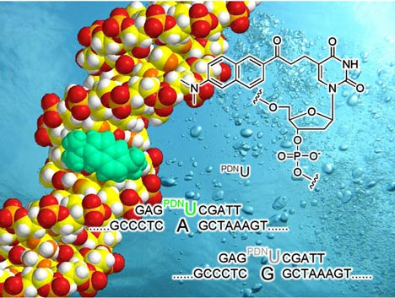
Sequence Generation

Slide 20
Markov Chains as Models of
Sequence Generation
0th-order
1st-order
1th-order
2
2nd-order

Slide 21
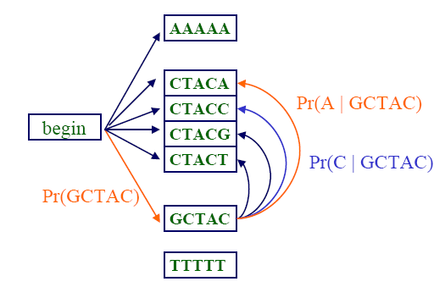
A Fifth Order Markov Chain

Slide 22
Example 4:
Rank the web page

Slide 23
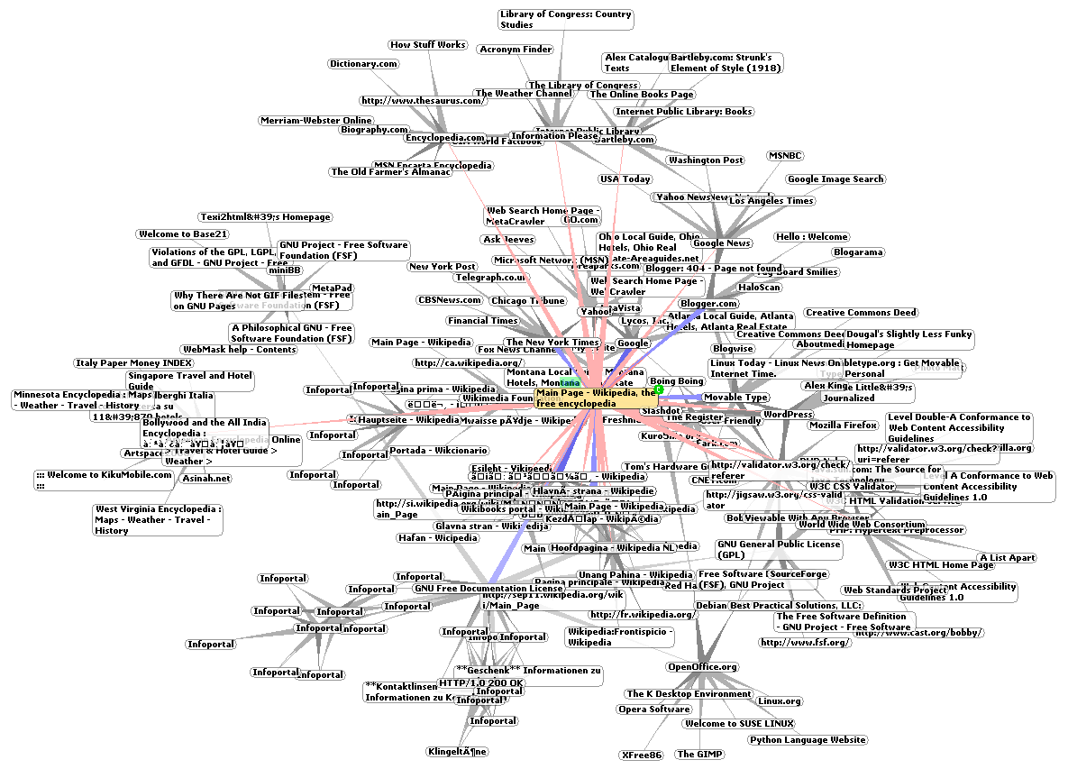
PageRank
How to rank the importance of web pages?

Slide 24
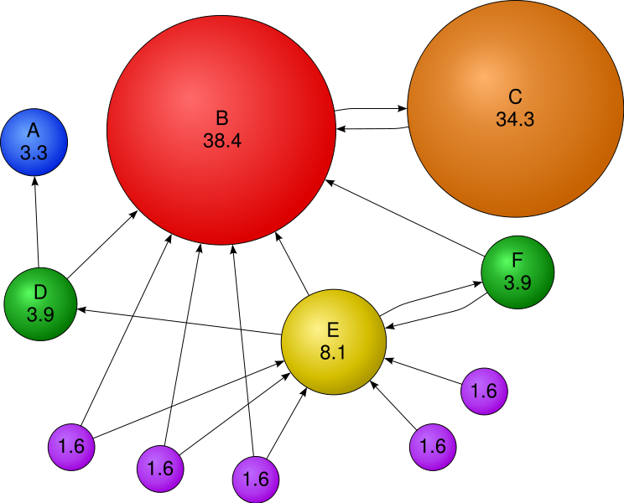
PageRank
http://en.wikipedia.org/wiki/Image:PageRanks-Example.svg

Slide 25
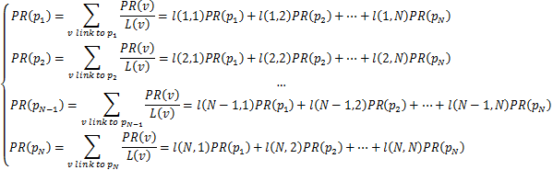

PageRank: Markov Chain
For N pages, say p1,…,pN
Write the Equation to compute PageRank as:
where l(i,j) is define to be:

Slide 26
PageRank: Markov Chain
Written in Matrix Form:

Slide 27
Example 5:
Life Cycle Analysis^{[4]}

Slide 28
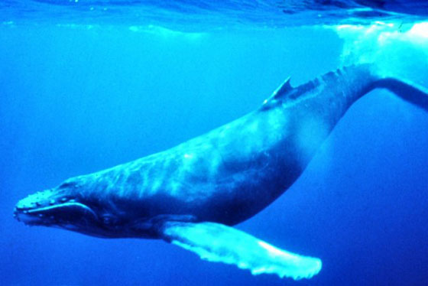
How to model life cycles of Whales?
http://www.specieslist.com/images/external/Humpback_Whale_underwater.jpg

Slide 29
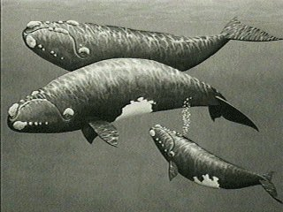
Life cycle analysis
In real application, we need to specify or learn the transition probability table
calf
immature
mature
mom
Post-mom
dead

Slide 30
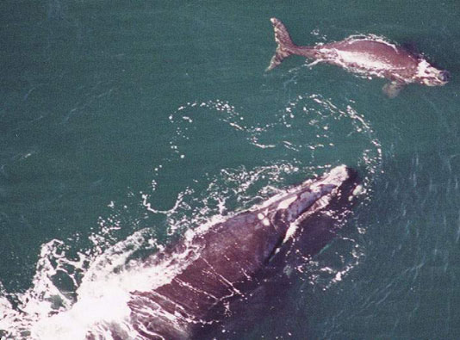
Application: The North Atlantic right whale
(Eubalaena glacialis)
Notes:
This is the north atlantic right whale; a mother and calf

Slide 31
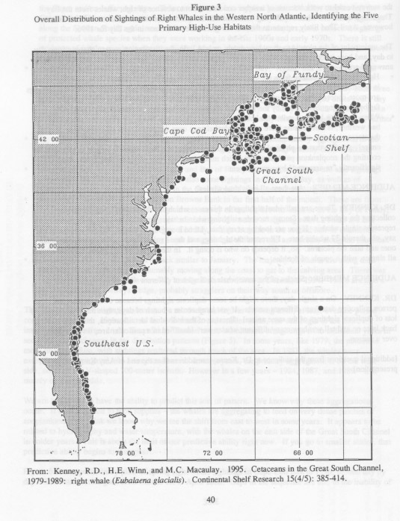
Endangered, by any standard
N < 300 individuals
Minimal recovery since 1935
Ship strikes
Entanglement with fishing gear
feeding
calving
Notes:
The right whale is distributed

Slide 32
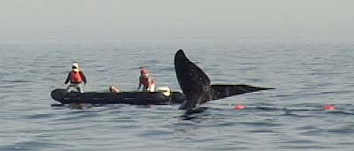
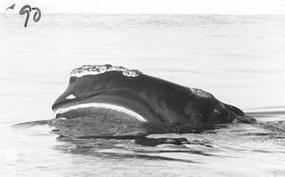
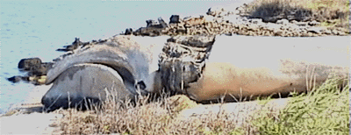
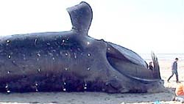
Mortality and serious injury
due to entanglement and ship strikes
2030: died October 1999
entanglement
1014 “Staccato” died April 1999 ship strike
Notes:
This is not unreasonable;
Every year several whales are killed by ship strikes or entanglement in fishing gear

Slide 33
0.96
time trend
best model
0.94
0.92
0.9
Calf survival
0.88
0.86
0.84
0.82
1980
1984
1988
1992
1996
Year

Slide 34
1
time trend
best model
0.95
0.9
0.85
0.8
Mother survival
0.75
0.7
0.65
0.6
1980
1984
1988
1992
1996
Year

Slide 35
0.5
time trend
best model
0.45
0.4
0.35
0.3
Birth probability
0.25
0.2
0.15
0.1
1980
1984
1988
1992
1996
Year

Slide 36
70
period
60
Things don’t look good for the right whale!
50
40
Life expectancy
30
20
10
1980
1982
1984
1986
1988
1990
1992
1994
1996
1998
Year

Slide 37
Summary
Markov Chains: state transition model
Some applications
  Natural Language Modeling
  Weather forecasting
  Enrollment assessment
  Sequence generation
  Rank the web page
  Life cycle analysis
  etc (Hopefully you will find more ☺ )

Slide 38
Thank you
Q&A

Slide 39
Reference
[1] http://adammikeal.org/courses/compute/presentations/Markov_model.ppt
[2] http://uaps.ucf.edu/doc/AIR2006MarkovChain051806.ppt
[3]http://germain.umemat.maine.edu/faculty/khalil/courses/MAT500/JGraber/genes2007.ppt
[4] http://www.csc2.ncsu.edu/conferences/nsmc/MAM2006/caswell.ppt

