Slide 1
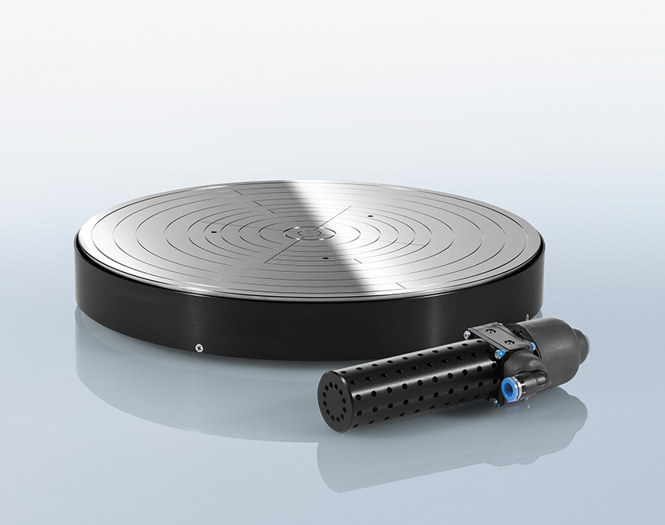

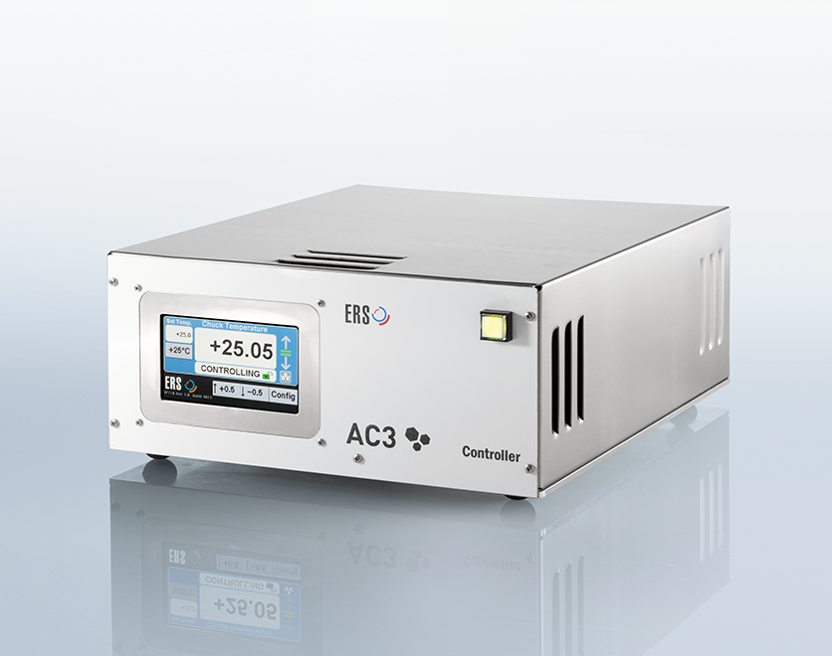
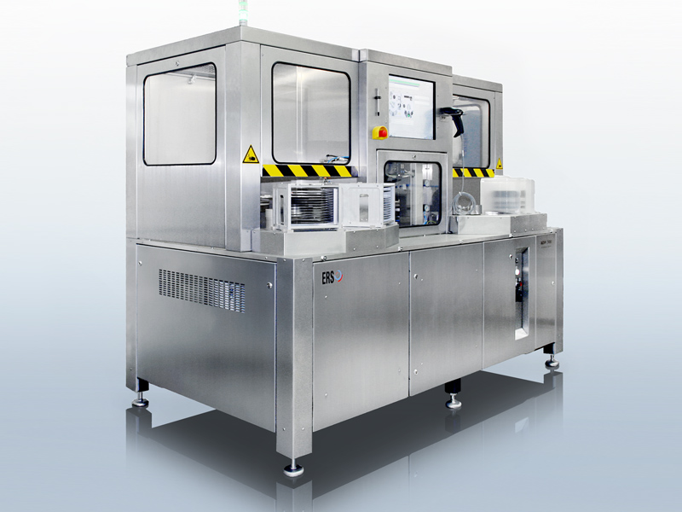
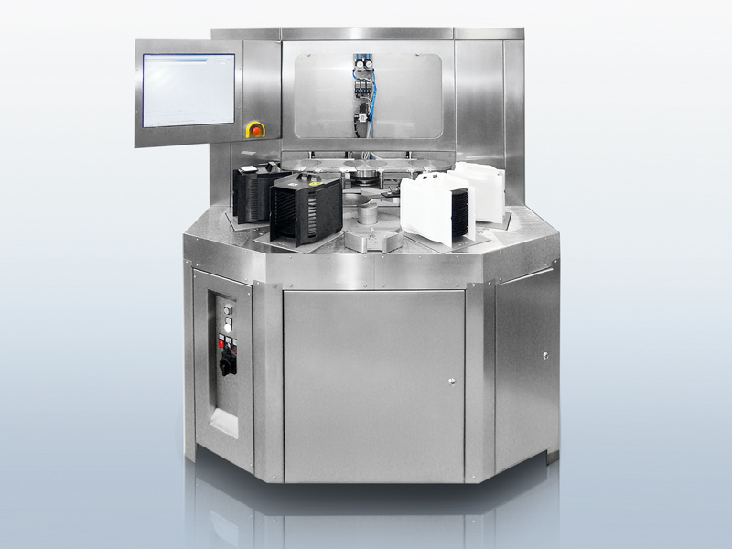
Innovation is in our lifeblood

Slide 2

EndtestData Data Entry Program
By Austin Ibele

Slide 3
Agenda
Why
Use

Slide 4
Why
Quality of Documents we give our customer
Stop accidental out-of-spec values
Collect data on product quality
Document bad parts, errors in drawings, etc

Slide 5
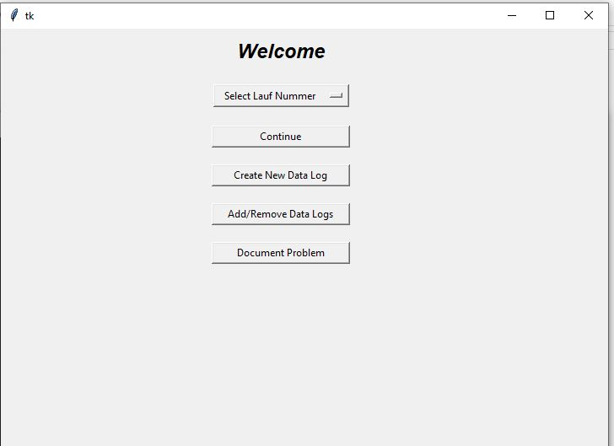
Start Page
Choose LF to enter data for
Continue to data entry pages
Add LF to program (first step)
Add/remove LFs from “active list” of LFs
Document problems with parts, instructions, etc
Notes:
Need to finish doing this..

Slide 6
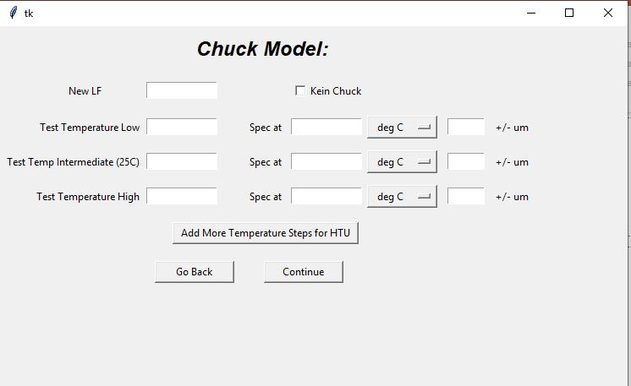
“Create New Data Log”
1. Enter Lauf Number and test temperatures
(able to add up to 6 temperatures for HTU)
2. Press Continue
Seriernnummern spreadsheet is searched for
LF number
Specifications are then automatically added
Specifications able to be changed for now, but
errors should be corrected in spec spread sheet
(more on this later)
3. Press save

Slide 7
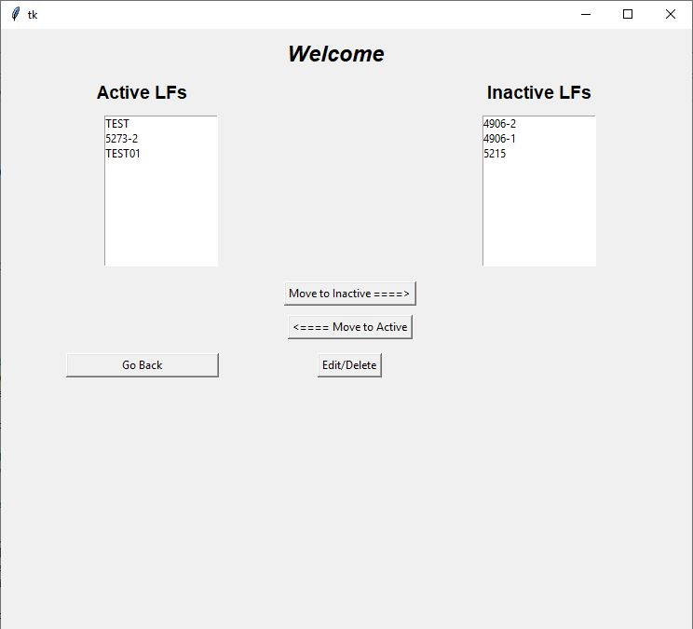
“Add/Remove Datalogs” / EditList Class
Only “Active LFs” are shown on the drop down menu
“Move to Inactive” after an order has shipped
Use “Edit/Delete” to delete and recreate an LF if needed
- I.e. If you want to remake an LF, you need to delete it first

Slide 8
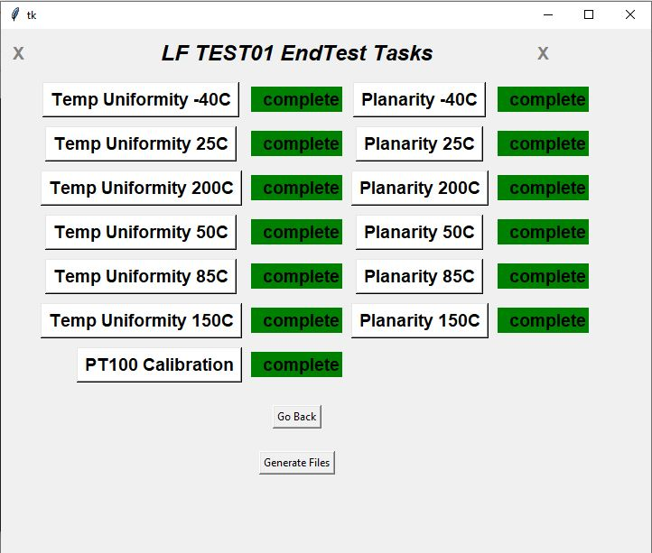
“Continue”
After selecting LF number and pressing “continue,” you
come to this page

Slide 9
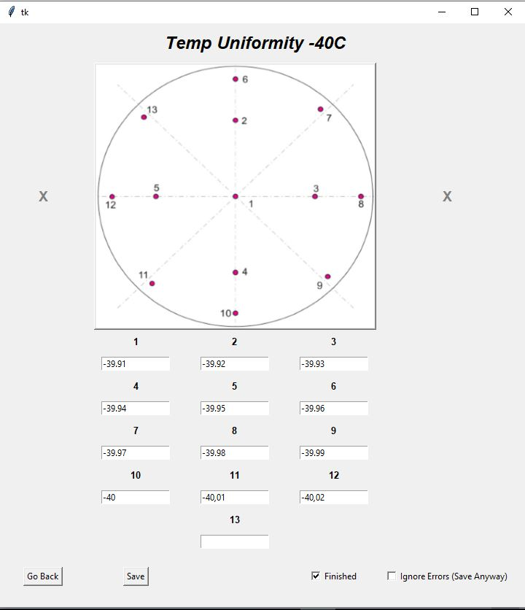
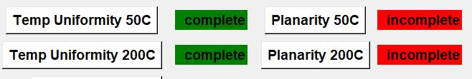
Data Entry
Enter data
Press save
Checked to make sure in spec, and to make sure all
values are entered
Check “Finish” before save
Updates the color in the manager from red to
green
“Ignore Errors” allows you to ignore errors and save anyway

Slide 10
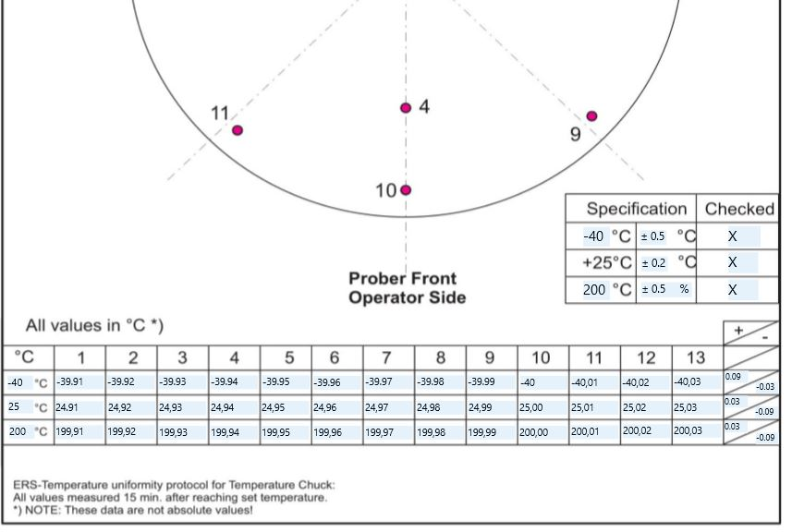
Generating Files (Master/End Test Only)
- After data entry is complete, create documents
by pressing “Generate Files”
- Chuck Department version of program does not
generate files
Files at : R:\Endtest\10_Dokumente\XXXX_ERSXXXX

Slide 11
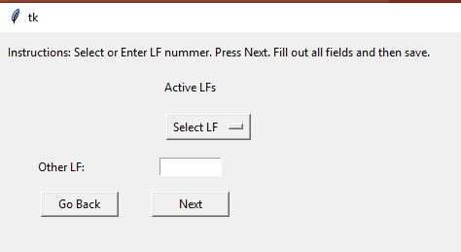
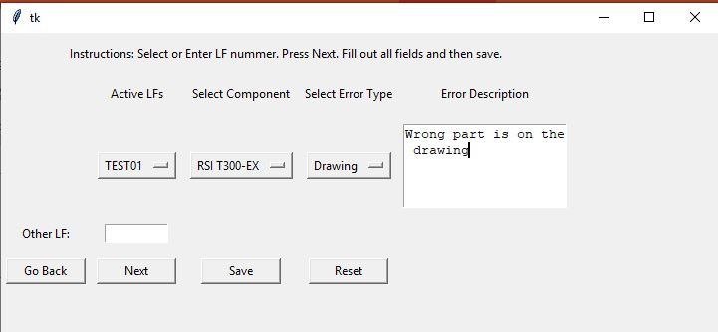
“Document problem”
Select LF from list, or enter the LF if not in the list
Press Next
Select component, error type, and type a description
Press save
If you change the LF after selecting, you must press reset first

Slide 12

Contact us
Interested in learning more? Contact us:
E-Mail: info@ers-gmbh.de
Web site: www.ers-gmbh.com
Telephone: +49 8989 4132-0
Follow us on social media:
Twitter: @ers_gmbh
LinkedIn: https://de.linkedin.com/company/ers-electronic-gmbh
Press contact: Miguel Resendiz
E-Mail: m.resendiz@ers-gmbh.de
Telephone/Mobile: +49 8989 4132-143

Slide 13

Thank You

