Slide 1


DM3D Project Proposal
G12
Abdelmounaim Salouani

Slide 2
Project Idea
Create, on user definition, a 3d model of a smartphone.
The user will act as a designer who choose the layout and dimensions of the phone
All this in a user friendly GUI app

Slide 3
Objectives
Create a little complex model from regular shapes (cube, polyhedron…)
Create an interactive GUI for user input
Storing the result properties in an obj file
Additional: python script to create the model in blender

Slide 4
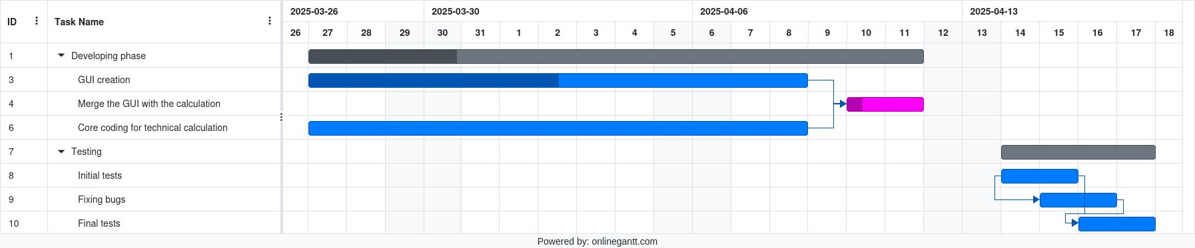
Time Plan

Slide 5
Tools
Python and libraries (to be determinated later)
Softwares: meshLab, Blender

Slide 6
That’s it!

