Slide 1

LEAP Initialisation
Modellers Meeting
Purpose: explain the structure and workflow, not full training.
Notes:
The goal today is not to train everyone to initialise a LEAP area from start to finish. The goal is to explain what initialisation is, why the structure looks the way it does, and what modellers should understand before working with the model.

Slide 2
Related resources:
Github: https://github.com/asia-pacific-energy-research-centre
Guides and notes: e.g. LEAP initialisation guide.docx
Leap clean slate models

Slide 3
PURPOSE
02
Setting the scene
These are the major steps. Initialisation creates the working starting point for each economy.
Clean slate
area
Initialised
area
Working
area
Final results
Model structure and development
Branch imports
Import workbooks
Settings/rules
Reconciliation
Assumptions
Researcher work
Iteration
Visualisations
Report writing
The initialised model is a structured starting point, not a final scenario result.
Notes:
Initialisation creates a detailed, reusable, ESTO-aligned starting point for each economy's LEAP model. It sets up the major structure, placeholder branches, transformation and supply systems, base-year estimates, and projection-year estimates before detailed demand models and power modelling are fully imported.
Definitions
Branch import = copies LEAP structure. Workbook import = puts values/data into that structure. LEAP export workbook = tells the code what LEAP’s input structure looks like. Results export = shows what LEAP calculated after running. Baseline seed = first import workbook that gives the model enough data to calculate. Reconciliation = comparing LEAP outputs with ESTO/9th and deciding what to update.

Slide 4
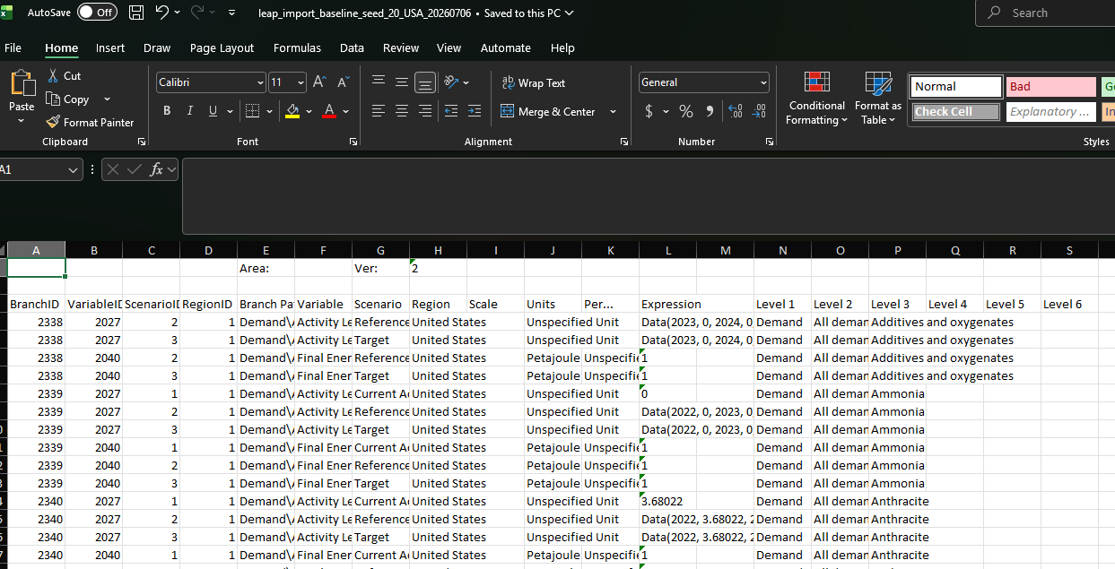
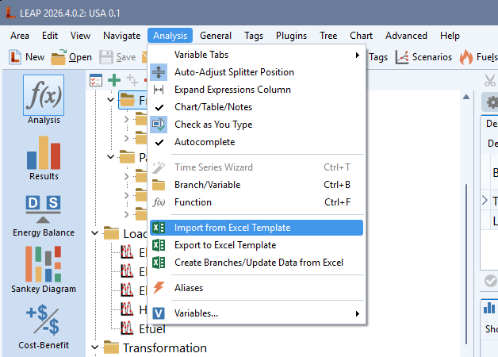
Introducing some common processes:
Import workbook
How we will input most data to LEAP

Slide 5
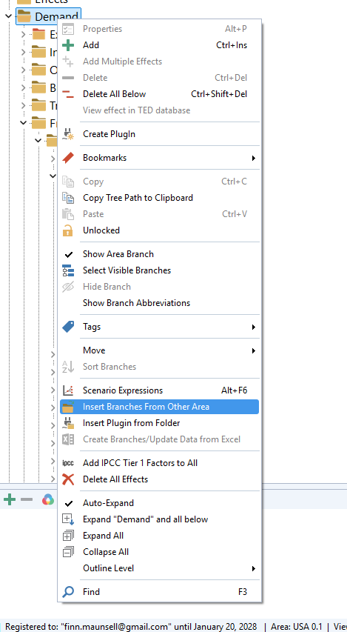
Importing model branches
The detailed model branches we are building which we will import:
Road
Transport non road
Agriculture/fishing and non specified others
Industry
Buildings
Electricity
Heat
CHP

Slide 6
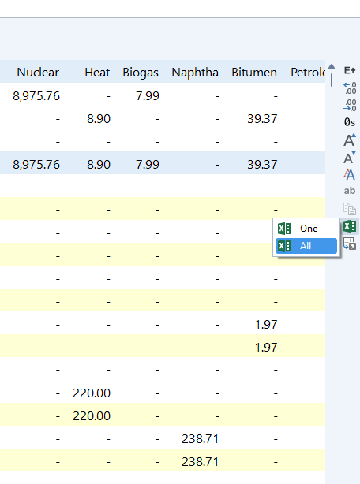
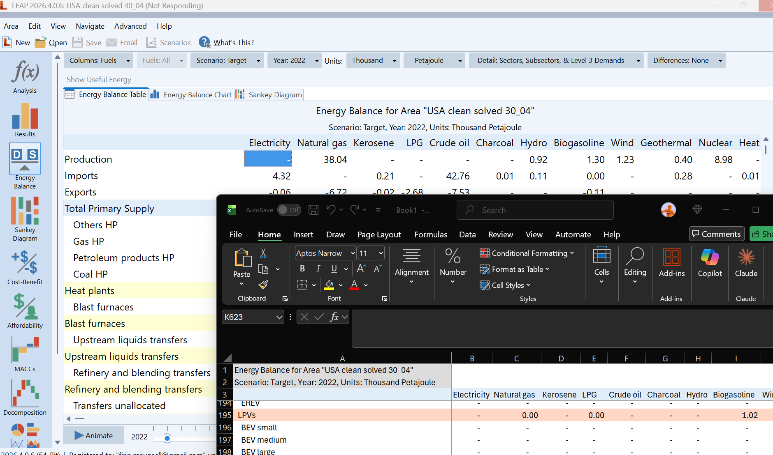
Results export
Notes:
Not to be confused with the LEAP export workbook which can be used to understand and quickly change branch paths, variables, scenarios, units, etc. before re-importing.

Slide 7
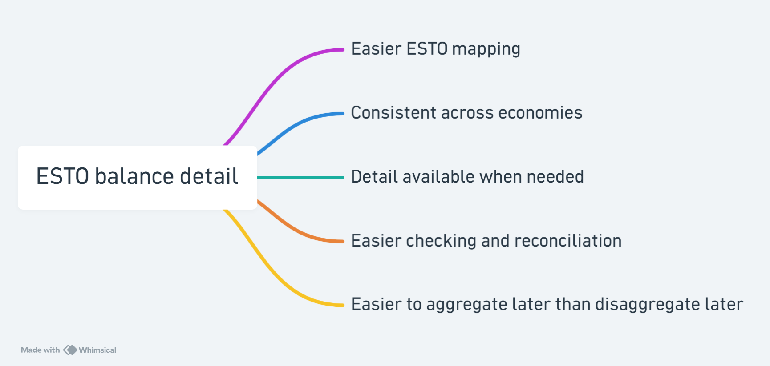
MODEL STRUCTURE
04
Why is there so much detail?
We keep as much useful ESTO balance detail as practical.
Notes:
The point is not that every detailed ESTO item needs a complicated model. The point is that preserving detail makes mapping, comparison, checking, reconciliation, consistency across economies, and future updates easier. We can always aggregate later, but reconstructing lost detail is much harder.

Slide 8
Baseline seed
mode
AUTOMATION LAYER
06
What the leap_initialisation code does:
It converts structure, mappings, and energy data into LEAP-ready workbooks.
LEAP model structure
LEAP
ESTO / 9th energy data
leap_initialisation
Baseline seed estimates
leap_initialisation
Update process
mappings
Notes:
The code uses the LEAP export workbook as a guide to branch paths, variables, scenarios, units, and workbook format. It then creates a LEAP import workbook that puts data into the right branches. The first major output is the baseline seed. Later outputs update the same structure as mappings, assumptions, sector inputs, and reconciliation improve.

Slide 9

WHOLE-SYSTEM SETUP
08
What gets initialised
Initialisation covers the connected energy system, leaving placeholders/interim branches for demand and power to replace later
Transformation
Demand
Supply
resources
Aggregated demand (placeholder)
Exports, imports, production
Power (interim) • Refining
• Other transformation
• Transfers • Losses and own use
Settings: scenarios, years, fuels, units, surplus and shortfall rules
Notes:
Initialisation prepares demand placeholder or initial sector-fuel branches, power branches, refining, other transformation modules including transfer-related modules, supply/resources, and supporting settings such as scenarios, years, fuels, units, lifecycle profiles, time slices, and yearly shapes. The key modelling logic is that demand, transformation, and supply must calculate together as a connected balance.

Slide 10
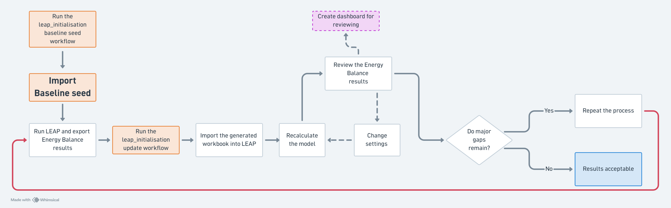
What the leap_initialisation code does:
AUTOMATION LAYER
06
Update mode
Initialisation is complete once the base year energy matches ESTO and projections match previous Outlook projections, or thereabouts(i.e. fully reconciled).
Notes:
The code uses the LEAP export workbook as a guide to branch paths, variables, scenarios, units, and workbook format. It then creates a LEAP import workbook that puts data into the right branches. The first major output is the baseline seed. Later outputs update the same structure as mappings, assumptions, sector inputs, and reconciliation improve.
When you receive an initialised model, look for strange imports, strange exports, unmet requirements, odd transformation outputs, unexpected zeroes, duplicated demand, or placeholder branches that should have been replaced.

Slide 11
TEMPORARY STRUCTURE
09
Why placeholder or interim branches exist
They let the whole system calculate before detailed sector imports are final.
Before detailed imports:
Placeholder
demand
Interim
power
Other Transformation / Supply
System can
calculate
Once detailed demand and power branches are imported:
Replace some
Delete all
Or set to zero
Detailed sector branches replace temporary placeholders or interim branches, which are used so we can do most of the initialisation before the detailed models are ready.
Notes:
Detailed demand and power models may not be ready at the same time, but LEAP still needs enough structure to calculate. Placeholder branches provide temporary values and interim branches help test whether transformation and supply can satisfy requirements. Once detailed models are imported, interim branches can be deleted, set to zero, or replaced.

Slide 12
PRACTICAL HANDOVER
11
What modellers should do next
Use the initialised area as a starting point, then check and improve it.
1
2
3
4
Finish models and replace
placeholders
Document and teach
Help with initialisation
Record
issues and fixes
Notes:
Modellers do not need to understand every technical detail immediately, but they do need to understand the structure, know the difference between branch imports and workbook imports/exports, treat the initialised model as a starting point, check whether results make sense, look for strange imports, exports, unmet requirements, or transformation outputs, record issues clearly, and replace placeholder/interim structures with detailed sector inputs when ready.

