Slide 1





ASIA PACIFIC ENERGY RESEARCH CENTRE · LEAP MODELLING SYSTEM
AN INTRODUCTION FOR RESEARCHERS
The road transport model
How APERC turns assumptions into road energy demand and how the model is prepared before it reaches LEAP.

Slide 2
01 · WHAT THE MODEL IS
It estimates road transport energy demand
The road transport model is part of the APERC LEAP modelling system. It estimates future energy demand for passenger and freight vehicles, by fuel.
WHAT IT TURNS INTO ENERGY
VEHICLES IT COVERS
The model translates assumptions about vehicle stock, sales, technology uptake, mileage and fuel economy into energy demand by fuel — for every vehicle and drive type on the road.
Passenger — cars, motorcycles and buses
Freight — light commercial vehicles and trucks
Each split further by drive type and fuel
ROAD TRANSPORT MODEL
02

Slide 3
02 · THE CORE IDEA
The model is built around one simple idea
Energy
=
Stock
×
Mileage
×
Fuel economy
vehicles on the road
distance per vehicle
energy used per kilometre
In practice the model holds many vehicle types, drive types and fuels — but the logic stays this simple. You don't need to follow every internal calculation to use it confidently.
ROAD TRANSPORT MODEL
03

Slide 4
03 · WHAT THE MODEL ASKS
At a high level, it answers four questions
1
How many vehicles are on the road
2
What kinds of vehicles they are
3
How quickly older vehicles are replaced
4
What fuels and technologies new vehicles use
ROAD TRANSPORT MODEL
04

Slide 5
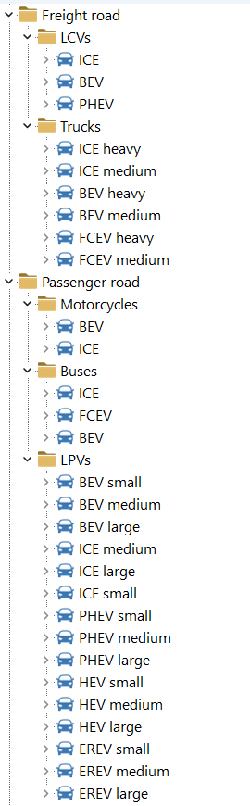
04 · WHAT THE MODEL COVERS
Every vehicle, drive and fuel has its own branch
The road branch divides into passenger road and freight road . Each path is split by drive type and fuel, so every leaf carries its own stock, mileage, fuel economy and energy. Detail is concentrated where it earns its place:
cars carry the most branches, as they are usually the largest part of the fleet and they are where we have the best data
PASSENGER
FREIGHT
Cars · motorcycles · buses
Light commercial vehicles · trucks
DRIVE TYPES
ENDS IN A FUEL
ICE · hybrid · plug-in · battery · fuel cell
Petrol · diesel · electricity · hydrogen · more
ROAD TRANSPORT MODEL
05

Slide 6
05 · WHY TURNOVER MATTERS
A new technology reaches the road slowly
Sales shares describe new vehicles, not the whole fleet. The fleet changes only as older vehicles retire — so an assumption can take years to show up in energy demand.
WHY IT MATTERS
An 80% electric sales share
Turnover sets the speed of change . A young, long-lived fleet turns over slowly; an older fleet — or one retired faster by policy — turns over more quickly.
is not an 80% electric fleet.
It means 80% of new vehicles are electric. The share on the road rises only gradually, as today's vehicles reach the end of their life.
This is why survival profiles, the age of today's fleet and the sales trajectory are prepared together: they set the pace at which any scenario takes effect.
ROAD TRANSPORT MODEL
06

Slide 7
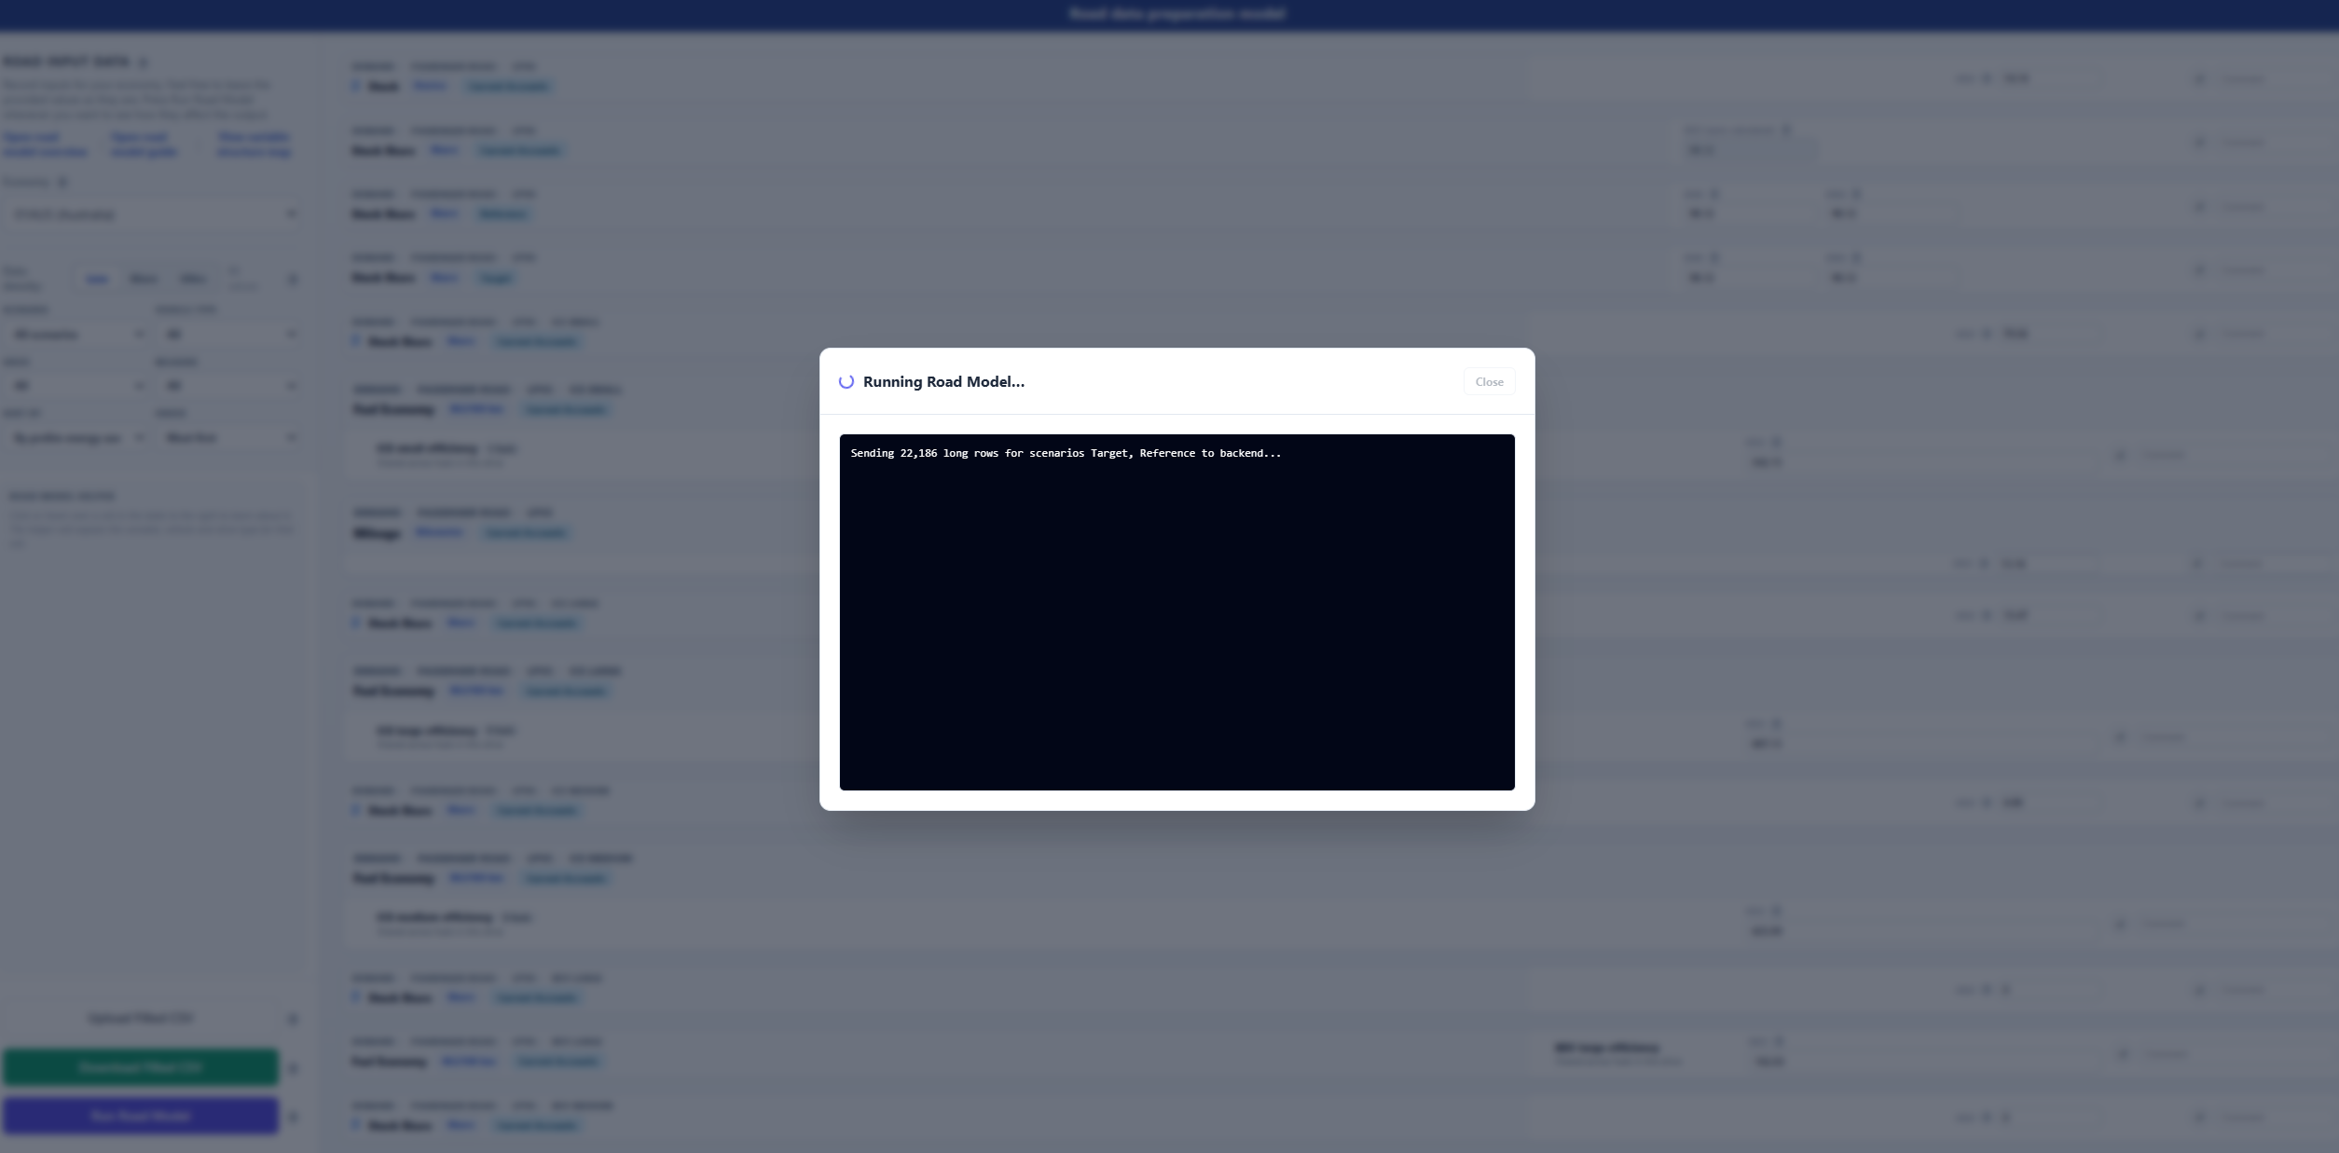
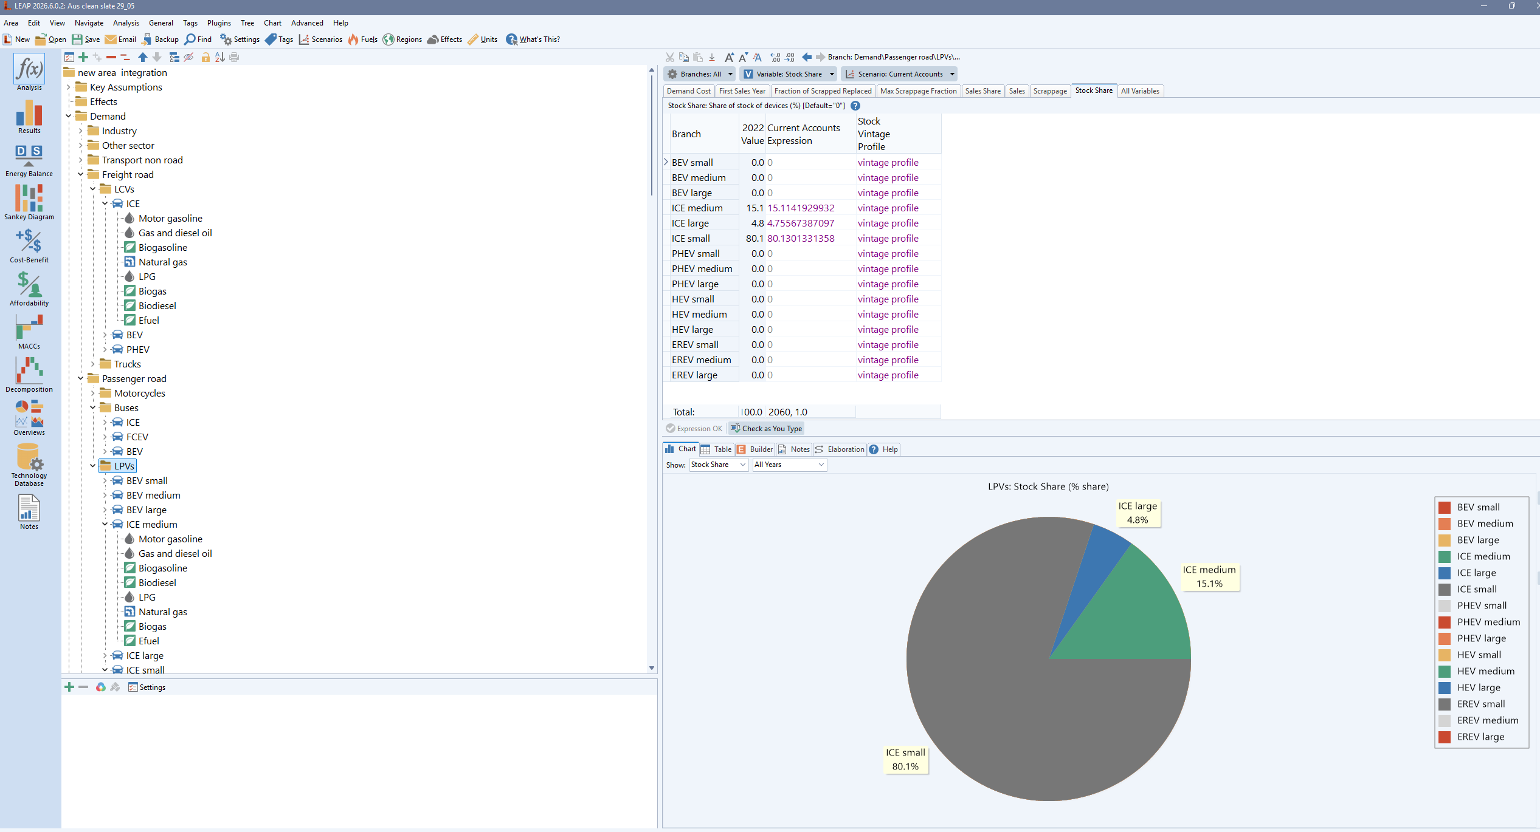
06 · HOW THE WORK IS SPLIT
A large part of the model is prepared before LEAP
The workflow begins outside LEAP. This is more than data preparation: stock, sales, retirements and energy have to stay internally consistent, so they are built together first.
PREPARED OUTSIDE LEAP
PROJECTED IN LEAP
A browser interface and a Python workflow
The official projection platform
Researchers review and update the main assumptions in one place; the Python workflow then turns them into a calibrated, LEAP-ready set of inputs and runs quality checks.
Once the prepared inputs are imported, LEAP runs the official road transport projection as part of the wider APERC energy system model.
ROAD TRANSPORT MODEL
07

Slide 8
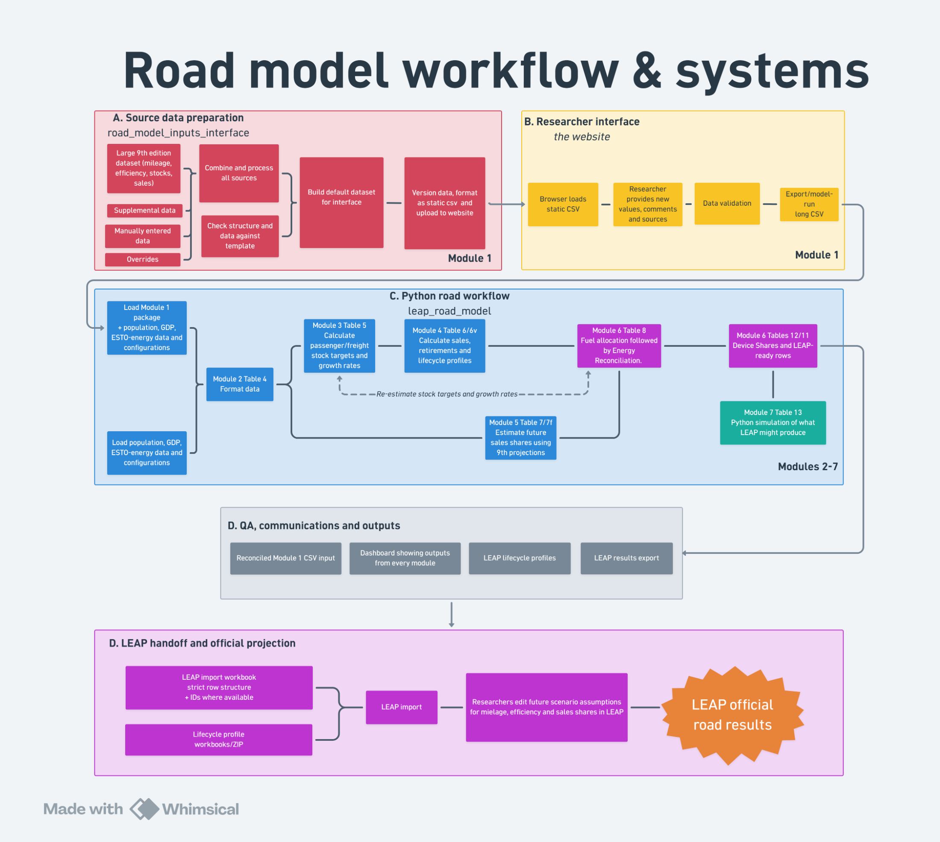
07 · THE END-TO-END WORKFLOW

Slide 9
08 · THE RESEARCHER INTERFACE
One place to review, update and document inputs
A browser-based interface gives users a single view of the main assumptions. The inputs fall into three groups.
GROUP 01
GROUP 02
GROUP 03
Base-year evidence
Projection assumptions
LEAP-adjustable variables
Estimates of stock, mileage and fuel economy — plus reconciliation settings such as weights, bounds and adjustment rules that align the data with ESTO energy balances.
Structural assumptions not meant to be edited in LEAP — the stock and sales trajectory, vehicle-type shares, survival and vintage profiles, freight growth and PHEV utilisation.
Variables that may later be tuned in LEAP — technology sales shares, mileage and fuel-economy factors, fuel or device shares — can be pre-set and tested here first.
ROAD TRANSPORT MODEL
09

Slide 10
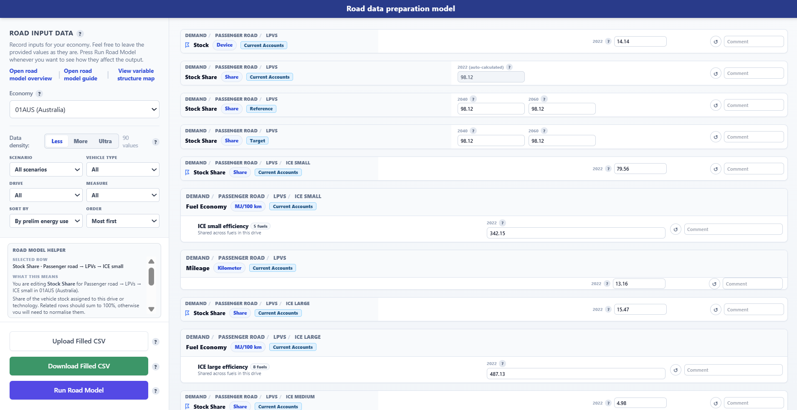
09 · THE INTERFACE, IN PRACTICE
What a researcher actually sees
Pick an economy, then run. Every field opens pre-filled with a sensible default — leave it as is, or override it.
Less · More · Ultra. Density sets how many values appear — start with the few that matter, reveal the rest only if you want them. If you want more detail, let me know
A helper explains each row. Select any input and it tells you, in plain language, what it means and what it affects.
Run Road Model. See how a change moves stock, sales and energy before anything reaches LEAP. Iterate until you are happy
ROAD TRANSPORT MODEL
10

Slide 11
10 · THE PYTHON WORKFLOW
It turns the inputs into a LEAP-ready package
The Python workflow converts the prepared inputs into the structure LEAP expects — and helps users check their assumptions before the full model runs.
Converts inputs into the structure LEAP expects
A SUPPORT TOOL AROUND LEAP
The pre-LEAP checks are not the official projection. They help users see whether their assumptions produce sensible stock, sales, retirement and energy outcomes before the full LEAP model is run.
Creates the import workbooks for LEAP
Runs optional checks and simplified pre-LEAP simulations
ROAD TRANSPORT MODEL
11

Slide 12
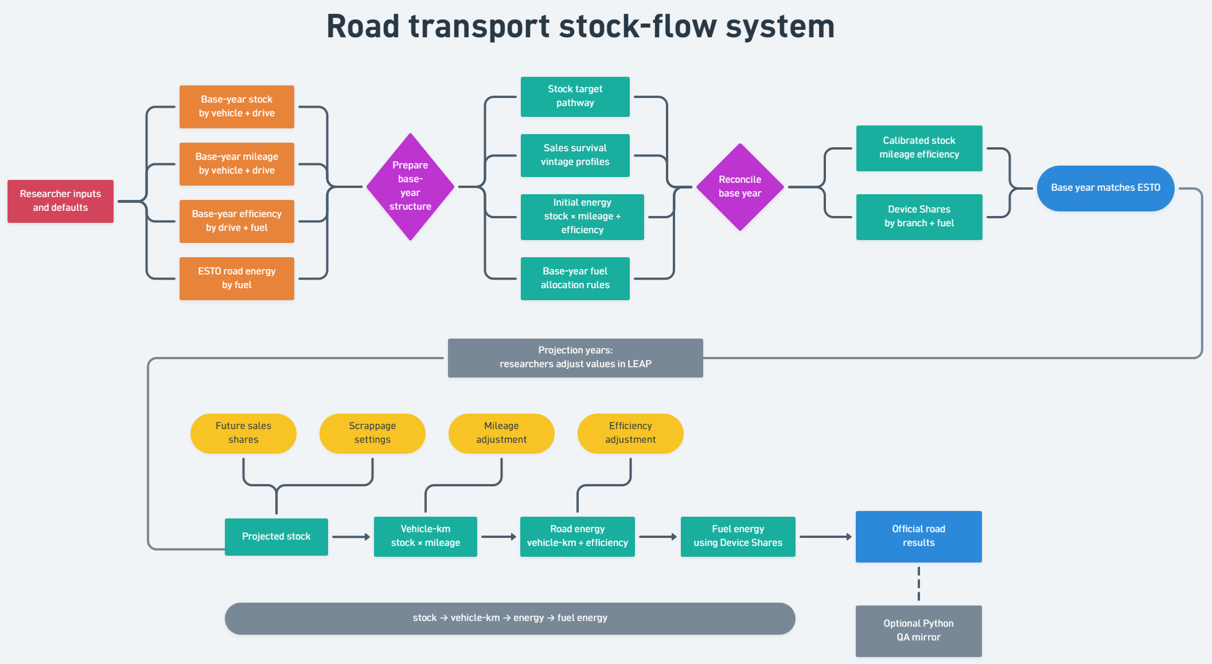
11 · THE STOCK-FLOW SYSTEM

Slide 13
12 · HOW THE FLEET IS PROJECTED
Passenger and freight are projected differently — on purpose
Before anything else, the model sets a target for how many vehicles are on the road. Passenger and freight follow different logic because different forces drive them.
PASSENGER · OWNERSHIP THAT SATURATES
FREIGHT · TIED TO THE ECONOMY
Vehicles grow with income, then level off
Stock grows with GDP, through an elasticity
Ownership rises with GDP per capita, but growth fades as the economy nears a long-run saturation level — so it slows rather than rising forever.
Freight stock is linked to GDP growth: a single elasticity answers “if GDP grows 1%, how much should the freight fleet grow?”
Why vehicle-equivalents: a bus moves far more people than a car, so vehicles are weighted before projecting — one bus is not counted like one car.
Why kept simpler: freight data are usually weaker, so a transparent, reviewable elasticity is preferred over a heavier tonne-kilometre model.
ROAD TRANSPORT MODEL
13

Slide 14
13 · WHERE EACH ASSUMPTION LIVES
Prepared before LEAP, or adjusted inside it
PREPARED BEFORE LEAP — STRUCTURAL
ADJUSTED IN LEAP — SCENARIO
Road stock & sales trajectory
Vehicle-type shares — cars, motorcycles, buses, trucks
Survival & vintage profiles
Freight stock-growth & elasticity
PHEV utilisation shares
Base-year stock, mileage & fuel economy
Reconciliation weights, bounds & rules
Technology sales shares — ICE, BEV, PHEV, FCEV
Mileage adjustment factors
Fuel-economy adjustment factors
Fuel or device shares — avoid adjusting PHEV utilization shares
Scrappage & accelerated retirement — still needs testing
Be careful not to adjust pre-leap variables within LEAP!
ROAD TRANSPORT MODEL
14

Slide 15
14 · STAYING CONSISTENT WITH THE DATA
The base year is calibrated to ESTO
Road transport energy in the base year should match the ESTO energy balances. The vehicle data are rarely complete or perfectly consistent, so some reconciliation is usually still needed.
If the estimated number of vehicles, their mileage and their fuel economy imply too much or too little fuel , the model adjusts within reasonable bounds — so the base year stays consistent with the observed energy totals before anything reaches LEAP.
THE PRINCIPLE
Detailed vehicle data, reconciled to the real base-year energy balance.
ROAD TRANSPORT MODEL
15

Slide 16
15 · BASE-YEAR RECONCILIATION
How a mismatch with ESTO is resolved
When the bottom-up estimate doesn’t match the ESTO total, the gap has to go somewhere. Rather than force one number, the model shares the correction across the inputs that are least certain.
STEP 01
STEP 02
STEP 03
Compare
Share the correction
Keep it plausible
Stock × mileage ÷ fuel economy gives a bottom-up estimate. It is measured against the ESTO fuel total to find the gap.
The gap is split across stock, mileage and fuel economy using reconciliation weights — more adjustment goes to the inputs you trust least.
Bounds stop any value moving too far. A gap that can’t close within bounds is flagged for review, not hidden.
This is why reconciliation weights and bounds are inputs in their own right — they tell the model where the truth is most likely to sit.
ROAD TRANSPORT MODEL
16

Slide 17
17 · IN SHORT
A bridge from transport assumptions to energy projections
INTERFACE
PYTHON WORKFLOW
LEAP
Prepare the inputs
Build & check
The official projection
Update base-year data, set reconciliation rules, prepare projection assumptions, and test the LEAP-adjustable variables.
Turn those assumptions into LEAP-ready inputs, with quality checks and a simplified pre-LEAP simulation.
LEAP produces the official road transport energy projection within the wider APERC energy system model.
Detailed where it needs to be — straightforward to use.

