Slide 1

The Environment of the Shape Grammar Processing
Author: Joanna Mirochna
Joanna.mirochna@gmail.com
Promoter: Maciej Paszynski
Department of Computer Science
AGH University of Science and Technology
Krakow, Poland

Slide 2
Outline
Introduction
Methodology
Related work
Solution
Evaluation
References

Slide 3
Introduction
Shapes Grammar is widely used in computer graphics.
The Shapes Grammar Processing Environment will be created as a tool for students, who wants to learn about the Grammar Shaper
The application will be used to present the two-dimensional Grammar Shape and allow to design them in an easy way
The main purpose of the research is to implement optimal and transparent application for Shape Grammar

Slide 4
Methodology
According to a definition of the Grammar shape is:
G = <V_{T}, V_{M}, R, I>
Where:
V_{T} - a finite set of terminal shapes
V_{M} – a finite set of no-terminal shapes
R - a set of shape rules
I – an initial shape (Components of S belongs both to V_{T} and V_{M})
Sets V_{T} and V_{M} are separable.
The Shape Grammar generate a language, which consists of shape set, created, based on the initial shape P.
Each element of such language will be a finite shape or part of the finite shape.

Slide 5
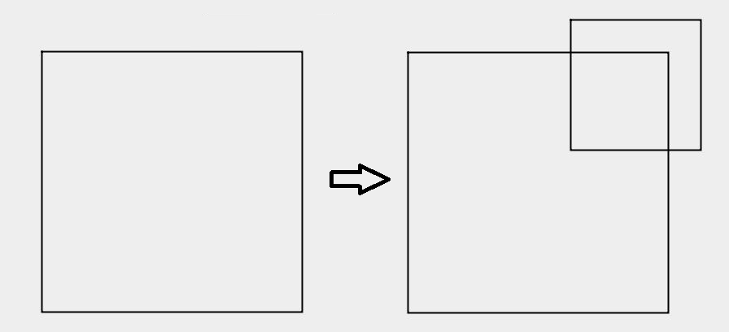
Methodology
The shape rule can be defined, by expression:
A -> B
And it consists of Left-Hand Side shape (here – A) and Right-Hand Side shape (here – B).
The rule A -> B can be applied to shape C, only when it is possible to separate a subshape of C, from A.
An example of adding rule (Own source)

Slide 6
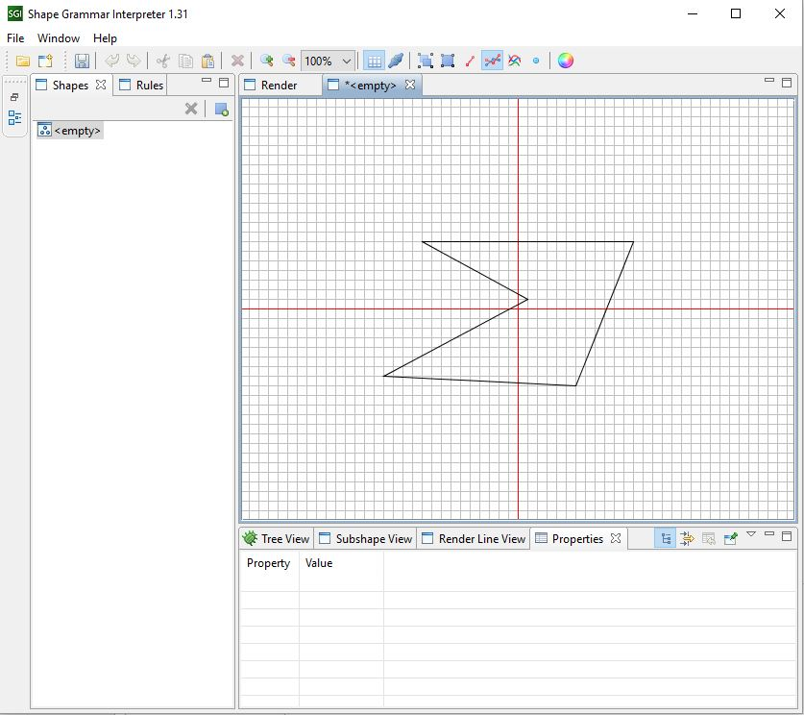
Related work
One of the already existed system for Grammar Shaper processing is Shape Grammar Interpreter.
It was released in 2011 and is compatible with Windows System.
The program has obsolete interface and is inconvenient to use.
It currently is use on labolatories, by students.
The Shape Grammar was also described in Doctoral thesis by Michał Turek.
The paper described an application, designed for three-dimensional Grammar Shape.
Screenshot of Shape Grammar Interpreter (Own source)

Slide 7
Solution
The Grammar Shaper Processing Environment will be implemented in Java language.
It will include user-friendly interface and possibility of easy defining of Grammar Shape
The Environment will deliver tree types of Grammar rules: adding, subtituting and modifying
Users of the previous, two-dimensional program - Shape Grammar Interpreter, have to provide the shape manually
The new system will allow to use standard shapes like squares or circles.

Slide 8
Evaluation
Please insert here the contents of this section
Please insert here the contents of this section
…..

Slide 9
Summary
Conclusion 1
Conclusion 2
…..

Slide 10
References
Koncepcja Kaskadowych gramatyk kształtu jako modelu przetwarzania kształtów graficznych w systemach bazujących na zastosowaniu metod półformalnych. Michał Turek. 2010
Shape grammars and the generative specification of painting and sculpture. George Stiny and James Gips. 1972.

