Slide 1




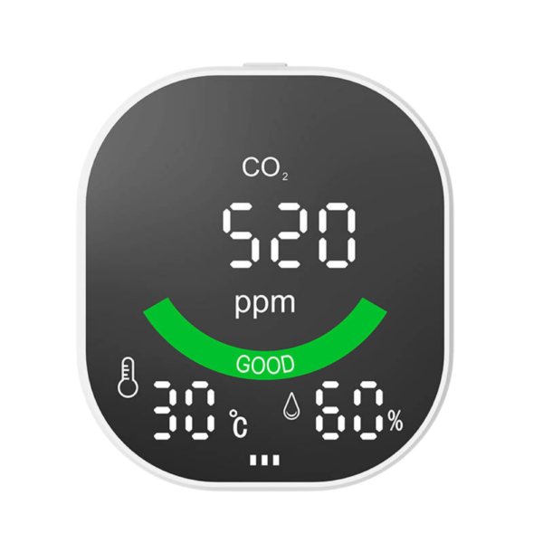





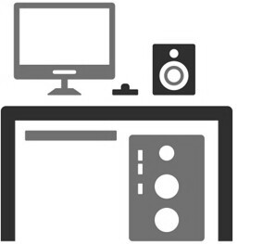



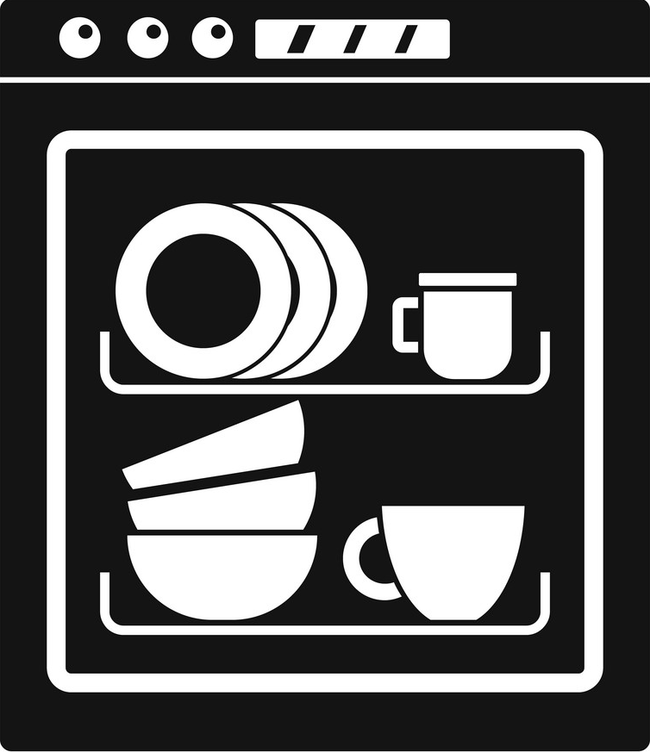



Fresh Air
Air Mixing Chamber
Supply Air
Return Air
1
1
2
1
Kitchen Zone
Bedroom Zone
3
4
2
1
2
Sensors
Activities
Actuators
Appliances
Occupancy estimation
1
Using smartphone
Supply vent
Smart Light
Refrigerator
1
1
1
3
Indoor Air Quality
2
Return vent
Dishwasher
Stove
Sleeping
2
4
Occupancy tracking
2
2
3

