Slide 1
TRIZ Basics
P. H. King, PhD, PE

Slide 2
Genrich Altshuller: born 1926, Tashkent USSR.
9th grade - patent for diving apparatus
10th grade - boat w rocket engine using carbide fuel
20 y/o - submarine escape method w/o diving gear => Navy employment, patent office
21 y/o - noxious gas - military use
studied patents, noticed trends
22 y/o letter to Stalin
24 y/o sabotage => prison 25 years

Slide 3
Altschuller, cont.
Gulag => forestry => isolation
Gulag => coal mining => "university"
continued study of patents, psychology of invention
late 20's Stalin died, released ~1.5 years later
30 y/o Psychology of Inventive Creativity (TRIZ) papers

Slide 4
Altschuller, cont.
-1960-1990 teaching/publication/studies of ~200,000 patents => 1,500 contradictions => 40 principals of invention => matrix
-1989 TRIZ association => College
-1990's on => extensions and generalities (later lectures & software package)
- ~1998 Death

Slide 5
Altshuller's Goals
systematic, step-by-step procedure
guide through a broad solution space toward an ideal solution
be repeatable and reliable and not dependent on psychological tools & motivation

Slide 6
Altshuller's Goals, cont.
be able to access the body of inventive knowledge
be able to add to the body of inventive knowledge
be familiar enough to inventors by following the general approach to problem solving

Slide 7
Level
Degree of inventiveness
% of solutions
Source of knowledge
Approximate # of solutions to consider
1
Apparent solution
32%
Personal knowledge
10
2
Minor improvement
45%
Knowledge within company
100
3
Major improvement
18%
Knowledge within the industry
1000
4
New concept
4%
Knowledge outside the industry
100,000
5
Discovery
1%
All that is knowable
1,000,000

Slide 8
Law of Ideality
All systems evolve toward an ideal
Mechanism => Fields
Single use => multiple use
Human interaction => automation
Complex => apparently simple
Maximize ratio of
- Useful/cost
- Useful/harmful
Benefit/cost

Slide 9
Contradictions
The improvement of one facet of a system involves the degradation of another facet of a system => contradiction wrt goal of the designer.
Increasing power (car/plane/etc.) involves increasing the engine size involves decrease in efficiency …
Compromise or fix?

Slide 10
Evolution of systems
life cycle: birth => growth => middle age => death
dynamization: rigid => flexible
multiplication: mono => poly
shrink: macro => micro
synchronization: => simultaneous
scale up or down: drug development
uneven part development: jet engine airplane
replacement of human effort

Slide 11
TRIZ - Basic
  ID Problem
  Restate to elaborate contradictions
  Search for previously well solved problem
  Search for analogous solutions

Slide 12
TRIZ - advanced (later)
ARIZ - algorithmic inventive problem solving
Su-Field Analysis = substance-field or object-action diagramming & investigation
Directed product evolution => ideal
Anticipatory Failure determination

Slide 13
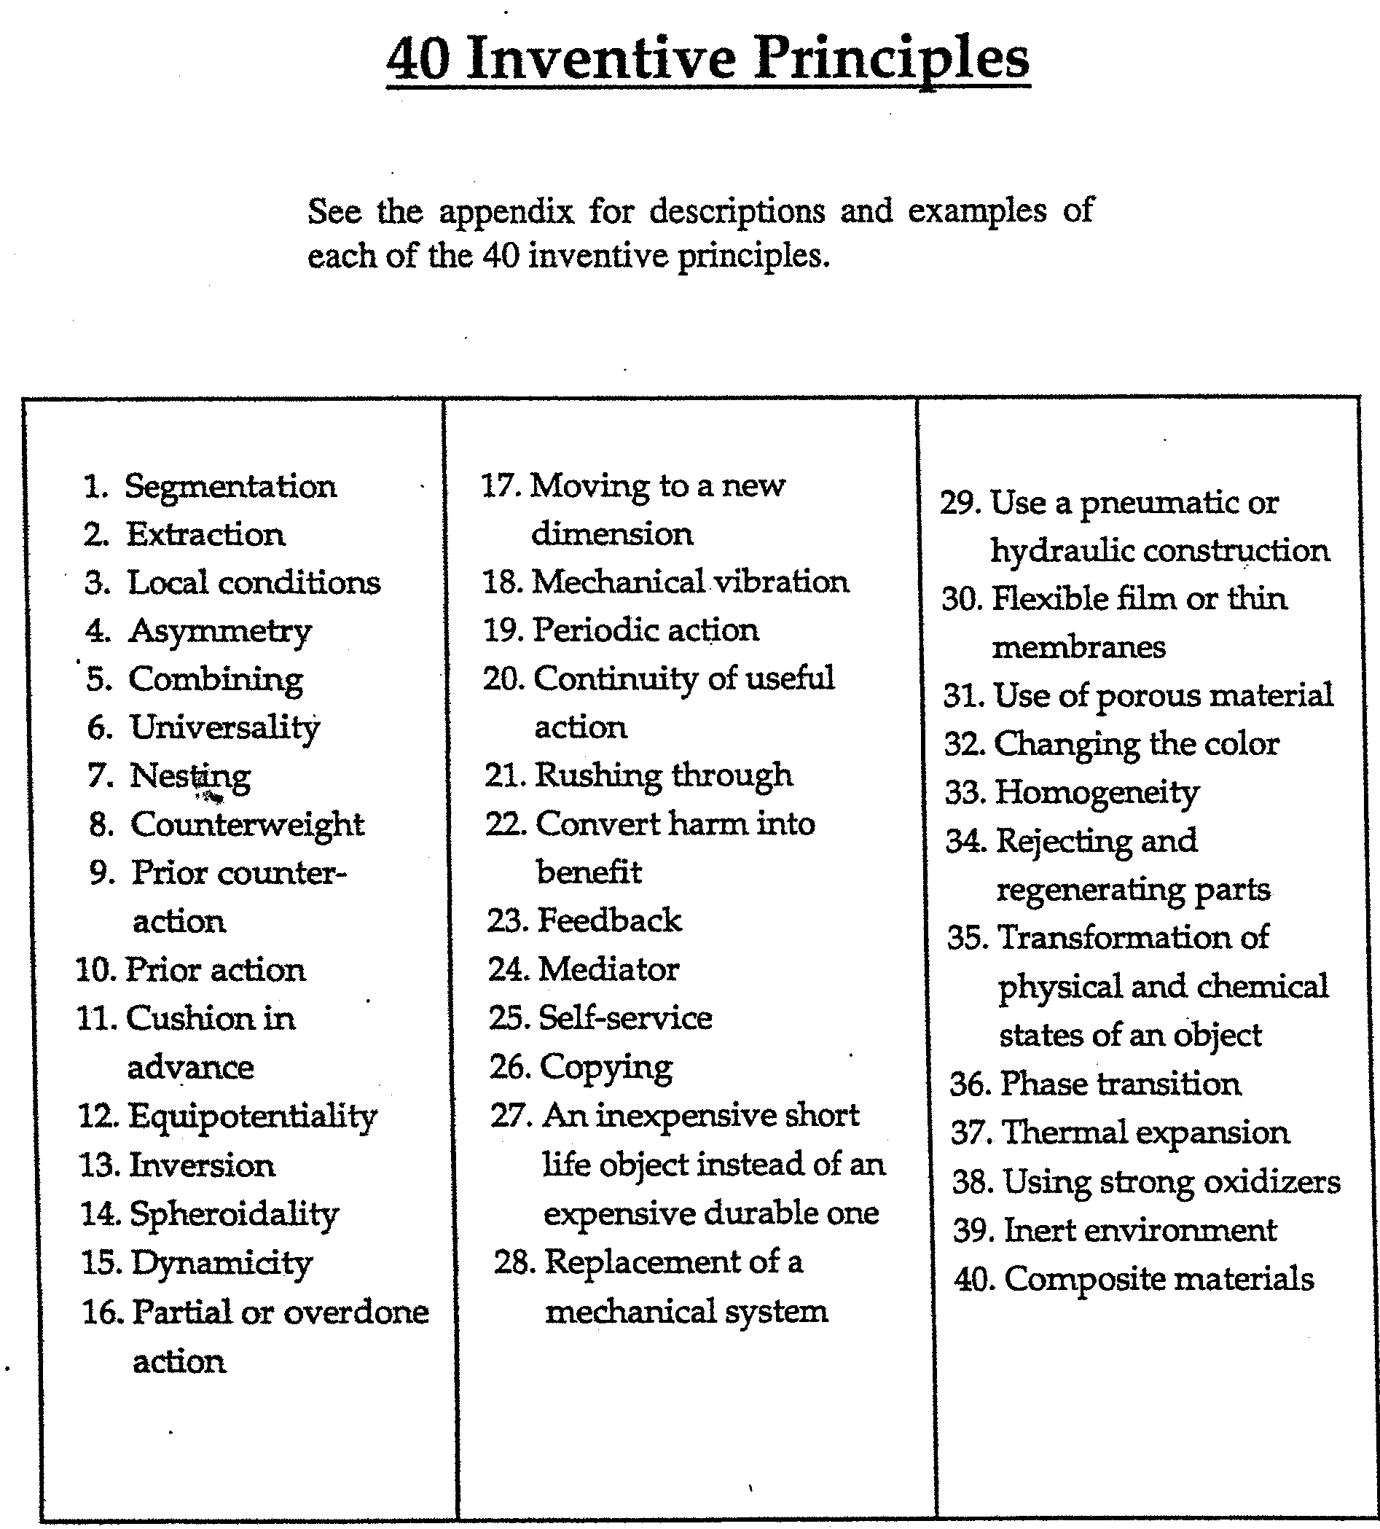

Slide 14
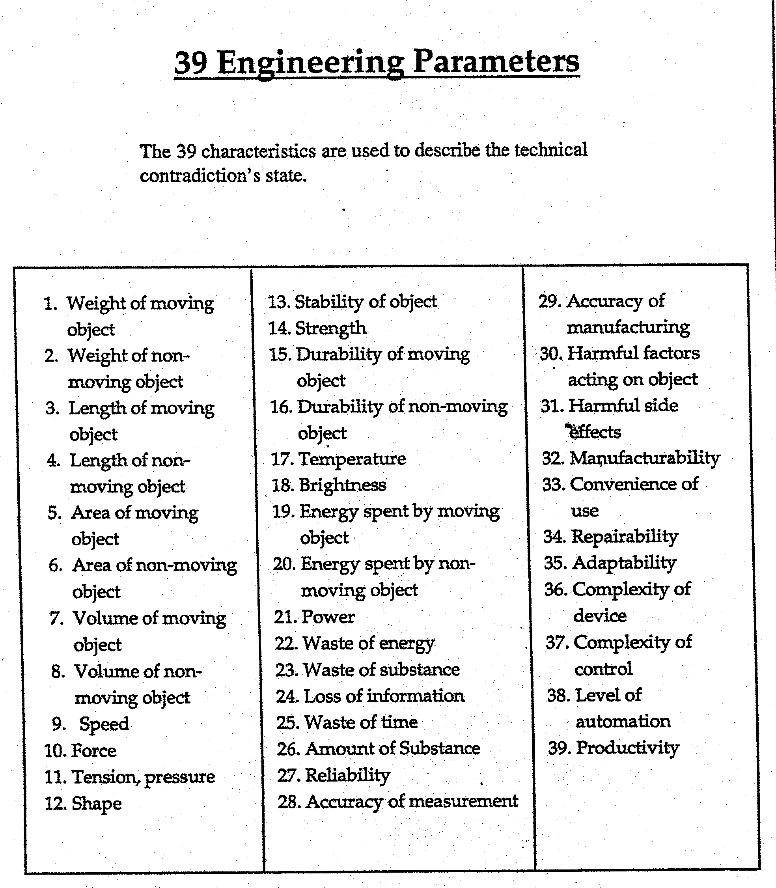

Slide 15
