Slide 1

TRIZ – Innovation
Vishwanath Ramdas

Slide 2
This presentation thanks
http://Mazur.net/triz
www.Triz-journal.com
Presentation style
  Tom Asacker
  Tom Peters

Slide 3
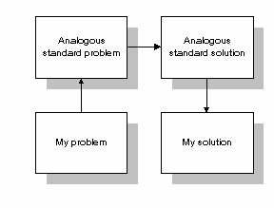
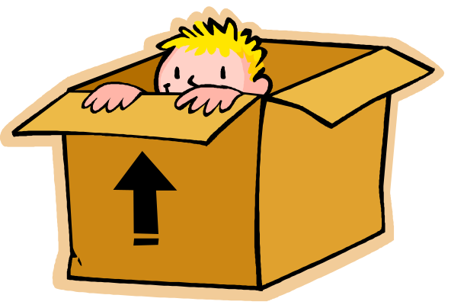
How do we think {innovate}?
Inside the Box
[ within the scheme of things }
Look for analogous solutions

Slide 4
Let us Distinguish
How do we think {innovate}?
To innovate!
Get the RIGHT answer
Question & Re-Define
Create something New
Extend What is
Solve for NOW
Get the answer RIGHT
To Solve a Problem

Slide 5
Random – Trial & Error!
How do we think {innovate}?
Brainstorming
Define
Detail
Analyze Gaps
Brain-Storm
Experiment
Implement
…
Past Experiences
Psychological Dependant
This leads to ….

Slide 6
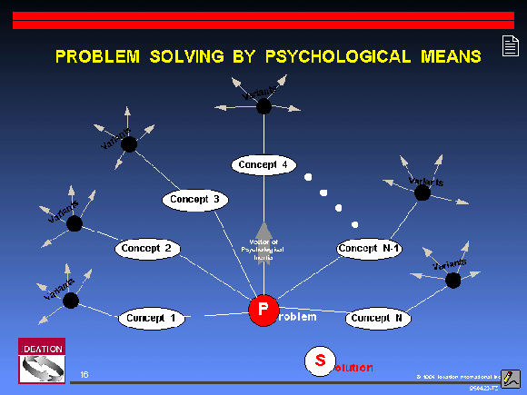
Psychologically constrained approach
How do we think {innovate}?

Slide 7

How do we think {innovate}?
inability to go beyond the current realm of knowledge
By the Individual
By the Group
Psychological inertia.

Slide 8
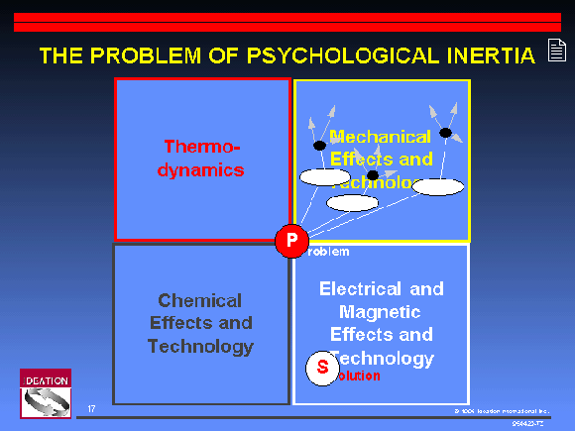
How do we think {innovate}?

Slide 9
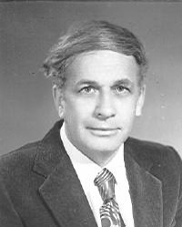
Genrich Altshuller
http://en.wikipedia.org/wiki/Genrich_Altshuller – Thank you!
October 15, 1926 - September 24, 1998
Tools
40 Inventive Principles 1946-1971,
ARIZ 1959-1985,
Separation Principles 1973-1985,
Su-Field Analysis 1973-1981,
76 Standard Solutions 1977-1985,
Natural Effects (Scientific Effects) 1970-1980,
Patterns of Evolution 1975-1980...
200K Patents – ‘69
40 Principles
Published his science fiction under the pseudonym Genrikh Altov, often in collaboration with his wife, Valentina Zhuravleva.

Slide 10
TRIZ – Theory of Innovative Problem Solving
{ Teoriya Resheniya Izobreatatelskikh Zadatch }
Founding Principle..
Be a systematic step by step procedure.
be repeatable and reliable

Slide 11
Founding Principles
TRIZ
be able to access the body of inventive knowledge
be able to add to the body of inventive knowledge
be familiar enough to inventors

Slide 12
Altshuller studied patents.
TRIZ
200 K Patents..
Found that only a small portion are true innovations
Remaining are straight forward improvements
Today it is 1.4 Million Patents..
he then classified these patents

Slide 13
Classified patents into Strata..
TRIZ
<1%
Level 5
A rare scientific discovery or pioneering invention of essentially a new system
4%
New generation principle to perform primary functions. Solution found in science than in technology.
Level 4
Level 3
18%
Fundamental improvements by methods known outside the industry. Contradictions resolved
Level 2
45%
Minor improvements, by methods within the industry. Usually with some compromise
Level 1
32%
Routine design problems solved by methods well known within the specialty. No invention needed

Slide 14
The levels again!
TRIZ
Table 1. Levels of Inventiveness.
Lvl | Degree of inventiveness | % | Source of knowledge | # of solns.
1 | Apparent solution | 32% | Personal knowledge | 10
2 | Minor improvement | 45% | Knowledge within company | 100
3 | Major improvement | 18% | Knowledge within the industry | 1000
4 | New concept | 4% | Knowledge outside the industry | 100,000
5 | Discovery | 1% | All that is knowable | 1,000,000
95% of the solutions had been solved before!

Slide 15

Altshuller found ….
TRIZ
True innovation strived to
overcome contradictions.
Contradictions between opposing forces like
Speed – Friction
Complexity – Utility

Slide 16
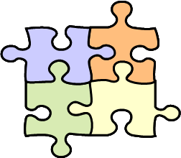
Altshuller found ….
TRIZ
that most inventions seemed to have
similar patterns (40 of them!)
Patterns used in resolving the contradictions.

Slide 17

TRIZ – The Approach
The first Steps

Slide 18

Law of increasing Ideality..
The Approach
Net Utility divided by Harmfulness
Harm >> cost, footprint, energy consumed, pollution, danger, etc
The faster you get there the more inventive you are!
The evolution of the mechanical spring-driven watch into the electronic quartz crystal watch is an example of moving towards ideality.

Slide 19
Environment Matters..
The Approach
Super System
System
Sub System

Slide 20
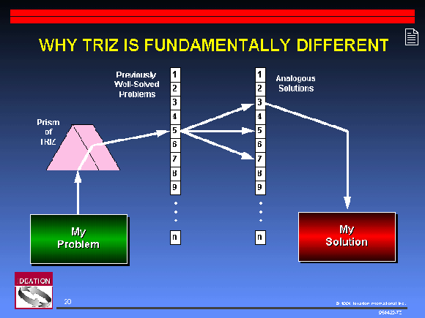
ARIZ
The Approach

Slide 21
Identify the Problem.
The Approach
Innovative Situation Questionnaire
Operating environment
Resource requirements
Primary useful function
Harmful effects
Ideal result.

Slide 22
Formulate the Problem.
The Approach
Function Trees..
Super & Sub System
Su Field Analysis
Define Contradictions Identify characteristics
QFD
Mind-Map
Root Cause Analysis

Slide 23
39 Characteristics.
The Approach
Qualities – Static & In Motion (6*2 > 12)
  Dimension, area, volume, weight, durability, energy
Physical Qualities (7)
  Shape, strength, speed, pressure, force, brightness, temperature, power
Performance Qualities
  Stability, reliability, control complexity, system complexity
Product outcomes (6)
  Ease of use, ease of repair, harmful side fx, harmful factors, measurement accuracy, manufacturing accuracy
Wastes (5)
  Time, effort, material, materials used, information
Process Characteristics (8)
  Adaptability, manufacturability, productivity,, automation

Slide 24
Mind Map of Characteristics
The Approach
weight
Dimension
Durability
weight
Area
Quality
in motion
Volume
Durability
Area
Shape
Dimension
Force
Static
Qualities
Phy. Qualities
Energy
Volume
Pressure
Brightness
Energy
39 conflicting
parameters
Stability
strength
Reliability
Temperature
Performance
Qualities
Speed
effort
System
complexity
Information
Control
complexity
Wastes
Harmful
Factors
Ease of Use
Material
Processing
Adaptatbility
Outcomes
time
Harmful
Side effects
Productivity
Usage of Mttl
Accuracy of
measurement
Ease of
Repair
Accuracy of
manufacture
Automation
Manufacturability

Slide 25
Seek Analogous Solutions to Adapt
The Approach
40 Inventive Principles
Applied through Altshuller Matrix
[39*38 = 1482] Situations
For each identify Principle

Slide 26
40 Inventive Principles
The Approach
Organize (6)
  Segmentation, merge, Abstraction ( extract out), Nesting,
  Counter weight, Asymmetry
Compose (7)
  Local Quality, Universality,
  Homogenity, composites,
  Spheroids, thin films, Cheap disposables
Physical (4)
  Porosity, Additional Dimension,, Thermal Expansion, Colour Changes
Chemical (4)
  Oxidate – reduce, inertness,
  Transform states, Phase transition
Interactions (5)
  Reduce Mechanical Movement, Bring Fluidity
  Equipotence, dynamicity, vibration
Process (9)
  Do it in reverse, ++ / --, continued action, repeated action, skip through, negative to positive
  Prior Cushioning, Prior Actions, Prior Counter Actions
Service (5)
  Self service, intermediary, feedback,
  use and retrieve, cheap copies

Slide 27
Mind Map – 40 Inventive Princples
The Approach
homogenous
Thin films
composites
Nest
shperoids
Compose
Local quality
Merge
Counter
weight
Thermal
expansion
Segment
+ dimension
Organize
Physically
universality
Abstract –
extract
porosity
Cheap
disposables
Color
changes
asymmetry
40 inventive
Principles
feedback
Phase
transition
Self service
Transform
states
Service
Chemically
intermediary
Dispose
retrieve
cheap
copy
inertness
Oxidate
invert
Negative to
positive
Less mechanical
Skip
through
Interactions
Equi potence
Repeated
Action
Process
dynamism
Continued
Useful action
++ / --
actions
Prior
Cushioning
Prior Counter
Action
Prior
Action
fluidity
vibrations

Slide 28

Identify my specific problem
The Approach
Search Patent Databases
Identify Near by solutions
Experiment
Implement.
95% of the solutions that had been solved before!

Slide 29

TRIZ - TRIX
Tools of the Trade..

Slide 30
ARIZ - Algorithm for Inventive Problem Solving
Formulate the problem.
Transform the problem into a model.
Analyze the model.
Resolve physical contradictions.
Formulate ideal solution.

Slide 31
Su-Field Analysis
Interactions of objects ( substances )
Through Fields
Standard triangulation
Between subject and object and
The Field in between.
The field is where the contradiction is

Slide 32
Anticipatory Failure Determination (AFD)
Failure factor analysis
? FMEA/ QFD / Ishikawa?

Slide 33
Directed Product Evolution (DPE)
Road map to the future!
Following Principles
  Technology lifecycle
  Increasing IFR ( ideal final result)
  Increasing complexity followed by simplicity Uneven development of sub systems
  Matching mis-matching of parts
  Macro to micronization
  Increasing Dynamism and control
  Reducing human intervention – automation

Slide 34
Some companies with TRIZ
Allied Signal Aerospace Sector
Chrysler Corp.
Emerson Electric
Ford Motor Co.
General Motors Corp.
Johnson & Johnson
Rockwell International
UNISYS
Xerox Corporation
LG group

Slide 35

40 Triz Principles
Foundation of TRIZ..

Slide 36
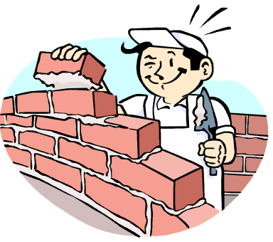
Divide an object into independent parts.
40 TRIZ Principles
1
Merging
Segmentation
Make object easy to disassemble
Increase the degree of fragmentation or segmentation.
Civilization
Bricks in a Wall
Object Oriented Design
N-Tier Architecture
Packet Switching

Slide 37

Focus on a specific element
40 TRIZ Principles
2
Nesting
Extract Out
Remove interfering part
Focus on Necessary part
Filtering
USP Advertising
Data Warehousing
SDLC - Skunkworks

Slide 38
Uniform to Non Uniform
40 TRIZ Principles
3
Universality
Local Quality
change an external environment
Each part to do its function
Each part suitable for its purpose
SME in Teams
PDO
Razor Blades
Agriculture implements
Tyres

Slide 39
Skew distribution
40 TRIZ Principles
4
Counter Weight
Asymmetry
Skew it
Change the degree of Skew
DB – File Management
DB - Indexing
Variable Pay
Road Rollers

Slide 40
Bring closer / unify
40 TRIZ Principles
5
Segmentation
Merging
Assemble into one
Parallel / Contiguous Processes
HPC
Cell based manufacture
SOA
TOC

Slide 41
Use everywhere
40 TRIZ Principles
6
Local Quality
Universality
Standard Object in multiple contexts
Casio – Screw
Standards
Rationalize
SOA
Normalization

Slide 42
One inside another
40 TRIZ Principles
7
Extract Out
Nested Doll-Matrushka
Pass through Cavity
Containers
Protocols
Parcels
Wiring

Slide 43
Counter inertia
40 TRIZ Principles
8
Asymmetry
Counter-Weight
Compensate through other objects
Compensate through environment
AJAX
Cranes

Slide 44
Prepare counter Harm
40 TRIZ Principles
9
Prior Anti-Action
Pre-stress in opposite direction
Take anti-Risk Measures
FMEA / Risk Management
Security / SSH
Rail-sleepers

Slide 45
Prepare before time is due
40 TRIZ Principles
10
Prior Action
Pre process activities – offline
Pre Arrange and ready for event
Cron Jobs
Indexes
DW-DM
Assembly line
Cooking
Pre-Fab Construction

Slide 46
Prepare emergencies before hand
40 TRIZ Principles
11
Prior Cushioning
Redundancy
Risk Mitigation
PPA-FMEA
DR-BC
Redundancy
Peak Demands

Slide 47
Reduce Position changes
40 TRIZ Principles
12
Vibration
Equi-potentiality
Eliminate the need to re-structure
Job Rotation-Peter Principle
Flexible Matrix Organization

Slide 48
Counter Intuition / Norm
40 TRIZ Principles
13
Do it in reverse
Invert the Actions – the other way around
Change the conditions of elements
Change orientations
LD Process
Flux Core Welding
‘Ready, Fire, Aim’ - Tom Peters
Unlearning

Slide 49
Curvature
40 TRIZ Principles
14
Spheroidality
Rectilinear – Curvilinear
Rollers Balls Spirals Domes
Linear to Rotary motion
Electric engines
Chamfering
Ergonomics-Aesthetics
Quality Circles
Token Rings
SAN - Ring

Slide 50
Allow / Encourage Change
40 TRIZ Principles
15
Dynamics
Self Optimizing
Moving parts
Adaptive Components
SWAT
Self learning
DM-DW
DHTML-AJAX
Customization

Slide 51
Increase or Reduce
40 TRIZ Principles
16
Partial / Excess Action
Trial and Error
80 – 20 rule
95% confidence level
‘If it ain’t broke, improve it anyway’
Phased approach
Simple – back of the envelope

Slide 52
Another Dimension
40 TRIZ Principles
17
New Dimension
Move 2D – 3D
Re-Arrange Physically
Change direction
Outsource - consult
DB - Normalization
Status – Flags WFlow
External Service Dependence
Array Objects – Object DB
XML - CSV

Slide 53
Increase Disturbance
40 TRIZ Principles
18
Equipotentiality
Vibration
Oscillate Vibrate
Increase Frequency
Use Resonance
Use other Vibration Fields
Heighten Tension
Silo – powder flow
Fear – Excitement

Slide 54
Pulsated Action
40 TRIZ Principles
19
Periodic Action
Batch Production
Change Frequency
Use Pauses Usefully
Cron Jobs
Project Management
Management by Exception
Night Shifts
Follow the Sun Service

Slide 55
Work round the clock
40 TRIZ Principles
20
Skip Through
Continued Action
Full load Full time
Eliminate Waste - Time
Multi-Skilling
VMWare – Virtualization
Loosely coupled

Slide 56
Rush through
40 TRIZ Principles
21
Continued Action
Skip through
Hazardous steps fast
Prototyping – Spiral Model
Fail Fast; Learn Fast’
Just Do IT
Analysis Paralysis
Hockey stick phenomenon

Slide 57
Turn Lemons into Lemonade
40 TRIZ Principles
22
Negative to Positive
Harm + Harm = Good
Change the focus of harm
Amplify harm into feature
Bug – Feature
Suburb living

Slide 58
Listen and Respond
40 TRIZ Principles
23
Feedback
Introduce Feedback
Increase Feedback
SPC
Sense and Response
Logging – DM
360 Appraisals

Slide 59
Representative Agent
40 TRIZ Principles
24
Self Service
Intermediary
For Execution
For Translation
Interfaces
Consultant
PDO
Outsourcng

Slide 60
Do it yourself
40 TRIZ Principles
25
Intermediary
Self Service
Self acting
Self Driving – use waste / by products
Gobar Gas
Dynamic online help
Math Coding

Slide 61
Don’t Reinvent the wheel
40 TRIZ Principles
26
Copying
Expensive Originals – Cheap Copies
Real – Virtual
Open Source
OTS-modules
Buy out – Merger
Online help – Digital docs
Display to Projector
Best practice - BOK

Slide 62
Cheap Objects
40 TRIZ Principles
27
Cheap Shortlife Objects
Cheap Compromises
Paper cutlery
Lesser Payload

Slide 63
Physical to Field
40 TRIZ Principles
28
Substitute Mechanics
EM, optics, acoustic fields
Static – Dynamic Fields
Field - Particles
Flash Drives
Fewer DB hops
Electric engines
Maglev trains
Jet Engines
Laser cutting
Digital Music

Slide 64
Pneumatics & hydraulics
40 TRIZ Principles
29
Fluidity
Gaseuos – liquid parts
Air Cushions
Panama Canal

Slide 65
Thin protective layer
40 TRIZ Principles
30
Porosity
Flexible Thin Shells
Isolation layers
Minimal Overhead
Interfaces
Protocols
Firewalls
Rain coats
Skin
Condoms

Slide 66
Allow Ingress / Interactions
40 TRIZ Principles
31
Thin Flexi Shells
Porosity
Conditional - Osmosis
Non conditional
SSH
Firewall
Skin

Slide 67
Change Surface Characteristics
40 TRIZ Principles
32
Change color
W.r.t to environment
Transparency
Flexible GUI
Personalization
Localization

Slide 68
Identical Properties
40 TRIZ Principles
33
Composites
Homogenity
W.r.t to environment
Transparency
Constancy of purpose
Standards
Patterns

Slide 69
Throw and Re-Use
40 TRIZ Principles
34
Discard & Recover
Discard useless Parts
Retain / Recover Consumables
Shuttle
Session Variables
Persistance
PDO
Cache

Slide 70
Change State
40 TRIZ Principles
35
Parameter Changes
Change Density/Concentration
Degree of Flexibility
Simulation
Telephone Banking

Slide 71
Change State
40 TRIZ Principles
36
Phase Transitions
Phenomena during transitions
Simulation
Telephone Banking

Slide 72
Material Expansion / Contraction
40 TRIZ Principles
37
Thermal Expansion
Differential Expansion
Motivation

Slide 73
Catalysis / Enhance Action
40 TRIZ Principles
38
Inertness
Strong Oxidation
Accelerate Action
Ionization
Case-Studies
Best Practices

Slide 74
Reduce Action
40 TRIZ Principles
39
Oxidation
Inert Atmosphere
Isolation – for Focus
Protection
Corporate Retreats
Boot camp
Hardening
Authentication
Welding

Slide 75
Uniform to Mixtures
40 TRIZ Principles
40
Homogenity
Composite Materials
Combinatorial Benefits
SME
Multi Discipline Teams
Concrete
Fiber Glass
Bullet Proof Glass

Slide 76
Thanks Again to
http://Mazur.net/triz
www.Triz-journal.com
Presentation style
  Tom Asacker
  Tom Peters
Work in Progress ….
To be Continued

Slide 77
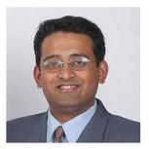
Vishwanath Ramdas is …
Process and Business Consultant
Working in areas like ITSM, Software development, process consulting …
Based in bangalore [India]
Visit him @
  http://gopu44.googlepages.com

