Slide 1
Keras的函数式模型
fastai中文社区 杨杰

Slide 2
目录
函数式模型
空气质量回归

Slide 3
函数式模型
函数式模型把每个网络层看成一个函数，并提供把这些函数组合为更大的计算图的操作
函数式模型model即广义的拥有输入和输出的模型
from keras.layers import Input, Dense
from keras.models import Model
# This returns a tensor
inputs = Input(shape=(784,))
# a layer instance is callable on a tensor, and returns a tensor
x = Dense(64, activation='relu')(inputs)
x = Dense(64, activation='relu')(x)
predictions = Dense(10, activation='softmax')(x)
# This creates a model that includes
# the Input layer and three Dense layers
model = Model(inputs=inputs, outputs=predictions)
model.compile(optimizer='rmsprop',
loss='categorical_crossentropy',
metrics=['accuracy'])
model.fit(data, labels) # starts training

Slide 4
所有的模型都是可调用的，就像层一样
利用函数式模型的接口，我们可以很容易的重用已经训练好的模型：你可以把模型当作一个层一样，通过提供一个tensor来调用它。注意当你调用一个模型时，你不仅仅重用了它的结构，也重用了它的权重。
x = Input(shape=(784,))
# This works, and returns the 10-way softmax we defined above.
y = model(x)
这种方式可以允许你快速的创建能处理序列信号的模型，你可以很快将一个图像分类的模型变为一个对视频分类的模型，只需要一行代码：
from keras.layers import TimeDistributed
# Input tensor for sequences of 20 timesteps,
# each containing a 784-dimensional vector
input_sequences = Input(shape=(20, 784))
# This applies our previous model to every timestep in the input sequences.
# the output of the previous model was a 10-way softmax,
# so the output of the layer below will be a sequence of 20 vectors of size 10.
processed_sequences = TimeDistributed(model)(input_sequences)

Slide 5
空气质量回归

Slide 6
1. 背景
本例将预测苯在空气中的浓度，给定一些其他变量例如一氧化碳、氧化亚氮在空气中的的浓度以及温度和湿度。
数据集我们采用的是UCI机器学习知识库的空气质量数据
https://archive.ics.uci.edu/ml/datasets/Air+Quality。
数据集包括9358个从5个金属氧化物化学传感器得到的小时平均读数。记录时间是2004.3-2005.2.

Slide 7
2. 导入库和模块
from __future__ import division, print_function
from keras.layers import Input
from keras.layers.core import Dense
from keras.models import Model
from sklearn.preprocessing import StandardScaler
import matplotlib.pyplot as plt
import numpy as np
import os
import pandas as pd

Slide 8
3. 加载数据
DATA_DIR = "../data"
AIRQUALITY_FILE = os.path.join(DATA_DIR, "AirQualityUCI.csv")
aqdf = pd.read_csv(AIRQUALITY_FILE, sep=";", decimal=",", header=0)

Slide 9
4. 预处理输入数据
# remove first and last 2 cols
del aqdf["#Date"]
del aqdf["Time"]
del aqdf["Unnamed: 15"]
del aqdf["Unnamed: 16"]
# fill NaNs in each column with the mean value
aqdf = aqdf.fillna(aqdf.mean())
# aqdf.head()
Xorig = aqdf.as_matrix()

Slide 10
5. 预处理数据
scaler = StandardScaler()
Xscaled = scaler.fit_transform(Xorig)
# store these off for predictions with unseen data
Xmeans = scaler.mean_
Xstds = scaler.scale_
y = Xscaled[:, 3]
X = np.delete(Xscaled, 3, axis=1)

Slide 11
6. 定义模型框架
# define the network
readings = Input(shape=(12,))
x = Dense(8, activation="relu", kernel_initializer="glorot_uniform")(readings)
benzene = Dense(1, kernel_initializer="glorot_uniform")(x)
model = Model(inputs=[readings], outputs=[benzene])

Slide 12
7. 编译模型
# 编译模型
model.compile(loss="mse", optimizer="adam")

Slide 13
8. 训练模型
# train network
NUM_EPOCHS = 20
BATCH_SIZE = 10
history = model.fit(Xtrain, ytrain, batch_size=BATCH_SIZE, epochs=NUM_EPOCHS,
validation_split=0.2)

Slide 14
9. 做一些预测
# show some predictions
ytest_ = model.predict(Xtest).flatten()
for i in range(10):
label = (ytest[i] * Xstds[3]) + Xmeans[3]
prediction = (ytest_[i] * Xstds[3]) + Xmeans[3]
print("Benzene Conc. expected: {:.3f}, predicted: {:.3f}".format(label, prediction))

Slide 15
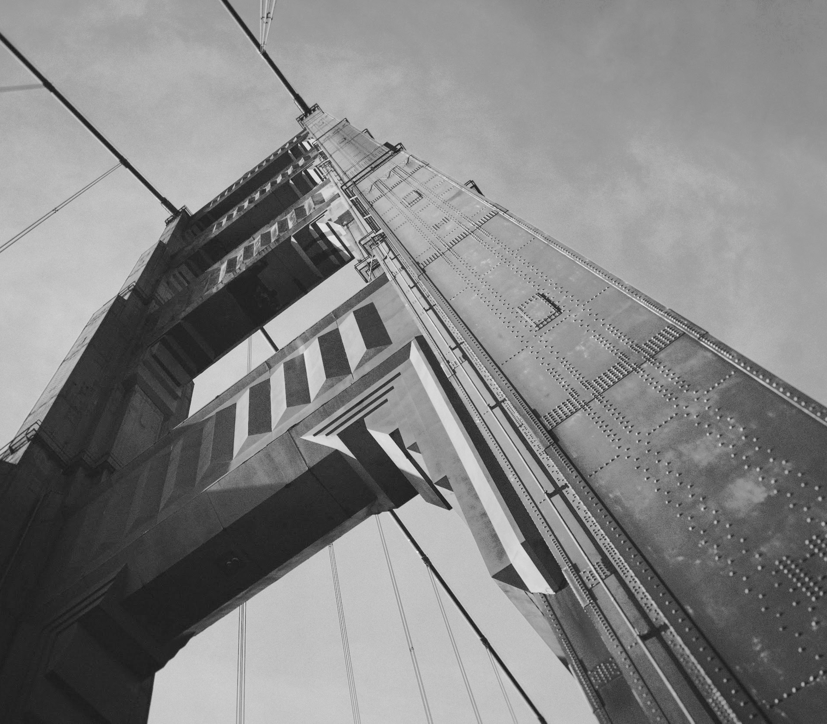
Thanks!
Contact:
yangjie@fastai.com.cn

