Slide 1
Reinforcement Learning
What is reinforcement learning
Example: Robot in a room
A Painless Q-learning Tutorial
Train a smartcab

Slide 2
What is learning?
Learning takes place as a result of interaction between an agent and the world.
The idea behind learning is that ：
Percepts received by an agent should be used not only for acting, but also for improving the agent’s ability to behave optimally in the future to achieve the goal.

Slide 3
Learning Types
Supervised learning:
A situation in which sample (input, output) pairs of the function to be learned can be perceived or are given
Reinforcement learning:
In the case of the agent acts on its environment, it receives some evaluation of its action (reinforcement), but is not told of which action is the correct one to achieve its goal

Slide 4
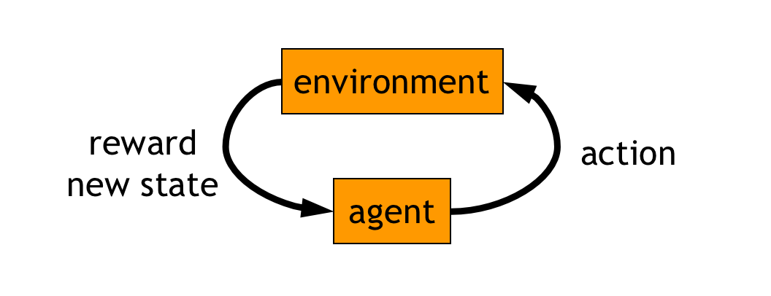
Reinforcement learning
Learn via experience!

Slide 5
Example!

Slide 6
Robot in a room
 |  |  | +1
 |  |  | -1
START
Actions: UP, DOWN, LEFT, RIGHT
Given a police :UP
80% move UP
10% move LEFT
10% move RIGHT
reward +1 at [4,3], -1 at [4,2]
reward -0.04 for each step
what’s the strategy to achieve max reward?
what if the actions were deterministic?
Notes:
want to learn a policy (what’s the solution?)
can we learn it using (un)supervised learning? why not?
so how do we learn it? any ideas?
let the robot explore the environment

Slide 7
Optimal policy
State
 |  |  | +1
 |  |  | -1
reward +1 at [4,3], -1 at [4,2]
reward -0.04 for each step
Given all the states, we can find the optimal policy for every state.

Slide 8
Reward for each step: -2
 |  |  | +1
 |  |  | -1

Slide 9
Reward for each step: -0.1
 |  |  | +1
 |  |  | -1

Slide 10
Reward for each step: -0.04
 |  |  | +1
 |  |  | -1

Slide 11
Reward for each step: +0.01
 |  |  | +1
 |  |  | -1

Slide 12
Q_learning!
A Painless Q-learning Tutorial

Slide 13
Train a smartcab!
训练智能出租车

