Slide 1
Product Architecture and Terms and Definitons

Slide 2
Product Architecture

Slide 3
Overview
ElectricCommander product packaging
Components under the hood
Top level objects
Inheritance
“ectool”

Slide 4
Product Packaging
ElectricCommander product packaging includes following components:
Commander Server
Agent
MySQL database
Apache Web server
Repository server
Tools – command line tools needed to communicate to server
These components can be installed on separate machines.
We will not cover installation here.

Slide 5
Architecture
Scripts & Tools
Browser
Command Line
Perl
Web Interface
API
Artifact
Metadata
Commander Server
Artifact
Repository Server
Database
Workspace
Agent
Agent
Agent
Agent
Agent
Cache
Resources

Slide 6
Multi-Site Architectuer
Artifact
Repository Server
Site 2
HQ
Database
Agent
Artifact
Repository Server
Commander Server
Web Server
Workspace
WAN
Browser
Workspace
Site 3
Web Server
Agent
Agent
Artifact
Repository Server
Web Server
Workspace
WAN
Site 1 (web only)
Browser
Browser

Slide 7
SDK
Scripts & Tools
Browser
Command Line
Perl
Web Interface
API
Artifact
Metadata
Commander Server
SDK
Artifact
Repository Server
Database
Workspace
Agent
Agent
Agent
Agent
Agent
Cache
Resources

Slide 8












SDK (cont.)
Integrations (100+ available)
Plugins
Weather Report
CI Dashboard
SDK
DashboardX
DashboardY
DashboardZ
Custom Integrations
Custom Integrations

Slide 9

Object Types
Container for processes and results
Job
Project
When to run a procedure
Job
Step
Job
Step
Procedure
Job
Step
Step
Step
Setup
Step
Step
Process to run automatically
Step
Step
Step
Schedule/Trigger
Snapshot
Step
Step
Step
Step
Step
Compile
Step
Step
Command or script
Step
Step
Step
Unit Test
Step
Step
Step
Step
Report
Step
Pool
Records results of running a procedure
Linux server
Linux server
Linux server
Windows server
Test harness
Resources
Slide 9
Notes:
9
9

Slide 10
Top-level objects
/groups
/projects
/jobs
/resources
/server
/users
/workspaces
/artifacts
/artifactVersions
These are also referred to as “containers” because these contain child objects.
Child objects can also be containers because they contain nested objects.

Slide 11
Properties‏
“Fixed”
Product-specific
Job-specific
Configuration Inputs
server name
repository location
branch
password
directory
targets
Cross-Build Info
Job
process id
Working Data
last green build
Step
resource to use
counter for build ids
Step
Step
Job Results
Step
success/ failure
QA status
Post-Completion Info
error count
promotion level
warning message
problem notes
Slide 11
Notes:
11

Slide 12
Properties (cont.)
Resource
Project
Procedure
Job
Memory size, tool chain
Step
Step
Step
Procedure
Parameters: branch, platform
Source code repository, build id
Job
Step
Step
Step
Procedure
Tag for last good build
Attach arbitrary name-value pairs to any object
Uniform and flexible model that adapts to your processes and needs

Slide 13
Hierarchy Project Container
projects
/
/EC-Examples
/procedures
/Approve
/steps
/“approve action”
/approved
Project = “EC-Examples”
Procedure = “Build-Test-Deploy Template”
Procedure = “Approve”
Step = “approve_action”
Parameter = “action”
Parameter = “person”
Step = “Setup”
Step = “Extract Sources”
Step = “Build and Test Windows”
Property = “Version”
Property = approved
/
projects/EC-Examples/procedures/“Build-Test-Deploy Template”/version
Notes:
/projects/EC-Examples/procedures/Approve/steps/”approve action”/approved

Slide 14
Inheritance
The concept of inheritance is pervasive in ElectricCommander
If a property’s value isn’t defined, it’s value is “inherited” from parent object, for example:
Project has a property called Default Workspace (value=“default”)
Procedure also has a property called Default Workspace (value=<not defined>)
Step also has a property called Default Workspace (value=<not defined>)
Recall hierarchy: Projects (top level) > Procedures (child) > Steps (child)
Project:
(Default Workspace=“default”)
Procedure:
(Default Workspace=<not defined>)
Step:
(Default Workspace=<not defined>)

Slide 15
Inheritance (cont.)
Project:
(Default Workspace=“default”)
Procedure:
(Default Workspace=<not defined>)
Step:
(Default Workspace=<not defined>)
If this property isn’t defined in a step, the value for Default Workspace is inherited from it’s parent (procedure). If procedure doesn’t define this property, then it is inherited from its parent (project).
During execution, step’s Default Workspace property value will be “default”.
However, a step can define a different value which will take precedence, i.e., step’s value will be used instead of inheriting from parent.

Slide 16
Inheritance (cont.)
Project:
(Default Workspace=“default”)
Procedure:
(Default Workspace=<not defined>)
Step:
(Default Workspace=“local”)
What happens when a parent and child define different values?
Child object’s value take precedence, i.e., step’s value will be used instead of inheriting from parent.

Slide 17
ectool
ectool is a Command Line Interface (CLI) to ElectricCommander
Can perform any UI operation; and more!
(Relatively) simple tool
Can be called from a Job Step
Not as efficient as Perl API
Examples:
> ectool getProperty /server/installDirectory
> ectool setProperty /myJob/result1 –value “success”

Slide 18
Summary
ElectricCommander product packaging
Components under the hood
Top level objects
Inheritance
ectool

Slide 20
Terms and Definitions

Slide 21
Overview
UI terminology
ElectricCommander terms

Slide 22
Terms and Definitions
Commander web UI or Web UI
Commander or Commander server - Refers to the server instance of ElectricCommander
“ectool” –
Command line tool used to communicate to Commander server
Installed as part of “Express Server” and “Express Agent” installation
Can be installed separately

Slide 23
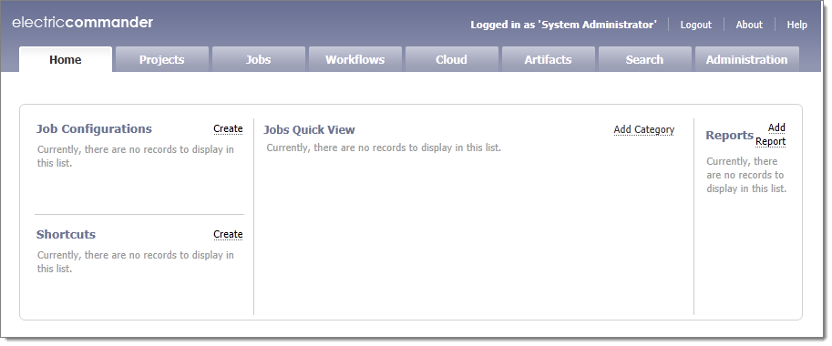
Web UI Terminology
Homepage
Current user
Online Help (OLH)

Slide 24
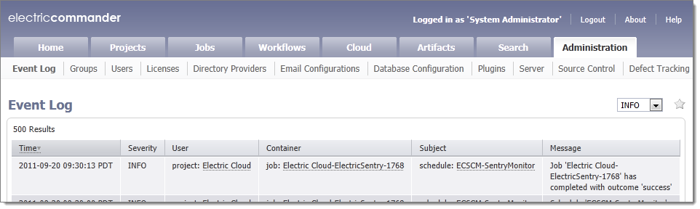
Web UI Terminology (cont.)
Tabs – Eight default tabs (out-of-the-box)
These tabs are on every page in Commander Web UI
Sub-tabs
“Star” –
List of shortcuts to nested pages
Allows quick access to pages that are multiple clicks away
Same as bookmarks in a web browser

Slide 25
Commander Terms
Projects –
Refers to top-level container object for Procedures, Schedules, Workflows and Properties
Use multiple projects for different purposes
Top-level object (/projects)
Procedures –
Executable entities within ElectricCommander
Define series of steps you want ElectricCommander to execute
Child of Projects (/projects/<projectName>/procedures)
Steps –
Contain commands (or scripts) that execute on a resource. These are actual tasks performed on a resource.
For example, checkout code from SCM
Child of Procedures

Slide 26
Commander Terms (cont.)
Resource –
A machine name where a step executes
Top-level object (/resources)
Also referred to as an “agent”
Workspace –
Folder location on a resource or on a network where job logs are stored.
Default workspaces can be assigned to a Resource, Project, Procedure or a Step.
Top-level object (/workspaces)

Slide 27
Commander Terms (cont.)
Artifacts –
Top-level object (/artifacts)
Defines an artifact object which contains artifact versions , a name template for
Published artifact versions
Artifact properties
Access control
Artifact Version –
Top-level object (/artifactVersions) contains artifact version metadata
A collection of 0 to N files that were published to an artifact repository

Slide 28
Commander Terms (cont.)
Jobs –
Each execution of a “procedure” is called a job
Top-level object in ElectricCommander (/jobs)
Workflow –
Each execution of a “workflow definition” is called a workflow.
Top-level object in ElectricCommander (/workflows)
Workflow::Workflow Definition →analogous to Job::Procedures

Slide 29
Terms and Definitions (cont.)
Workflow Definitions –
Implementation or design of a workflow in ElectricCommander.
Consists of state definitions, transition definitions, formal parameters and notifiers
Child of Projects (/projects/<projectName>/workflowDefinitions)
State Definitions –
Implementation or design of a single state within a workflow.
Child of Workflow Definitions
Transition Definitions –
Implementation or design of a state transition.
Defines criteria for how workflow might progress from one state to another.
Child of State Definitions

Slide 30
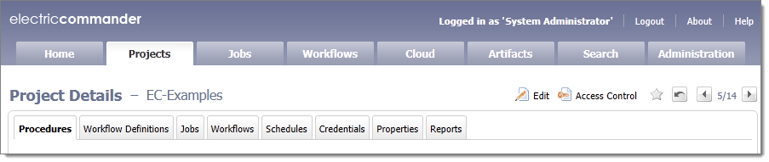
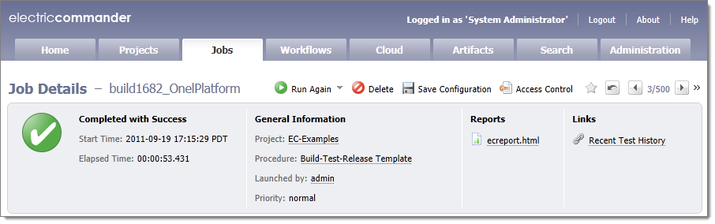
Commander Terms (cont.)
XYZ Details page –
Allows user to view detail configuration of an XYZ object
For example, Project Details page, Job Details page, etc.

Slide 31
Summary
UI terminology
Commander terminology

