Slide 1
AI Project 2
Data Classification Using AI
Iris Dataset • KNN Supervised Learning

Slide 2
1. Project Goal
Build a basic classification model using a small dataset.
Load and understand the dataset.
Split data into training and testing sets.
Apply a simple classification algorithm.

Slide 3
2. Iris Dataset
150 samples
3 classes: setosa, versicolor, virginica
4 features: sepal length, sepal width, petal length, petal width
Balanced benchmark dataset.

Slide 4
3. Data Preparation
Shuffle the data before splitting.
Use an 80% training / 20% testing split.
Apply StandardScaler to normalize feature ranges.
Fit the scaler only on training data.

Slide 5
4. K-Nearest Neighbors
KNN is a supervised classification algorithm.
The model compares a new sample with nearby training samples.
This project uses k = 5.
Majority voting determines the predicted class.

Slide 6
5. Training and Prediction
Instantiate KNeighborsClassifier(n_neighbors=5).
Train using model.fit(X_train, y_train).
Predict using model.predict(X_test).
Evaluate predictions against the true test labels.

Slide 7
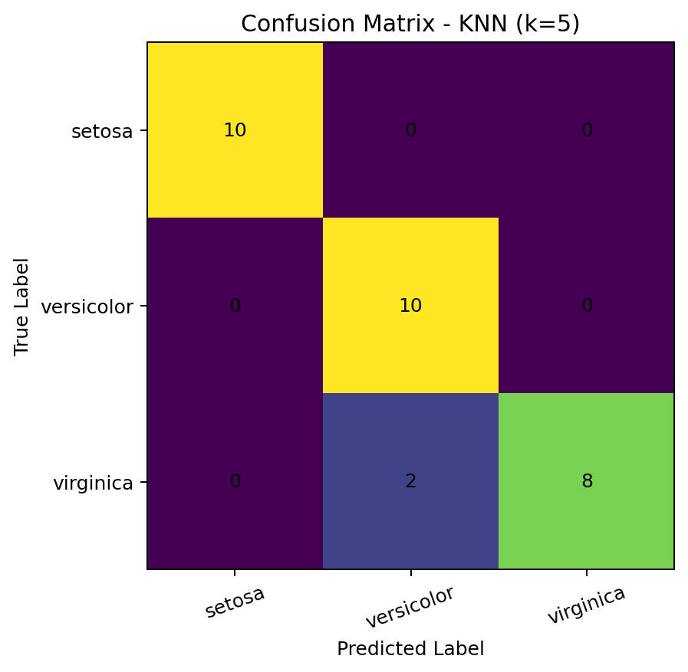
6. Confusion Matrix

Slide 8
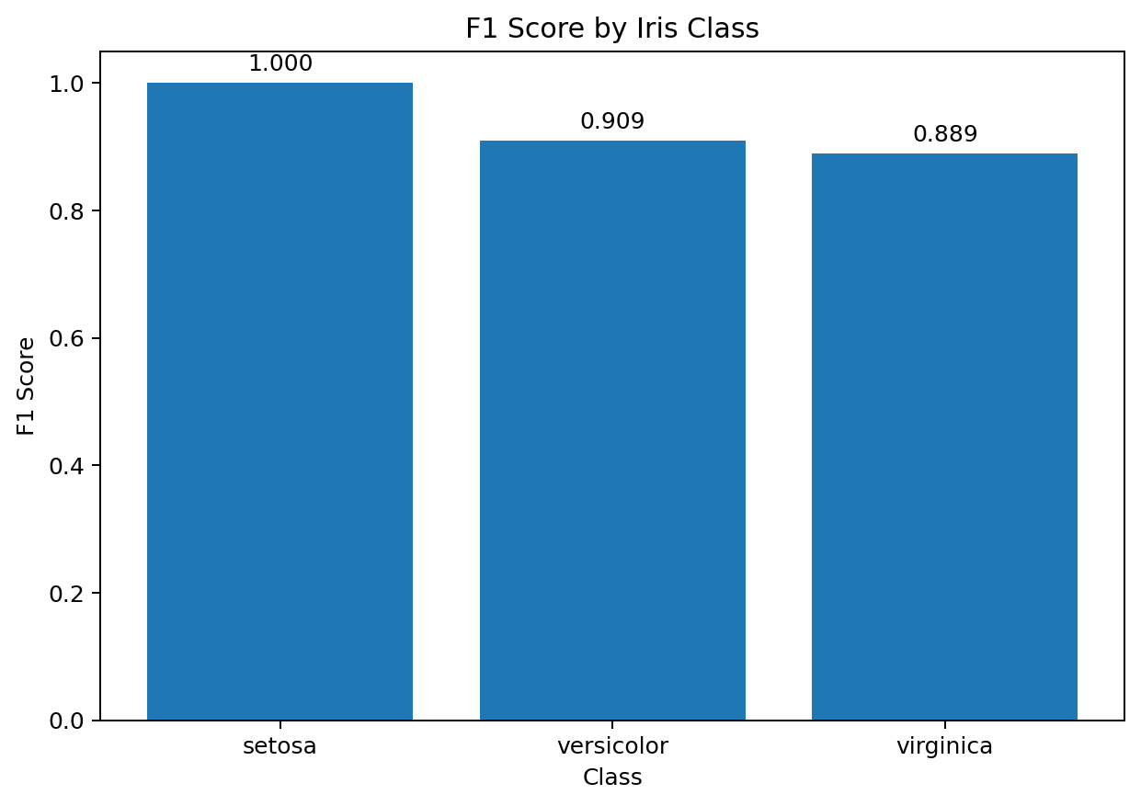
7. F1 Score

Slide 9
8. Results
Accuracy: 93.33%
Weighted Precision: 0.9444
Weighted Recall: 0.9333
Weighted F1 Score: 0.9327

Slide 10
9. Conclusion
The project demonstrates a complete supervised-learning classification pipeline.
KNN successfully classifies the Iris test samples.
Confusion matrix and F1 score provide deeper evaluation than accuracy alone.
The project is ready for local execution and GitHub upload.

Slide 11
Thank You
AI Project 2 — Data Classification Using AI
DecodeLabs Industrial Training Kit — Batch 2026

