Slide 1
PDC Tracking Abnormity

Slide 2

Experiment Layout
TOF Wall
DC2
DC1
DC0
32D02
2.24m
32Q01
PDCU0
PDCU1
PDCD0
MUSIC1
PDCD1
MUSIC0
x
TOF stop
target
z
8.45m
11.46m

Slide 3
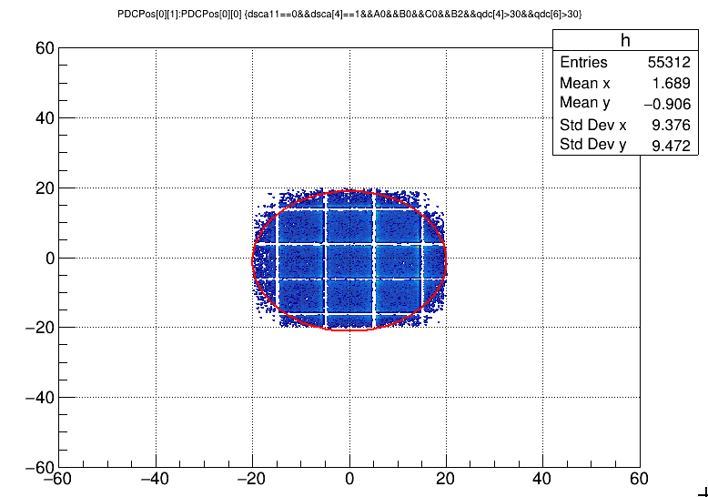
BeamPos - PDCU0
B0

Slide 4
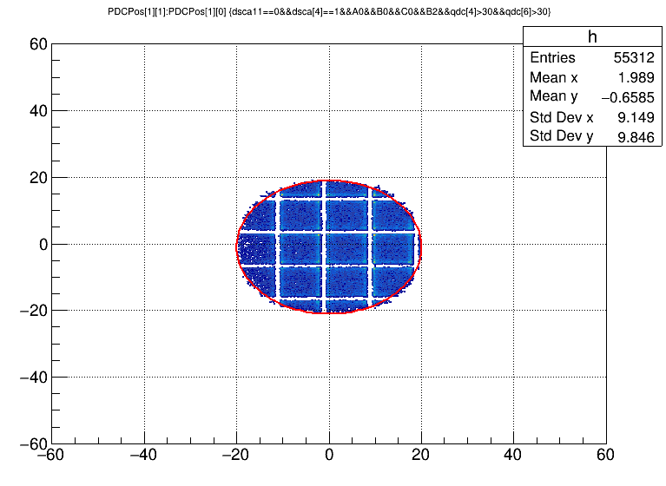

BeamPos - PDCU1
B0

Slide 5
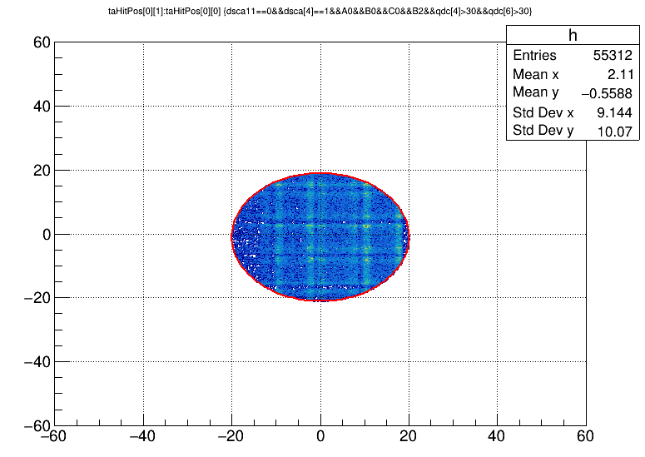
BeamPos - Target

Slide 6
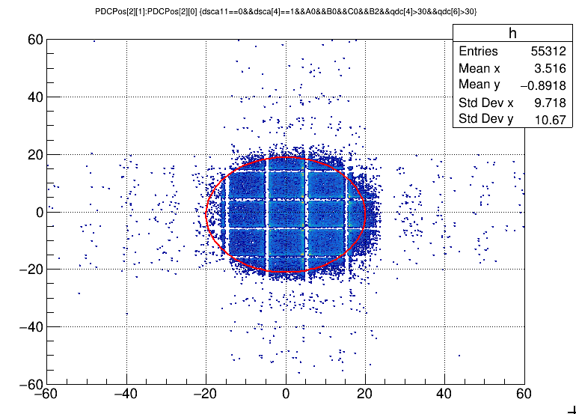
BeamPos - PDCD0

Slide 7
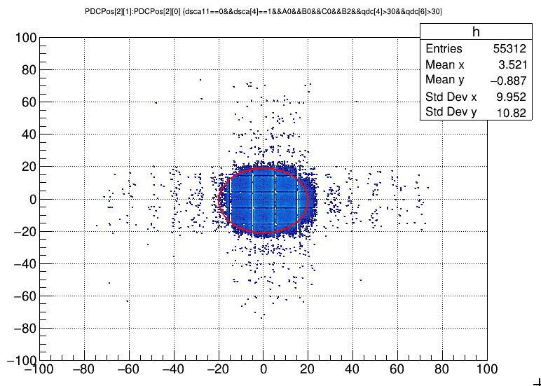
BeamPos - PDCD0

Slide 8
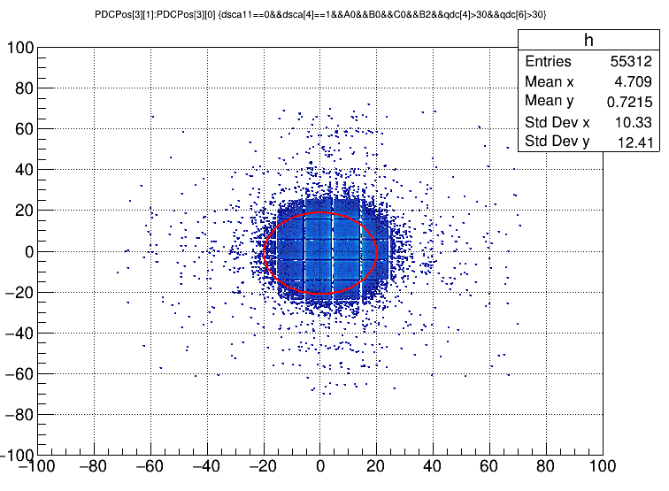
BeamPos - PDCD1

Slide 9
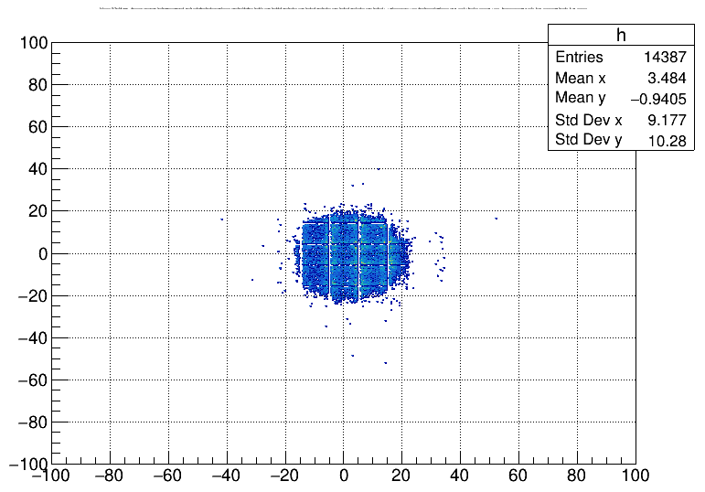
Rigid CUT
Commands that cut off the horizontal and verticla tails of beamPos at PDCU0:
treeTrack->Draw("PDCPos[2][1]:PDCPos[2][0]>>h(500, -100., 100., 500, -100., 100.)", "dsca11==0&&dsca[4]==1&&A0&&B0&&C0&&B2&&qdc[4]>30&&qdc[6]>30 &&nuTa[1][0][0]>=0&&nuTa[1][0][1]>=0&&nuTa[1][0][2]>=0&&nuTa[1][0][3]>=0&& chiTa[1][0][0]>-1.8&&chiTa[1][0][0]<0.1&&chiTa[1][0][1]>-1.8&&chiTa[1][0][1]<0.1&&chiTa[1][0][2]>-1.8&&chiTa[1][0][2]<0.1&&chiTa[1][0][3]>-1.8&&chiTa[1][0][3]<0.1 &&nuTa[1][1][0]>=0&&nuTa[1][1][1]>=0&&nuTa[1][1][2]>=0&&nuTa[1][1][3]>=0&& chiTa[1][1][0]>-1.8&&chiTa[1][1][0]<0.1&&chiTa[1][1][1]>-1.8&&chiTa[1][1][1]<0.1&&chiTa[1][1][2]>-1.8&&chiTa[1][1][2]<0.1&&chiTa[1][1][3]>-1.8&&chiTa[1][1][3]<0.1", "colbox")
Which translates into:
Each wire plane has a valid fired wire belonging to the track && the tracking residue is within 3sigma of the main peak of residue distribution.
Only 27% events survive the seemingly normal cut.

Slide 10
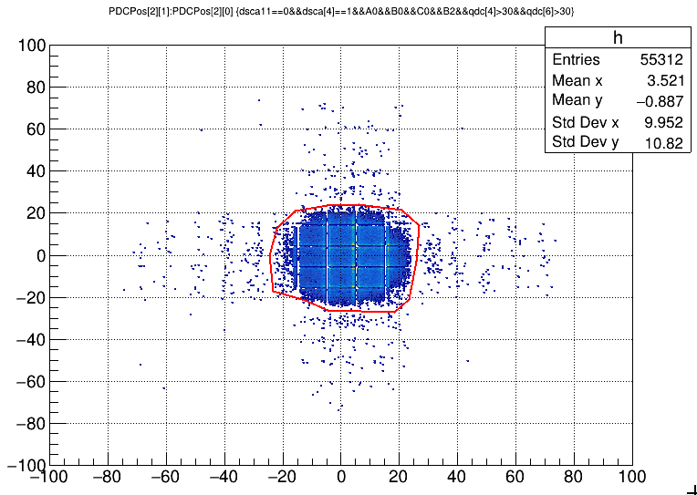
55312 v.s. 49668, out: 10.20%

Slide 11
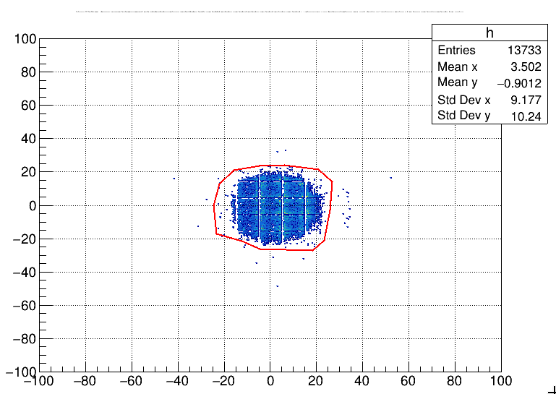
13733 v.s. 13705, out: 0.20%

Slide 12
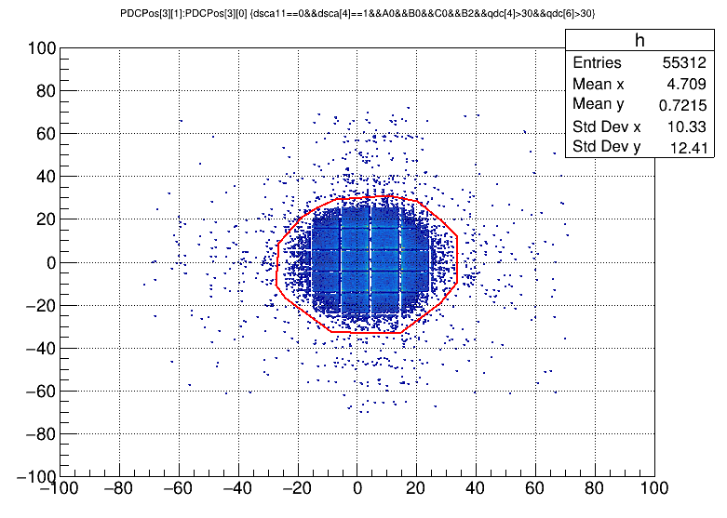
BeamPos – PDCD1

Slide 13
55312 v.s. 49555, out: 10.41%

Slide 14
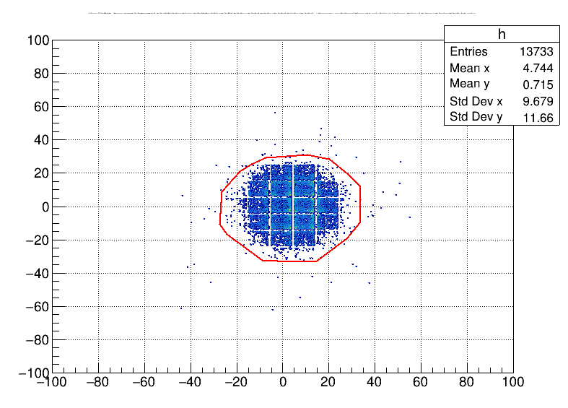
BeamPos – PDCD1 – Rigid CUT

Slide 15
13733 v.s. 13674, out: 0.43%

Slide 16
Conclusion
For geometrical efficiency calculations of PDCs, we should resort to events with prime tracking qualities so as to be free from tracking errors.
Q.: Why is the mis-reconstructed positions distribute only horizontally and vertically?
A.: The track mis-reconstruction is a small probability event in X(Y) direction. So much more often than not it happens in X(Y) direction when tracking in Y(X) direction is normal. This is the reason why the tails in the beam position spectra don’t propagate in a slant way. The probability of tracking errors happening both in X and Y direction at the same time is much more lower than it is in either direction.

