Slide 1
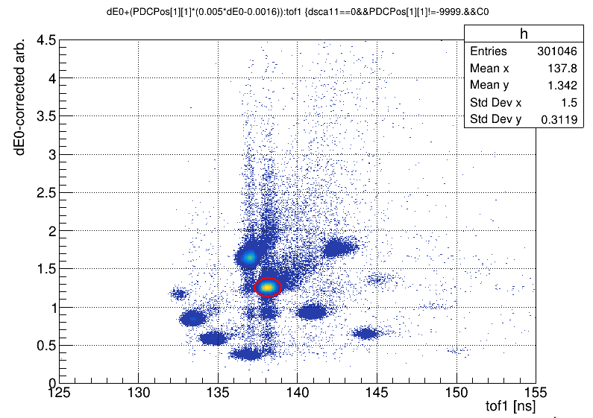
A0
A0

Slide 2
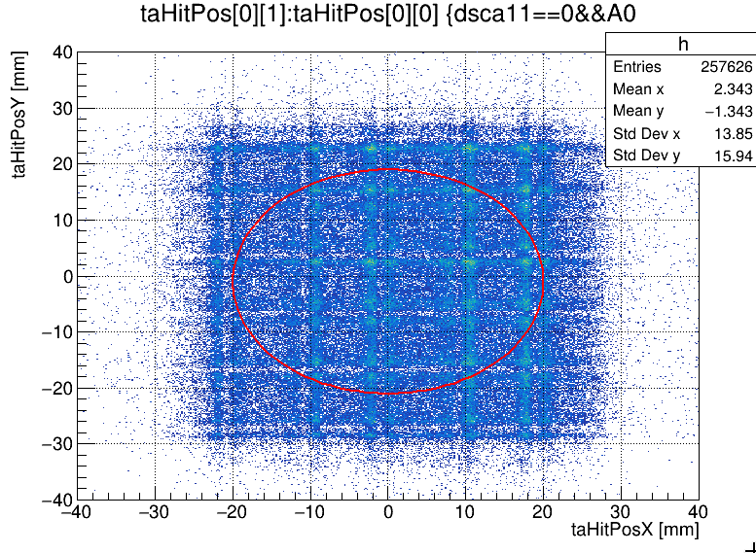
B0

Slide 3
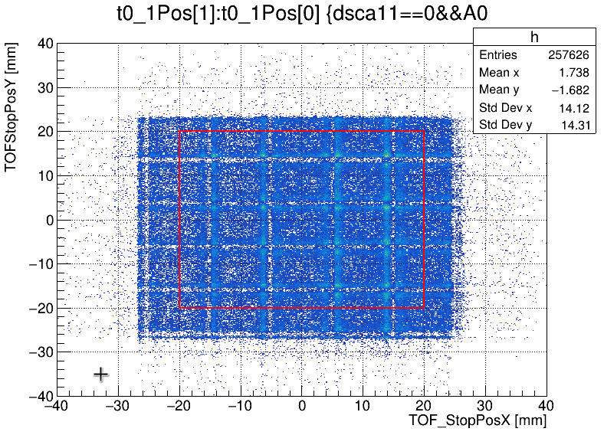
C0

Slide 4
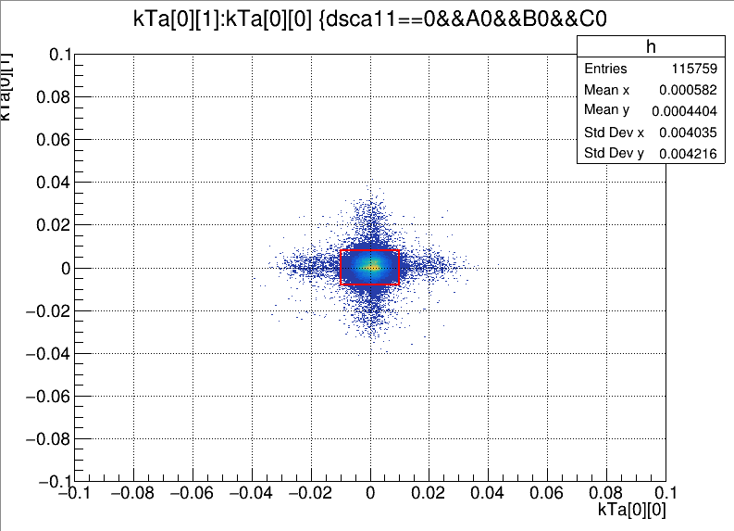
B2

Slide 5
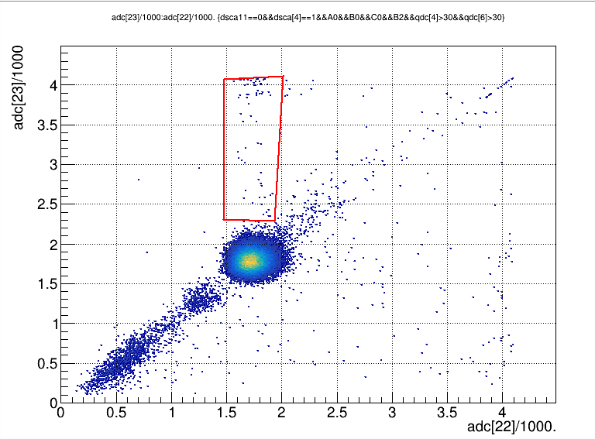
p0
240MeV/u C14

Slide 6
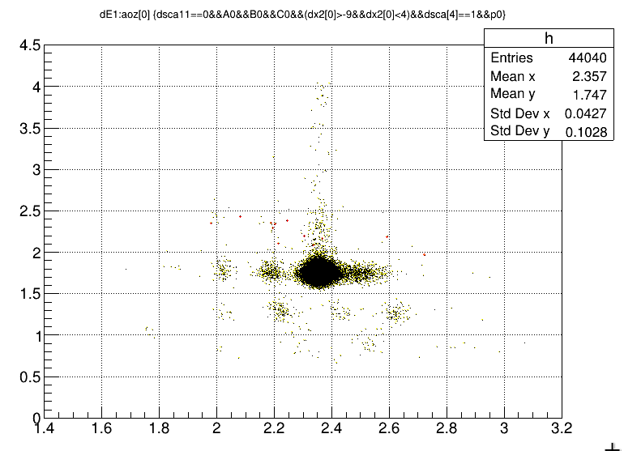
240MeV/u C14

Slide 7
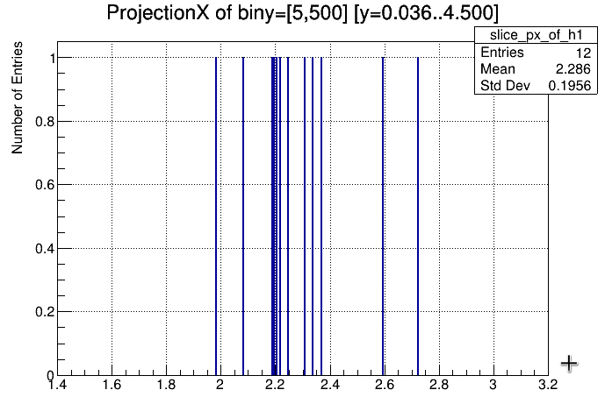
p0
240MeV/u C14

Slide 8
240MeV/u C14

Slide 9
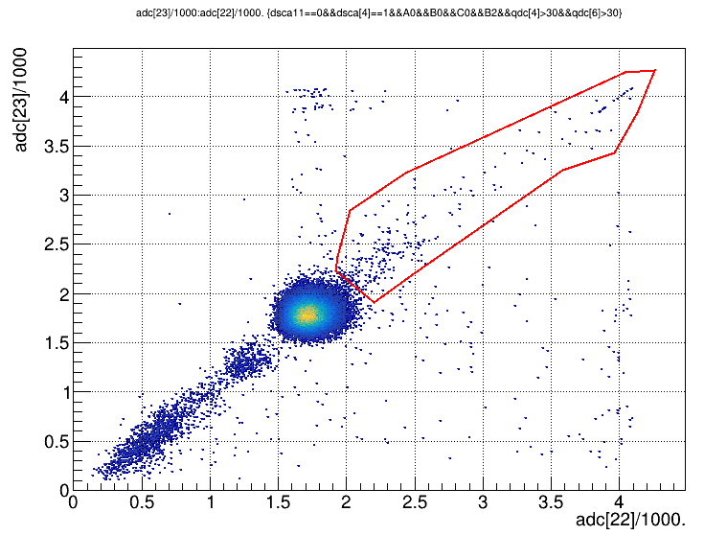
p1
240MeV/u C14

Slide 10
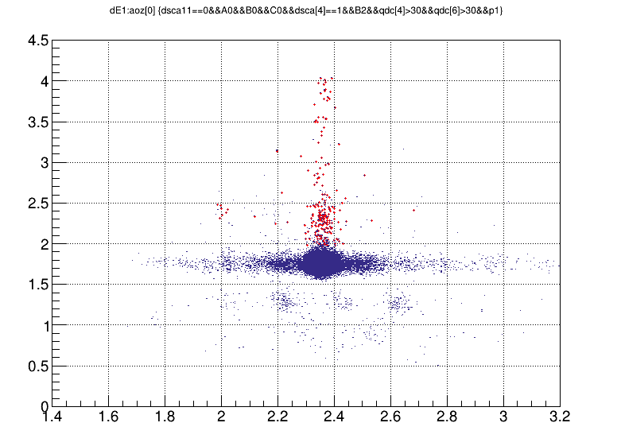
p1
240MeV/u C14

Slide 11

p10
240MeV/u C14

Slide 12
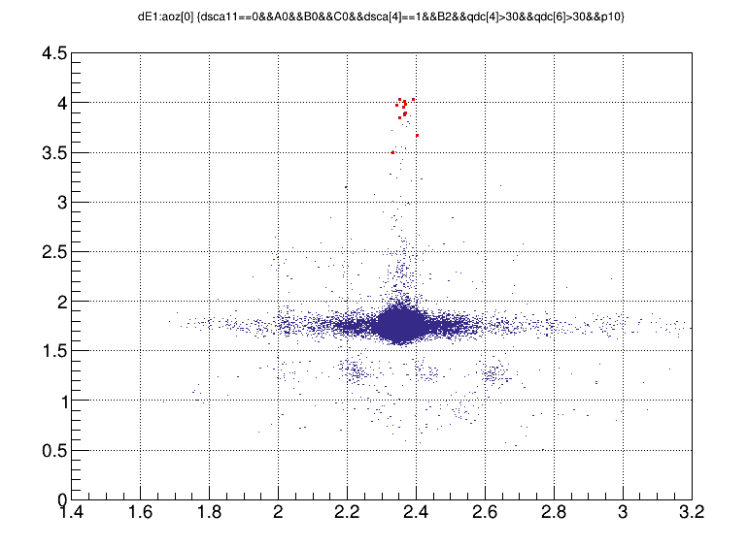
p10
240MeV/u C14

Slide 13
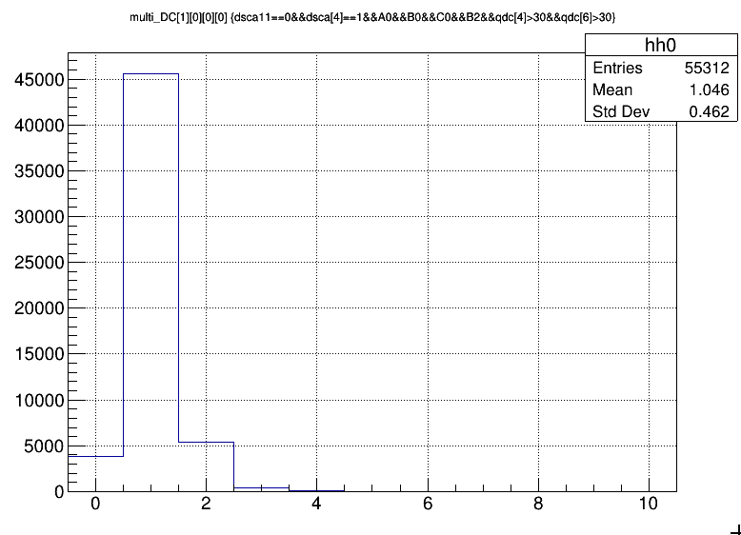
240MeV/u C14
240MeV/u C14

Slide 14
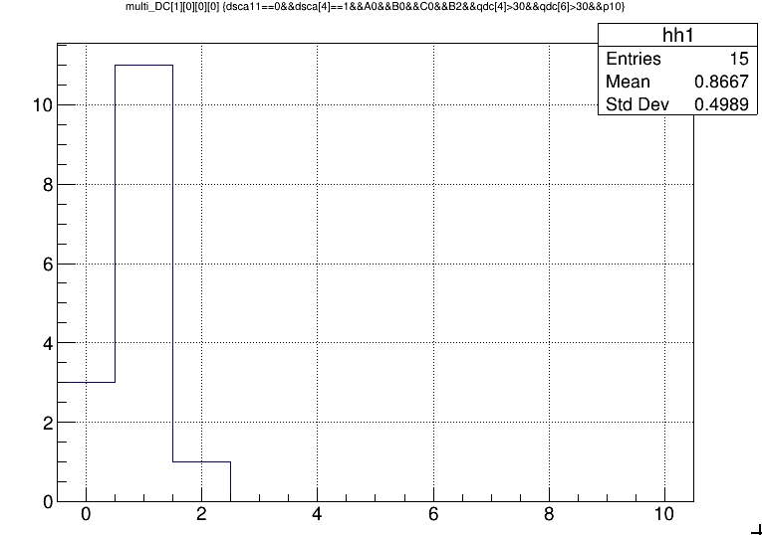
240MeV/u C14

Slide 15
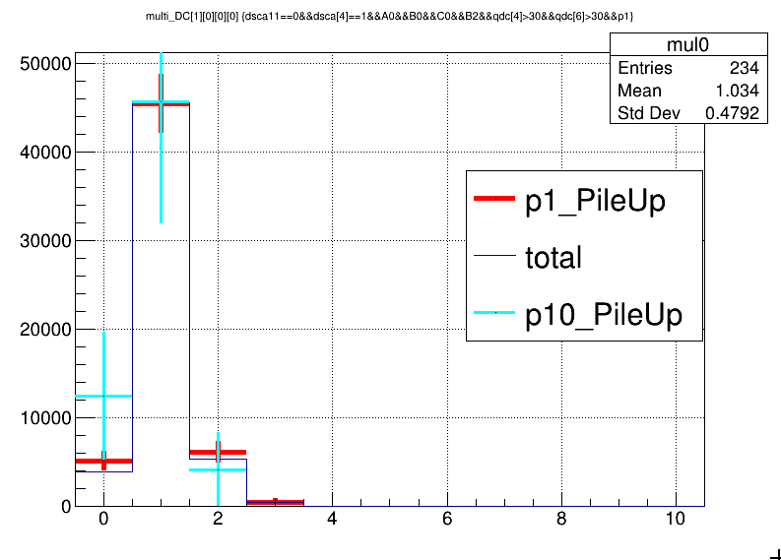
240MeV/u C14

Slide 16
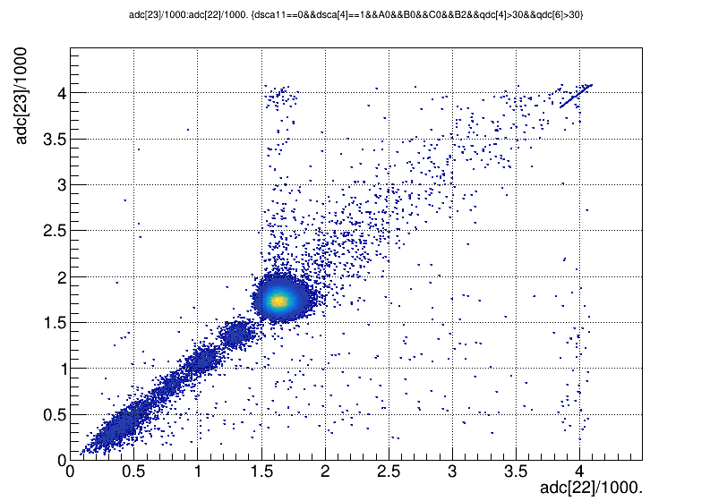
Dsca[4]==1 is not a strict cut. Pile_up events is still comparable to situations with C14
280MeV/u O18

Slide 17
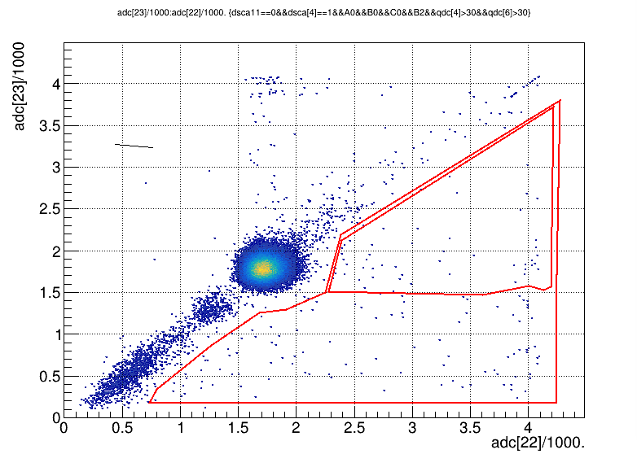
240MeV/u C14
p20
p2

Slide 18
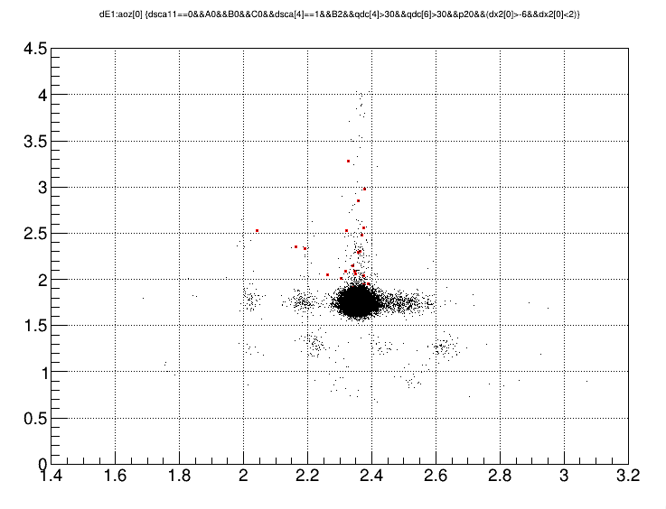
240MeV/u C14
p20

Slide 19
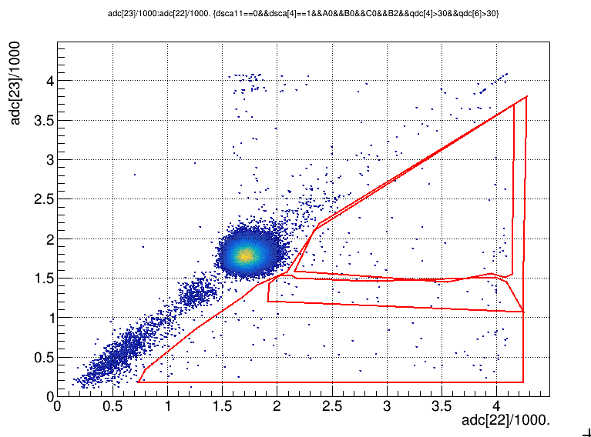
240MeV/u C14
p20
p21
p2

Slide 20
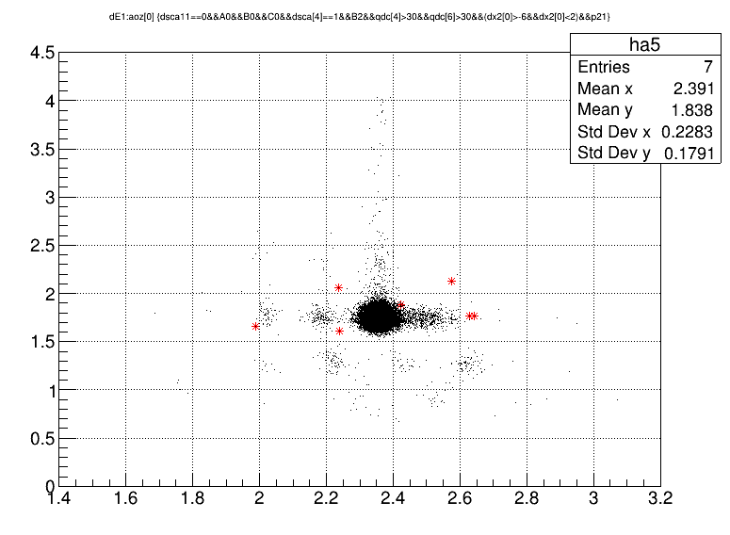
240MeV/u C14
p21

Slide 21
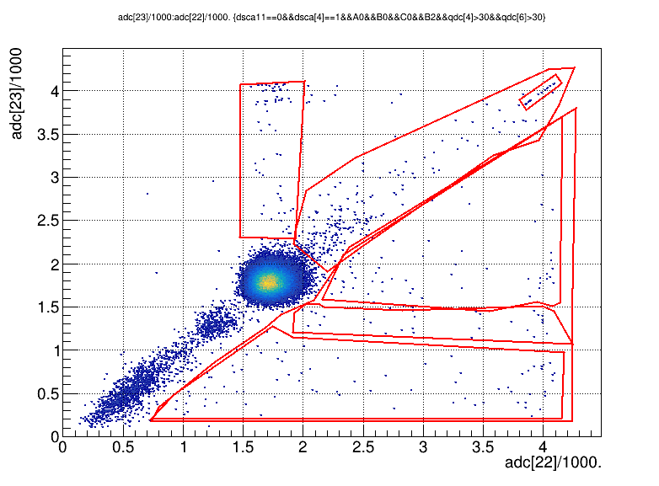
p1
240MeV/u C14
p20
p21
p3
p2

Slide 22
p1
p10
p0
240MeV/u C14
p20
p21
p3
p2

Slide 23
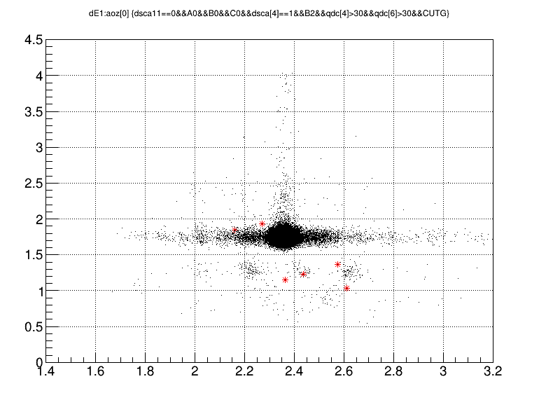
NtrLs[1][0]>0: 6
NtrLs[3][0]>0: 30
Total: 76
240MeV/u C14
p3

Slide 24
240MeV/u C14

Slide 25
240MeV/u C14

Slide 26
So what is the situation when ...
When dsca[4]==1 is false, i.e. what is going on in the difference between dsca10==0 and dsca10==0&&dsca[4]==1 ?
240MeV/u C14

Slide 27
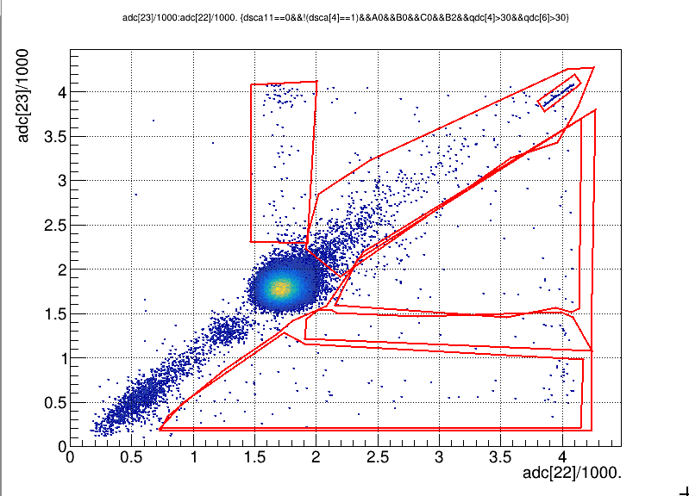
Low aoz efficiencies (i.e. tracking efficiency) in p0(~0.5) and p3(0.05).
Headscratching in the low eff in p0.
P1
877
P10
86
P0
116
240MeV/u C14
P20
98
P21 19
P3 82
P2 224

Slide 28
P10
15
86
Total:
52950
55312
P1
234
877
P0
64
116
240MeV/u C14
P20
53
98
P21 19 28
P3 76 82
P2
166
224

Slide 29
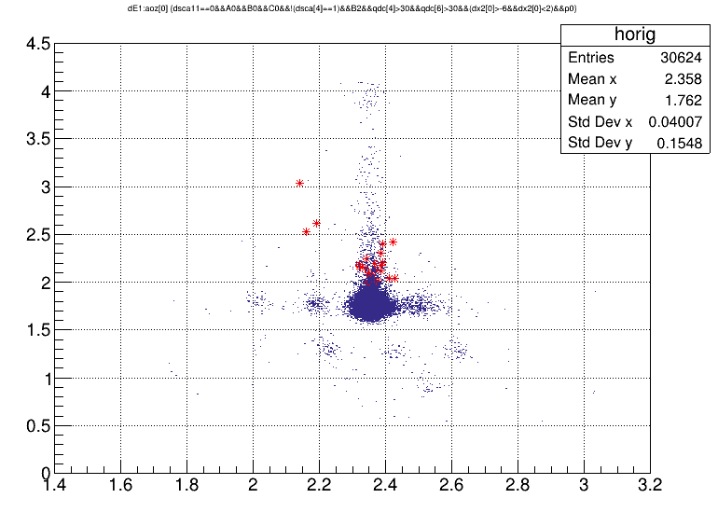
p0
240MeV/u C14

Slide 30
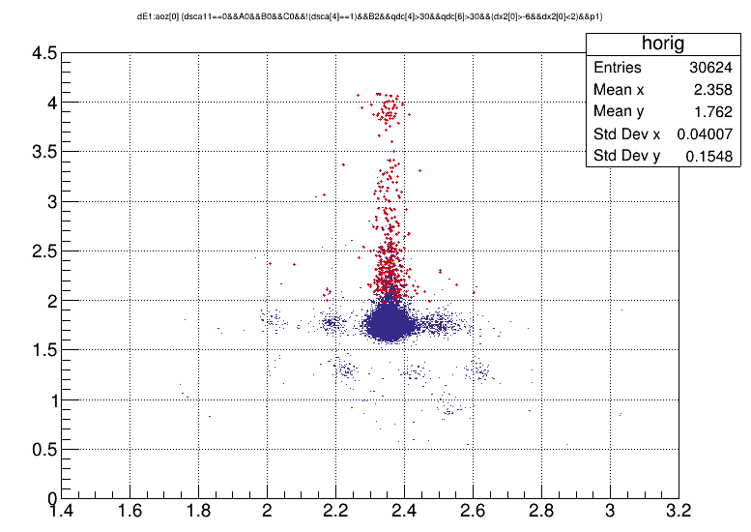
p1
240MeV/u C14

Slide 31
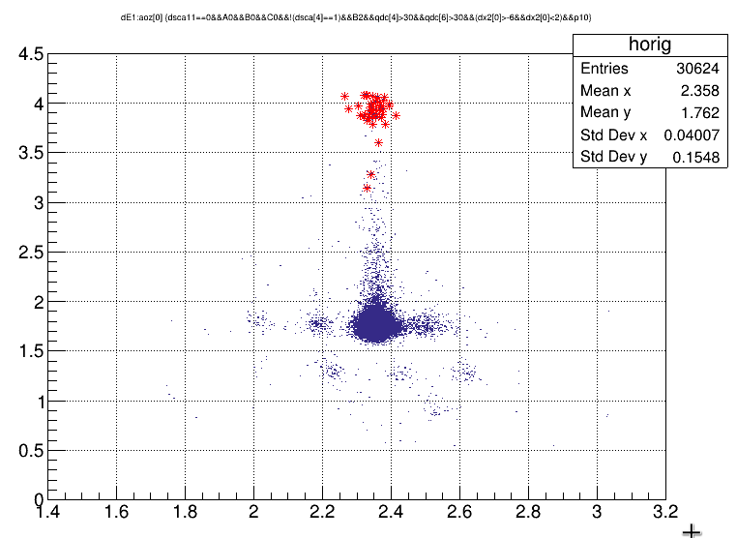
p10
240MeV/u C14

Slide 32
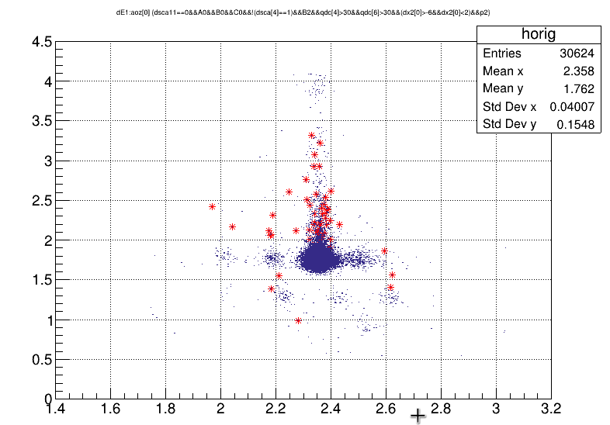
p2
240MeV/u C14

Slide 33
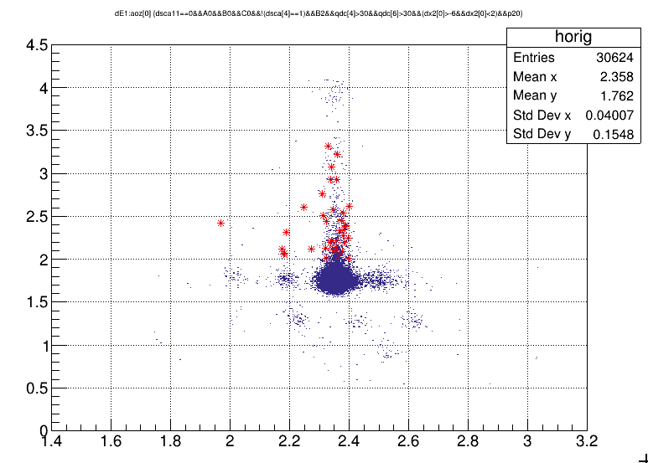
p20
240MeV/u C14

Slide 34
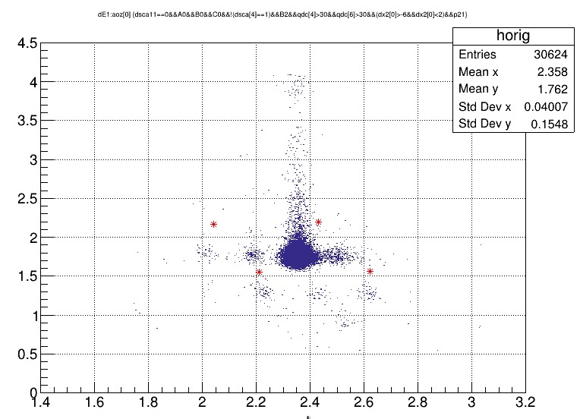
p21
240MeV/u C14

Slide 35
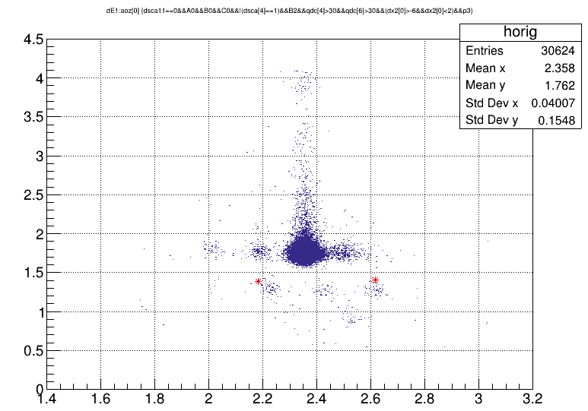
p3
240MeV/u C14

Slide 36
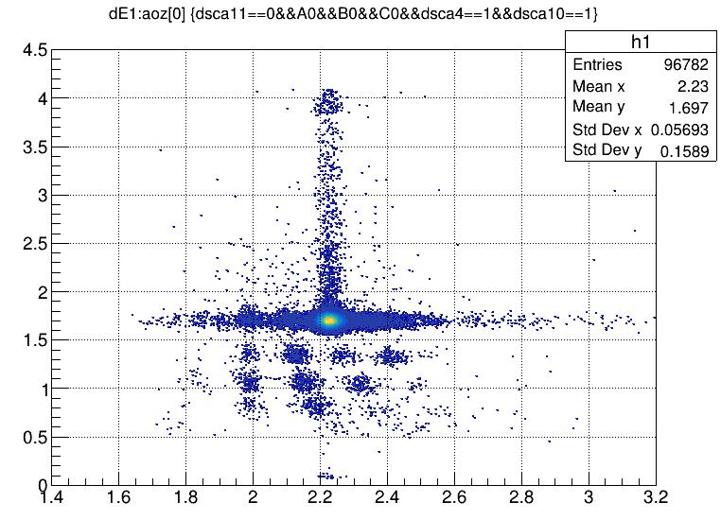
280MeV/u O18
Dsca4==1 is not a clear cut to rule out pile-up events.

Slide 37
Conclusions
Pile-up events in adc[23]-adc[22] spectrum (p1 zone) falls in aoz~C14 range. They are unreacted C14.
No correlated multiplicity response of MWDC0 (first MWDC downstream of diple magnet) is observed for p1 events compared with non-pile-up events. They may caused by multiple particles that are remotely related in time (>500us, Daq busy time), or from accumulated effects (e.g., failed baseline recovery).
P20 zone is mainly populated by events of unreacted C14 and a few fragments of C14 by 1n and 2n removal. The removal process must have happened before entering the Mag-Field. Asymmetrical energy losses in adc[22] and adc[23] suggests that the neutron-removal, or some elastic scattering might have happened in MUSIC unit corrected with adc[22], which absorbs more energy from the incident particle.
P21 zone is resulted from nucleon-removal involving protons in MUISC unit corresponding to adc[22]. P21 and P3 should be merged into one because they share the same reaction mechanism (p- and(or)- n- participating removal and (or) evaporation) and reaction spot (MUSIC unit of adc[22]).

Slide 38
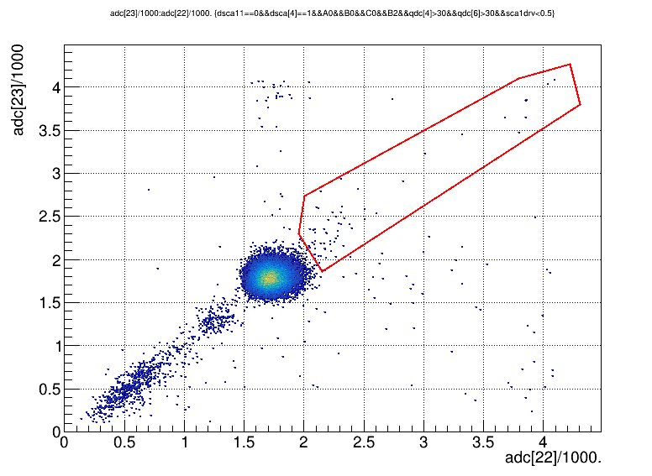
Appendix
Scadrv1: beam rate(derivative of sca1 over clock)
p1
P1/total: 7/5296=0.13%. (scadrv1<0.2)
P1/total: 64/26268=0.24%. (scadrv1<0.5)
P1 proportion decreases with beam rate. So it indeed comes from pile up.
Some of p1 also comes from reacted particles in MUSIC2.
P1/total: 64/26268=0.405%. (scadrv1<inifinity)

Slide 39
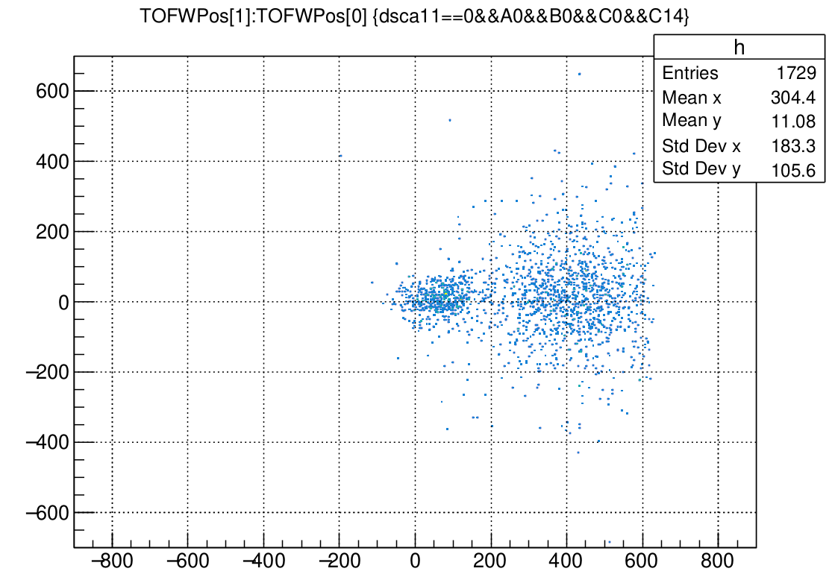
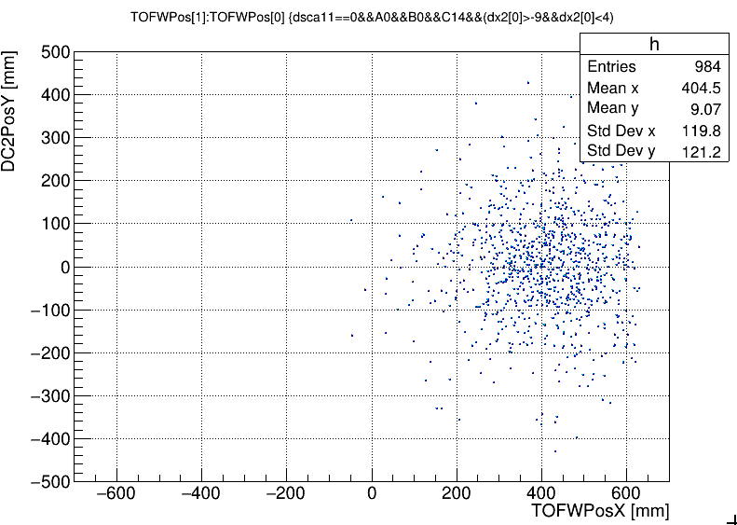
(16C, 14C): 14C pos distribution in TOFW
Unreacted 16C
Removed by dx2 (Track Matching Quality Cut pre-post Magnet)

Slide 40
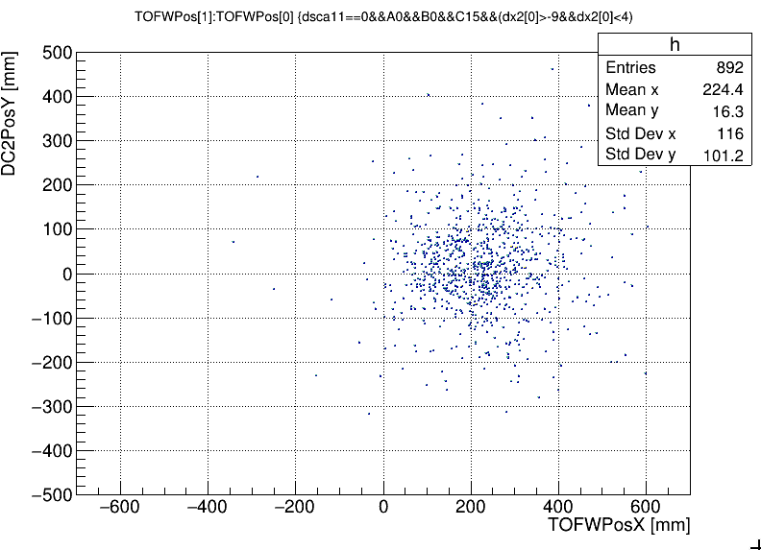
(16C, 15C)
15C fragment pos distribution in TOFW.
From the fig. in the right, we can claim that c.s. uncertainty brought about by TOFW strip gaps can be neglected. Because the fringe of the beam spot is so blurred and wide-distributed. Acceptance would barely change along with the translation of the beam spot in the TOFW plane.

Slide 41
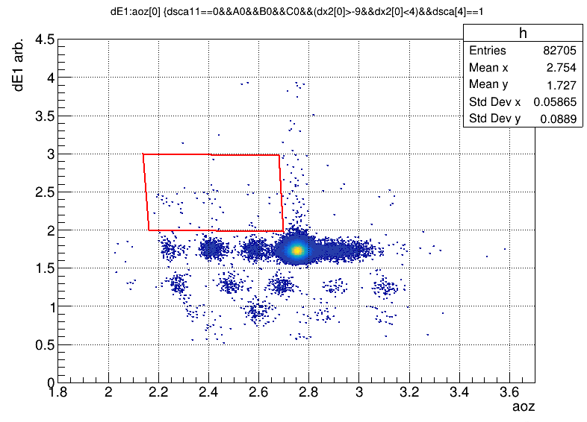
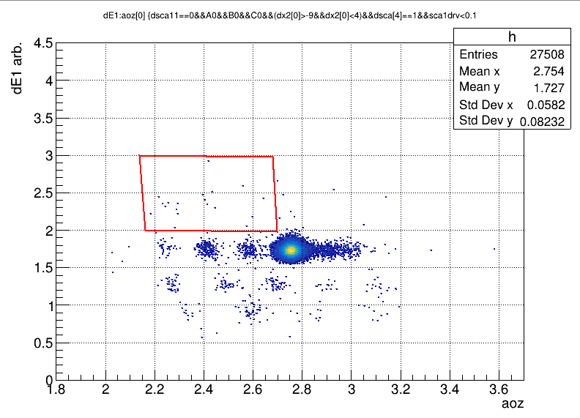
Events in red box is those reacted in MUSIC2, and barely change with beam rate.
(0.0727% for sca1drv<infinity to 0.0617% for sca1drv<0.1). (target-in runs)
On the other hand, events in the blue box have been mostly removed, which again support the claim that they are pile-up events.

Slide 42
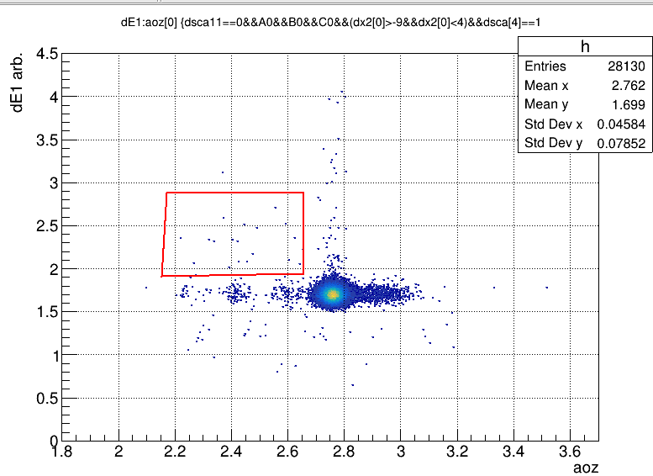
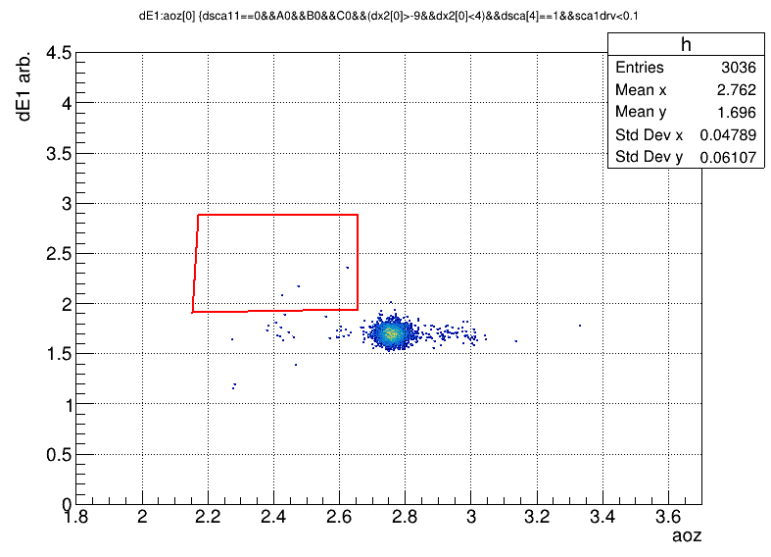
This is also supported by the fact that despite low fragments yields in target-out runs, the red box proportion doesn’t change. This is easy to understand. Because the red box is due to reaction of incident beam particles in MUSIC2, which has nothing to do with the presence of a target.
For target-out runs, event proportion in red box is 0.0711% for sca1drv<infinity to 0.0988% (3/3036) for sca1drv<0.1.

