Slide 1
PDC Tracking Residue Correlation
Nov 13th, 2018
Lanzhou

Slide 2
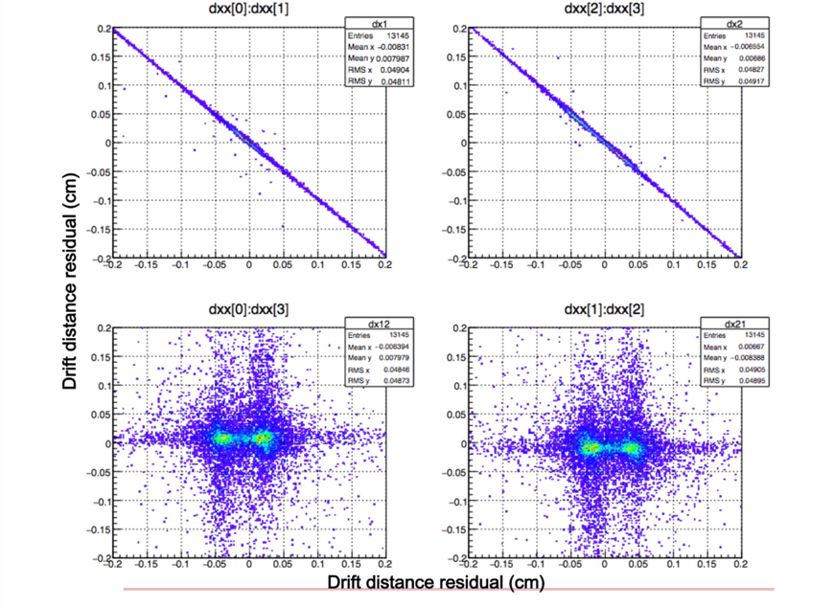
Question Description
PDC0
PDC1
z
a
b
Tracking residue (dxx) spectra
Fig a.: dxx(PDC0-X1) v.s.dxx(PDC0-X2)
Fig b.: dxx(PDC1-X1) v.s.dxx(PDC1-X2)
Fig c.: dxx(PDC0-X1) v.s.dxx(PDC1-X2)
Fig d.: dxx(PDC0-X2) v.s.dxx(PDC1-X1)
Residues belonging to the same PDC satisfy dxx_X1=-dxx_X2, while this relation doesn’t applies to the pair of residues that are from two separate PDCs.
c
d
Figures are provided by ZHAO Jianwei from BUAA.

Slide 3
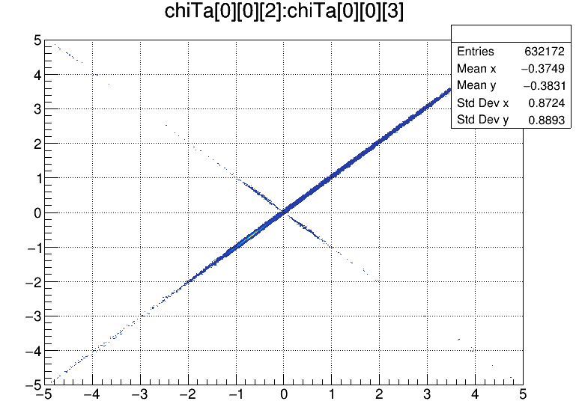
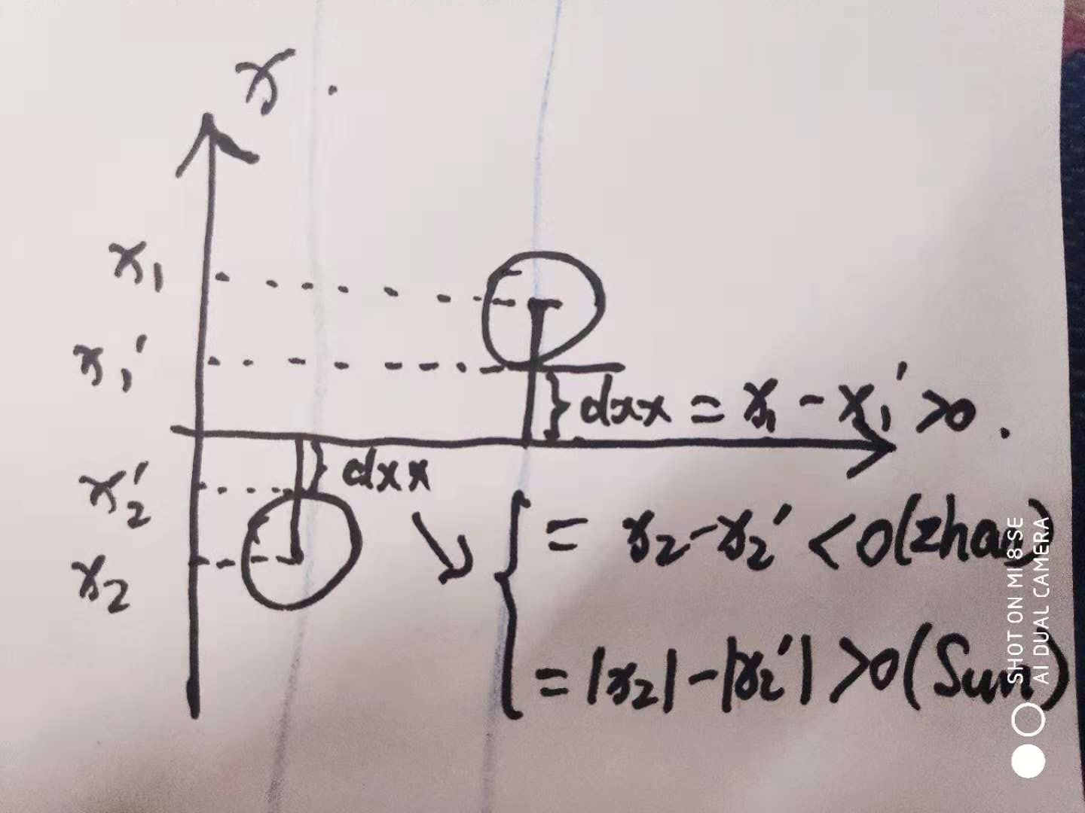
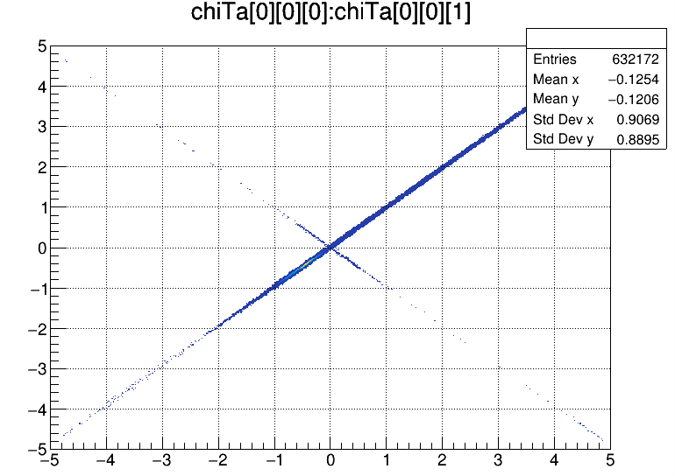
Question Check
The phenomena have been reproduced in my (SUN Yazhou, IMP) computer, which uses an independently developed data analysis framework.
Definition of chiTa: chiTa[2][2][4]:[PDCArrayU-D][X-Y][DC0X1-DC0X2-DC1X1-DC1X2].
The relation turns into dxx_X1=dxx_X2, not dxx_X1=-dxx_X2. Well I guess this arises from the difference of residue definitions between Zhao and me, as illustrated below.

Slide 4
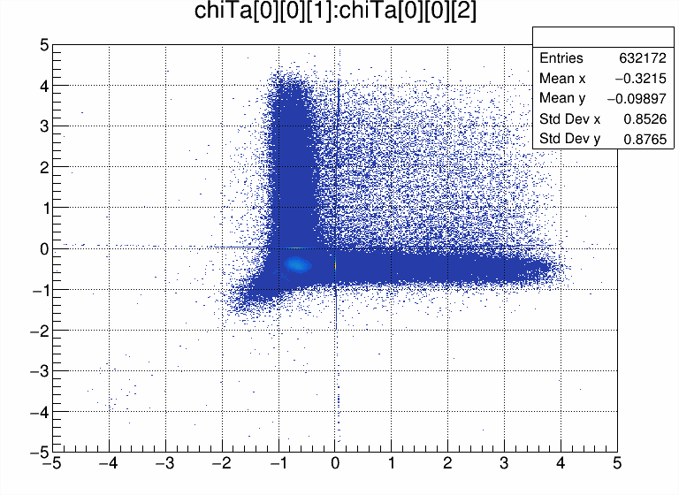
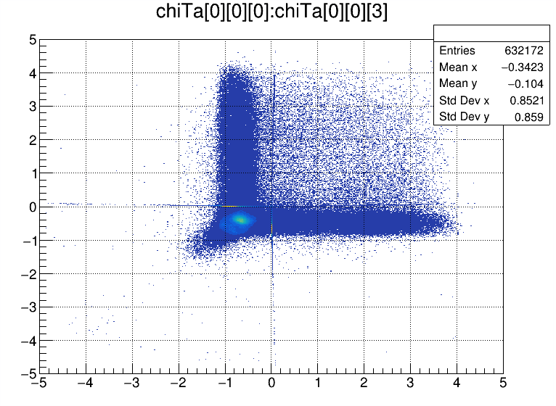
Residues from Separate PDCs

Slide 5
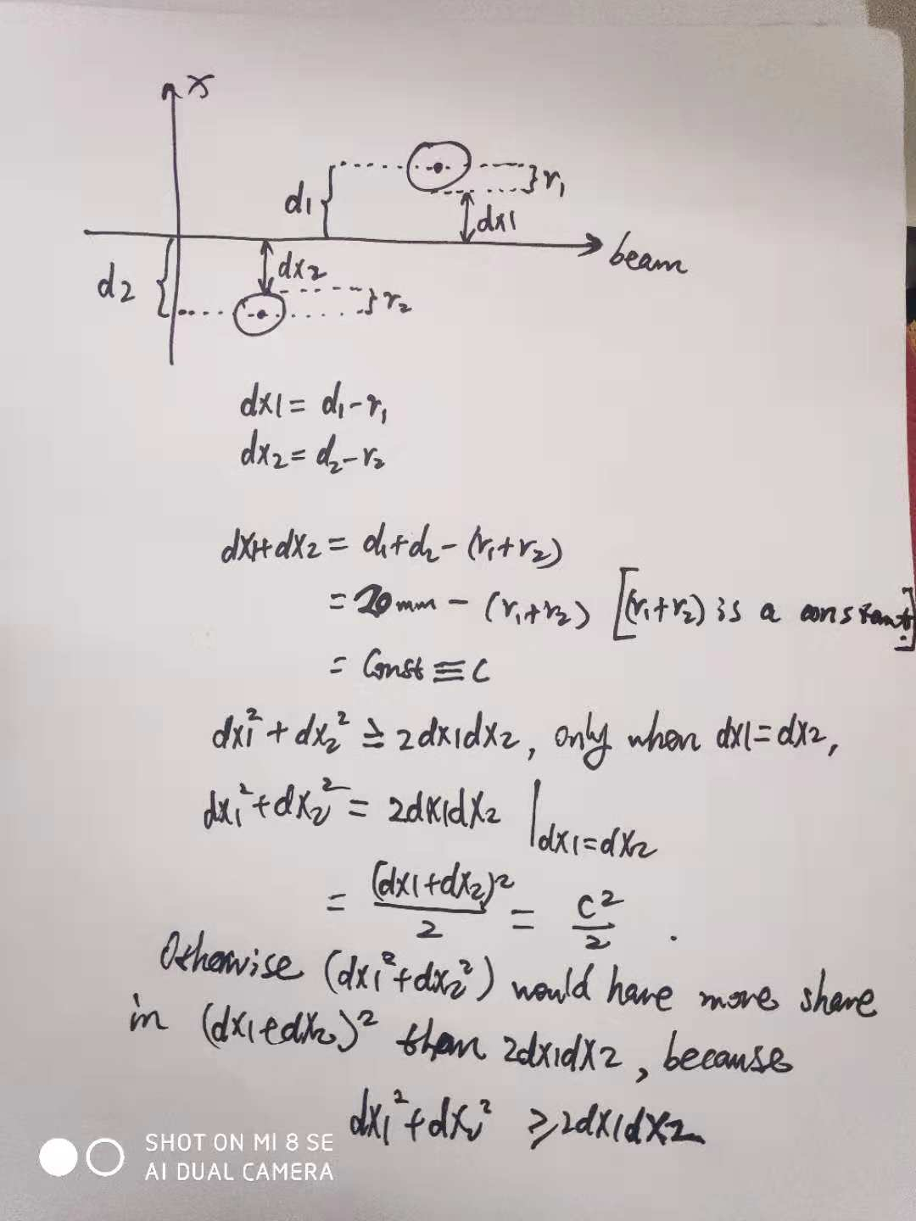
A Possible Explanation
dx1 and dx2 are distances of sense wire to particle track, so it is a function to track slope k and intercept b.
dx1+dx2=Const. means that Const(k, b) barely change throughout (k, b) space.
dx1+dx2=Const. is not satisfied for residues from separate PDCs.
Because the (dx1+dx2) here is much more sensitive to the slight variations of track slope k than in the situation of only ONE PDC.

Slide 6
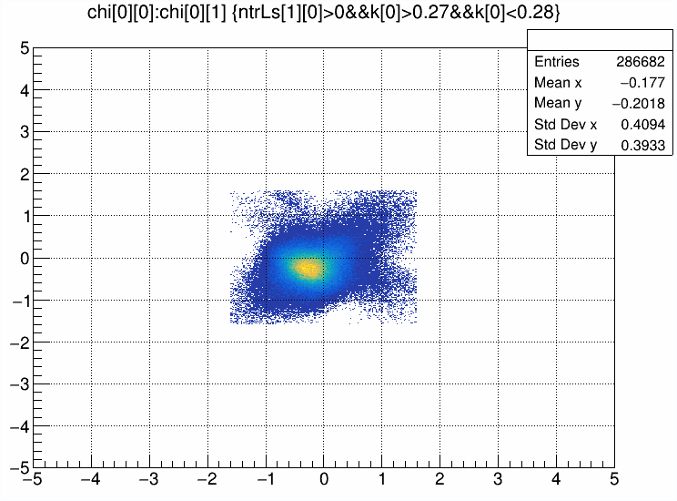
Talk
The residues’ relation is not true, but a result of compromise to achieve chi2 minimization.
Tracking residues of X1 and X2 of DC0 from MWDC array R (3-DC array).

