Slide 1
Enhancing load, wind and solar generation for day-ahead forecasting of electricity prices
Authors: ​
Joanna Stawik​
Adriana Naumczuk​
Date: 15.01.2024
Authors of original report: ​
Katarzyna Maciejowska
Weronika Nitka Tomasz Weron
Notes:
Hi, I'm Adriana, and along with my friend Joanna,

Slide 2

Notes:
we are excited to present our replication of the research titled "Enhancing Load, Wind, and Solar Generation for a Day-Ahead Forecasting of Electricity Prices" by Katarzyna Maciejowska, Weronika Nitka, and Tomasz Weron.

Slide 3
Software used
PyCharm 2021.2.2 (Community Edition) and Matlab R2021b are the software tools used for implementation. Microsoft Excel v. 1808 is used for chart visualisations.
For fundamental forecasts, a rolling window approach with a combination of short and long windows is employed.
Short windows include τ values of {56, 84, 112} (equivalent to 8, 12, and 16 weeks), while long windows have τ values of {351, 358, 365} for a balanced short-term effect. Predictions are obtained through a simple average of individual forecasts.
Electricity price models use a one-year observation window to capture the direct impact of enhanced fundamental forecasts.
Notes:
To begin with we utilized the Python programming language for the forecasts, MATLAB for some error statistics, and Microsoft Excel for certain visualization charts. We adopted a rolling window approach, employing 3 short and 3 long windows to consider both short and long-term changes and dependencies. The observation window spanned a one-year interval, and we calculated the final forecast as an average across all windows.

Slide 4
Dataset
Data | Notation | Units | Source
Day-ahead prices | DA | EUR/MWh | EPEX SPOT, http://www.epexspot.com
Intraday prices | ID | EUR/MWh | EPEX SPOT, http://www.epexspot.com
Load | L | GWh | https://transparency.entsoe.eu
Wind generation | W | GWh | https://transparency.entsoe.eu
PV generation | S | GWh | https://transparency.entsoe.eu
Forecasted load | FL | GWh | https://transparency.entsoe.eu
Forecasted wind generation | FW | GWh | https://transparency.entsoe.eu
Forecasted PV generation | FS | GWh | https://transparency.entsoe.eu
Forecasted temperature | FT | ℃ | https://api.meteo.pl
Notation | Start date | End date
2015 | 1 October 2015 | 30 September 2016
2016 | 1 October 2016 | 30 September 2017
2017 | 1 October 2017 | 30 September 2018
2018 | 1 October 2018 | 30 September 2019
Notes:
We obtained the data from the authors upon request, and it's crucial to note that the date notation follows a pattern where a specific year refers to dates from October 1 of that year to September 30 of the following year. So if we have 2015 we have the dates from beginning of October 2015 till the end of September 2016. Additionally, some datasets required adjustment, particularly quarterly values aggregated after hours, which needed to be divided by 4 to represent hourly averages accurately. The data is from the Germanys market.

Slide 5
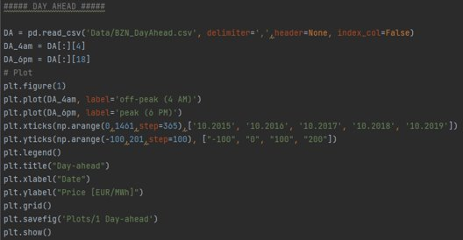
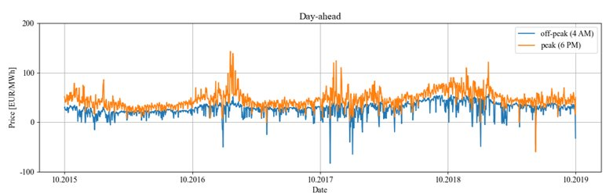
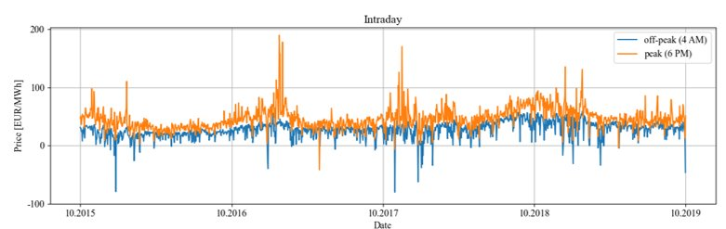
Day-Ahead ​and ​Intraday Prices
Notes:
Moving to the initial data visualization, we followed the original step-by-step approach, starting with an overview and plotting the data to understand patterns. Notably, we observed peak and off-peak hours, with the peak occurring at 6 pm and off-peak at 4 am.

Slide 6
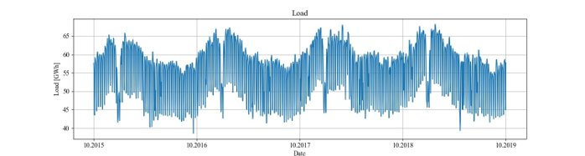
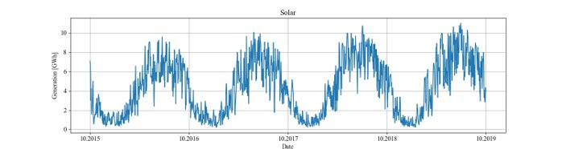
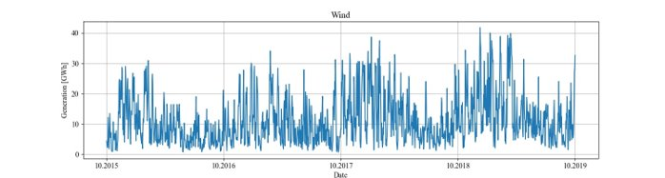
LOAD
SOLAR
WIND
Notes:
Then we visualised our fundamental variables which are load, solar and wind.
Load exhibited a strong dependence on the day of the week, Following a yearly seasonality, peaking during winter for heating needs and decreasing in warmer temperatures. Also Slight increasing during summer, attributed to air-conditioning usage.
Solar Generation peaked in summer, approaching zero in winter due to shorter days and insufficient sunlight.
While wind generation rises in winter, with slight drops in summer. Short-term variation is notable.

Slide 7
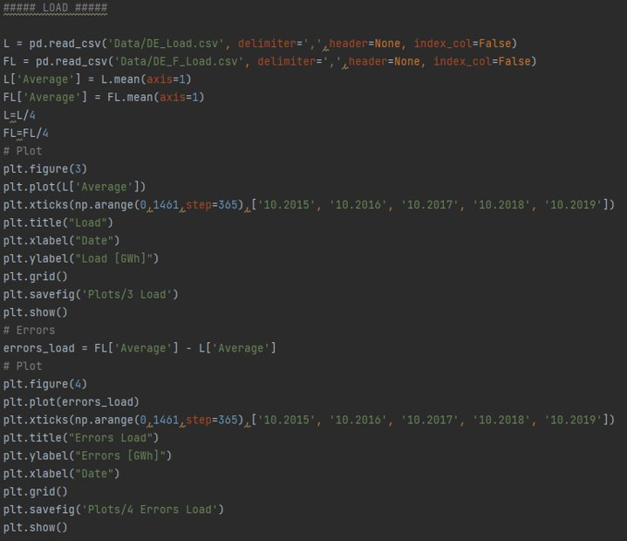
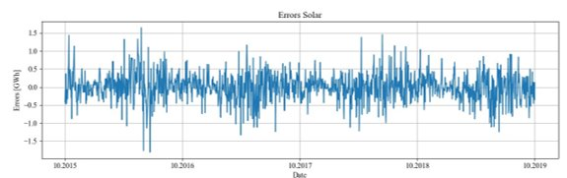
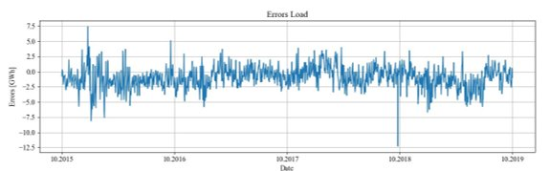
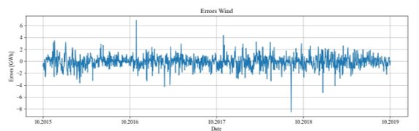
Notes:
Having the visualization of the real values we went on to calculating the errors between them and Transmission System Operator forecasts which we will call TSO in the rest of the presentation. Unlike fundamentals, forecast errors show no clear weekly or yearly patterns. Solar forecast errors are larger in spring, coinciding with increased photovoltaic generation.

Slide 8
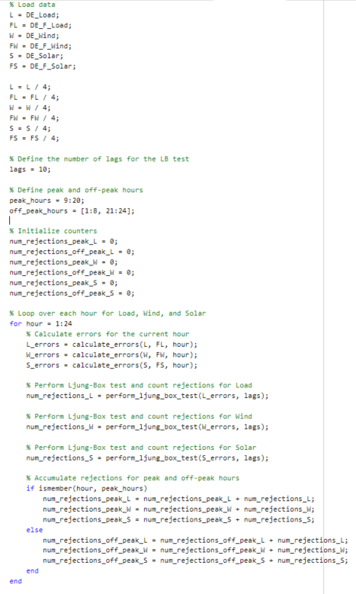
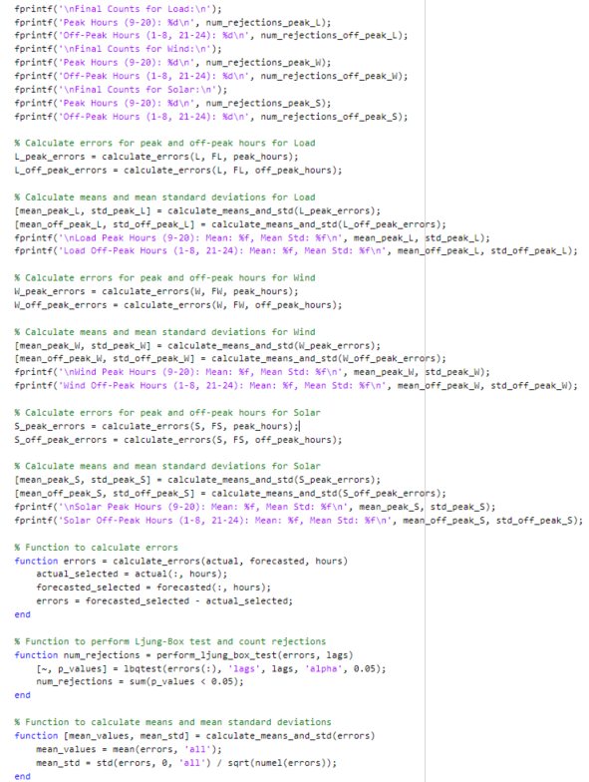
TSO forecast
error statistics
Statistics | Peak |  |  | Off-peak
 | Load | Wind | Solar | Load | Wind | Solar
Mean | -1.022 | -0.041 | 0.009 | -0.915 | -0.139 | 0.002
STD | 0.017 | 0.012 | 0.008 | 0.014 | 0.012 | 0.001
LB test | 12 | 11 | 12 | 12 | 12 | 5
Notes:
Moving on to the matlab results including mean errors, standard deviations and Ljung-Box test.
I am going to skip the coding parts because the time is catching up so the magic stays in the code and in the table we can see the results which are:
in the Mean Errors: we notice a Substantial bias across all fundamental variables. Load exhibits systematic underestimation. While Standard Deviations: Varied biases from zero.
And the LB test reveals strong autocorrelation of forecast errors, particularly evident in solar and wind generation during specific hours.

Slide 9
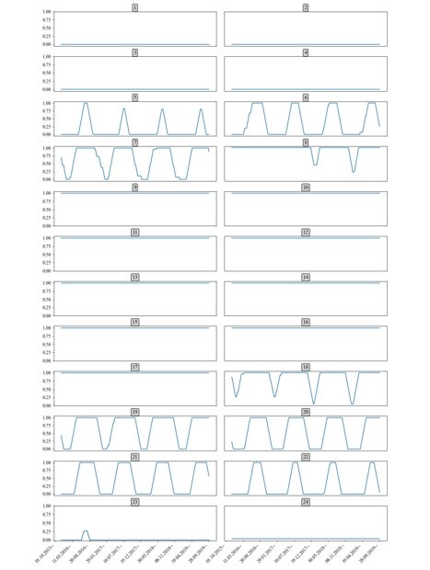
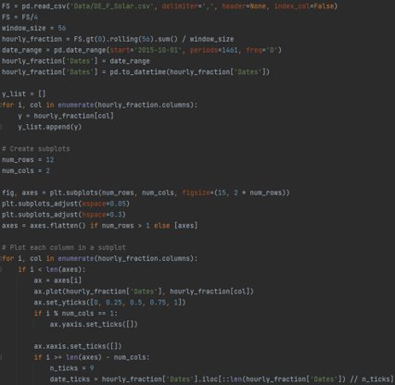

Fraction of days within a rolling 56-day period where forecasted solar energy values exceed 0 MWh for each hour of the day
Notes:
In our study, we examined how often forecasted solar energy values exceeded zero during a rolling 56-day period. This evaluation helps us assess the accuracy of (TSO) solar forecasts for specific hours within this timeframe. From the plots we can see that we are focusing on hours 8 to 17.

Slide 10
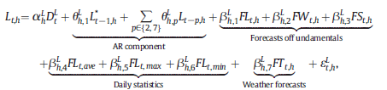
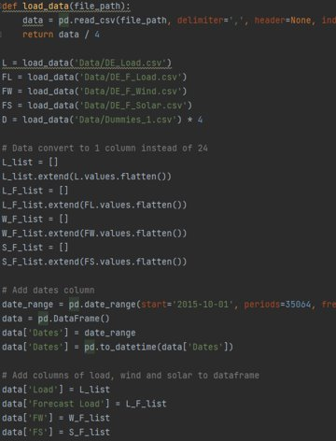
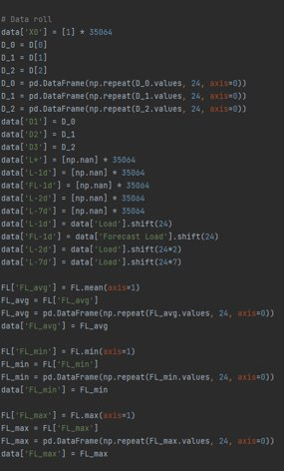

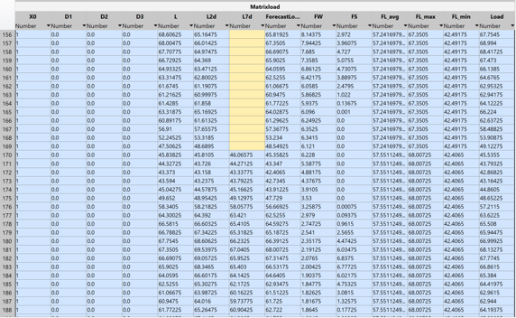
MATRIX LOAD
Notes:
From this slide onward we'll focus on load as an example. We had very similar approach to every fundamental variable so it wouldn’t have a much added value to the presentation if we show all fundamentals.
So on this slide you can see the code that creates a matrix of all variables from the formula seen in the upper right corner. It consists of dummy variables, of L* which is either real Load if the hour is smaller or equal to 10 and the forecast load if h is bigger than 10. The autoregressive (AR) component considers past load values for 1, 2, and 7 days. Second we have the forecasts of fundamentals, load, wind and solar which will also be either TSO, enhanced, real or none. Next we have the daily statistics so we have the daily average, maximum and minimum values of load and last and least the weather forecast which turns out not to bring any difference so we left it out.

Slide 11
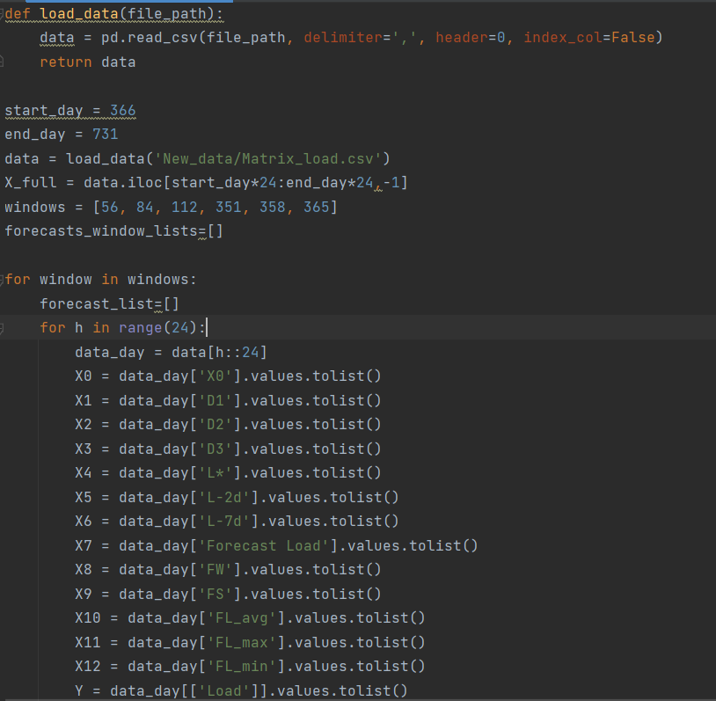
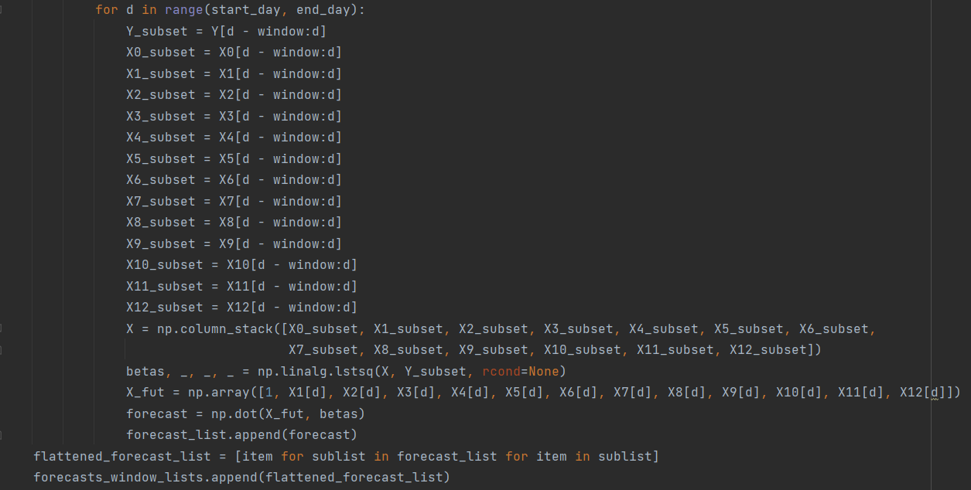
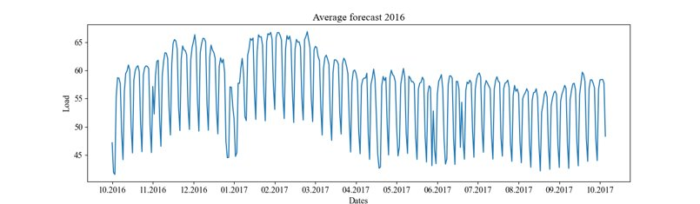
ENHANCED LOAD FORECAST
Notes:
After creating the matrix, we employ a rolling approach to generate an average forecast. The presented plot depicts the load forecast using enhanced fundamentals for the year 2016, with the code showcasing the data loading, window definition, loop processing, beta definition, and formula building.

Slide 12
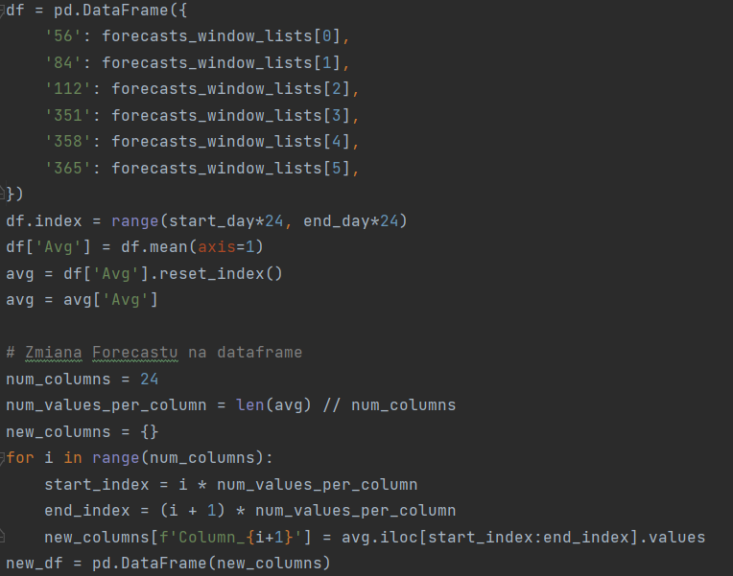
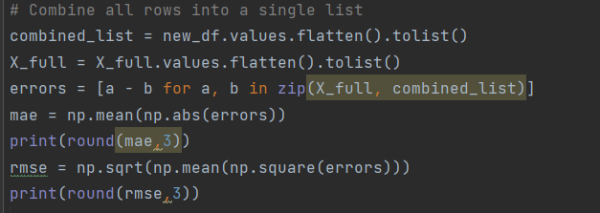
ENHANCED LOAD FORECAST
Notes:
In the end we have the average of all windows and we create a dataframe so that we can put it nicely into a csv file to calculate further statistics on it.

Slide 13


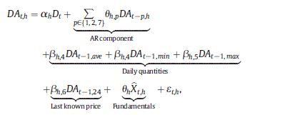
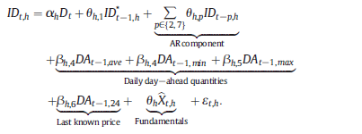

WIND AND SOLAR MODELS
ELECTRICITY PRICE MODELS
Notes:
Moving on as I said the same approach was applied with similar formulas and occasional adjustments to address issues such as linearity. Sometimes the data had to be truncated due to taking into account an hour ahead of the forecast, etc. Apart from The fundamentals the next step was to do forecasts for Day ahead and intraday prices. Where intraday prices had 2 models originally in the report.

Slide 14

TWO VERSIONS of 2nd Intraday model
In our approach, in model below, we use the day-ahead forecast calculated for the same fundamental variable for which we aim to compute the intraday price forecast.
Additionally we want to check if Intraday price forecast will provide us with better results when for each fundamental we use the same day-ahead forecast computed for Enhanced fundamental.
Notes:
During our replications, we randomly discovered a potential improvement by using the same enhanced fundamental forecast for both day-ahead and intraday models. We want to see if this helps us make more accurate predictions for intraday prices. It's a simpler approach that could give us better results. Let's see what we find out!

Slide 15
R E S U L T S
Notes:
Okay, so now let’s see results ------>

Slide 16
MAE & RMSE
Variable | Load |  |  | Wind |  |  | Solar
Year | 2016 | 2017 | 2018 | 2016 | 2017 | 2018 | 2016 | 2017 | 2018
MAE
TSO | 1.527 | 1.539 | 1.938 | 1.002 | 1.178 | 1.160 | 0.741 | 0.678 | 0.718
Enhanced | 1.110 | 1.150 | 1.258 | 1.002 | 1.153 | 1.136 | 0.745 | 0.677 | 0.710
RMSE
TSO | 1.960 | 2.026 | 2.473 | 1.544 | 1.760 | 1.580 | 1.077 | 1.003 | 1.014
Enhanced | 1.565 | 1.641 | 1.662 | 1.525 | 1.734 | 1.529 | 1.080 | 0.999 | 1.011
Notes:
First we focused on calculating errors Mean Absolute Error (MAE) and Root Mean Squared Error (RMSE) in Load, Wind and Solar forecasts - Ada mentioned these models before.
As you can see we get better outcome using enhanced models in every one of variable. --------->

Slide 17
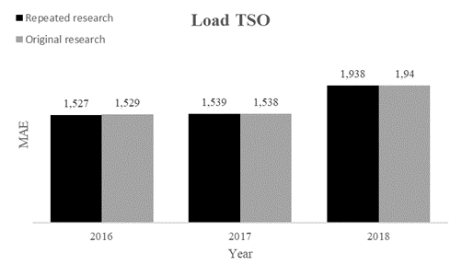
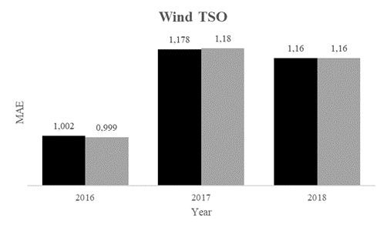
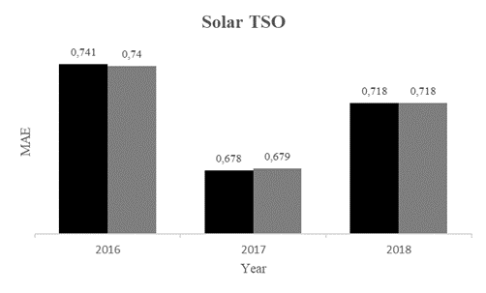
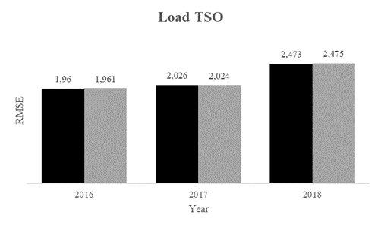
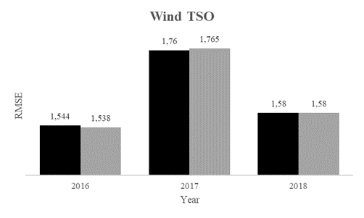
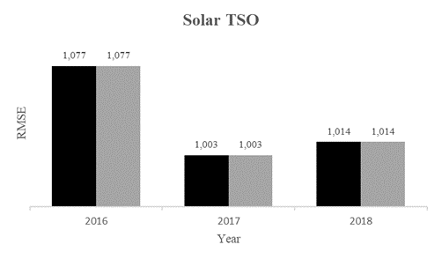
MAE & RMSE - TSO
Notes:
As you can see here, our results closely resemble the outcomes of the original article, the grey color represents original study, while black color represents our replicated research ------>

Slide 18
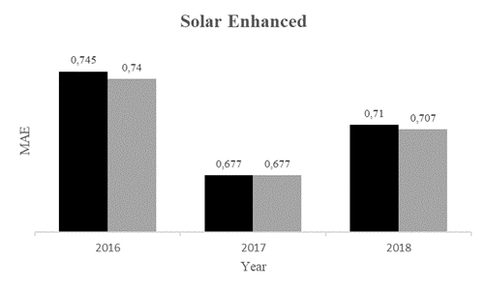
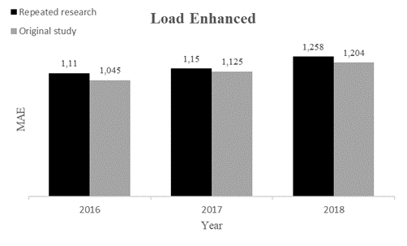
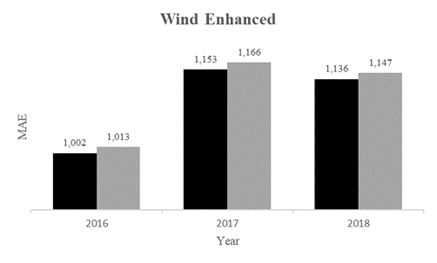
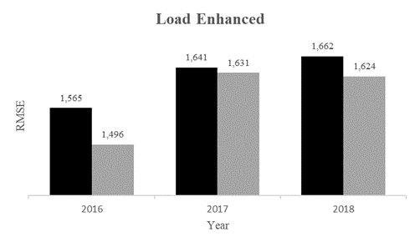
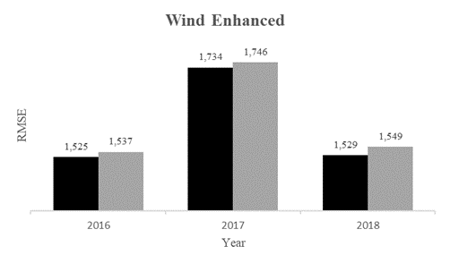
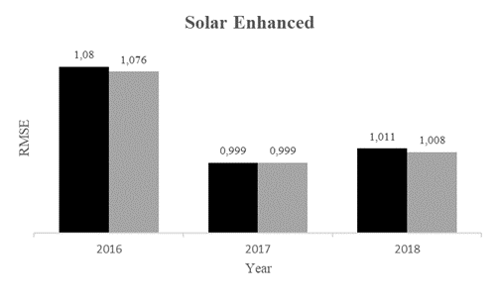
MAE & RMSE - Enhanced
Notes:
1When it comes to enhanced forecasts, as expected, our results also resemble the outcomes of the original one. Little differences might be visible due to different software used or modified algorithms.
Also it’s good to mention that in solar forecast: Both original and repeated research find solar prediction challenging due to limitations in capturing its dynamic structure. Also we excluded negative forecasted Solar generations from further consideration.-------->

Slide 19
Price forecasting results
Variable | Model | Measure | Fundamentals
 |  |  | TSO | None | Enhanced | Real
DA | (5) | MAE | 6.050 | 7.252 | 5.983 | 5.939
 |  | RMSE | 8.591 | 10.951 | 8.245 | 8.637
ID | (6) | MAE | 7.753 | 8.642 | 7.683 | 7.187
 |  | RMSE | 11.319 | 13.09 | 10.453 | 10.599
 | (8) | MAE | 7.630 | 8.362 | 7.314 | 6.800
 |  | RMSE | 10.937 | 11.797 | 10.047 | 10.524
 | (9) | MAE | 7.548 | 7.015 | 7.314 | 6.423
 |  | RMSE | 10.177 | 9.747 | 10.047 | 9.086
Notes:
Another part of our research: In our analysis, we explore the influence of enhanced load, wind, and solar generation predictions on electricity price forecasting using four different model configurations. As fundamentals we take TSO, Enhanced, Real and None as a important part of the model.
In this table you can see that ID model (9) has the smallest errors comparing to other ID models.
But in general electricity price predictions were better using Enhanced fundamentals and this is what we should expect ------>

Slide 20
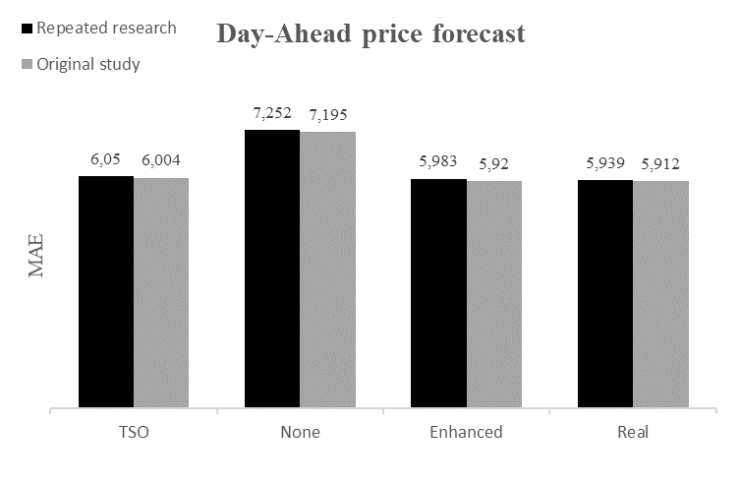
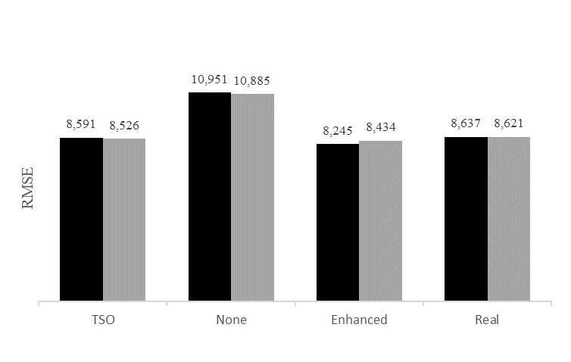
MAE & RMSE
for Day-Ahead model
TSO, None, Enhanced or Real
Notes:
It’s clearly visible that price forecasts for model Day-Ahead using enhanced forecasts lead to lower errors. We got similar results as authors of original study. ---------->

Slide 21
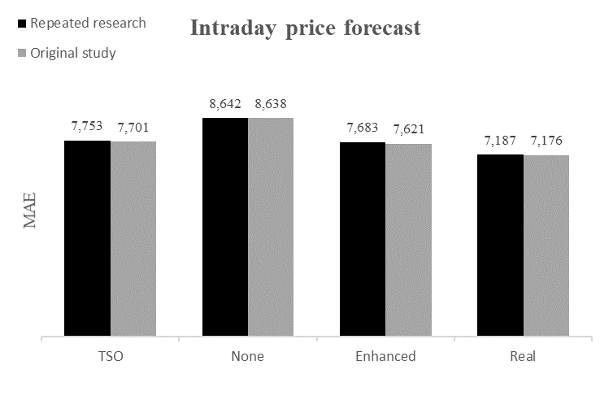
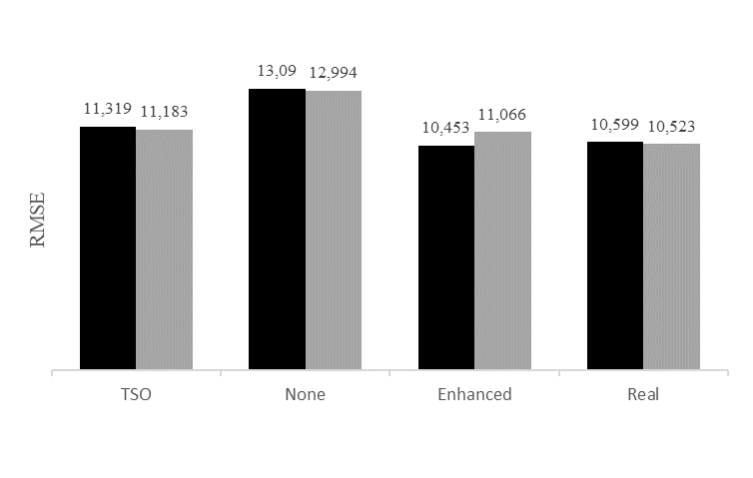
MAE & RMSE
for Intraday (6) model
TSO, None, Enhanced or Real
Notes:
Same situation for Intraday model (6) - usage of enhanced forecasts lead to better MAE/RMSE scores. ---------->

Slide 22
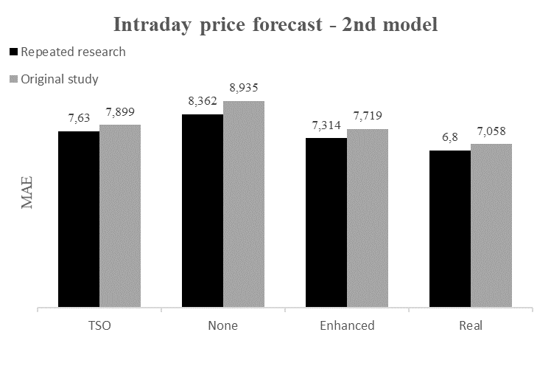
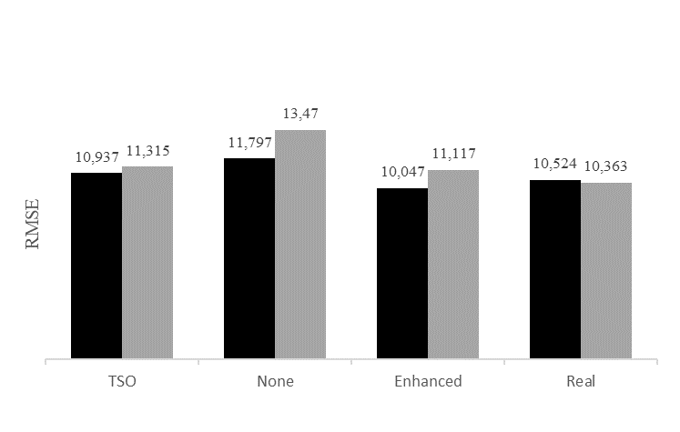
MAE & RMSE
for Intraday (8) model
TSO, None, Enhanced or Real
Notes:
What is interesting, our findings for the Intraday price forecast using model (8) improved results across nearly all fundamentals comparing to original article. The reason in such improving could be related to hidden thoughts in the article or our different understanding of the model ------->

Slide 23
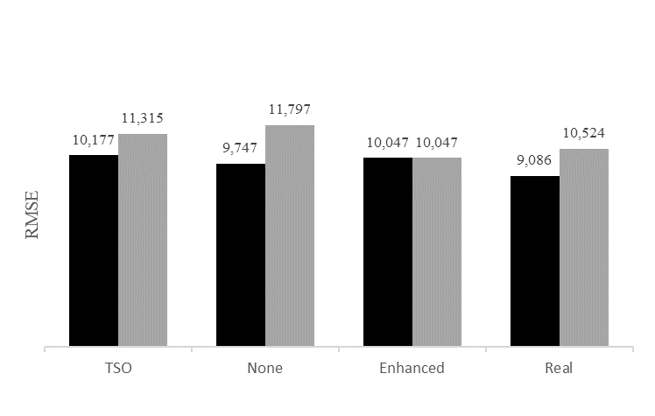
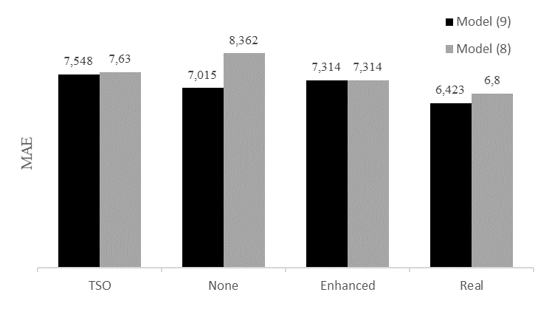
MAE & RMSE - comparison between two models:
2nd model (8) as implemented by the original authors and our proposed model (9)
Different for TSO, None, Enhanced or Real
Constant
Model (8):
Model (9):
Notes:
Lastly, we compare two models: model (8) as implemented by the original authors and our proposed model (9) that Ada talked about before.
It's evident that our model outperforms the original approach across almost all fundamental variables we forecasted. ---------->

Slide 24


MARKET CHOICE
price spread sign
Models |  | Correct classifications, p (%) |  |  | Revenues, π (EUR)
DA | ID | TSO | Enhanced | Real | TSO | Enhanced | Real
(5) | (6) | 50.71 | 50.93 | 51.86 | 2045 | 2078 | 2632
(5) | (8) | 50.63 | 51.55 | 64.20 | 2419 | 6912 | 10960
(5) | (9) | 56.97 | 51.55 | 61.20 | 6443 | 6912 | 8715
Notes:
Lastly, the market choice is determined by the price spread sign as binary variable. The accuracy of forecasts in this article is evaluated using two measures: the correct prediction ratio (p) and additional revenues (π).
In our research Enhanced forecasts outperforms TSO based forecasts. -------->

Slide 25
C O N C L U S I O N S
Notes:
Let’s sum up ------->

Slide 26
Original study focused on load, wind, and solar predictions; our replication improved every one of them using enhanced forecasts over 2016-2018.
Addressing complexities in solar dynamics, excluding negatively forecasted solar generations became crucial for refined predictions and ensuring consistency.
Introduction of innovative Intraday model (9) showcased significant improvements across fundamental variables.
Market classification accuracy slightly improved for both TSO-based and enhanced forecasts, with intraday models (8) and (9) displaying the highest accuracy.
Financial gains from enhanced forecasts consistently outperformed TSO predictions, affirming the profitability of enhanced forecasts.
Notes:
It’s important to point out that solar predictions could be improved in the future.
Our results as you saw very closely resemble results obtained by original authors.
We are also happy to share that our model (9) yielded to better predictions in price forecasting.
In summary usage of enhanced fundamentals improves the predictions always - for load/solar/wind predictions and also for price forecasting and market classifications! ------>

Slide 27
Thanks!
Do you have any questions?
Authors: ​
Joanna Stawik​
Adriana Naumczuk​

