Slide 1
Efficient Asymmetric Cryptography for RFID Access Control
Progress Report
Notes:
Objective of the project was to produce an access control system that implements an authentication protocol based on asymmetric key cryptography.
So I had to write:
- card issuing terminal application
- card-side authentication protocol application
- door-side authentication protocol application
Opted to implement a protocol called OPACITY – will explain the reasons in a minute.
OPACITY uses ECC for authentication.

Slide 2
Benefits of OPACITY
The OPACITY-FS protocol provides:
Mutual authentication
User untraceability
These were listed as possible extensions in the proposal.
Notes:
Contrast a naïve authentication protocol (e.g. OPACITY_ZKM) against OPACITY-FS.
Mutual authentication – both the user and the terminal are authenticated. That is, the reader is verified by the card to be a valid reader (and not a rogue one), and similarly the reader verifies that the card has access to the current location.
Untraceability – The protocol doesn’t divulge any data that would allow the correlation of two protocol executions with the same card.
Listed as extensions in the proposal, so by implementing OPACITY-FS, I essentially get them for free.
Alternative would’ve been redesigning another protocol, which is generally a big no-no when it comes to cryptographic schemes.

Slide 3
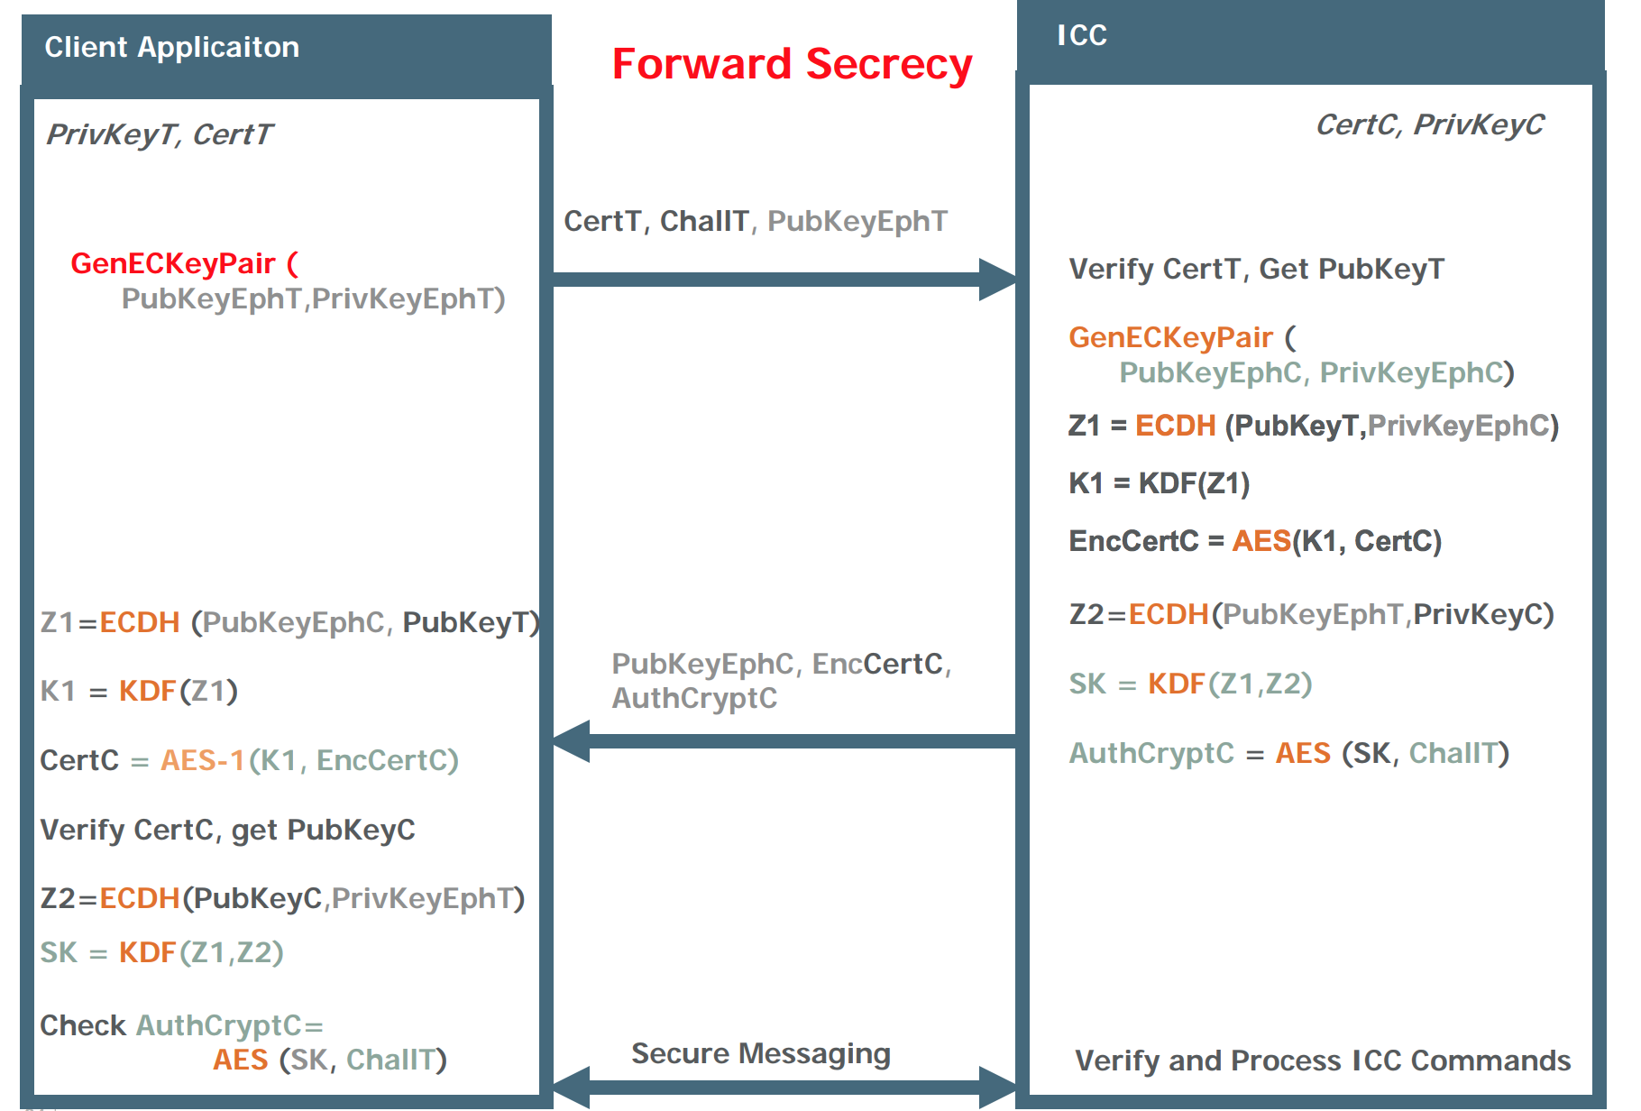
Open Protocol for Access Control Identification and Ticketing with privacY - OPACITY
Notes:
Note that card’s public key is AES encrypted using a key which can only be derived on a valid terminal (because terminal private key is required).
In other words, an attacker can’t simply eavesdrop an exchange and replay it, because they won’t be able to decrypt the card’s public key.
For true mutual authentication, one additional step is needed – terminal must send an encrypted message to card.
This message could be anything – the easiest would be some predetermined hard-coded challenge value.
This is the only way the card can be sure that the terminal was actually able to derive the secret key SK (and thus is a real terminal).
In actual fact, it doesn’t really matter for the purpose of access control, since the card has 2 aims:
- Only reveal information about itself to real terminals
- Gain access
Both are achieved even in a replay scenario.
Should mention that the spec for OPACITY-FS define a so-called “persistent binding” ability.
The idea is that you only do the DH negotiation once, because it’s slow, and store some data from this negotiation.
From then on, when the card encounters the same reader, there’s a faster protocol that uses the stored data.
However, a security analysis revealed that with PB, the protocol doesn’t achieve user untraceability.
Thus my implementation will not include PB.

Slide 4
Issuing Terminal
Card
GENERATE ECDSA KEY PAIR
CARD PUBLIC KEY
STORE ECDSA(PUBKEY|CRSID|GROUP_ID|SIGNATURE_EXPIRY),
CRSID, GROUP_ID, SIGNATURE_EXPIRY, TERMINAL PUBLIC KEY
STORE SUCCESSFUL
CHECK STORED DATA
SIGNATURE, CRSID, GROUP_ID, EXPIRY
LOCK
LOCK SUCCESSFUL
Notes:
CRSID, GROUP_ID and SIGNATURE_EXPIRY are passed as command line arguments to the provisioning application.
Terminal public key is stored to allow verification of door terminal public keys.
Check is done to ensure nothing was corrupted in transmission.
Lock the card so that DoS attack isn’t possible.
Note that a similar provisioning process is done for door terminals.

Slide 5
Schedule
Provisioning application has been implemented and tested.
Protocol not yet fully implemented.
Approx. 2 weeks behind schedule
However, last 6 weeks of Lent were allocated for bug fixes and implementing extensions.
Notes:
These 6 weeks can easily be repurposed for completing the core implementation (which will actually include implementation of 2 extensions).
For this reason, I’m not planning to change my schedule.

