Slide 1
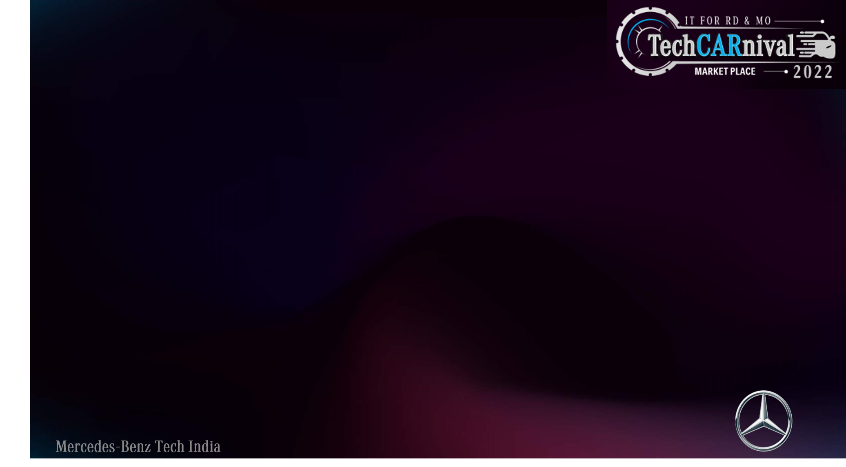
IoT MO - Manufacturing Service Bus (MSB)

Slide 2
Agenda
Project Overview
Use Case of MSB Project
Project Footprint
Q & A

Slide 3
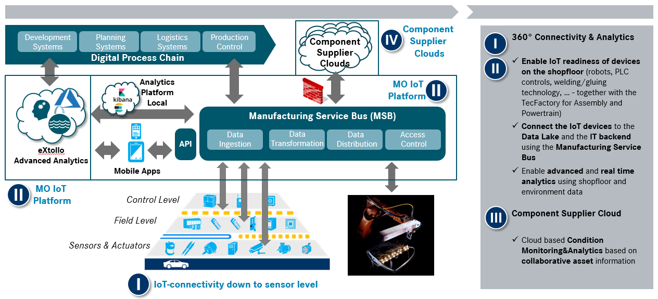
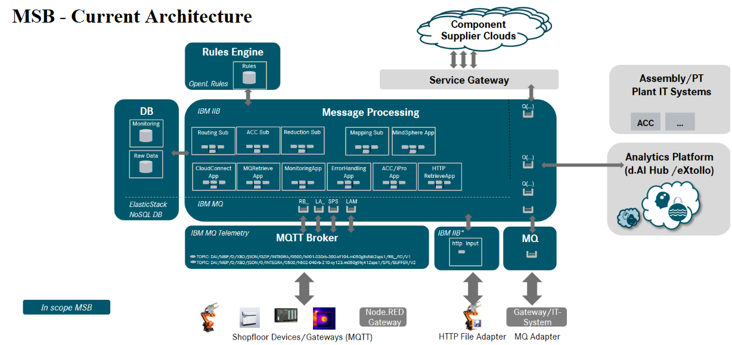
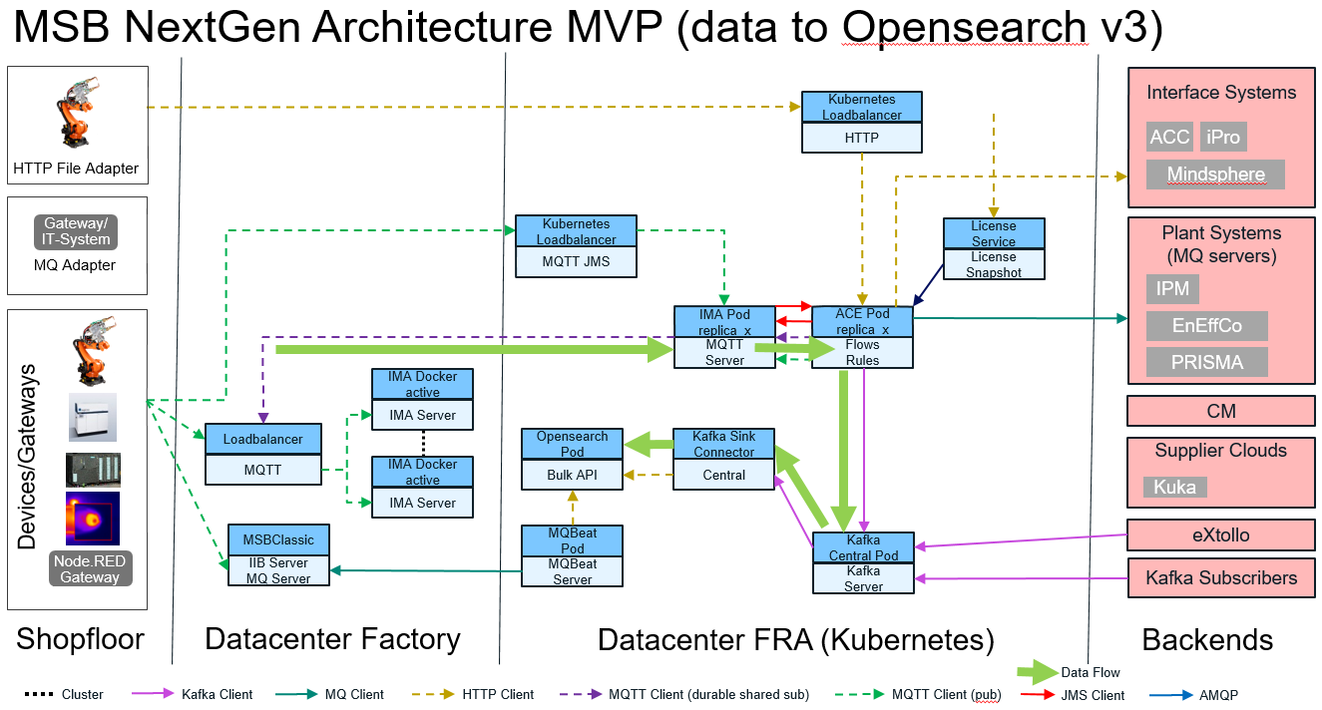
Project Overview
Lead Role:
Kubernetes Administration
App Connect Enterprise (ACE)
Eclipse Amlen (IMA)
IBM MQ/MQXR
Lightning Stack
Logstash/fluentD
IBM Integration Bus
Support Role:
Grafana
Prometheus
Elastic Stack
Kafka

Slide 4
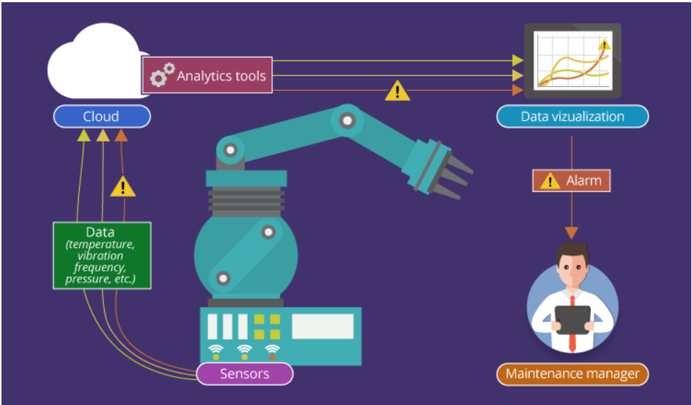
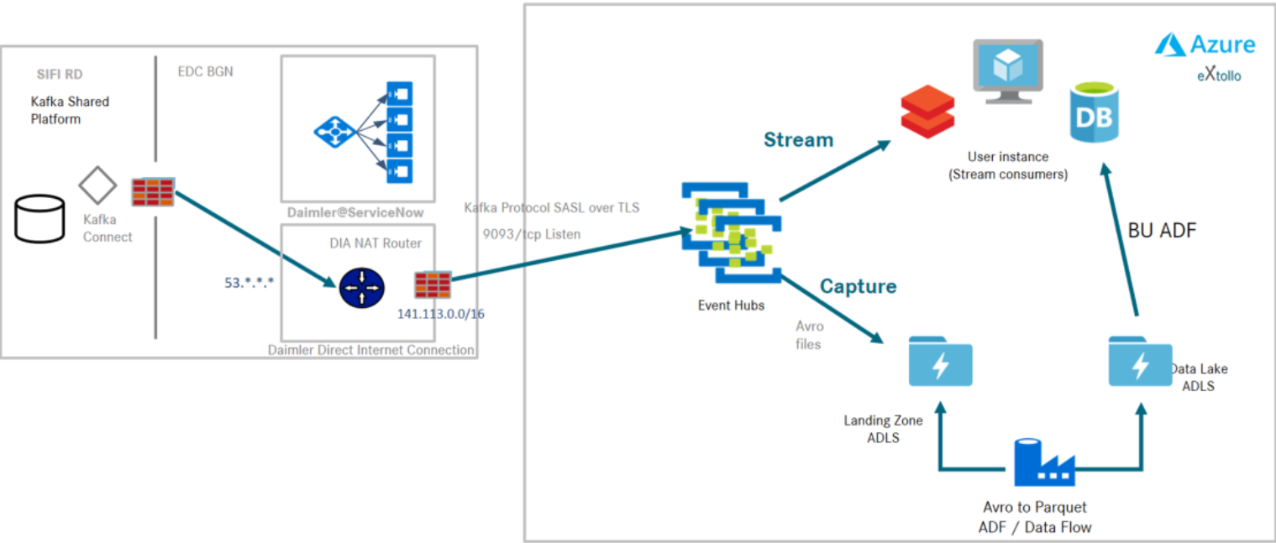
Use Case of MSB Project
Condition Monitoring
Extollo Datalake Analytics

Slide 5
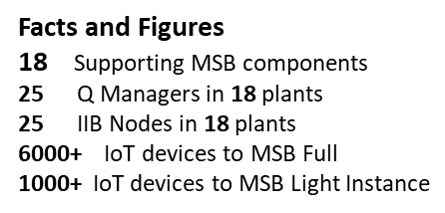
Project Footprint
Düsseldorf, Germany MSB Light
Bremen, Germany MSB Full
Charleston, USA MSB Light
Beijing (BBAC) China MSB Full
Ludwigsfelde, Germany MSB Light
Kamenz, Germany MSB Light
Tuscaloosa, USA
MSB Full
Rastatt, Germany MSB Full
Jawor, Poland MSB Light
Kecskemét, Hungary
MSB Full
Shunyi, China MSB Light
Untertürkheim; Germany MSB Light
Viktoria, Spain MSB Light
Hambach, France MSB Light
MSB Full & MSB LightBerlin & DFC Berlin, Germany
Sindelfingen, Germany MSB Full
East London, South Africa MSB Light
ITP/IE | MSB Overview | August 2022
5

Slide 6
Q & A

Slide 7

THANK YOU

