Slide 1

Bangladesh University of Business and Technology (BUBT)
Dept of EEE
Course Tittle: VLSI Circuits I Lab Course Code: EEE 330 Topic: 4 Bit Asynchronous up counter using D flip flop.
Name | Id | Intake
Md Asib Hossain | 17181108006 | 22
Resaet Ahmed | 17181108010 | 22
Sujon Saha | 17181108012 | 22
Sarafat Hossain | 17181108026 | 22
Uzzal Chakma | 17181108028 | 22

Slide 2
Table Of Content
Background
Motivation
Objectives
Literature Review
Methodology
Simulation Layout
Output WaveShape
Result
Discussion
Conclusion
References

Slide 3
Background
In digital electronics, an asynchronous circuit or self-timed circuit, is a sequential digital logic circuit which is not governed by a clock circuit or global clock signal. Instead it often uses signals that indicate completion of instructions and operations, specified by simple data transfer protocols. This type of circuit is contrasted with synchronous circuits, in which changes to the signal values in the circuit are triggered by repetitive pulses called a clock signal. However asynchronous circuits have the potential to be faster, and may also have advantages in lower power consumption, lower electromagnetic interference, and better modularity in large systems. Asynchronous circuits are an active area of research in digital logic design.

Slide 4
Motivation
Here we share some advantages of 4 bit asynchronous up counter. For this advantages we motivate to do project on 4 bit asynchronous up counter.
✓ They are simple and easy to design by Toggle flip flop or D flip flop. ✓ They can be used in low speed circuits. ✓ They are most reliable because they use the same clock signal for all flip flops. ✓ They can be used as Truncated counters.

Slide 5
Objective
This project is aim to design a 4-bit asynchronous counter using D flip flop with the help of Microwind (a custom Simulation tool) following necessary steps and rules. A counter is a collection of flip flop each representing a digit in a binary number representation. Counting is a fundamental function of digital circuits. A digital counter consists of a collection of flip-flops that change state (set or reset) in a prescribed sequence. Asynchronous counter is also known as serial or ripple counter.

Slide 6
Literature Review
Edward Fredkin and Tommaso Toffoli [1, 2] based on the concept of reversibility they introduced new reversible gates known as Fredkin and Toffoli reversible gates. These gates have zero power dissipation and are used as universal gates in the reversible circuits. These gates have three outputs and three inputs, hence they are known as 3*3 reversible gates.
Peres [3] introduced a new gate known as peres gate. Peres gate is also a 3*3 gate but it is not a universal gate like the Fredkin and Toffoli gate. Even though this gate is not universal gate it is widely used in many application because it has less quantum cost when compared to the universal gate.

Slide 7
Methodology
We are designed for 4 bit counter and results are evaluated for parameters like area, delay, speed and power. This work can be further extended for higher number of bits. New architectures can be designed in order to reduce the power, area and delay of the circuits. Steps may be taken to optimize the other parameters like frequency, number of gate clocks, length etc. In this work, we propose asynchronous circuit for a 4 bit binary counter using microwind by D flip flop. The propose asynchronous circuit is the first attempt of designing the mentioned counter. It has minimum complexity and quantum cost considerably and efficient design in terms of hardware complexity, constant inputs, garbage outputs and number of gates. More complex systems can be also developed using our proposed approach.

Slide 8
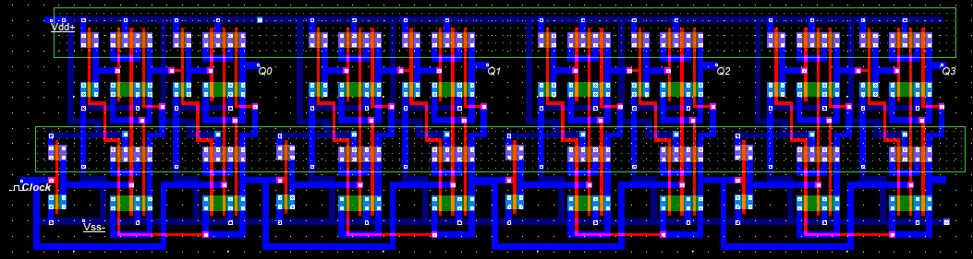
Simulation Layout

Slide 9
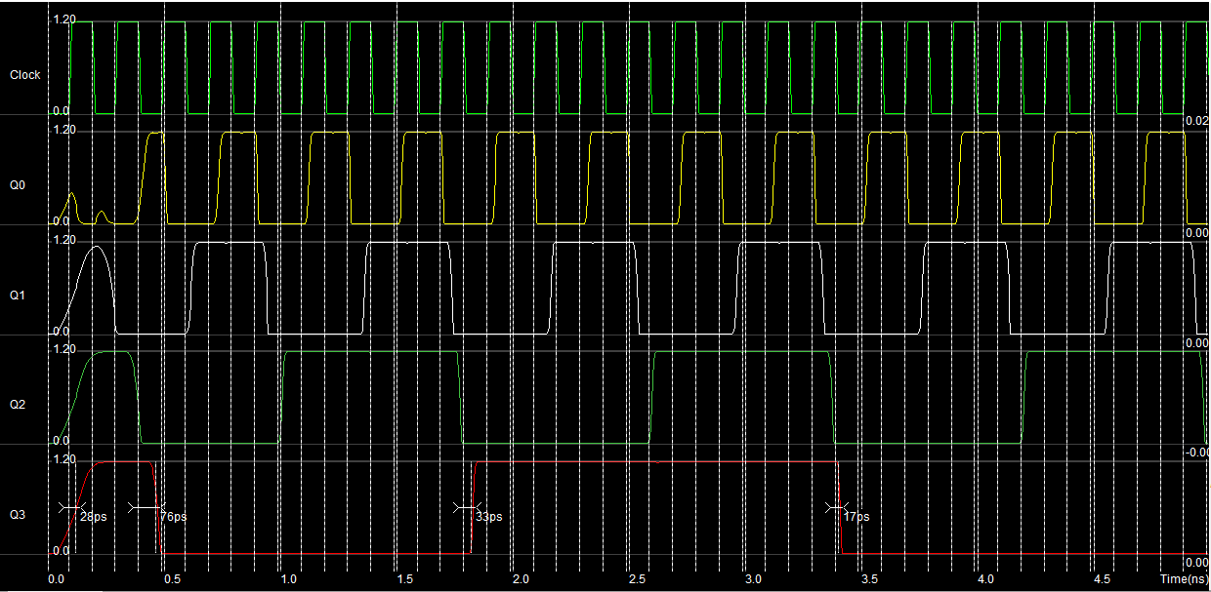
Output Waveshape

Slide 10
Results
We simulated the design and we got the right output but due to some technical issue and leggings the truth table result is not appearing perfect on the waveforms.

Slide 11
Discussion
How many flip-flops are needed in an up-asynchronous counter which can count up to 64.
If two binaries up and down counter start counting at the same time and from the same initial numbers, what is the relation between the two numbers in each counter.
Design a mod-7 asynchronous counter.

Slide 12
Conclusion
Overall the project was a successful one. The designed counter shows very good performance in terms of functionality, area and propagation delays. We also learnt different aspects of circuit design and layout while doing this project. We would like to perform the experimental tests once I get the chip back after fabrication.

Slide 13
References
[1] T. Toffoli., Reversible Computing, Tech memo MIT/LCS/TM-151, MIT Lab for Computer Science (1980).
[2] E. Fredkin and T. Toffoli, Conservative logic, Int. J. Theor. Phys., vol. 21, no. 3/4, pp.219 -253 1982.
[3]A. Peres, Reversible Logic and Quantum Computers, Physical Review A, vol. 32, pp. 3266-3276, 1985.

Slide 14
Thank You

