Slide 1
Paper Title:
Federated Learning for Enhanced Emotion Detection
from Bangla Audio in Decentralized Environments
CSE449 Submission 5
Team 26
Submitted by:
Asibur Rahman Bhuiyan
ID: 23341095
Priom Deb
ID: 23341092
Habiba Mahrin
ID: 20301339
Marzanul Momenine
ID: 22301196
Instructor: Annajiat Alim Rasel
Farah Binta Haque
ST, CSE449
Md Humaion Kabir Mehedi
RA, CSE449

Slide 2
Table of Contents
Chapter | Page No.
Introduction | 3
Related Research | 4
Methodologies | 5
Model Performances | 7
Results and Understanding Model Behavior | 8
Limitations | 14
Conclusion & Future Works | 15

Slide 3
Introduction
- Bangla emotion expression complexities unraveled.
- Human-computer interaction enriched via emotion.
- Bangla speech emotion recognition addressed scarcity.
- Framework developed for emotion analysis in Bangla.
- Applications in mental health, customer service.
- Paving the way for diverse uses.

Slide 4
Related Research
Privacy-preserving Speech Emotion Recognition through Semi-Supervised Federated Learning
Federated Acoustic modeling for speech recognition.
Speech emotion recognition with deep learning
Transfer Subspace Learning for Unsupervised Cross-Corpus Speech Emotion Recognition
Balancing Privacy and Accuracy in Federated Learning for Speech Emotion Recognition
Semi-FedSER: Semi-supervised Learning for Speech Emotion Recognition On Federated Learning using Multiview Pseudo-Labeling

Slide 5
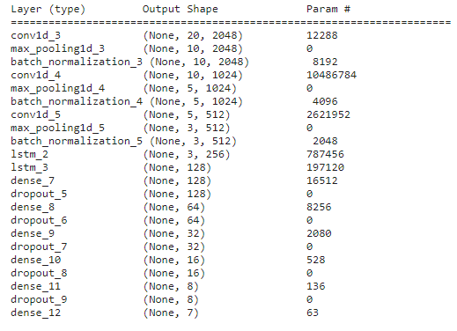
Methodologies
Dataset:
Main Dataset: SUBESCO (7000 audio, 20 speakers, 7 emotion classes)
Split into 4 Clients: Local datasets for individual clients
Model Architecture:
Global Model: CNN architecture defined for overall learning
Client Models: Same CNN architecture replicated for each client

Slide 6
Methodologies (Contd.)
Preprocessing:
Add noises
Stretch
Shift
Pitch variation
Extracted MFCC from audio files
Aggregation:
Aggregate local model learnings to the global model
Local Model Training:
Clients train their models locally on their respective datasets
Epochs: 300
Global Model Training:
Train the global model using aggregated knowledge
Epochs: 150

Slide 7
Model Performances
Performance of Client Models:
Client 1: 0.8637
Client 2: 0.6915
Client 3: 0.8142
Client 4: 0.7645
Performance of Global Model:
Global Model Accuracy: 90.08%

Slide 8
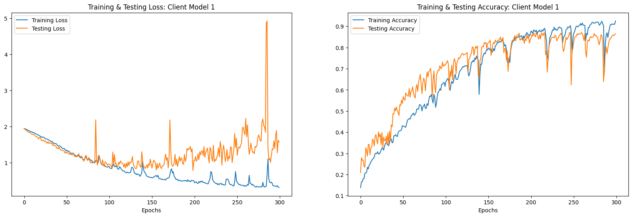
Results and Understanding Model Behavior
Figure 1: History plot of client model 1

Slide 9
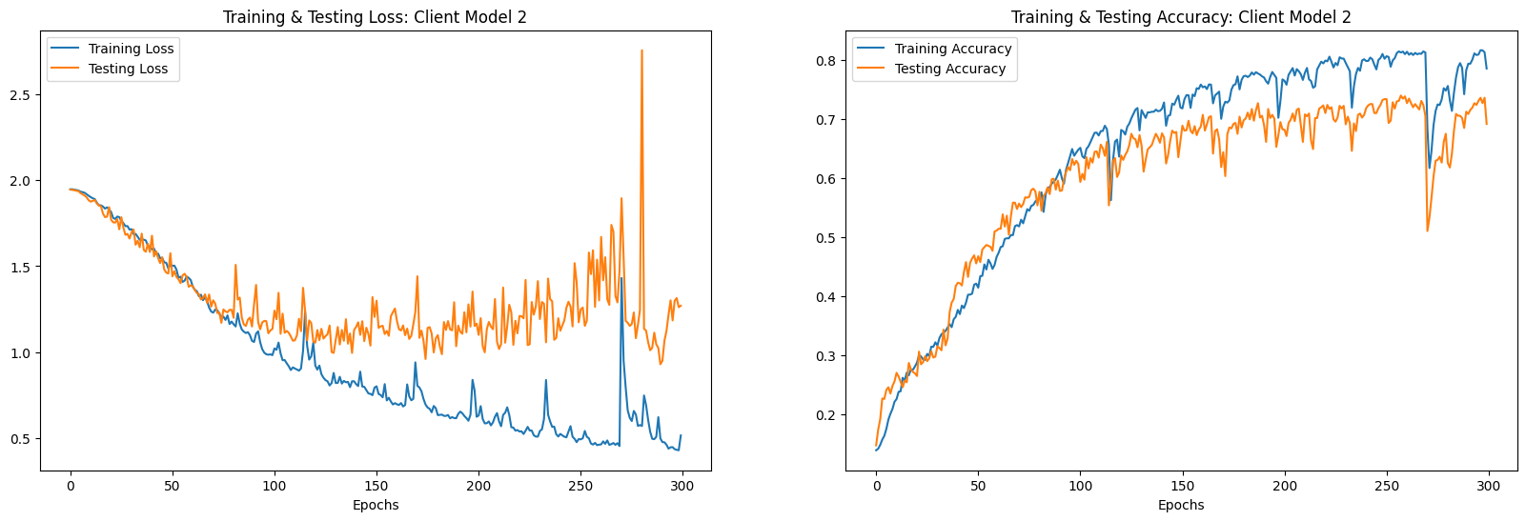
Results and Understanding Model Behavior (Contd.)
Figure 2: History plot of client model 2

Slide 10
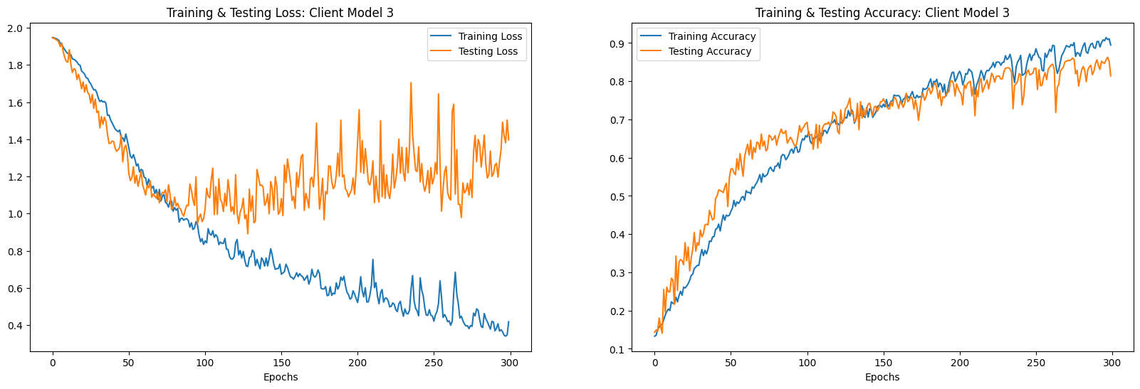
Results and Understanding Model Behavior (Contd.)
Figure 3: History plot of client model 3

Slide 11
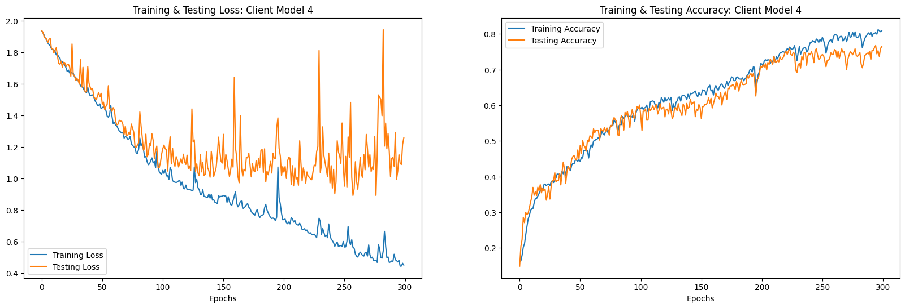
Results and Understanding Model Behavior (Contd.)
Figure 4: History plot of client model 4

Slide 12
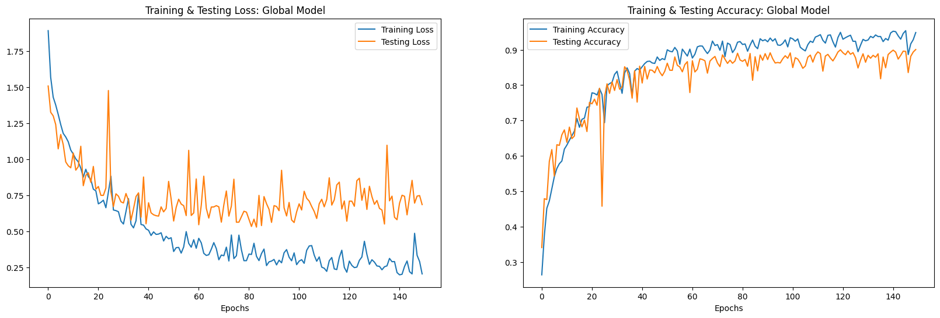
Results and Understanding Model Behavior (Contd.)
Figure 5: History plot of global model

Slide 13
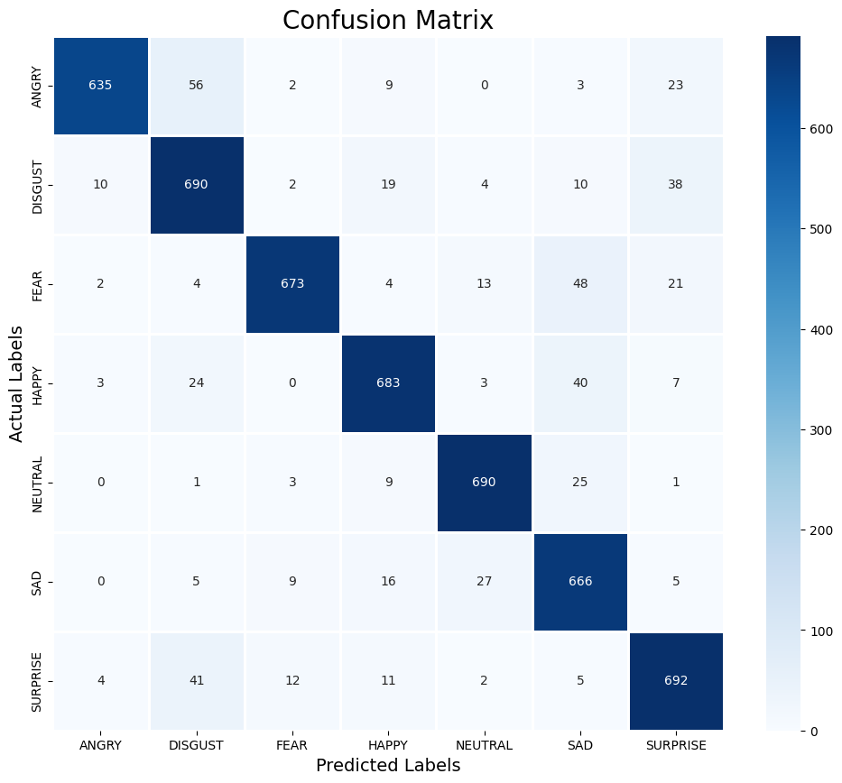
Results and Understanding Model Behavior (Contd.)
Figure 6: Confusion matrix of global model

Slide 14
Limitations
Data Heterogeneity
Communication Overhead
Privacy Concerns
Unequal Client Contributions
Low Computational Resources in Clients
Model Drift

Slide 15
Conclusion & Future Works
Enables culturally relevant emotion detection
Cross-Cultural Research and Understanding
Enhanced Human-Computer Interaction
Mental Health Applications
Security
Entertainment
Healthcare
Law enforcement
Customer service

