Slide 1
Audio analysis: speech recognition
Giedrius Puidokas
Jakub Perkowski
2024-12-12

Slide 2
Introduction
Main goal
Converts human speech to text or other data understanded by machines
Application of technology
Virtual assistants (Siri, Alexa)
Customer service
Healthcare (assistance with gathering patient information)

Slide 3
Main approaches
Word prediction (more rigid, easier to set up and train).
Letter prediction (more versatile, harder to train).
Phonetics* (probably the best, but difficult to implement).
* (/ˌɪlɪˈnɔɪ/ for Illinois)

Slide 4
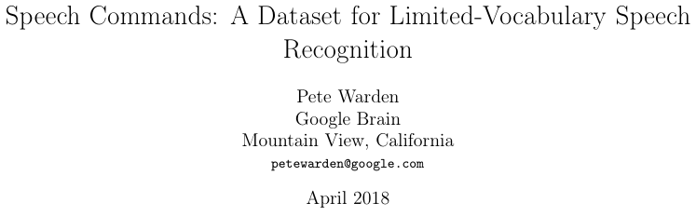
The Data
20 commands: Yes, No, Up , Down, Left, Right, On, Off, Stop, Go, Zero, One, Two, Three, Four, Five, Six, Seven, Eight, Nine.
10 random words: Bed, Bird, Cat, Dog, Happy, House, Marvin, Sheila, Tree, Wow.
~100k files (1 second each) in total → ~1.5k-4k files per word.
https://arxiv.org/abs/1804.03209

Slide 5
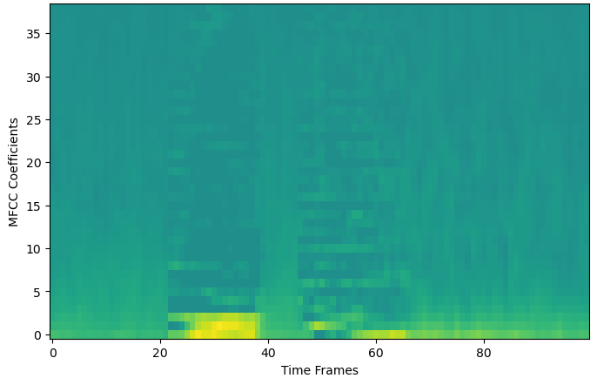
The Code: MFCC
Compute MFCC:
FFT of windowed signal.
Convert to Mel scale.
Use triangular overlapping windows.
Take log() of the powers.
Use discrete cosine transform.
Sampling rate = 16000 Hz.
n_FFT per window = 512.
Hop distance = 160 (16000/160 = 100 time frames).
n_MFCC coefficients = 40.
Added 1e-6 before log to avoid log(0).
Removed bottom coefficient (negative numbers).

Slide 6
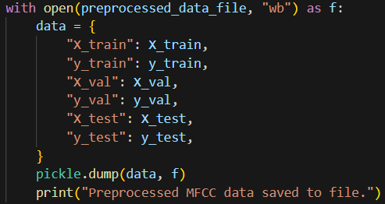
The Code: preprocessing

Slide 7
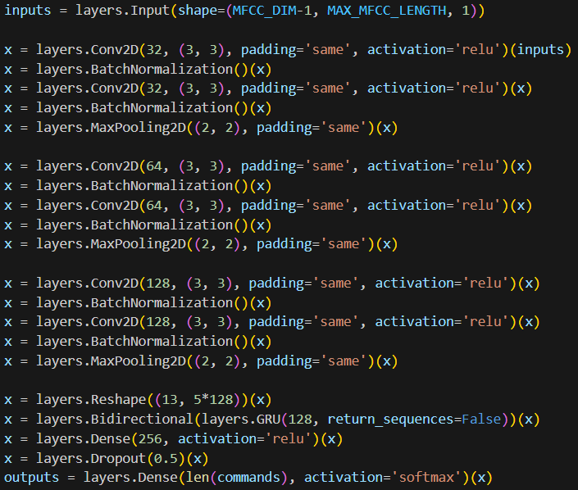
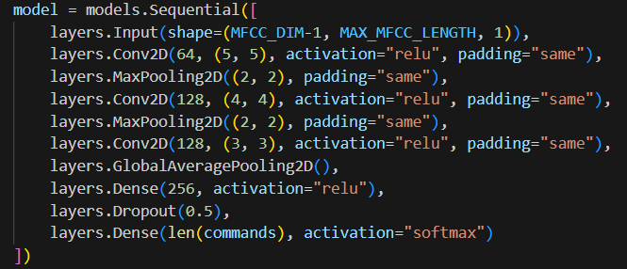
The Code: neural network

Slide 8
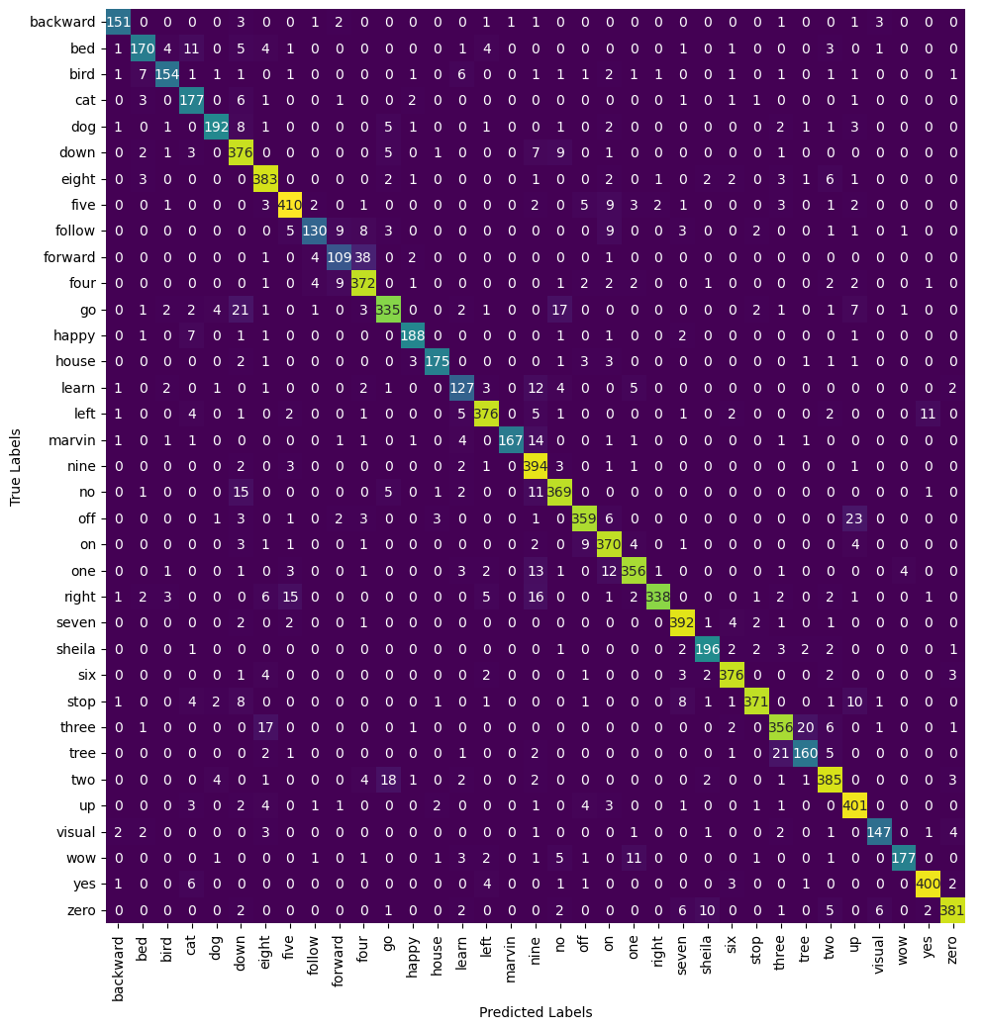
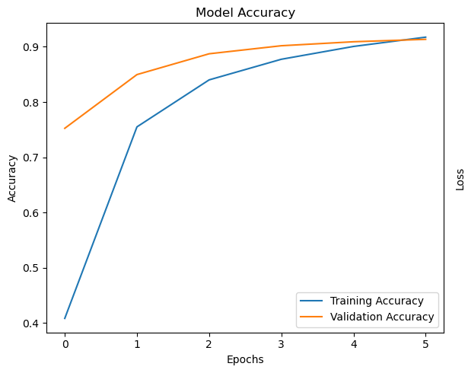
The Code: evaluation

Slide 9
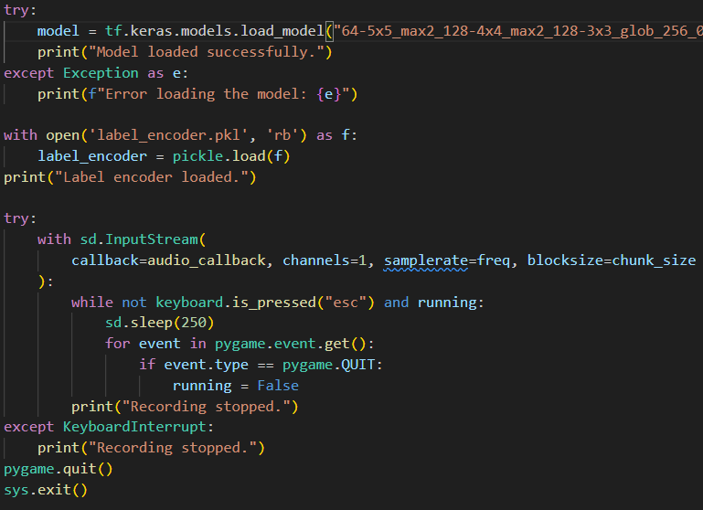
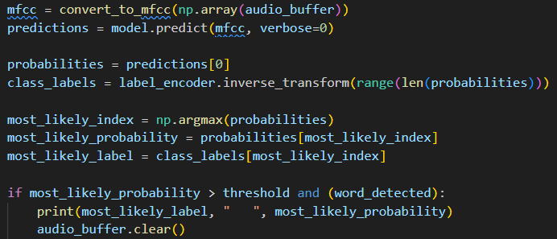
The Code: real-time processing

Slide 10
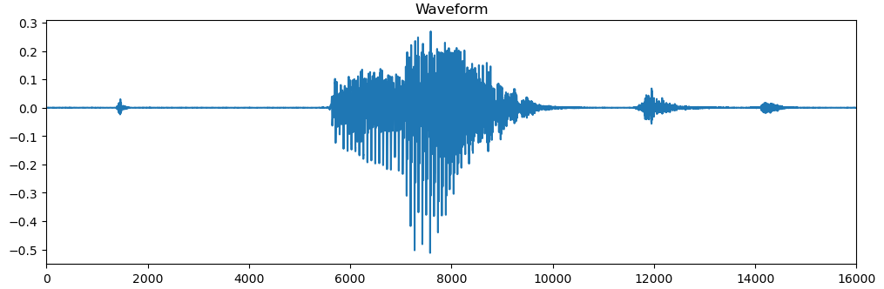
Limitations
Real time processing (due to model complexity)
Real time processing (due to longer words)
Multiple words in one scan period.
Word dependent confidence.

Slide 11
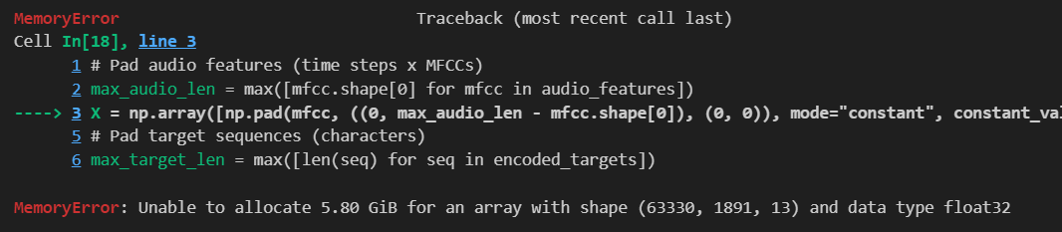

Limitations
Computational power and memory.
Data availability (possible to alleviate using augmentation).

Slide 12
Conclusions
Speech recognition using neural networks is effective but requires significant amounts of labeled data.
Training useful and more complex models, significant processing and memory resources are required.
Even though Python is a beginner-friendly language, it is not as computationally efficient.
Preprocessing audio data (e.g. MFCC) significantly compresses the input data and reduces required resources.

