Slide 1
SpaceX Senior FPGA Engineer Interview Presentation: Simple Uart
Frank Bruno

Slide 2


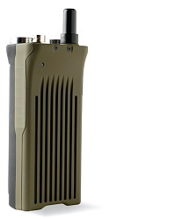

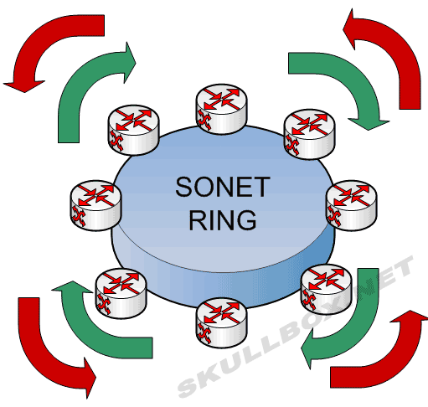
Background
20+ years digital design/ architecture
10+ ASICs
High speed/ large gate count
Low power
10+ FPGAs
Altera/ Xilinx/Lattice/Actel(Microsemi)
Low cost/ Low power
High speed/ large gate count
Networking/ Graphics/ SDR/ Defense

Slide 3
Definition
Support all standard baud rates up to 57600 baud
7x oversampling
Data/control bit determined by voting on the middle 3 samples
1 start bit, 13 data bits, programmable parity and one stop bit
8 entry FIFO buffer for RX and TX
8-bit CPU bus interface
RTS/CTS flow-control

Slide 4
Design Procedure
UART
standard component
Existing open core or vendor library.
New design
Show process
Design different enough
13 data bits
7x oversampling
Fifo Depth
Software reuse – CPU interface

Slide 5
Clocking choices
Create UART clock
Maximum clock rate due to oversampling: 7x57600 = 403.2Khz.
Extra clock domain
Closer to necessary frequency, larger the potential error and bit slip or more precise clock.
Create clock enable
Run at clock enable @ frequency approximating 7x oversampled baud rate

Slide 6
Determine clocking requirements
Support all standard baud rates up to 57600
Utilize higher frequency clock (100Mhz)
Divisor {HI, LO} = (clock frequency / (baud rate * 7))-1
Create programmable clock enable to mimic slower clock
Lower baud rate support but lowering system clock
Baud | HI | LO | %ERROR
300 | 8'hB9 | 8’hFF | -0.006382%
1200 | 8'h2E | 8’h7F | -0.006325%
2400 | 8'h17 | 8’h3F | -0.00625%
4800 | 8'h0B | 8’h9F | -0.0061%
9600 | 8'h05 | 8’hCF | -0.0058%
14400 | 8'h03 | 8'hDF | -0.0055%
19200 | 8'h02 | 8'hE7 | -0.0052%
28800 | 8'h01 | 8’hEF | -0.0046%
38400 | 8'h01 | 8’h73 | -0.004%
57600 | 8'h00 | 8'hF7 | -0.0028%
Speedtest.h

Slide 7
Protocol
RTS/CTS flow-control
TX: Check CTSn to make sure RX is ready (0=READY)
RX: RTSn shows RX FIFO full 0 = Not full, 1 = full
Programmable Parity
None, Even, Odd, (Stuck at level support not entirely tested)
7x Oversampling with voting:
Helps with bit slip
Allows larger rate mismatch
Voting strategy gives us 2/7 baud clock of margin
Noisy environment
2 out of 3 center signal

Slide 8
Architecture
RX/ TX SM
CPU Interface
cpu_csn
uart_rx
RX FIFO
cpu_rdwrn
ctsn
cpu_addr
cpu_din
TX FIFO
uart_tx
rtsn
cpu_valid
cpu_dout
cpu_int
sys_clk
sys_rstn
RX/TX Baud Clock Enable Gen

Slide 9
CPU interface
Custom or 16550
Custom was my first choice
Easier testing
16550 is industry standard with existing drivers
Re-using this interface requires only minor changes
2x Write Data or 2X read data
Minor changes for unused registers and signaling
FIFO levels are 8 values
Simple 8 bit interface for reading and writing.
Chip Select
3 bit address for 16 registers
Rd/Wrn
8 bit data in and out
Interrupts
Not asked for, but UART is very slow relative to system
Avoid tying up CPU

Slide 10
FIFO
Due to my design choices, I will utilize a synchronous FIFO.
Don’t need to worry about clock crossing
Coded by hand rather than generating a core
If we were running independent clocks, we would need to use an asynchronous FIFO.
Example included in appendix with discussion on FIFO clock crossing

Slide 11
Environment
Uart (Root)
Rtl (Verilog source code)
Stim (Testbench and build files)
Sim
Runsim –a (run all tests under ./tests)
Runsim –f ./tests/speedtest.h (run single test)
Supports .h and .h.gz files
Produces “passed” and “failed” files showing test status
Sim/tests
Self checking tests
If a test fails, it sets the test_failed flag
Vivado (FPGA build directory)

Slide 12
Testing
CPU Register R/W test
Simple Internal loopback test
Parity modes (none, Even, Odd)
Simple External loopback test
Rate performance testing
Two UART TX/ RX testing
Pass 128 values from UART->UART using RX polling
TX/ RX FIFO interrupt testing
Parity error mismatch to test parity errors on RX
Speed Mismatch and error detection

Slide 13
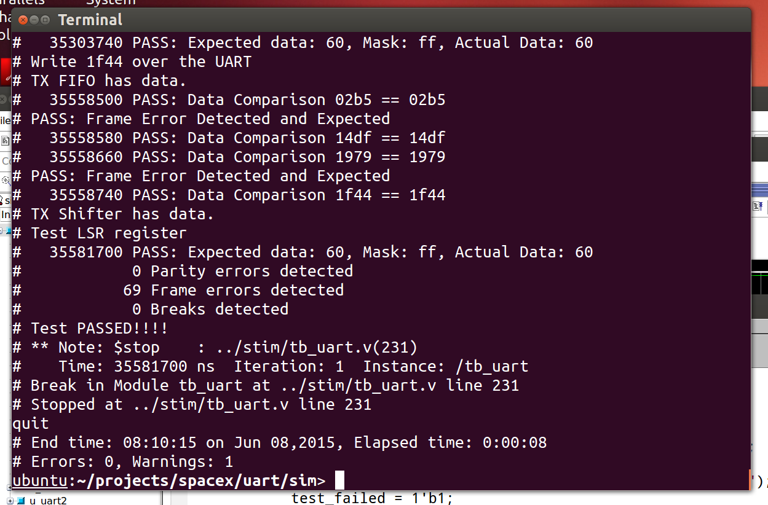
Self checking tests

Slide 14
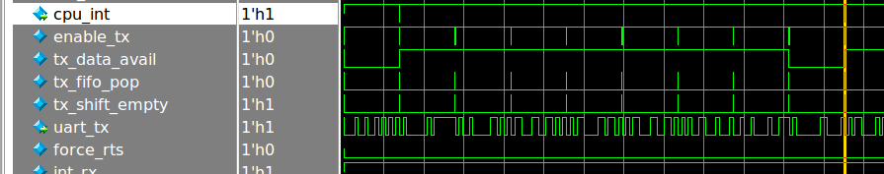
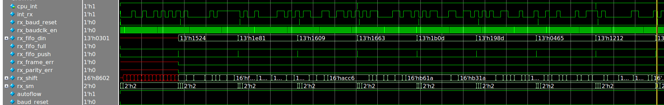
2x UART Simulation

Slide 15
Design Changes
Rate mismatch test showed problems
Change RX to terminate after Stop bit voting to help with slow sampling
Separate RX baud clock enable generation
Reset generation when RX starts

Slide 16

Thank You!

Slide 17
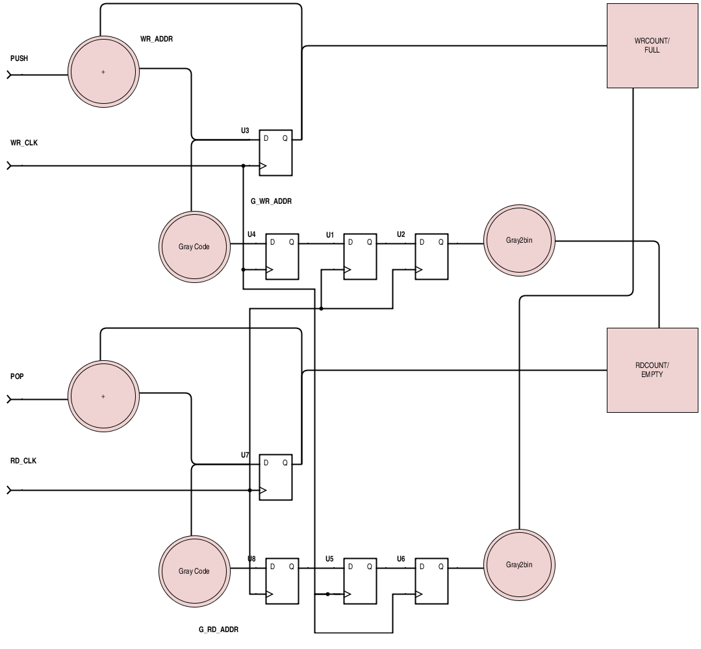
Appendix: Asynchronous - Gray Code for FIFO levels
Crossing mismatched clock domains
Fifo level is a difference between read and write pointers
Read and Write addresses:
Gray coded
Registered on own clock domain
2x Registered on opposite clock domain
Ensures a single bit transition.
Convert back to binary
Take the difference to generate Full, Almost Full, Almost Empty and Empty flags

